Slide 1
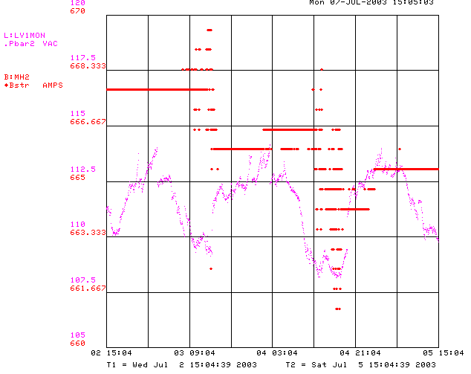
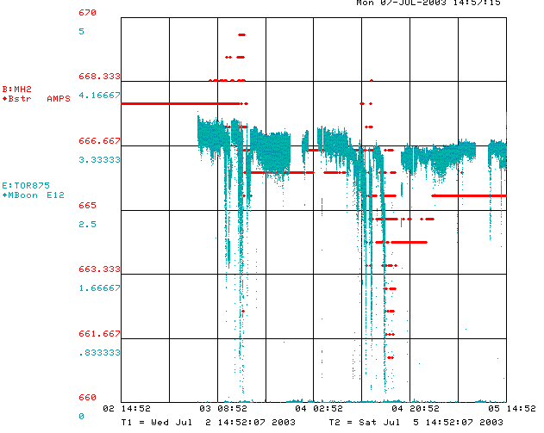
MH2 Regulation Problems
MH2 is the final horizontal bend in the 400 MeV line
It is rated for 60V, 1kA, but has run at ~62V for years.
Regulation problems occur at ~63V – VERY sensitive to line voltage.
MiniBooNE events cause line voltage to sag, which results in MH2 regulation problems.
Power supply seems to be deteriorating.
Have been lowering current setting and retuning line to compensate, but reaching the limit.
New supply (75V) ready for installation.
Need about a shift.
Effect on MiniBooNE intensity

