Slide 1
Major Proton Source Shutdown Projects
Linac
  Used shutdown to make characterization measurements needed for upcoming LLRF project
    Will improve linac energy stability and reduce injection loss
Booster
  New injection bump (ORBUMP) scheme installed and 400 MeV line reconfigured
    Will allow higher rep rate
    Improves injection orbit matching and reduces losses
  RF cavity drift tube cooling completed
    Will allow higher rep. rate
  One of the two extraction regions removed from Booster and relocated to the MI-8 transfer line
    Reduces losses during acceleration cycle
  New 13.8 kV transformers and switch gear installed for Booster RF system
    Improved reliability at high rep. rate
  400 MeV line LVPS replacement
    Better reliability and stability of Booster injection
  Sump water rerouting
    preventive maintenance for Tritium issue

Slide 2
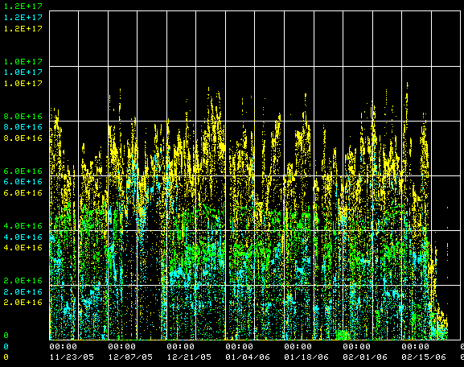
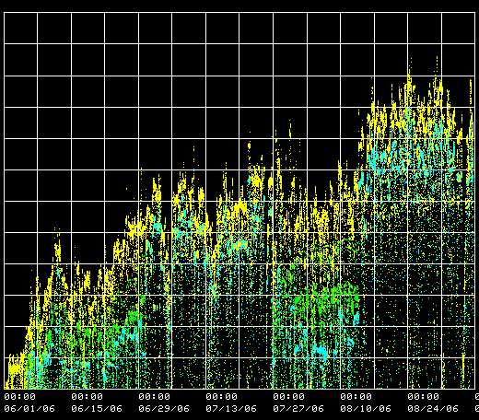
Hourly Rates
protons/hr (NuMI)
protons/hr (MiniBooNE)
protons/hr (total)
1E17
Before Shutdown
After Shutdown

Slide 3
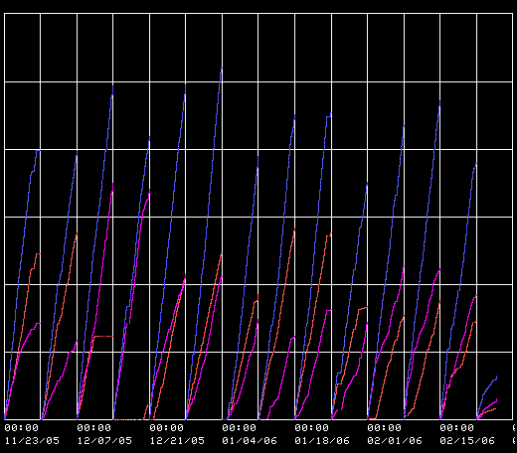
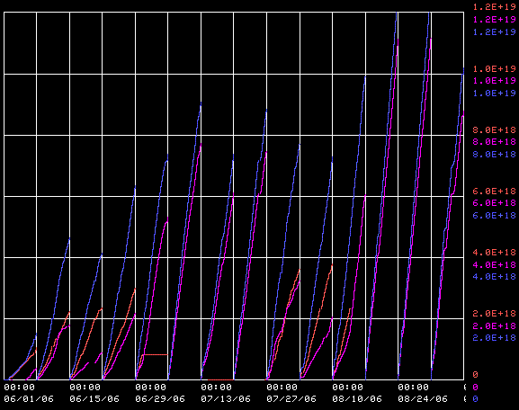
Hourly Rates
weekly sum (NuMI)
weekly sum (MiniBooNE)
weekly sum (total)
1E19
Before Shutdown
After Shutdown

Slide 4
Effects of Shutdown Work
Better Injection matching
  Beam motion reduced from 1 cm to ~2mm
Record efficiency -> Record performance
  Hourly rates
    9E16 pph MiniBooNE
    1E17 pph total
  Weekly totals
    1.08E19 to MiniBooNE
    1.2E19 total
Note: nothing that was done in this shutdown was expected to significantly increase beam to NuMI. That will come from
  Increased up time
  Reduced average MI cycle time
  Slip stacking (fully operational after next shutdown)

