Slide 1
Last Weekend’s RF Problems
RF 11 Work:
  New PA
  Clean choke
  Clean blocker
  Check done on 50 ohm damper loads
RF 13 Work:
  New PA
  Checked high voltage cable - ok
  New Choke
  New Blocker Cap
  Vacuumed
RF 15 Work:
  PA removed and checked then re-installed
  blocker cleaned
  new choke
  High Voltage cable repaired. (Radiation Damage!!)
  Cleaned
Only RF 15 was clearly radiation damaged. It has been hotter in the past than it is now, but we are a bit concerned. Still proceeding under the assumption that the triple whammy was just bad luck.

Slide 2
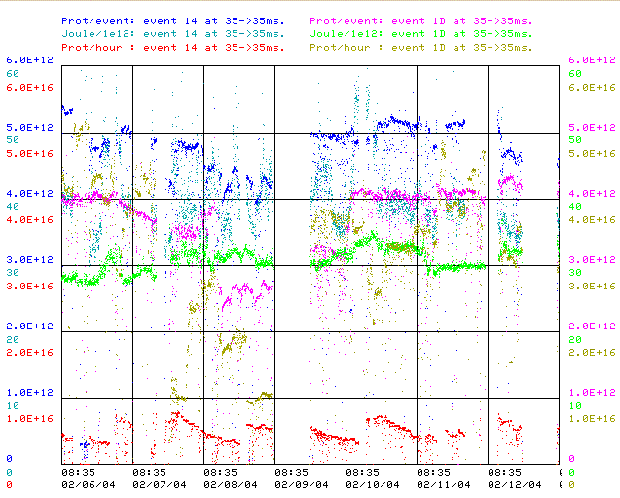
Performance

