Slide 1

Session 4 Summary: HE-LHC Injector and Infrastructure
Conveners: Eric Prebys; Luca Bottura (s. secr.)

Slide 2
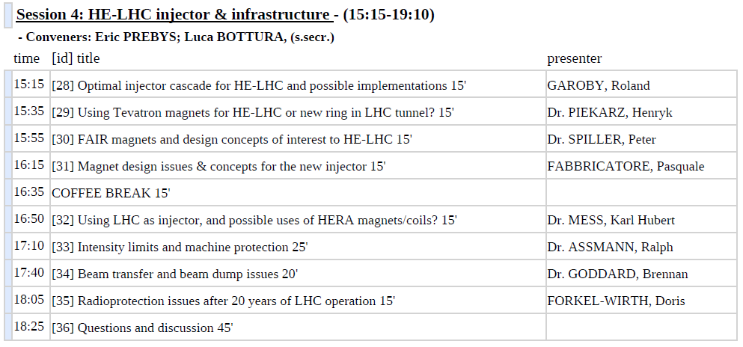
Speakers

Slide 3
Roland Garoby: Injector Cascade Issues
Note:
Matching the needs of the „High Luminosity LHC“ (HL-LHC) is the objective of the „LHC Injectors Upgrade“ (LIU) project
[time period: ~2017 – 2030],
The „High Energy LHC“ (HE-LHC) sets different requirements on the injectors, and with a different time-scale
[time period: ~2030 – 2050],
Past workshops (especially LER06 and LUMI06) are highly valuable sources of information.

Slide 4
Beam specifications
Derived from CERN-ATS-2010-177 [„First thoughts on a higher energy LHC“]
Specific to HE-LHC
 | Nominal LHC | HL-LHC | HE-LHC
Beam energy [GeV] | 450 | 450 | > 1000
Distance between bunches [ns] | 25 | 25 (resp. 50) | 50
Bunch population* [10¹¹ p/b] | 1.2 | ~1.8 (resp. 3.6) | ~1.4
Transverse normalized emittance [μm] | 3.75 | ≥ 2 | 3.75 (H) 1.84 (V) | 2.59 (H & V)
Longitudinal emittance [eVs] | 1 | 1 | ? (<4)
* At LHC entrance, assuming 5% loss wrt to start of physics data taking at high energy
Only injection energy beyond existing injector complex

Slide 5
Highest energy injector
Only requirement outside the capability of the existing injectors: need for > 1 TeV.
Two options:
In the SPS tunnel
New SPS (HE-SPS) with fast cycling sc dipoles
Replacement of equipment in TI2 and TI8 transfer lines (sc magnets)
In the LHC tunnel
No change to SPS and transfer lines
Additional double aperture 27 km ring compatible with detectors
Bypasses
Passage through detectors‘ centres using fast deflecting magnets

Slide 6
However…
Existing complex aging
PS will be 70 years old before HE-LHC could be built
Consider an integrated plan for HL-LHC, HE-LHC, and other CERN physics programs.
Perhaps arrive at something like Fermilab is considering
Bmax~5 T
Bdotmax~2T/s
Energy range | Machine | Other application
100 GeV – 1.2 TeV | HE-SPS | RIB acceleration?
~8 - 100 GeV | HE-PS | RIB acceleration ?
Up to ~8 GeV | SC linac | (+ 2 fixed energy rings) μ production for ν factory
Bmax~4 T
Bdotmax~3T/s

Slide 7
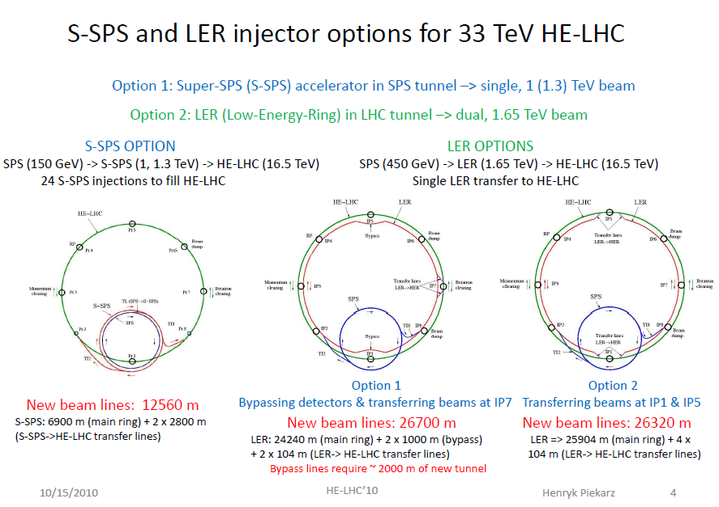
H. Piekarz: S-SPS vs. LER

Slide 8
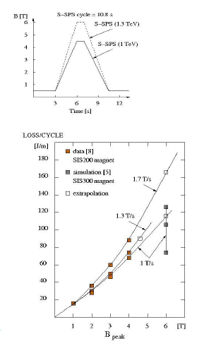
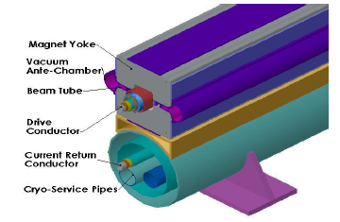
S-SPS vs. LER cont.
S-SPS complicated because of high ramp rate
Power for 4.5 T @ 1.3 T/s 15 W/m (might be high)
Cost: $2B based on FAIR
Consider LER based on VLHC design

Slide 9
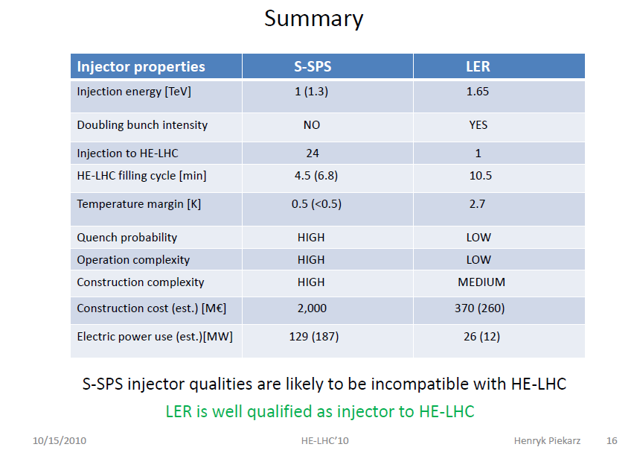

Slide 10
Peter Spiller: FAIR magnet R&D
FAIR
FAIR experiments require high average intensity > Fast ramped magnets
(short cycle times)
FAIR is supposed to be highly parallel and flexible
At a circumference of about 1km, curved dipole magnets are needed. > Restriction in total pulse power (magnet aperture) and acceptance drop by large sagitta.
CERN/SLHC
SIS100 magnet technolgy, its design and R&D may be of interest for a s.c. PS.
SIS300 magnets technology, its design and R&D may be of interest for a s.c. SPS (e.g. increase of final energy, energy consumption/pulse power)

Slide 11
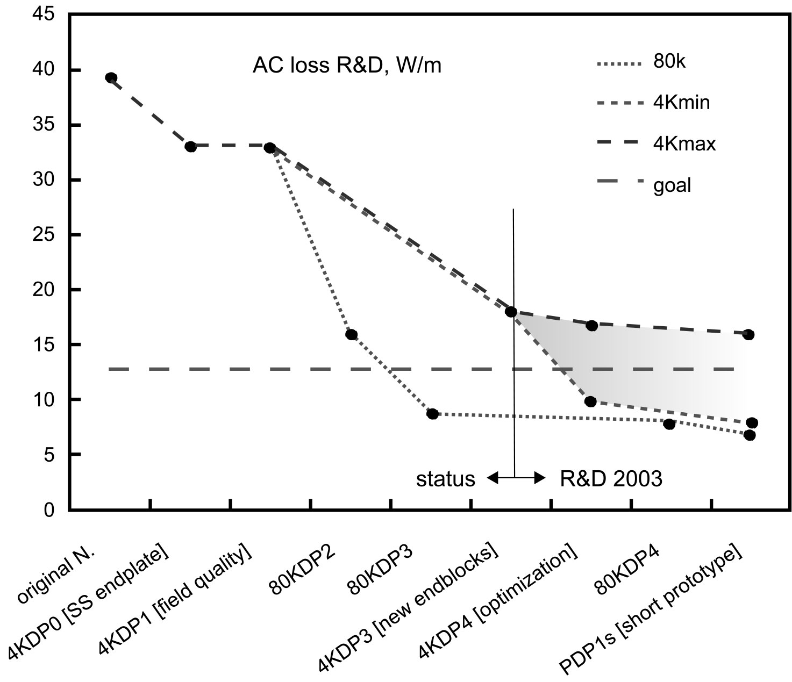
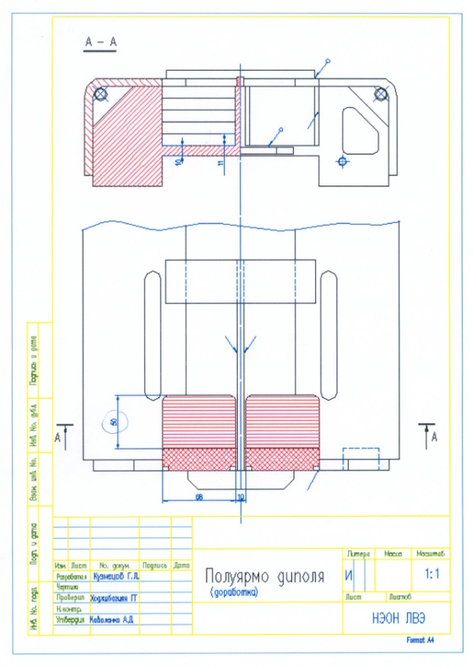
SIS 100 Fast Ramped S.C. Magnets
R&D goal: AC loss reduction to 13 W/m @ 2T, 4 T/s, 1 Hz
Front view
Top view
New endblock design

Slide 12
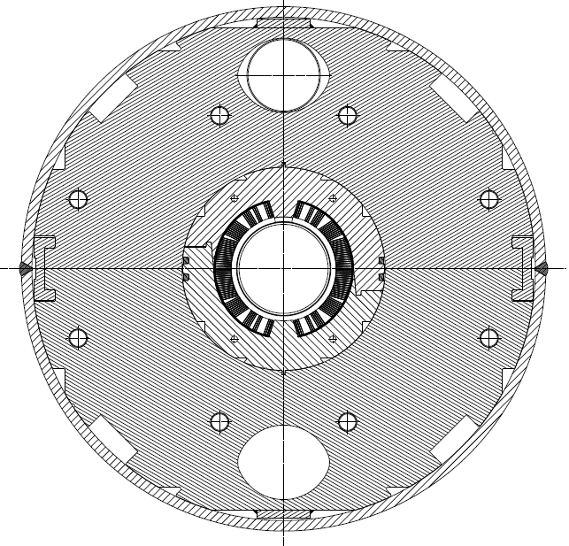
Pasquale Fabbricatore: SIS300 R&D
SIS300 dipoles: fast cycled and curved magnet

Slide 13
Criticities of SIS300 dipoles
 | Aperture (mm) | B (T) | dB/dt (T/s) | Π (T²/s) | Q (W/m)
LHC | 53 | 8.34 | 0.008 | 0.067 | 0.18
RHIC | 80 | 3.5 | 0.06 | 0.21 | 0.35
SIS300 | 100 | 4.5 | 1 | 4.5 | <10
Ramp 1T/s → ac losses → Limited performances
→ Costs of Cryogenics
Hence: Development of a low loss conductor
Design with loss minimization (taking care of eddy currents in structures)
Low ac losses→ Cored conductor→ Constructive problems
Curvature R=66.667 m (sagitta 117 mm ) → Design and constructive problems
10⁷ cycles → Fatigue → Mechanical design and materials optimization

Slide 14
Parameters | SIS300 dipole | Injector 4T 100mm 1.5T/s | Injector 6T 100mm 1.0T/s
Injection magnetic field [T] and b₃ | 1.5/ -0.75 | 0.4/ -4.5 | 0.4/-5.9
Maximum/ Peak magnetic field [T] | 4.5/4.9 | 4.0/4.4 | 6/6.42
Temperature Margin (K) | 0.97 | 1.66 | 0.65
AC losses in the superconducting cable during ramp [W/m] | 3.5 | 5.6 | 6.3
AC losses in the structures during ramp (eddy currents and magnetization) [W/m] | 3.5 | 5.9 | 4.3
Weight [T/m] | 1.28 | 1.28 | 1.68
Const. Cost [K€/m] evaluated on 60 magnets | 60-70 | 60-70 | 80-90

Slide 15
Karl Hubert Mess: LHC as injector + possible use of HERA magnets
Machine | LHC [1] | HERA [2]
Circumference | 26.7 km | 6.4 km
# of main bends | 1232 | 422
Magnet length | 14.3 m | 8.9 m
Field | 0.535...8.33 T | 0.227...4.649 (5.216) T
Current | 763...11850 A | 245...5027 (5640) A
Beam energy | 450...7000 GeV | 40...820 (920) GeV
Bending radius | 2804 m | 588 m
Sagitta | 9.14 mm | 14.4 mm
Inner coil diameter | 56 mm | 75 mm
Cold tube diameter | 50 mm | 55.3 mm
Nom. dI/dt | 10 A/s | 10 A/s
Tunnel diameter | 3.76 m | 5.20 m

Slide 16
However…
This area is “available for the new machine
⇒NO!

Slide 17
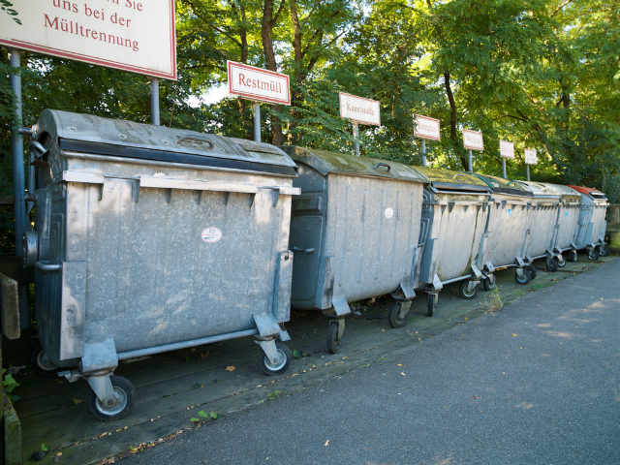
Recycling in a most drastic fashion ?

Slide 18
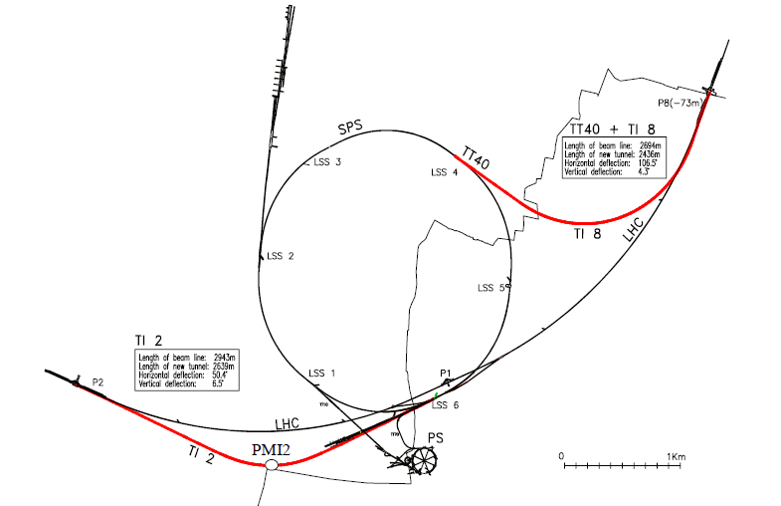
HERA Magnets [6]
The injection lines TI2 and TI8 have almost the bending radius as HERA.
The SPS has a larger radius and a wide tunnel, the HERA magnets would fit.
However HERA is slow and useless as a SPS upgrade.

Slide 19
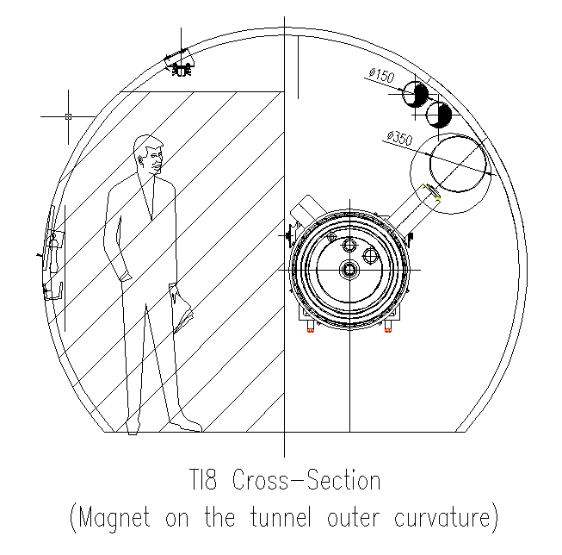
However…
Transfer lines very small
Polarity wrong
Cryogenics wrong
T12 slope a problem
⇒ with “free” stuff, sometimes you get what you pay for

Slide 20
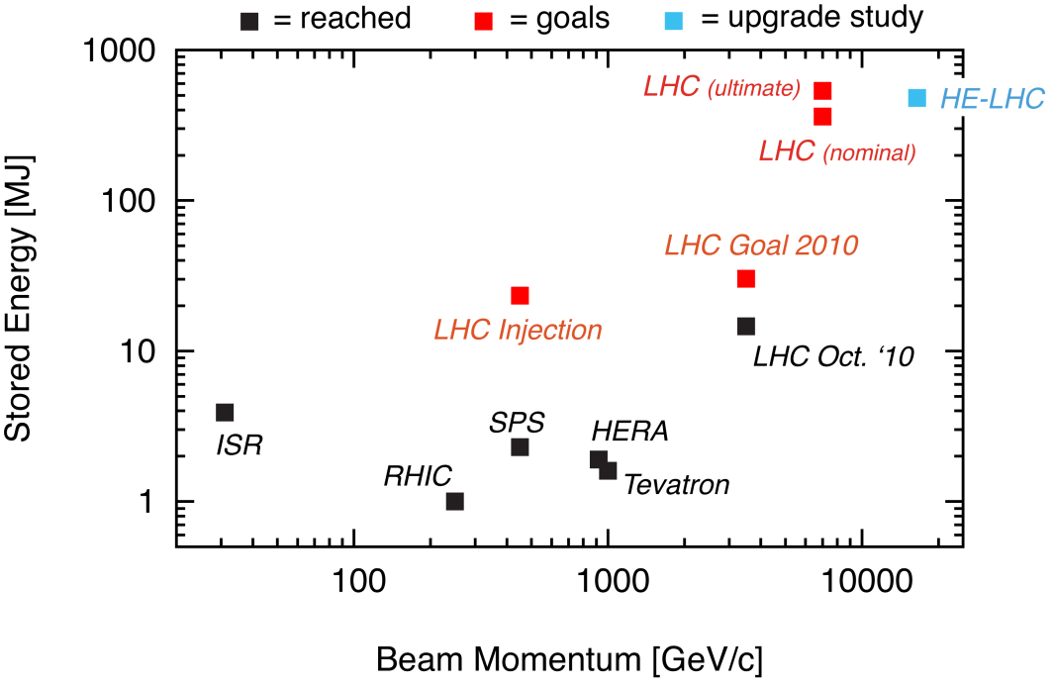
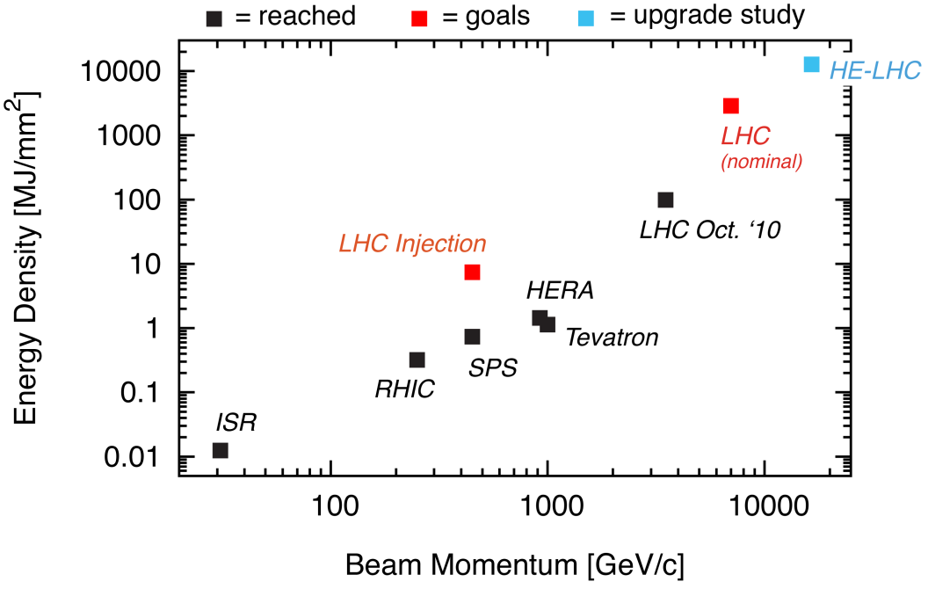
Ralph Assmann: Intensity Issues

Slide 21
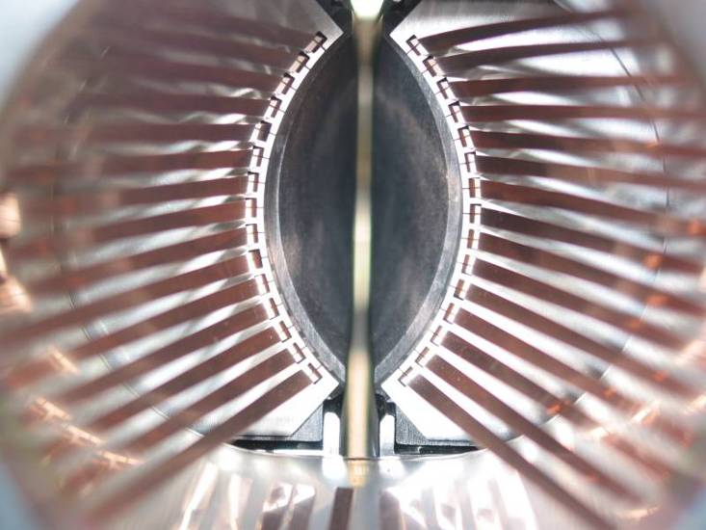
Multi-Stage Cleaning & Protection 3-4 Stages
CFC collimator
Beam propagation
Core
Unavoidable losses
Primary
halo (p)
Secondary halo
π
p
Shower
Impact parameter
≤ 1 μm
π
Tertiary halo
p
Primary
collimator
e
p
Shower
Secondary
collimator
e
Super-conducting magnets
High Z coll
SC magnets and particle physics exp.
High Z coll
CFC
CFC
W/Cu
W/Cu

Slide 22
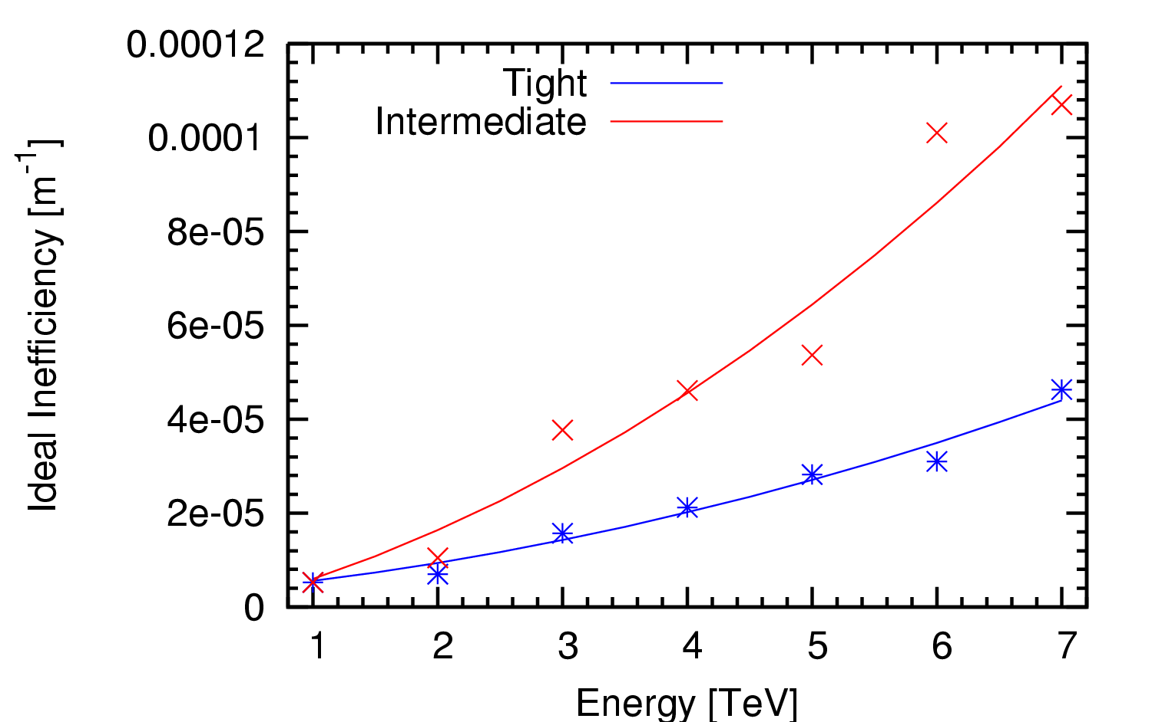
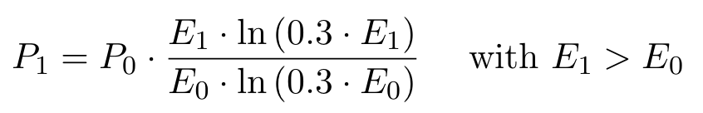
Cleaning inefficiency
The cleaning inefficiency is approximately proportional to the relative probability of a single diffractive scatter
Factor of 2.6 worse at 16.5 TeV than 7 TeV, but probably not a show stopper

Slide 23
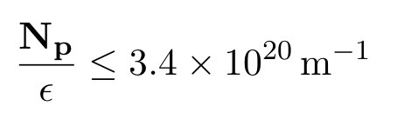
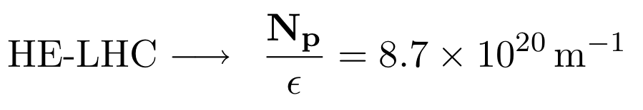
HE-LHC Situation for Robustness
Respect absolutely the following condition:
Present design parameters HE-LHC at 16.5 TeV:
→ Not a priori OK!
Comparison assumes similar kicker rise times, leakage, failure scenarios,…

Slide 24
HE-LHC with Present Technologies
Bunch density factor 2.6 above limit.
Possibility 1 (this works for sure):
Increase emittance: 0.15 nm → 0.38 nm
Feasible with present technologies.
Luminosity reach: 9.4 × 10³³ cm⁻² s⁻¹ (~ half)
Possibility 2 (can be good or bad news):
Review damage limits.
Further simulations.
Experimental studies: HiRadMat
Possibility 3 (looks quite promising):
New collimator and absorber technology
Studies are underway → EuCARD/ColMat
No showstopper

Slide 25
Issues with Smaller Gaps
Must try to keep collimator gaps reasonably large.
Ideally for available SC aperture a [σ] in collision:
a [σ] (16.5 TeV) = 1.5 × a [σ] (7 TeV)
This costs reach in β* or requires the same IR/DS apertures (in mm).
Alternative (if we keep collimation at ~6 σ):
New LHC collimator technology for factor 2 smaller gaps and even higher precision and reproducibility.
Live with much higher impedance.
Live with operational tolerances (orbit) at the 20-30 μm level.

Slide 26
Doris Forkel-Wirth: HE-LHC from RP’s Point of View
To convert LHC/HL-LHC into HE-LHC after 20 years of operation implies:
exposure of workers to ionizing radiation
removal of dipoles
removal of inner triplets (?)
removal of collimators (?)
modification of beam dumps (?)
LHC experiment modifications/upgrades
installation of new components
radioactive waste
production
conditioning
interim storage
final disposal

Slide 27
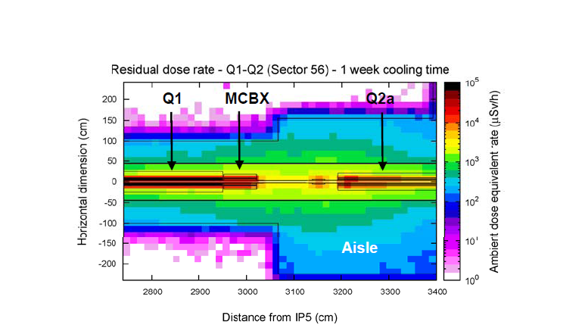
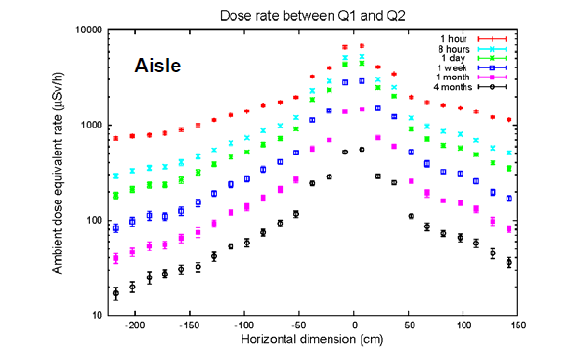
Inner Triplet
LHC mode | Duration | Ambient dose equivalent rate
nominal | 5 y | up to 600 uSv/h
HL-LHC | 10 y | up to 1 mSv/h
Monte Carlo results for 180 days at nominal luminosity

Slide 28
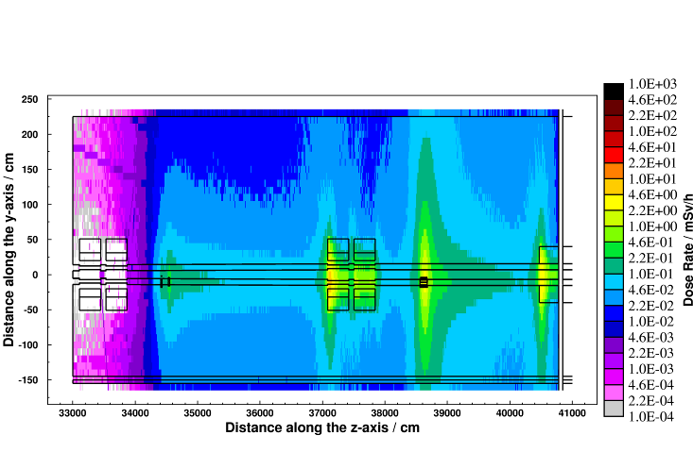
Collimators
2030 – after HL-LHC:
Aisle: 0.03 – 0.3 mSv/h
Close 0.3 – 3 mSv/h
Aisle: 0.01-0.1mSv/h
Close: 0.1-1mSv/h
Monte Carlo results for 180 days of nominal operation,
4 months cooling
Bottom line: need ALARA and possibly remote handling facilities

Slide 29
Waste Production
2030: LH-LHC, lower release limits
Radioactive after 10 years of LHC nominal operation and 4 months of cooling
ARC
?
LSS7
Low level waste at CSTFA: 3000 Euros/m^3
High level at CERN

Slide 30
(brief) Discussion of transfer kickers
Unfortunately, Brennan Goddard was not able to come, but some feeling that he “had a proposed solution”
Obviously an important issue
Discussion
Kicker effectiveness ∝ 1/E
Required septum aperture ∝ 1/E^{1/2}
Prob lem ∝ E^{1/2}

Slide 31
Summary of summaries
HE injector
S-SPS: Difficult and expensive because of high dB/dt
But lots of good work is being done
LER: Easier from an accelerator standpoint, but can it fit?
Intensity
Cleaning inefficiency a factor of 2-3 worse
Probably manageable
Energy density too high for carbon
Investigate new materials
Radioprotection
Levels on the order of ~1 mSv/hr after four month cooldown
Need to take care, but doable
Transfer kickers
Very important topic, not really covered
Encourage Brennan to to contribute to proceedings

