Slide 1
Status of MiniBooNE
Eric Prebys, FNAL/BooNE Collaboration

Slide 2
The MiniBooNE Collaboration
Y.Liu, I.Stancu
University of Alabama
S.Koutsoliotas
Bucknell University
E.Hawker, R.A.Johnson, J.L.Raaf
University of Cincinnati
T.Hart, R.H.Nelson, E.D.Zimmerman
University of Colorado
A.A.Aguilar-Arevalo, L.Bugel, J.M.Conrad, J.Link, J.Monroe, D.Schmitz, M.H.Shaevitz, M.Sorel, G.P.Zeller
Columbia University
D.Smith
Embry Riddle Aeronautical University
L.Bartoszek, C.Bhat, S.J.Brice, B.C.Brown, D.A.Finley, R.Ford, F.G.Garcia, P.Kasper, T.Kobilarcik, I.Kourbanis, A.Malensek, W.Marsh, P.Martin, F.Mills, C.Moore, E.Prebys, A.D.Russell, P.Spentzouris, R.Stefanski, T.Williams
Fermi National Accelerator Laboratory
D.Cox, A.Green, T.Katori, H.Meyer, R.Tayloe
Indiana University
G.T.Garvey, C.Green, W.C.Louis, G.McGregor, S.McKenney, G.B.Mills, H.Ray, V.Sandberg, B.Sapp, R.Schirato, R.Van de Water, N.L.Walbridge, D.H.White
Los Alamos National Laboratory
R.Imlay, W.Metcalf, S.Ouedraogo, M.Sung, M.O.Wascko
Louisiana State University
J.Cao, Y.Liu, B.P.Roe, H.J.Yang
University of Michigan
A.O.Bazarko, P.D.Meyers, R.B.Patterson, F.C.Shoemaker, H.A.Tanaka
Princeton University
P.Nienaber
St. Mary's University of Minnesota
B.T.Fleming
Yale University

Slide 3
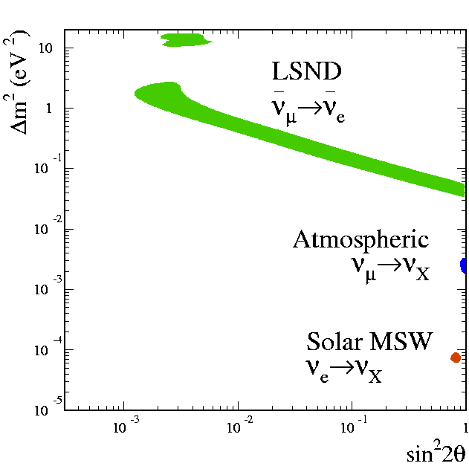
Motivation for the Experiment - LSND
State of Oscillation Results
Simplest model has three neutrino mass eigenstates, but…
Data indicates 3 mass differences
  Δm²_{atm} ~ 2-3x10⁻³ eV²
  Δm²_{sol} ~ 7x10⁻⁵ eV²
  Δm²_{LSND} ~ .1-10 eV²
(Soudan, Kamiokande,
MACRO, Super-K)
(Homestake, SAGE,
GALLEX, Super-K
SNO, KamLAND)

Slide 4
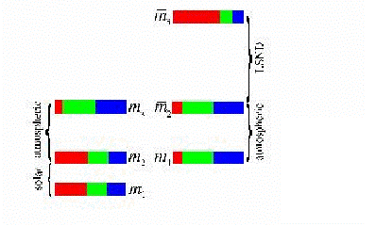
Possibilities
4 neutrinos?
  We know from Z lineshape there are only 3 active flavors
  Sterile?
CPT Violation?
LSND Wrong?
Must verify LSND Result-> MiniBooNE
  Optimized for L/E ~ 1
  Higher energy beam -> Different systematics than LSND
  Proposed: 12/97
  Began Construction: 10/99
  Completed: 5/02
  First Beam: 8/02

Slide 5
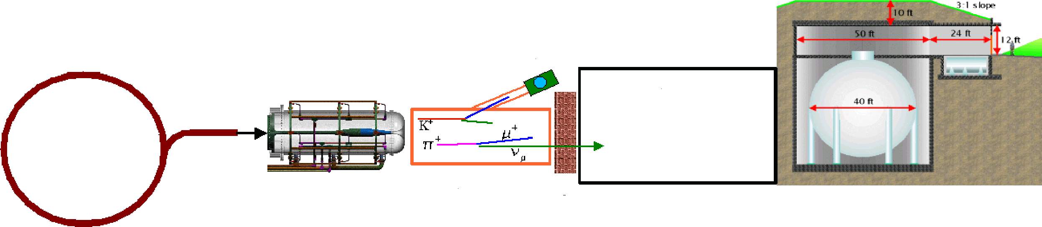
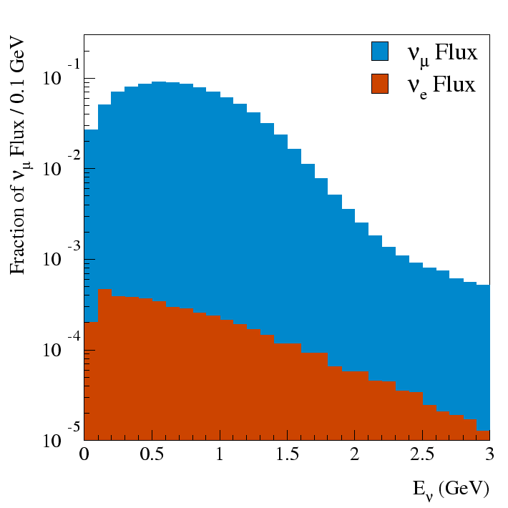
Neutrino Beam
“Little Muon Counter” (LMC): to understand K flux
FNAL
Booster
500m dirt
Be Target
and Horn
50 m Decay Region
Detector
8 GeV protons
Proton flux ~ 6E16 p/hr (goal 9E16 p/hr)
  ~ 1 detected neutrino/minute
  L/E ~ 1

Slide 6
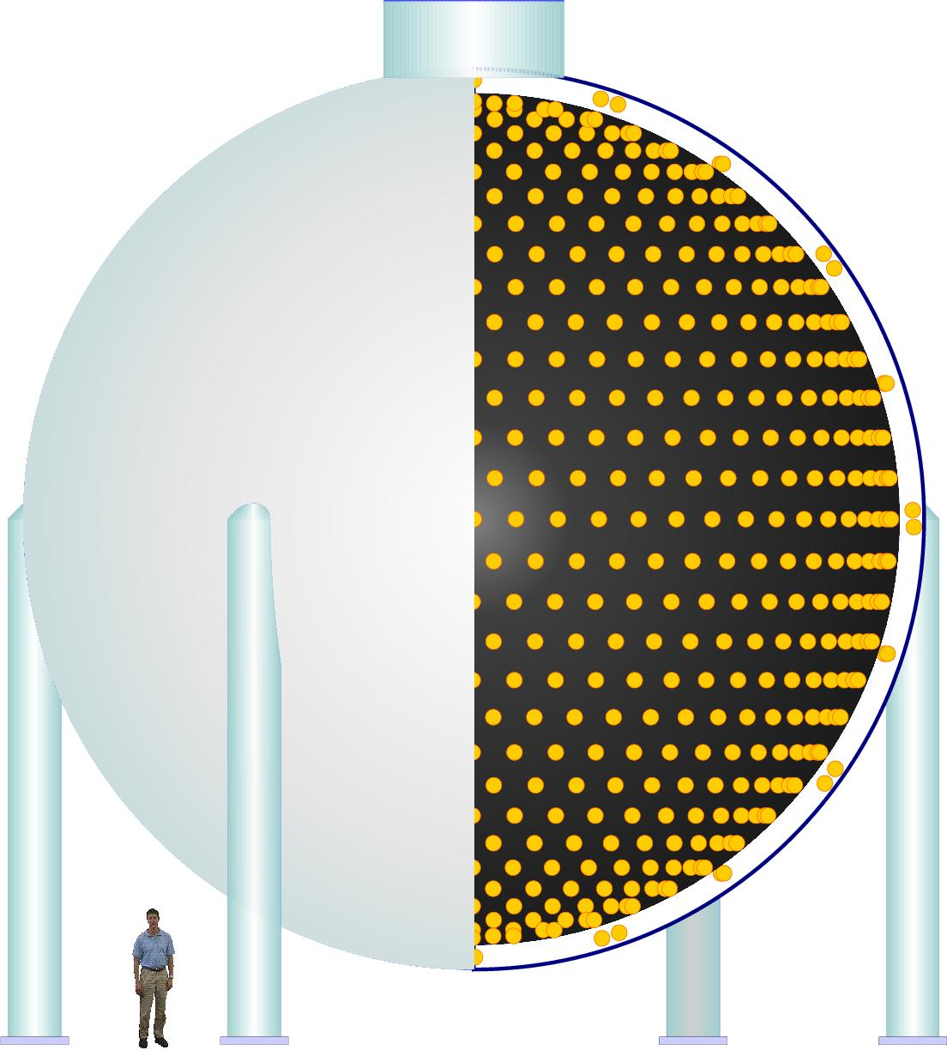
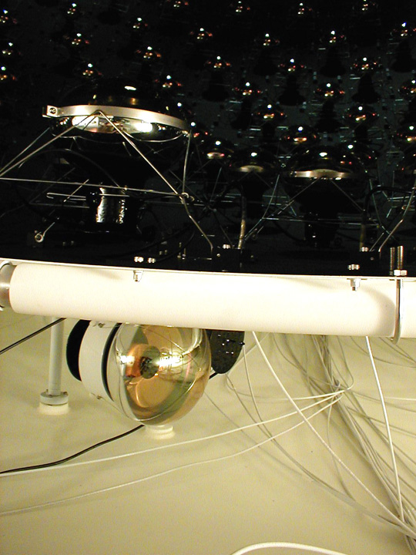
Detector
950,000 l of pure mineral oil
1280 PMT’s in inner region
240 PMT’s outer veto region
Light produced by Cerenkov radiation and scintillation
Trigger:
  All beam spills
  Cosmic ray triggers
  Laser/pulser triggers
  Supernova trigger
Light barrier

Slide 7
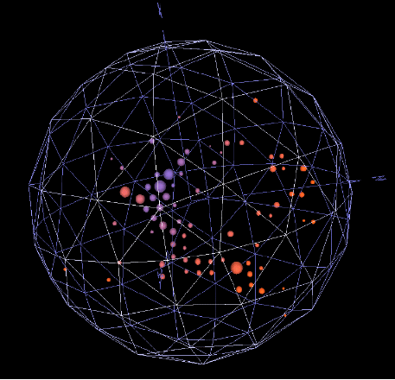
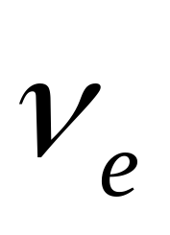
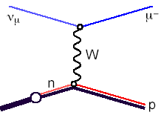
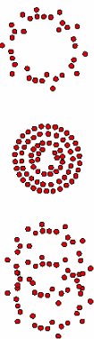

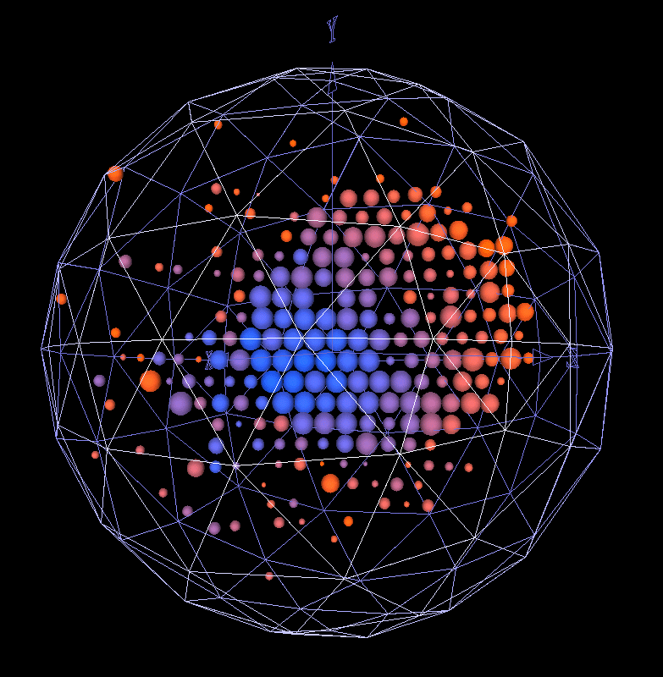
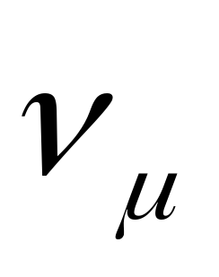
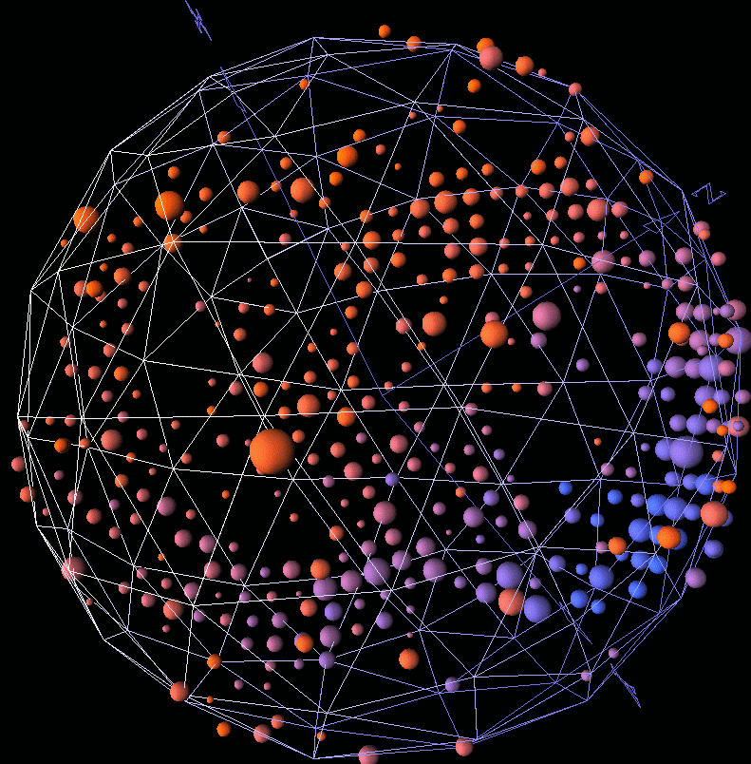
Neutrino Detection/Particle ID
ν_{e}
e⁻
W
n
p
ν_{μ}
μ⁻
W
n
p
ν_{μ}
ν_{μ}
Z
n
Δ⁰
π⁰
p
Important Background!!!

Slide 8
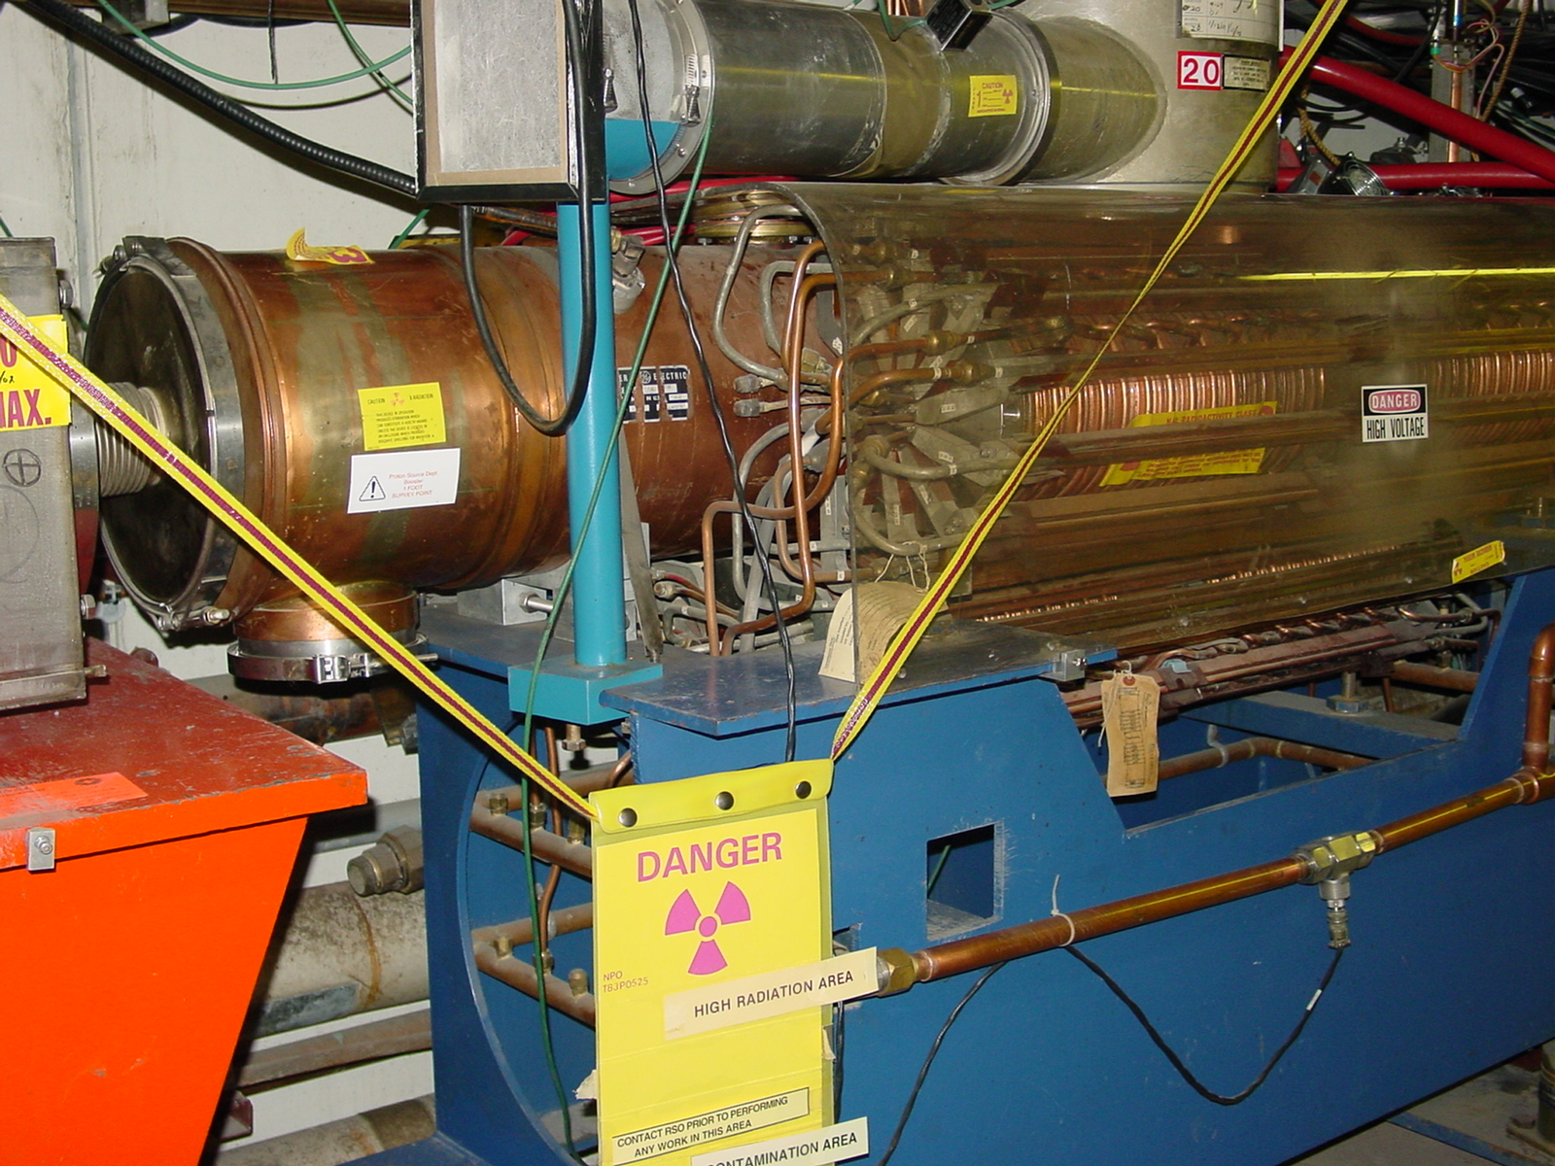
Delivering Protons
Requirements of MiniBooNE greatly exceed the historical performance of the 30+ year old 8 GeV Booster, pushes…
  Average repetition rate
  Above ground radiation
  Radiation damage and
  activation of accelerator
  components
Intense Program to improve
the Booster
  Shielding
  Loss monitoring and analysis
  Lattice improvements (result of Beam Physics involvement)
  Collimation system

Slide 9
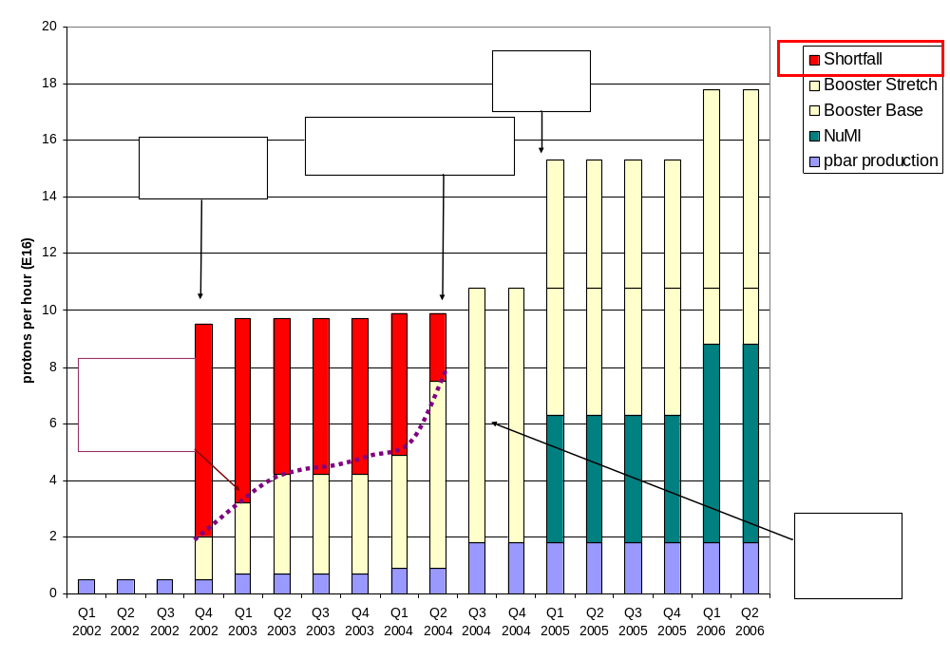
Demands on Fermilab Proton Source
Have now exceeded initial NuMI needs!!!!

Slide 10
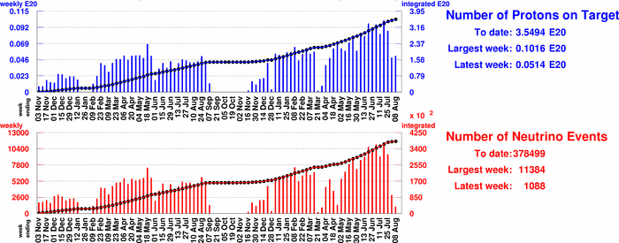
Beam Progress
To date: 3.5E20 protons on target
Will collect at least 5E20
Hope for 1E21

Slide 11
There are None So Blind…
This is a difficult analysis, and there are many opportunities for unintentional bias
Therefore, we consider a blind analysis essential
General philosophy: guilty until proven innocent
Events go “into the box” unless they are specifically tagged as being non-signal events, e.g
  Muons
    Single μ-like ring
    Topological cuts
  π⁰
    No Michel electron
    Clear two-ring fit, both with E>40 MeV
Will only look at remaining data when
  We have enough protons, AND
  We are confident that we model the beam and detector well.

Slide 12
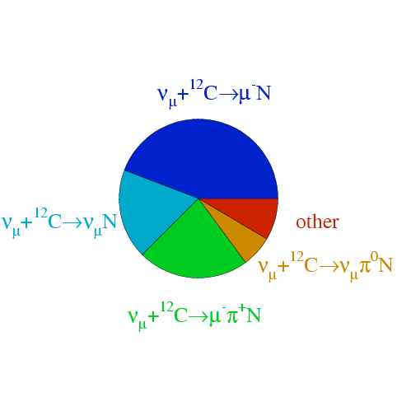
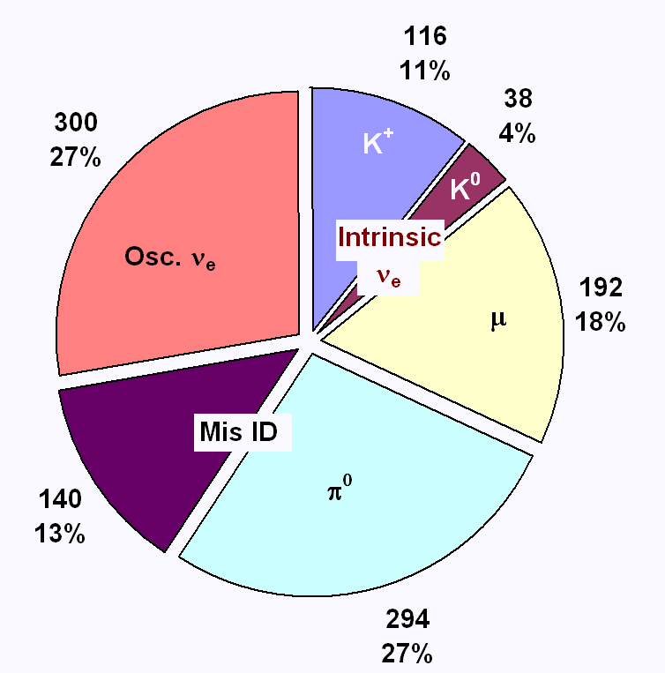
Event Rates
ν_{μ} Reactions
Contributions to ν_{e} Signal
Hope LMC+HARP will help with K background
ν_{μ} + ¹²C → μ⁻ N
Signal: Based on LSND average
(39%)
ν_{μ} + ¹²C → ν_{μ} N
other
(16%)
(13%)
ν_{μ} + ¹²C → ν_{μ} π⁰ N
ν_{μ} + ¹²C → μ⁻ π⁺ N
(7%)
(25%)
MC:
  Parametrized pBe interaction (our fit of BNL E910)
  GEANT4 model of target, horn, and beamline
  NUANCE MC of neutrino interaction
  Full hit-based MC of detector, including oil, PMT’s etc.
Can be constrained with data

Slide 13
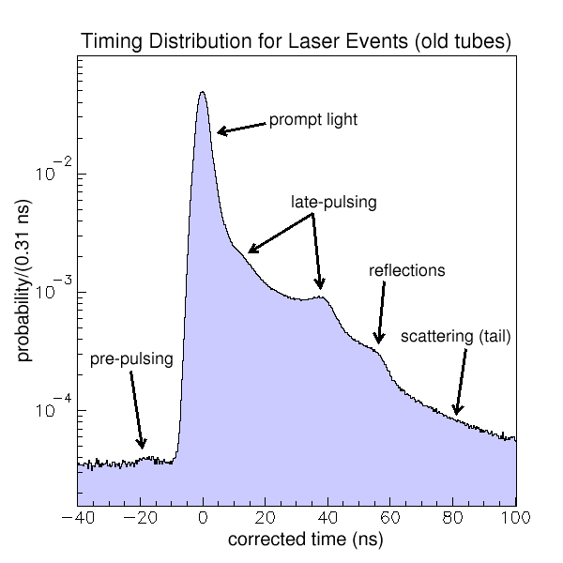
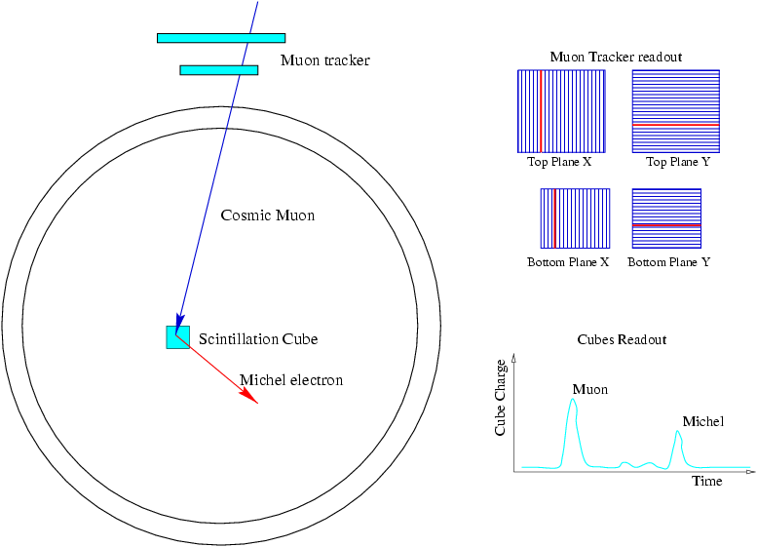
Characterizing the Detector
Laser Calibration
  Laser pulses illuminate one of 4 flasks which scatter light isotropically
  Used to understand PMT response
Cosmic Muons
  Muon Tracker used in conjunction with “cubes” to trigger on a particular endpoint (energy)
  Vital in understanding energy scale

Slide 14
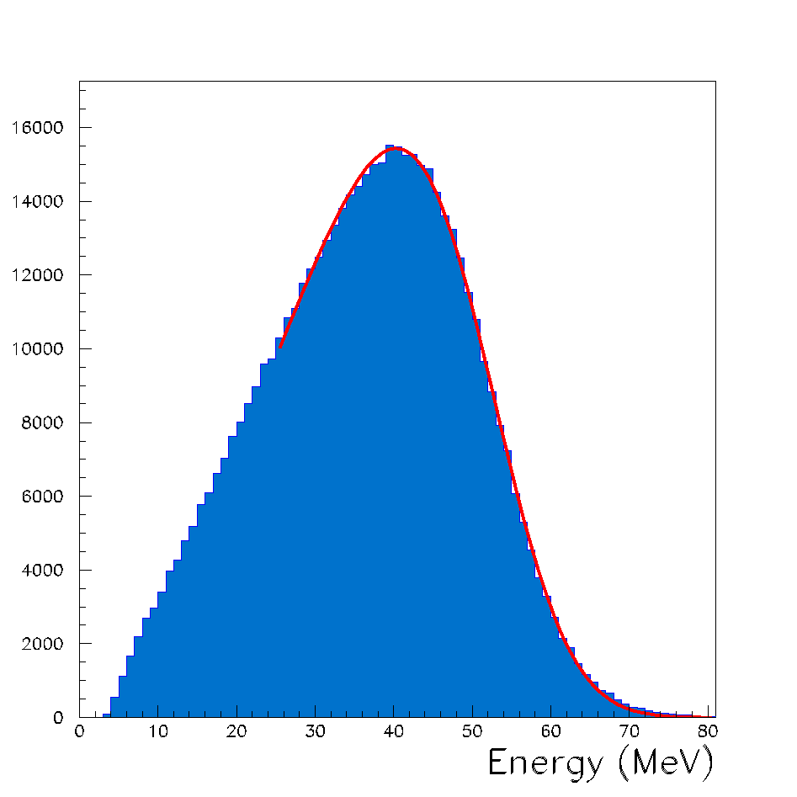
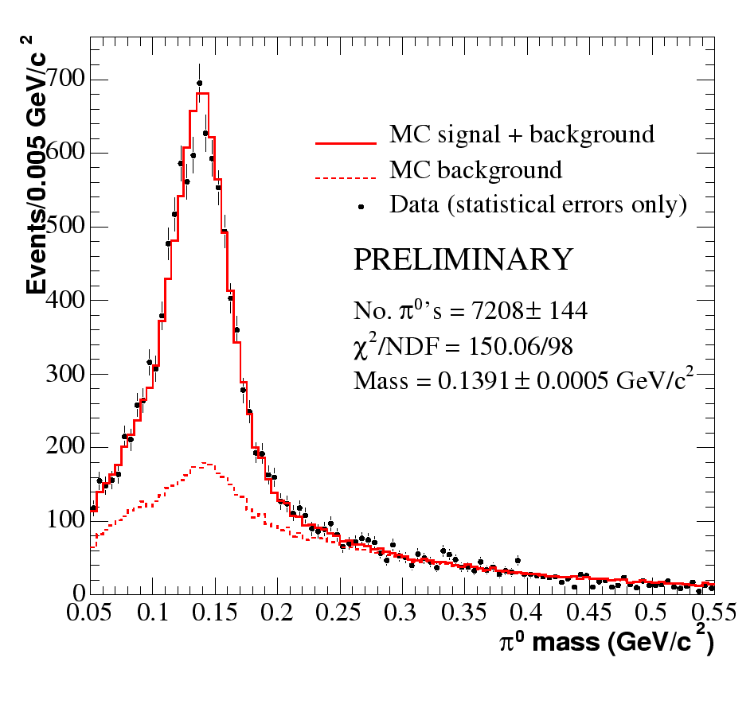
The Detector (cont’d)
Elecrons from muon decay (Michel electrons)
  Vital for understanding signal events.
π⁰ Events
  Help to understand higher energy ν_{e}
  Help fix energy scale

Slide 15
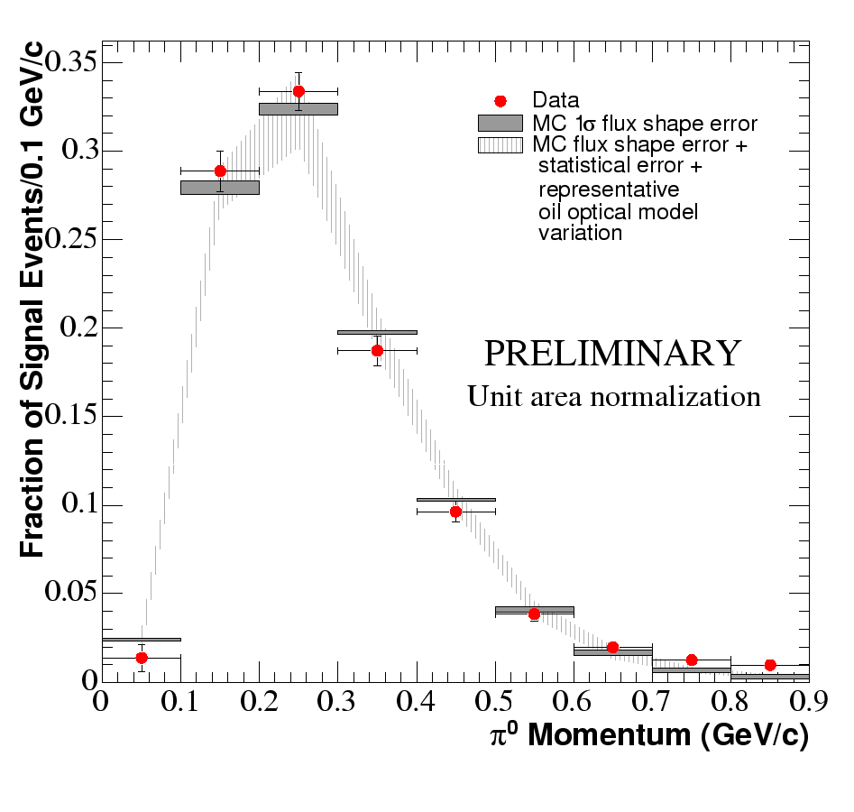
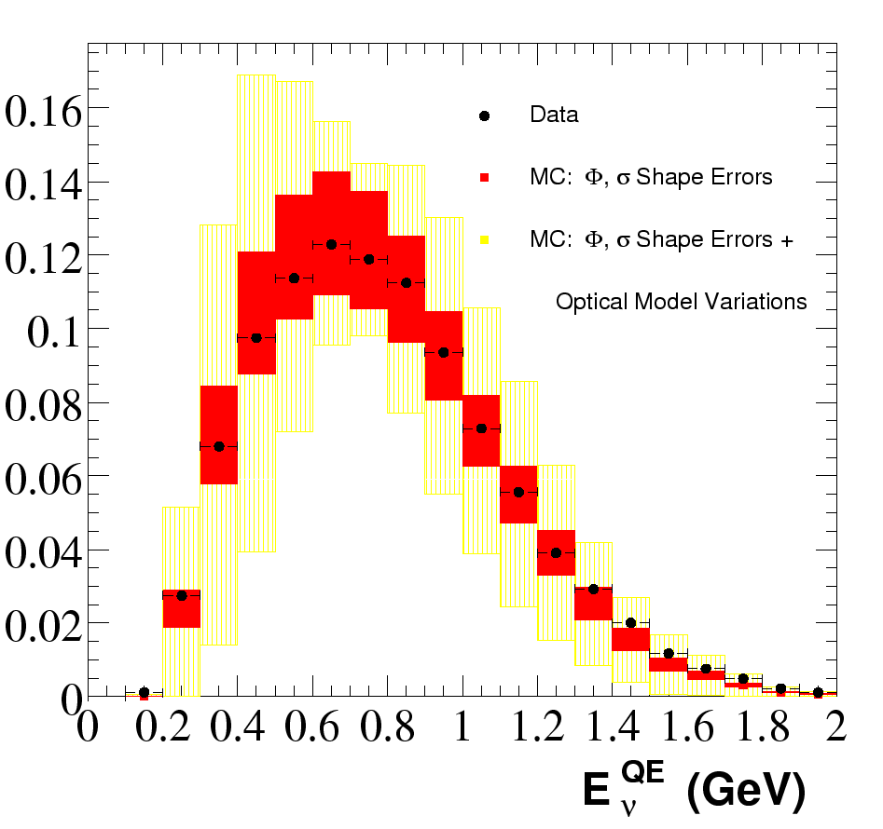
Understanding the Data: Examples
π⁰
Ε_{ν}

Slide 16
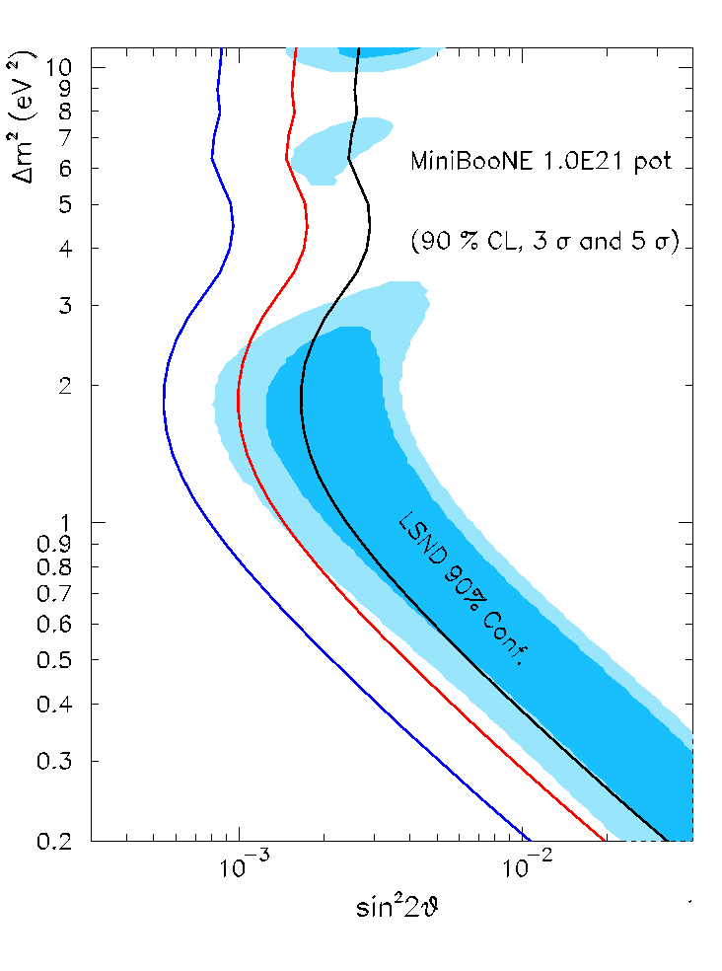
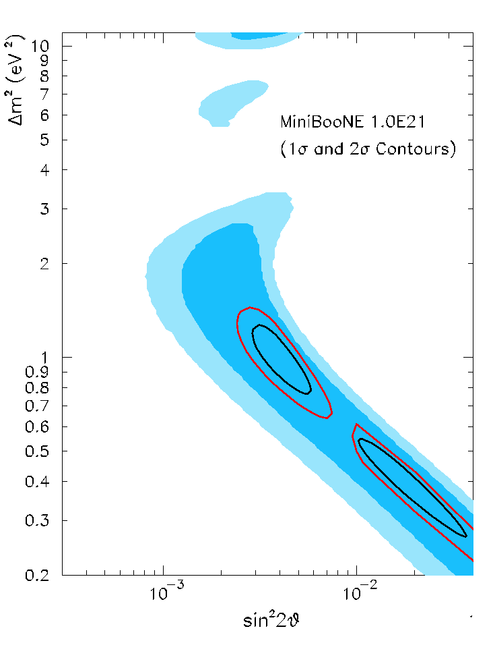
Experimental Sensitivity (1E21 POT)
No signal
  Can exclude most of LSND at 5σ
Signal
  Can achieve good Δm² separation

Slide 17
Recent Developments with the Horn
Horn currently has almost 100 million pulses
  Designed for 200 million pulses (2 years @5 Hz)
  Previous horn records .5Hz and 12M pulses
March, 2004: Horn developed an internal water leak
  Able to collect water and continue running
July 24th, 2004: Horn began to ground-fault
  ~600 Amps (out of 170,000) to ground
Conclusion
  Cannot safely run horn in this state.
  Horn (way) too hot to repair.
  Will run with horn OFF until Fall shutdown (starts August 23rd)
    Useful for systematics
  Will replace horn with a spare during shutdown.

Slide 18
Summary and Outlook
MiniBooNE has collected 3.5E20 protons
The experiment has made impressive progress in understanding both the detector and the data.
Fermilab is about to go into a 13 week shutdown, during which…
  The MiniBooNE horn will be replaced.
  Improvements will be made to the Booster, which should allow it to achieve the MiniBooNE intensity goals
NuMI will start in early 2005, BUT MiniBooNE should be able to continue taking data, albeit at a reduced intensity
  We could not have said this a few months ago.
  5E20 proton by early 2005
  1E21 somewhere between mid-2006 and mid-2007
Will not release ν_{e} appearance result before 5E20, but other physics along the way, e.g.
  NC π⁰ cross-section
  ν_{μ} disappearance result

