Slide 1
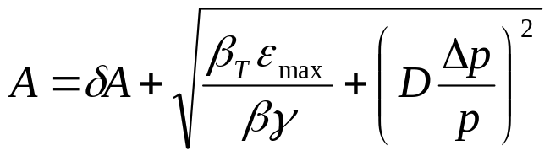
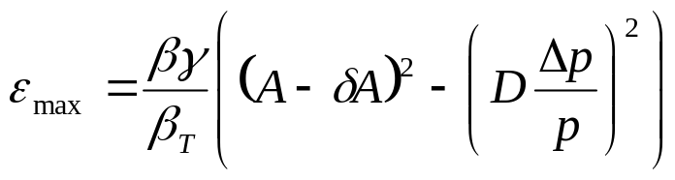
Evaluate Effect of Improvements
Calculate effect of various improvments based on increased acceptance (a la McGinnis):
Use:
Effective aperture
reduction
Condition | Date | δA | max D | max beta | Acceptance | Relative
 | Completed | (mm) | (m) | (m) | (π-mm-mr) | Increase (%)
Start of MiniBooNE | --- | 10 | 6.2 | 45.8 | 15.7 | -15
Dogleg 3 Fix | Oct-03 | 10 | 4.5 | 40.8 | 18.4 | 0
Dogleg 13 Fix | Oct-04 | 10 | 3.8 | 36.1 | 21.0 | 14
Alignment | Oct-05 | 8 | 3.8 | 36.1 | 24.3 | 32
ORBUMP | Oct-05 | 5 | 3.8 | 36.1 | 29.5 | 60
correctors | Oct-06 | 2 | 3.8 | 36.1 | 35.2 | 92
Ideal | --- | 0 | 3.19 | 33.7 | 42.3 | 130

Slide 2
Effect on Max Proton Intensity
Prior to this shutdown, regularly delivering 7.5E16pph with ~40% reduction in activation around most of the Booster.
  Assume after another year of tuning and collimator optimization, we could have hit 1E17 pph with no other improvments (“fallback” = .9E17).
Operational experience: tuning asymptotically approaches benefit of a particular improvement:
  Assume after one year of tuning, 50% of the benefit of a particular improvement is realized (fallback = 25%).
Date | “Design” Limit (1E16 p/hr) | Fallback Limit (1E16 p/hr) | Comment
1/2006 | 10.7 | 9.3 | Effect of collimators, dogleg fix, plus some alignment
1/2007 | 13.0 | 10.4 | Alignment and ORBUMP
1/2008 | 14.6 | 11.0 | New corrector system

Slide 3
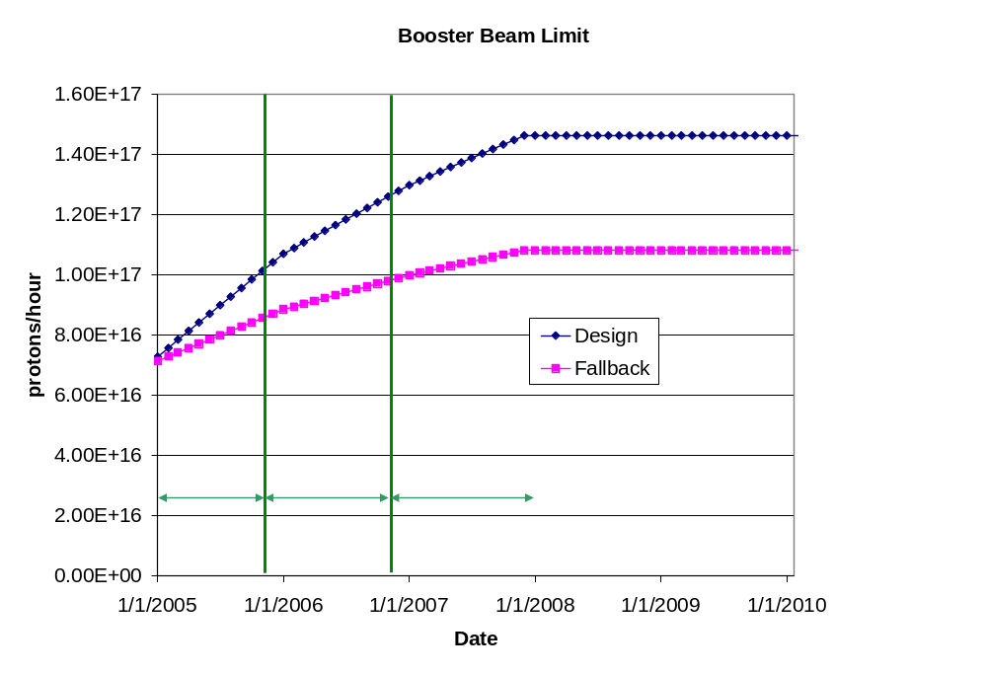
Predicted Proton Intensity Limits

Slide 4
Calculating NuMI PoT
Even the fallback scenario accommodates NuMI operation.
Assume the following
  Ramp up to full 5*5E12 batch operation by April 2005
  Ramp up to full 9*5.5E12 batch slipstacked operation a few months after MI RF upgrade.
  90% efficiency during slip stacking.
  10 month operation each year.
  81% total uptime for remainder of years (based on MiniBooNE. Includes scheduled and unscheduled downtime).
  85% avg/peak operating efficiency (negotiable).
Will add:
  Extra downtime for shot setup and fast transfers (~10%).

Slide 5
Calculating MiniBooNE PoT
Trickier:
  Still limited by beam loss, NOT rep. rate.
  Assume antiproton and NuMI have priority, so
  MB VERY sensitive to proton limit and its fluctuations.
Use:
(avg pph) = (pph lim.)*η – (NuMI pph) – (pbar pph)
Also assume:
  10 month operation
  81% up time (based on 2004)
Will add:
  Increased protons during shot setup.
Avg/pk ~ 86%

Slide 6
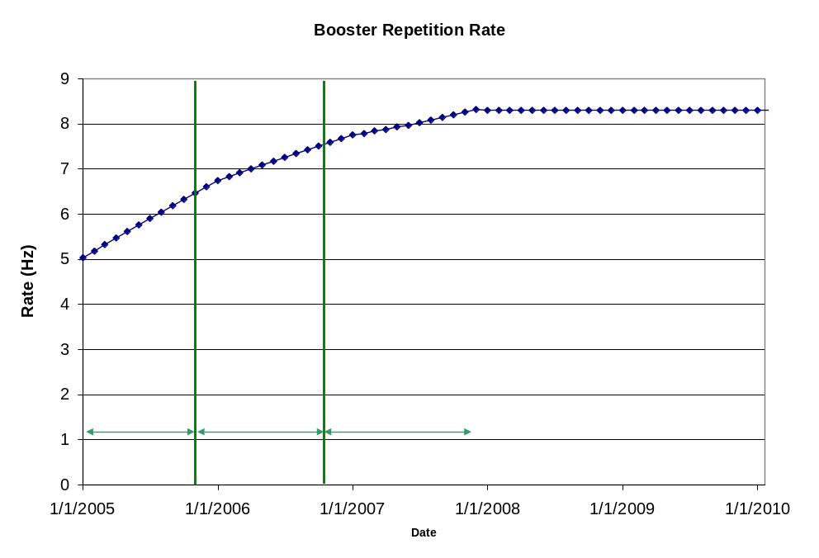
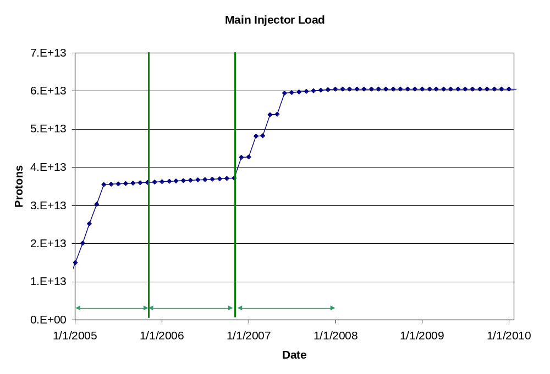
Machine Loading

Slide 7
“Design” PoT
Phase | Booster Batch Size | Main Injector Load | Cycle Time | MI Intensity | Booster Rate* | Total Proton Rate | Annual Rate at end of Phase
 |  | (AP + NuMI) | (sec) | (protons) | (Hz) | (p/hr) | NuMI | Mini-BooNE
July, 04 | 5.0E+12 | 1+0 | 2.0 | 0.5E+13 | 5.7 | 0.8E+17 | 0 | 3.9E+20
I | 5.10E+12 | 2+1→2+5 | 2.0 | 3.6E+13 | 6.3 | 1.0E+17 | 2.4E+20 | 1.2E+20
II | 5.3E+12 | 2+5 | 2.0 | 3.7E+13 | 7.5 | 1.2E+17 | 2.4E+20 | 2.4E+20
III | 5.50E+12 † | 2+9 | 2.2 | 6.1E+13 | 8.3 | 1.5E+17 | 3.7E+20 | 1.6E+20
11 Hz (beyond plan) | 5.50E+12 | 2+9 | 2.2 | 6.1E+13 | 11.0 | 2.0E+17 | 3.7E+20 | 4.4E+20

Slide 8
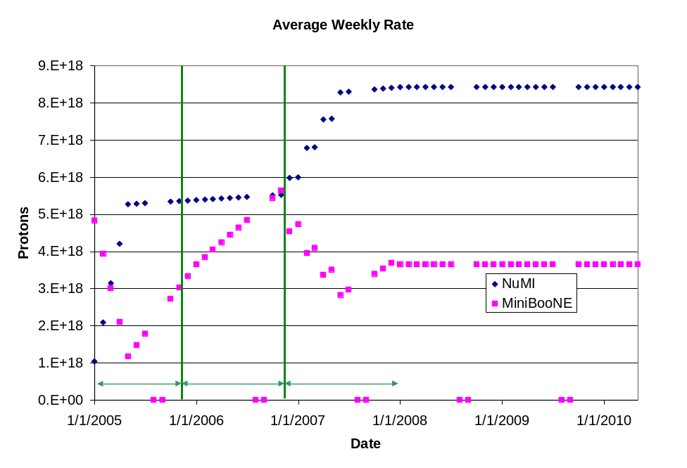
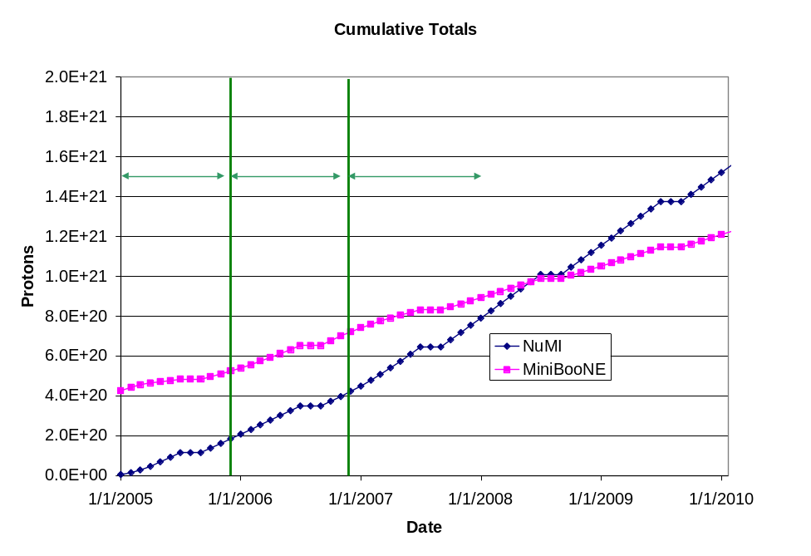
“Design” Totals

Slide 9
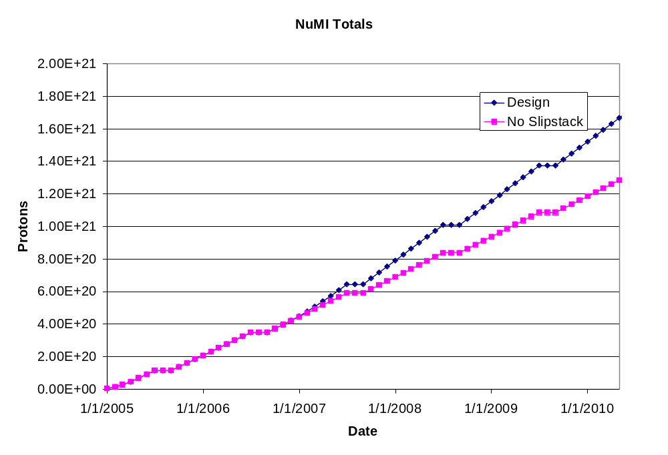
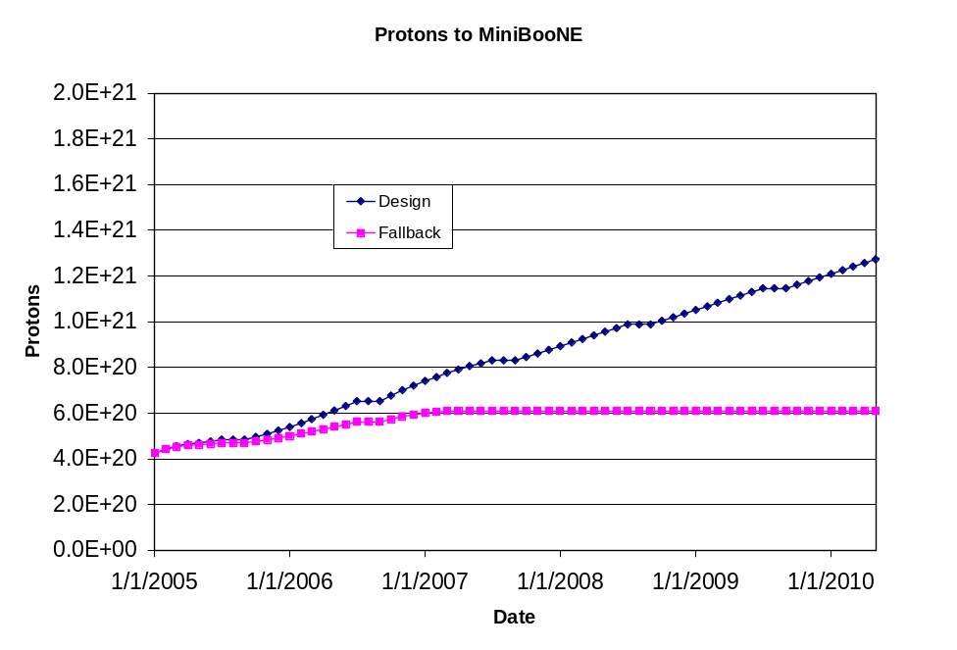
“Fallback” Totals

