Slide 1
Booster Injection Review
Eric Prebys

Slide 2
General
Schedule:
  Overall Concept - M. Popovic 30 Min.
  Girder Layout - J. Lackey 20 Min.
  Beamline Issues - F. Garcia 20 Min.
  Field Quality Issues - E. Prebys 10 Min.
  Booster Modeling - A. Drozhdin 20 Min.
  Discussion - 20 Min.
Goal:
  Reach a go/no-go decision by next Monday (4/25)

Slide 3
Field Quality Issues
It can be shown that field imperfections should have a negligible effect on beam optics.
Major worry is field non-uniformities leading to net dipole moment as beam moves laterally.
In a four magnet scheme, it is possible to arrange the magnets to cancel this effect at the quadrupole level.
This is more difficult in the three magnet case.
It should be noted that the current path insures dipole cancellation at lowest order (i.e. sum of currents for outer magnets equals current of inner magnet).

Slide 4
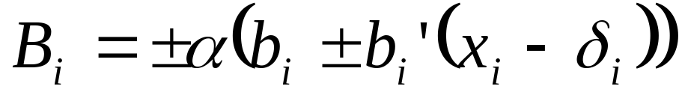
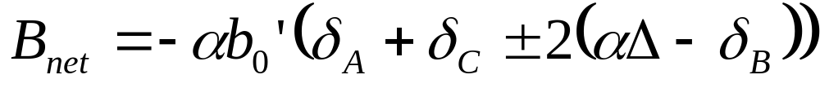
Net Dipole
The integrated field seen by the ith magnet can be expressed as
Net dipole of three magnet system:
Magnet orientation
Full field quad term
Magnet polarity
Fraction of full field
Full field dipole at center
Beam position
Magnet Offset
Max quad of outer magnets
Max beam deflection at center

Slide 5
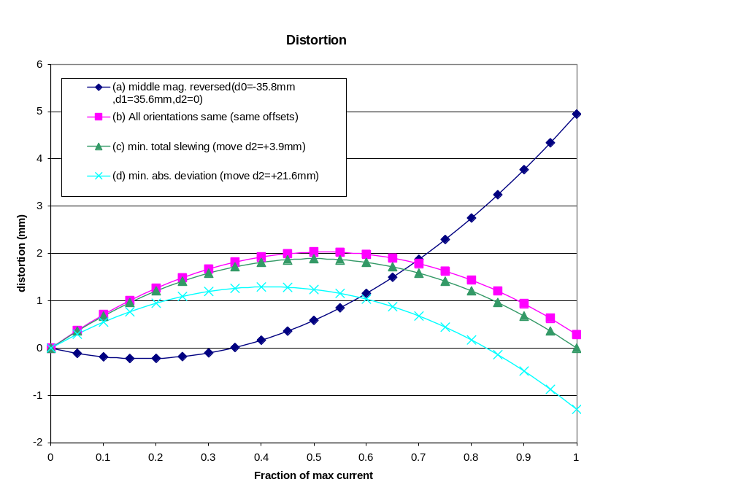
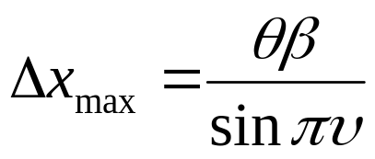
Maximum Closed Orbit Distortion

Slide 6
Conclusions
The new design is sensitive to magnetic field imperfections
Based on the measured quadrupole moment, we can arrange the magnets so that the maximum closed orbit distortion at any place in the ring is less than 2mm.
We are investigating simple measures to reduce the quadrupole term, but feel this amount of motion is acceptable.

