Slide 1
Linac and Booster Instrumentation
Eric Prebys
DOE Review, Instrumentation Breakout Session
July 22,2003

Slide 2
Existing Intrumentation
Linac
  BPM’s (marginal performance)
  Current toriods
  Dump wire (more meaningful after new Lambertson)
400 MeV Line
  BPM’s (recently upgraded)
  multiwires.
  Time of flight monitor (R. Webber, very important)
  Phase detector, relative to debuncher (R. Webber)
Booster
  24 periods x 2 subperiods x 2 planes = 96 BPM’s
  Resistive wall monitor (RWM): longitudinal profile
  Ionization profile monitor (IPM): both planes
  24 periods x 2 subperiods + 12 extraction = 60 BLM’s
  Crawling wires (not used except for “flying beam”).

Slide 3
Linac and Booster Instrumentation Summary
With some minor exceptions, we believe that the Linac and Booster have adequate instrumentation to meet the projected demands, both for Run II and the neutrino program (e.g. nothing in the Run II WBS).
Our biggest priority at the moment is consistent, repeatable, and reliable performance.
We are also interested in gaining a fundamental characterization of performance.
We are working to develop and improve our analysis tool to these ends.

Slide 4
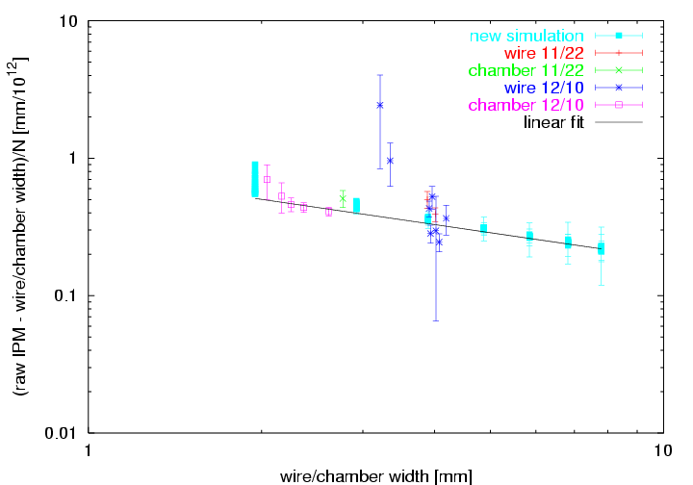
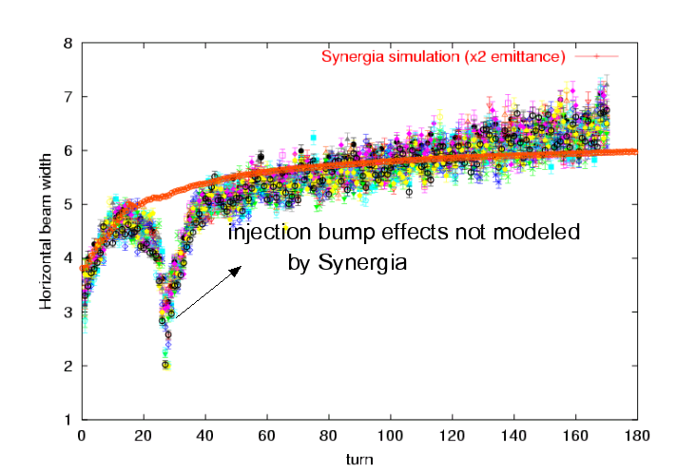
Ionization Profile Monitor (IPM)
The booster IPM’s are the only measure of transverse parameters during the acceleration cycle.
They’ve been in place for ~10 years, but suffer from intensity dependent systematics.
Recently, a lot of work has gone into calibrating them (P. Spentzouris, J. Amundsen, J. Zagel)
  Use “flying beam” measurement at injection (bumped beam sweeps across fixed wire).
  Use extracted beam profile at extraction.
Now have measurements which we can confidently compare to models (see modeling talk):

Slide 5
Monitoring Beam Loss in the Booster
Total flux out of the Booster is currently limited by uncontrolled beam loss
  Possible component damage
  Hands on maintenance
  Above ground limits
Monitoring beam loss is one of our primary measures of system performance:
  Measure a large number of individual beam loss monitors
  Use differential proton loss to calculate beam power loss (R. Webber). We currently limit this to 400W.
In addition to establishing limits, we’re working to effectively use this data to increase reliability and repeatability of the system.

Slide 6
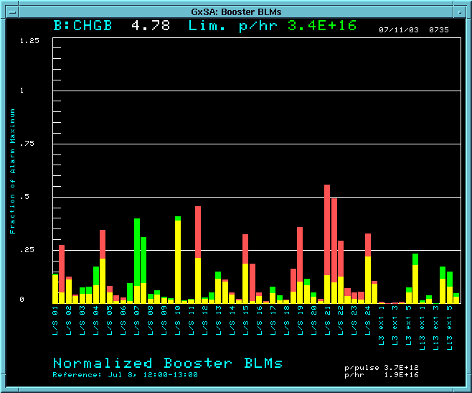
Improvements to Individual Loss Monitoring (P. Kasper)
We keep a running 100 second sum of 60 individual loss monitors, and display these normalized to their trip points
We now also have the ability to display losses relative to a reference set, to help use match loss patterns in periods of good running. We expect this to be very important.
Higher than reference set
Lower than reference set

Slide 7
Ramp Monitor Program (“rampmon”)
Many of the reliability problems in the proton source are the result of malfunctioning hardware.
The most insidious of these problems come from ramping devices and/or manifest themselves in varying quantities.
  Cannot be seen by the existing alarms and limits system.
  Must be deduced by human investigation.
The rapid cycle time of the Booster make it unfeasible to directly use the SDA tools to address this issue.
With the commitment of a CD person (G. Guglielmo) and the help of the controls group, we embarked on the development of a system to monitor varying quantities and flag deviation from ideal behavior.
The main challenge is that our existing controls system does not have enough throughput to snapshot the several hundred devices of interest in a single 67 ms cycle
  Must loop over all devices, reading a few each cycle
  Keep separate records for different event types (Stacking, MiniBooNE, etc).

Slide 8
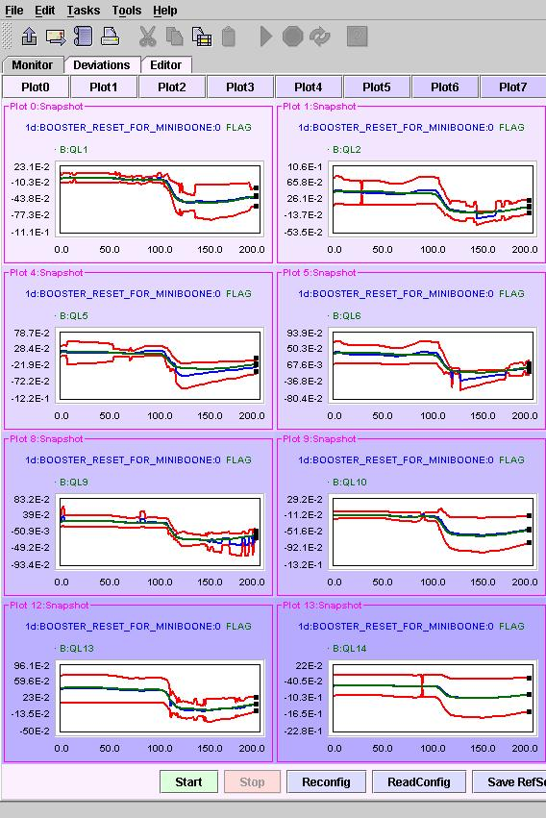
Rampmon Status
Basic (Java) engine now operational. For each device, it establishes (or loads) a reference curve and sigma, and if any point on the curve varies by more than a specified number of sigma, an entry is made to the standard datalogger.
Evaluating and building a list of hardware to monitor (ultimately several hundred). (P. Kasper, L. Coney, C. Jacobs).
Working on tools to mine and visualize the logger entries.
Reference curve
Limit

Slide 9
Other Integration and DAQ Issues
Booster BPM Readout:
  Existing system can read out turn-by-turn data for 2 (out of 96) BPM’s OR 50 (out of 20,000) turns for all BPM’s.
  We are upgrading the system to read out 96 BPM’s x 20,000 turns for one event. (S. Lackey, W. Marsh).
    Information already exists in the front ends
    Will be dead for several events while reading out, but that’s OK.
  This will allow much more sophisticated offline analysis
We have quite a bit of useful information which is not yet integrated into ACNET:
  Resistive Wall Monitor (RWM) readout
  Some damping and other LLRF information.

Slide 10
Instrumention R&D
Spinning wire “beam whacker” to measure beam halo (M. Popovic)
  Built, will be installed in the summer shutdown.
Instrumentation in dump line:
  High dynamic range halo monitor (a la LANL) - concept
  Bunch-by-bunch profile measurement with prototype diamond plane (K. Hoffman, UofC) - concept

