Slide 1
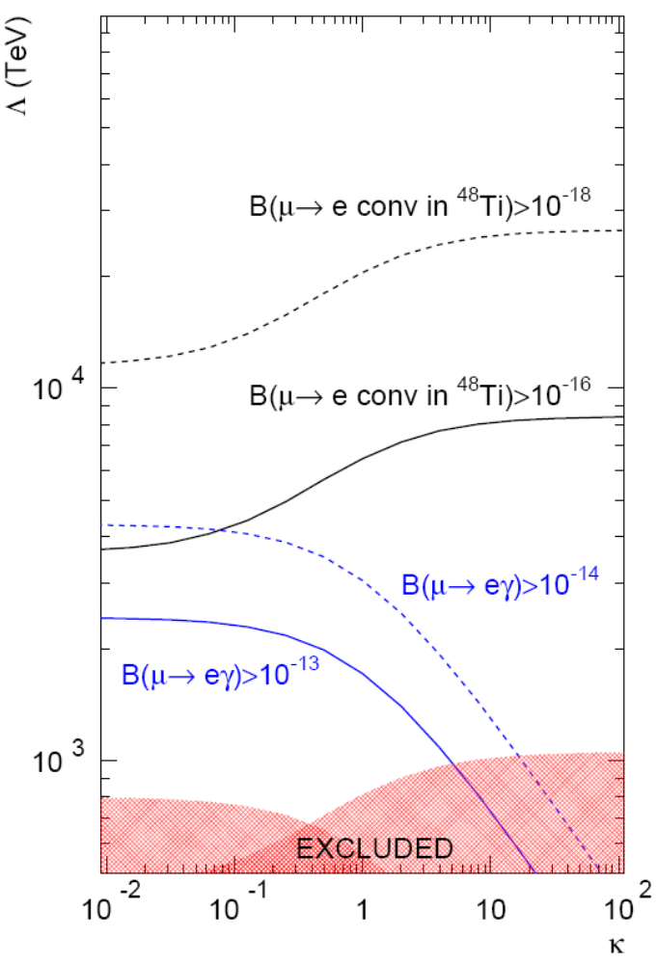
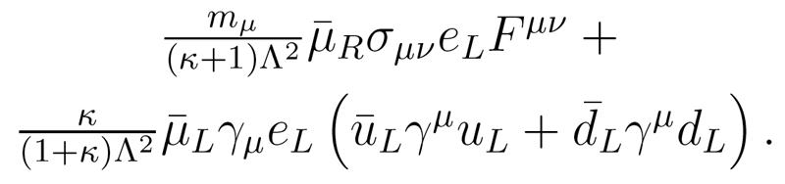
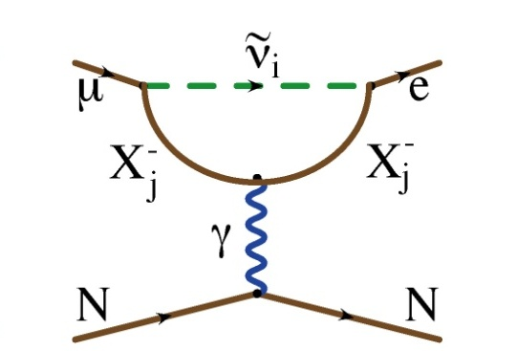
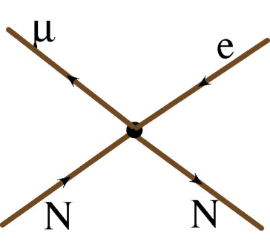
μ→e Conversion vs. μ→eγ
We can parameterize the relative strength of the dipole and four fermi interactions.
This is useful for comparing relative rates for μN→eN and μ→eγ
Courtesy: A. de Gouvea
?
?
?
MEG proposal
MEGA
Sindrum II

Slide 2
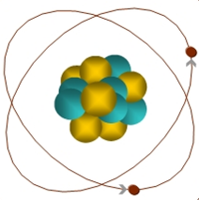
Muon-to-Electron Conversion: μ+N → e+N
When captured by a nucleus, a muon will have an enhanced probability of exchanging a virtual particle with the nucleus.
This reaction recoils against the entire nucleus, producing the striking signature of a mono-energetic electron carrying most of the muon rest energy
μ
105 MeV e⁻
Similar to μ→eγ, with important advantages:
  No combinatorial background
  Because the virtual particle can be a photon or heavy neutral boson, this reaction is sensitive to a broader range of BSM physics
Relative rate of μ→eγ and μN→eN is the most important clue regarding the details of the physics

Slide 3
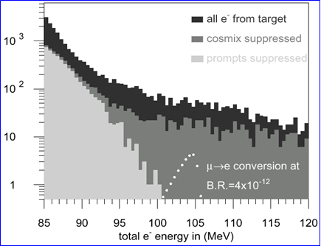
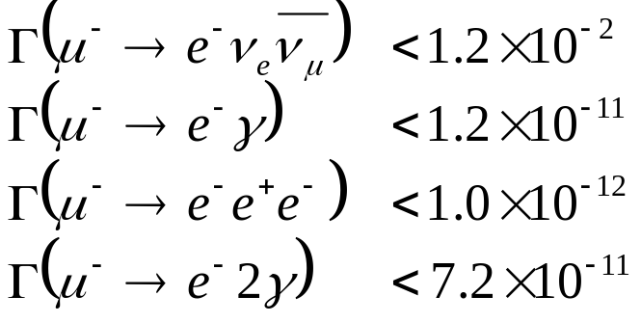
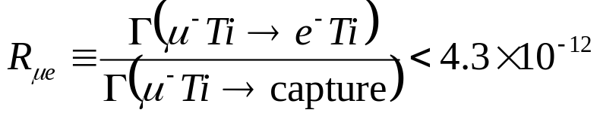
Previous muon decay/conversion limits (90% C.L.)
μ−>e Conversion: Sindrum II
LFV μ Decay:
High energy tail of coherent Decay-in-orbit (DIO)
Rate limited by need to veto prompt backgrounds!

Slide 4
Mu2e (MECO) Philosophy
Eliminate prompt beam backgrounds by using a primary beam with short proton pulses with separation on the order of a muon life time
Design a transport channel to optimize the transport of right-sign, low momentum muons from the production target to the muon capture target.
Design a detector to strongly suppress electrons from ordinary muon decays
~100 ns
~1-2 μs
Prompt backgrounds
live window

Slide 5
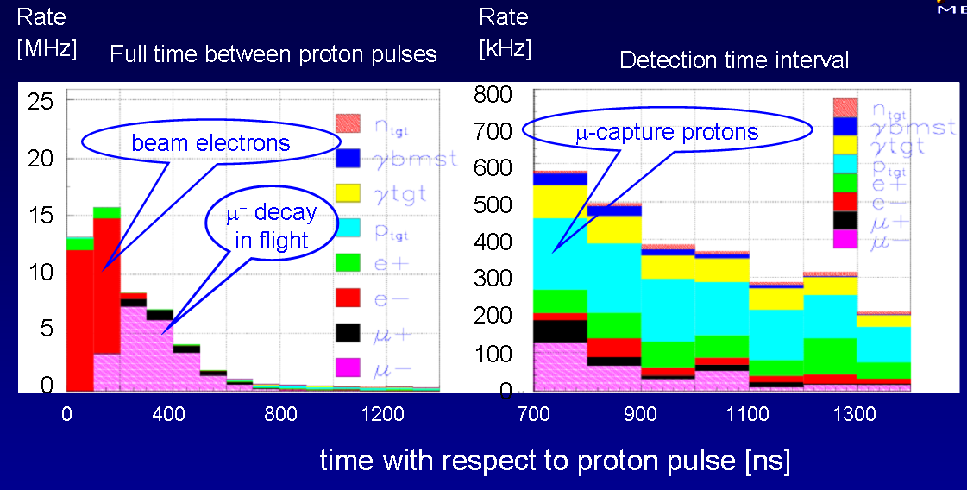
Beam Related Rates
Cut ~700 ns after pulse to eliminate most serious prompt backgrounds.

Slide 6
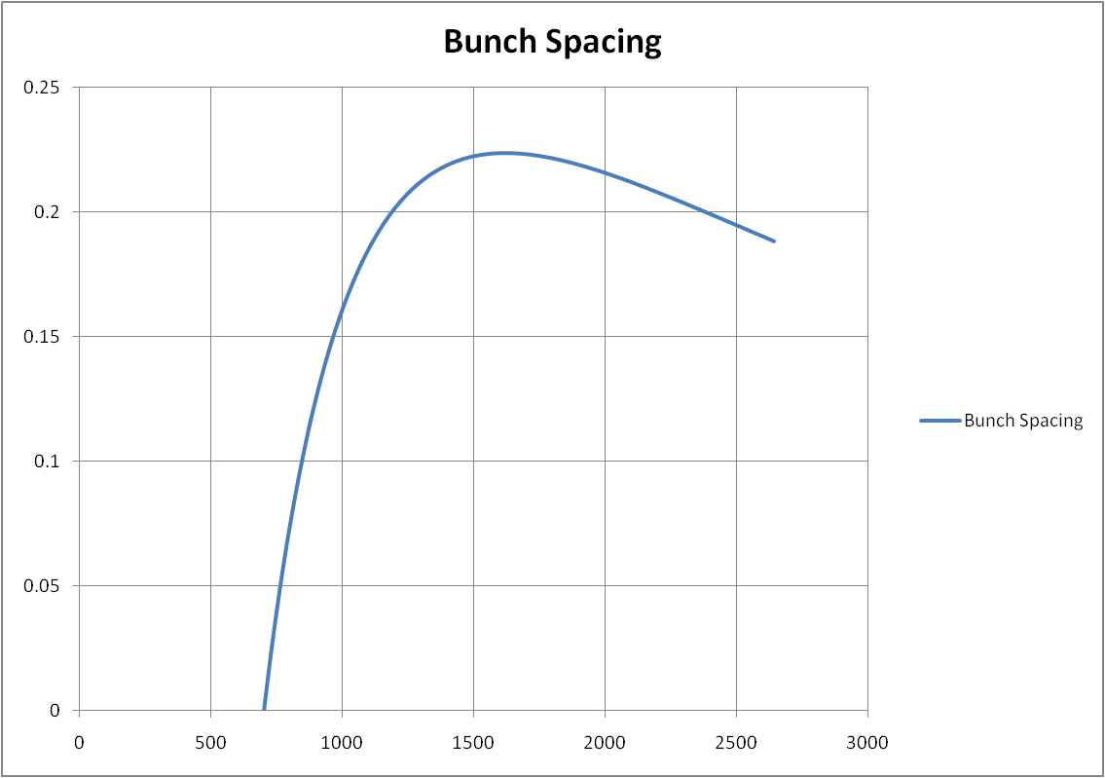
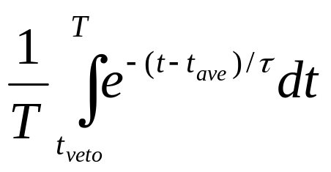
Optimum Bunch Spacing
Assume:
  Veto window: 700 ns
  Captured lifetime: 880 ns (Al target)
  Average arrival time: 300 ns relative to first
~1.7 μsec
ns

Slide 7
Modes of running project X
Assume slow extraction by “blast”
  1 “blast” = 9mA*1ms = 5.6e13 (protons)/(1.4 s cycle)
  = 4e13 p/s on average (!!)
  = 50 kW average beam power
  = 8e20/yr (2e7 seconds)
Compare to baseline proposal
  6*4e12 protons/(1.33 s NOvA cycle) = 1.8e13 p/s on average
  = 23 kW average beam power = 3.6e20
Modes of operation considered
  All “extra” blasts, extracted one at a time
    1 blast in 200 ms (sharing) = 14% duty factor
    4 in 800 ms = 57% duty factor
    2 blasts in 800 ms (timeline hog) = 57% duty factor, 50% “usage factor”
    1 blast in 800 ms (super hog) = 57% duty factor, 25% usage factor
4/23/08

Slide 8
Rate limit comes from straw chamber singles rate
Assume we cannot push it much higher than the MECO proposal (500 kHz during live window)
  Assume factor of ~2
Mode | Duty Factor | Peak Rate |  |  |  | Average Rate
 |  | protons/s | kW | rel to MECO | Rel. w/stretch | kW | p/year | rel. to MECO
MECO | 50% | 4.0E+13 | 51 | 1.00 | - | 26 | 4.0E+20 | 1.00
Phase 1 | 100% | 1.8E+13 | 23 | 0.45 | 0.45 | 23 | 3.6E+20 | 0.90
1 in 200ms | 14% | 2.8E+14 | 360 | 7.03 | 0.98 | 51 | 8.0E+20 | 2.01
4 in 800ms | 57% | 2.8E+14 | 360 | 7.03 | 4.01 | 206 | 3.2E+21 | 8.04
2 in 800ms | 57% | 1.4E+14 | 180 | 3.52 | 1.96 | 52 | 1.6E+21 | 4.02
1 in 800ms | 57% | 7.0E+13 | 90 | 1.76 | 1.00 | 51 | 8.0E+20 | 2.01

Slide 9
Conclusion
If we extract beam directly from the Recycler, then only the “super hog” mode appears to obviously benefit Mu2e
  Double the protons/yr rel. to phase 1
With a beam stretcher (assuming we get all of it), we could take an additional blast
  Quadruple rate/yr rel. to phase 1

