Slide 1
Accelerator Physics Fundamentals
Eric Prebys
FNAL Beams Division

Slide 2
Outline
Basic accelerator physics concepts
  Prehistory
  Horizontal motion (lattice functions, emittance)
  Tune plane
  Longitudinal motion (phase stability, longitudinal emittance)
  Luminosity
  Electrons vs. Protons
The Fermilab accelerator complex
Examples of other accelerators
Future or proposed accelerators
Accelerator physics as a career
Challenges in the field
Additional Resources

Slide 3
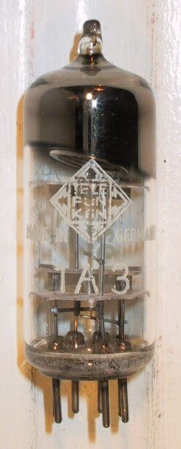



Particle Acceleration
The simplest accelerators accelerate charged particles through a static field. Example: vacuum tubes
Cathode
Anode
Limited by magnitude of static field:
  - TV Picture tube ~keV
  - X-ray tube ~10’s of keV
  - Van de Graaf ~MeV’s
Solutions:
  - Alternate fields to keep particles in accelerating fields -> RF acceleration
  - Bend particles so they see the same accelerating field over and over -> cyclotrons, synchrotrons

Slide 4
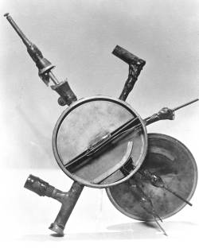
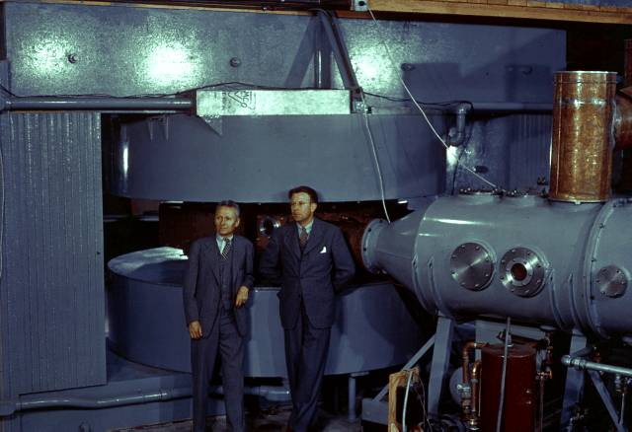
The first cyclotrons
1930 (Berkeley)
  Lawrence and Livingston
  K=80KeV
1935 - 60” Cyclotron
  Lawrence, et al. (LBL)
  ~19 MeV (D2)
  Prototype for many

Slide 5

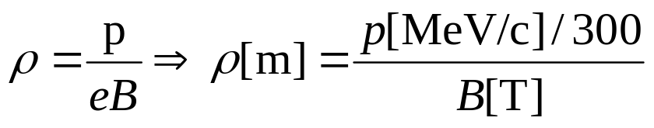

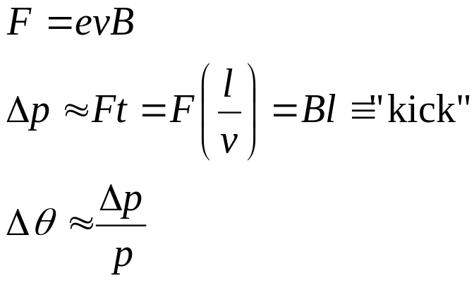



Dipole Field, Thin Lens Approximation.
side view
A uniform magnetic field will bend particles in path of constant curvature:
top view
For small deflections:
1 T-m = 300 MeV/c
“kink” at ≈ center of magnet

Slide 6

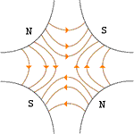



Quadrupole Fields (focusing elements)
Vertical Plane:
Horizontal Plane:
Luckily…
…pairs give net focusing in both planes!
“FODO cell”

Slide 7

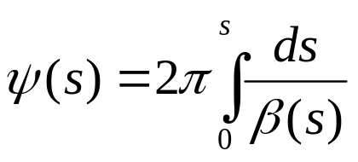

Betatron Motion
For a particular particle, the deviation from an idea orbit will undergo “pseudo-harmonic” oscillation as a function of the path along the orbit:
x
Lateral deviation in one plane
s
The “betatron function” β(s) is effectively the local wavelength and also defines the beam envelope.
Phase advance
Closely spaced strong quads -> small β -> small aperture
Sparsely spaced weak quads -> large β -> large aperture
β(s) is has the fundamental cell periodicity of the lattice
length of one, e.g., FODO cell
However, in general the phase (and therefore particle motion) does not, and indeed must not, follow the periodicity of the ring…

Slide 8
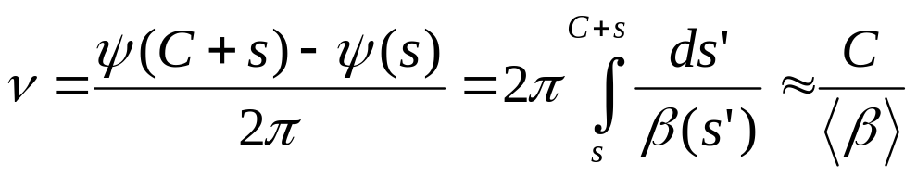
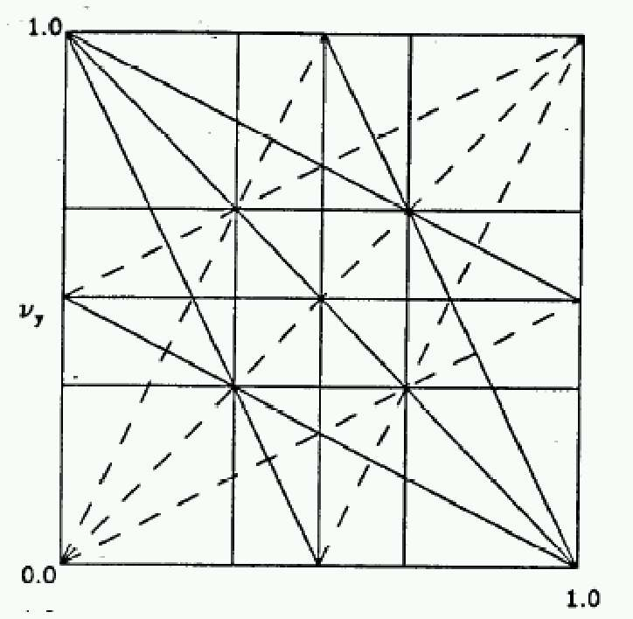
Tune and Tune Plane
We define the “tune” Q (or ν) as the number of complete betatron oscillations around the ring.
For example, the horizontal tune of the Booster is about:
6.7
Magnet Count/Aperture optimization
Beam Stability
In general…
“small” integers
Many deviations from the ideal lattice are characterized in terms of their resulting “tune-shift”. In general, the beam will become unstable if it shifts onto a resonance.
fract. part of Y tune
fract. part of X tune

Slide 9
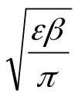

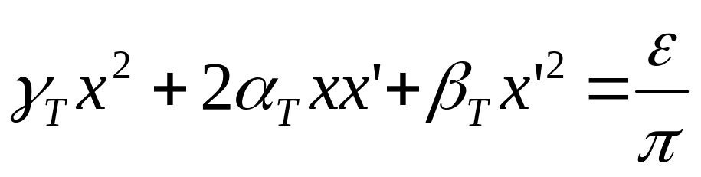


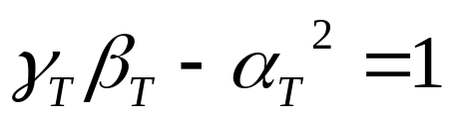
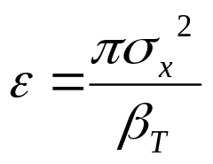
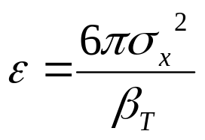
Emittance
As a particle returns to the same point on subsequent revolutions, it will map out an ellipse in phase space, defined by
Area = ε
Twiss Parameters
An ensemble of particles will have a “bounding” ε. This is referred to as the “emmitance” of the ensemble. Various definitions:
Electron machines:
Contains 39% of Gaussian particles
Usually leave π as a unit, e.g. E=12 π-mm-mrad
Proton machines:
(FNAL)
Contains 95% of Gaussian particles

Slide 10
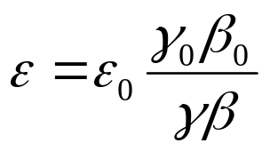

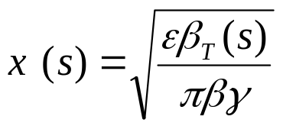
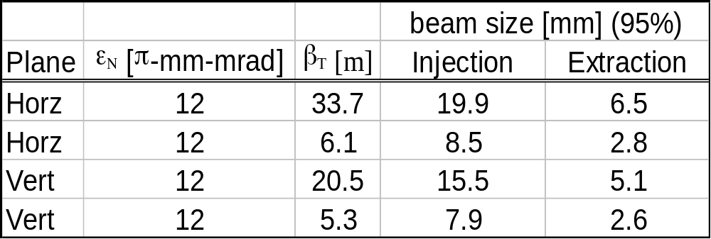
Normalized Emittance
As the beam accelerates “adiabatic damping” will reduce the emittance as:
The usual relativistic γ and β !!!!
so we define the “normalized emittance” as:
We can calculate the size of the beam at any time and position as:
Example: Booster

Slide 11
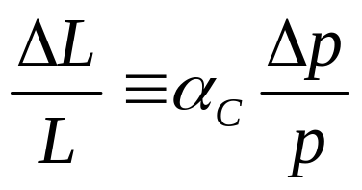
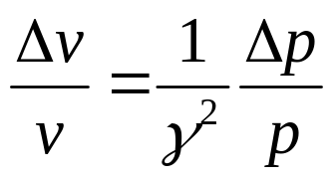
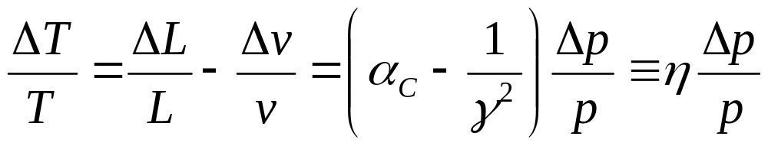
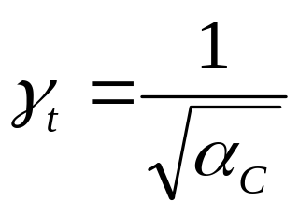
Slip Factor/Transition
A particle which deviates from the nominal momentum will travel a different path length given by….
“Momentum compaction factor”
It will also travel at a slightly different velocity, given by
… so the time it takes to make one revolution will change by an amount
“slip factor”
This changes sign at “transition”, defined by
Usually γ_{T} ≈ ν. In booster γ_{T} = 5.45

Slide 12


Longitudinal Motion: Phase Stability
As particles circulate around a ring, they pass through standing RF waves in accelerating cavities. The stability depends on the relative energy received by off-energy particles
Particles with lower E arrive earlier and see greater V.
Particles with lower E arrive later and see greater V.
Nominal Energy
Nominal Energy
Below Transition
Above Transition

Slide 13

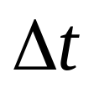
Longitudinal Phase Space
Stable particle motion (“bunch”)
Stable particle motion
Stable “bucket” (shrinks at high phase)
Stable “bucket”
φ=0 (no acceleration):
φ=60° (acceleration):
Generally, hold RF amplitude constant, and adjust phase to control acceleration.
If amplitude control is needed, it is accomplished by adjusting the relative phase of two sets of RF cavities.

Slide 14



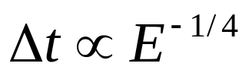
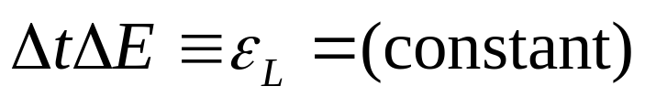
Longitudinal Emittance
As the particles accelerate
Typical values out of the booster are about .15 eV-s
Longitudinal Emittance. Usually expressed in eV-s

Slide 15
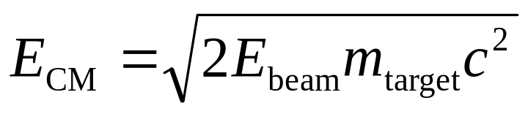
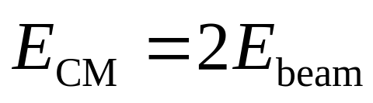
The Case for Colliding Beams
One very important parameter of an interaction is the center of mass energy. For a relativistic beam hitting a fixed target, the center of mass energy is:
For 1TeV beam on H, E_{CM}=43.3 GeV!!
On the other hand, for colliding beams (of equal mass and energy):
Of course, energy isn’t the only important thing….

Slide 16
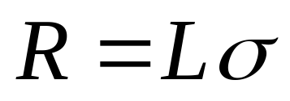


Luminosity
Rate
The relationship of the beam to the rate of observed physics processes is given by the “Luminosity”
Cross-section (“physics”)
“Luminosity”
Standard unit for Luminosity is cm⁻²s⁻¹
For fixed (thin) target:
Target thickness
For MiniBooNe primary target:
Incident rate
Target number density

Slide 17
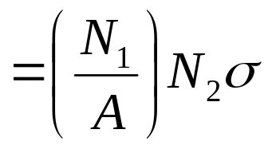
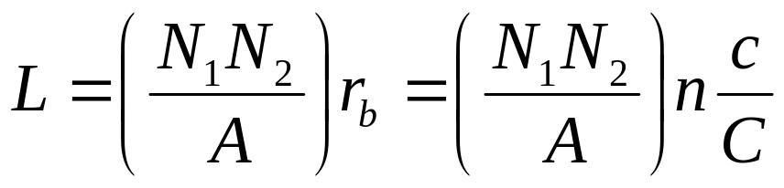
Colliding Beam Luminosity
Circulating beams typically “bunched”
(number of interactions)
Cross-sectional area of beam
Total Luminosity:
Circumference of machine
Number of bunches
Record Tevatron Luminosity: 4.2E31 cm⁻²s⁻¹
Record e+e- Luminosity (KEK-B): 1E34 cm⁻²s⁻¹

Slide 18
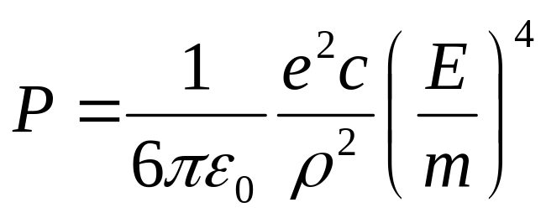
Electrons versus Protons: Synchrotron Radiation
Whenever you accelerate a charged particle, it radiates. This is called bremsstrahlung or synchrotron radiation, depending on the context.
A particle being bent through a radius of curvature ρ will radiate energy at a rate
An electron will radiate about 10¹³ times more power than a proton of the same energy!!!!
Protons: Synchrotron radiation does not affect kinematics
Electrons: Beyond a few MeV, synchrotron radiation becomes very important
- Good Effects:
- Naturally “cools” beam in all dimensions
- Basis for light sources, FEL’s, etc.
- Bad Effects:
- Beam pipe heating
- Energy loss ultimately limits circular accelerators
- Exacerbates beam-beam effects

Slide 19
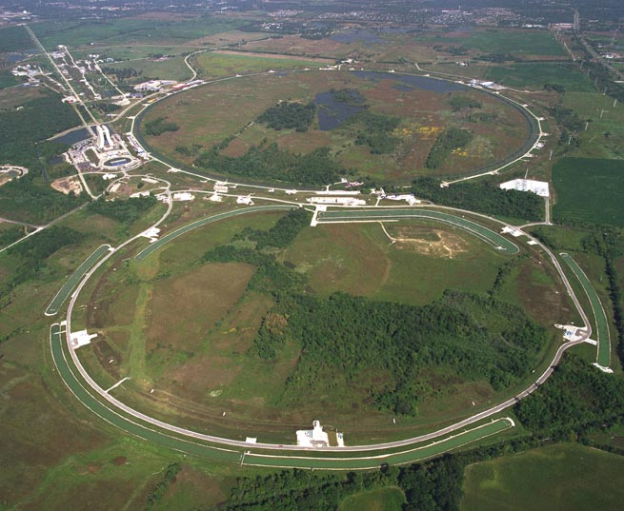
Fermilab Accelerators
History
Early 1960’s – plans solidify for a high energy national accelerator laboratory.
1966 – The AEC chooses the Weston, IL site from amongst hundreds proposed.
1968 – Construction begins.
1972 – First 200 GeV beam in the Main Ring.
1983 – First (512 GeV) beam in the Tevatron (“Energy Doubler”). Old Main Ring serves as “injector”.
1985 – First proton-antiproton collisions observed at CDF (1.6 TeV CoM).
1995 – Top quark discovery. End of Run I.
1999 – Main Injector complete.
2001 – Run II begins.

Slide 20
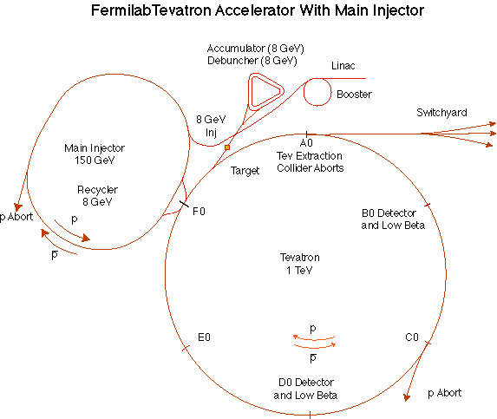
The Fermilab Accelerator Complex
MinBooNE
NUMI

Slide 21
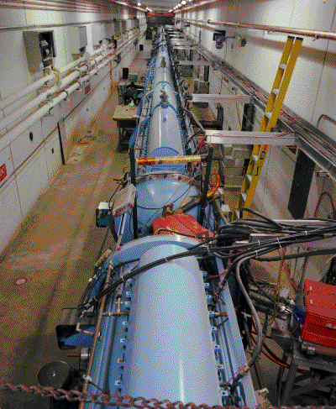
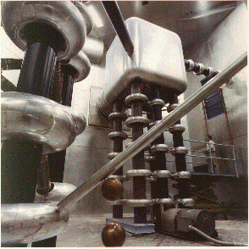
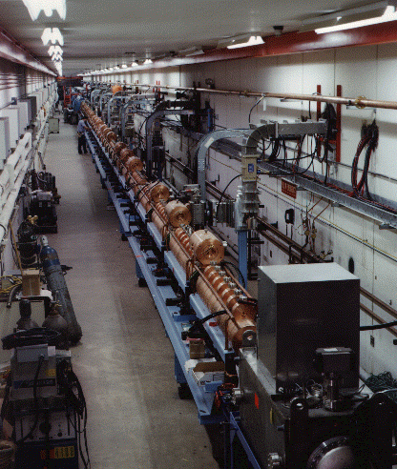
Preac(cellerator) and Linac
“New linac”- 800 MHz “π cavities” accelerate H- ions from 116 MeV to 400 MeV
“Preac” - Coolest looking thing at Fermilab. Static Cockroft-Walton generator accelerates H- ions from 0 to 750 KeV. (Actually, there are two of these, H- and I-)
“Old linac”- 200 MHz “Alvarez tubes” accelerate H- ions from 750 keV to 116 MeV
Preac/Linac can deliver about 45 mA of current for about 35 usec at a 15 Hz repetition rate

Slide 22
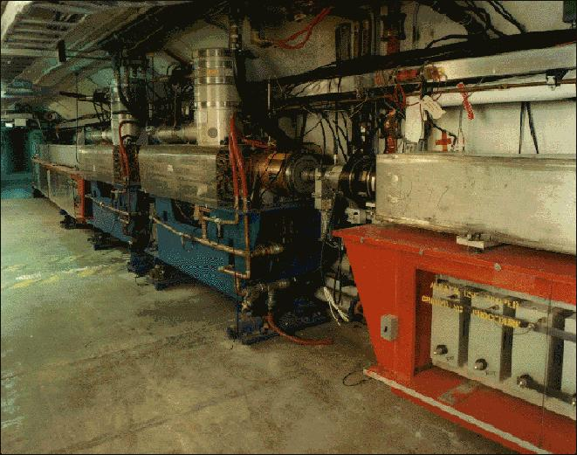
Booster
400 MeV Linac H- beam is injected into booster over several (up to 15) “turns”. The ion beam allows one to “cheat” Liouville’s theorem and inject (negative) beam on top of existing (positive) beam.
The main magnets of the Booster form a 15 Hz offset resonant circuit , so the Booster field is continuously “ramping”, whether there is beam in the machine or not. Ramped elements limit the average rep rate to somewhat lower.
From the Booster, beam can be directed to
  The Main Injector
  MiniBooNE (switch occurs in the MI-8 transfer line).
  The Radiation Damage Facility (RDF) – actually, this is the old main ring transfer line.
  A dump.
One full booster “batch” sets a fundamental unit of protons throughout the accelerator complex (max 5E12).
This is divided amongst 84 53 MHz RF buckets, which sets another fundamental sub-unit (max 6E10).

Slide 23
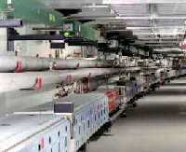
Main Injector
The Main Injector can accept 8 GeV protons OR antiprotons from
  Booster
  The anti-proton accumulator
  The Recycler (which shares the same tunnel)
It can accelerate protons to 120 GeV (in a minimum of 1.4 s) and deliver them to
  The antiproton production target.
  (soon) The fixed target area.
  (soon) The NUMI beamline.
It can accelerate protons OR antiprotons to 150 GeV and inject them into the Tevatron.
The Main Injector can also accept 150 GeV antiprotons from the Tevatron and decelerate them to 8 GeV for transfer to the Recycler.
The Main Injector is exactly 7 times the circumference of the Booster. Allowing one empty “slot” for switching, it can hold six booster batches, in the absence of exotic stacking schemes (slip stacking, RF barrier).
It’s envisioned that one batch will be used for stacking and the rest for NUMI and/or switchyard 120.

Slide 24
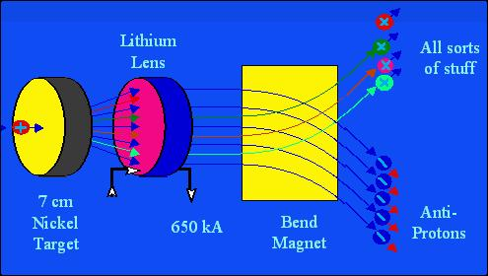
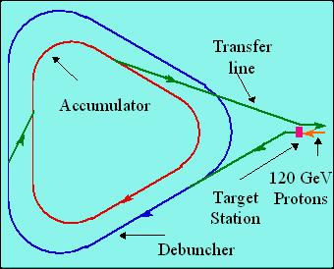
Antiproton Source
120 GeV protons strike a target, producing many things, including antiprotons.
a Lithium lens focuses these particles.
a bend magnet selects the negative particles around 8 GeV. Everything but antiprotons decays away.
The antiproton ring consists of 2 parts – the debuncher and the accumulator.

Slide 25
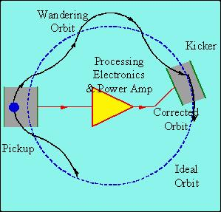




Antiproton Source – Debunching and Cooling
Debunching
Cooling
Particles enter with a narrow time spread and broad energy spread.
High (low) energy pbars take more (less) to go around…
…and the RF is phased so they are decelerated (accelerated),
resulting in a narrow energy spread and broad time spread.
Pickups detect deviations from an ideal orbit, which are used to “kick” the orbit back to the nominal. This reduces the transverse emittance in a statistical way.
The anti-proton source can typically “stack” at about 7E10 pbars/h, up to a maximum of about 120E10, at which point anti-protons are transferred to the Tevatron (via the M.I.).

Slide 26
Tevatron
The Tevatron was the world’s first superconducting accelerator.
It accepts protons AND pbars at 150 GeV from the Main Injector. Typically:
  36 proton bunches with 180E9 protons in each. (Run IIa goal: 270E9)
  36 pbar bunches with 12E9 pbars in each. (Run IIa goal: 33E9)
These are accelerated to 980 GeV.
Collisions (“low beta”) are initiated at the B0 (CDF) and D0 detector regions.
These “stores” are kept for typically 16 hours, while more antiprotons are made for the next “shot”.

Slide 27
Recycler
The Recycler is an 8 GeV storage ring in the same tunnel as the Main Injector.
The main lattice elements (dipoles and quadrupoles) are made out of permanent magnets).
The Recycler can accept 8 GeV antiprotons from
  The antiproton accumulator.
  The Main Injector (after deceleration).
The Recycler can deliver these antiprotons to the Main Injector for acceleration.
The goal of the recycler is
  To store antiprotons from the accumulator, thereby increasing the total antiproton production capacity.
  To recover antiprotons from a Tevatron store for use in subsequent stores.
At the moment, the recycler is not being used in standard operation.

Slide 28
Primary Modes of Operation
Stacking: full booster batches (~5E12 p) are accelerated to 120 GeV by the Main Injector, and delivered to the pbar target about once every 3 seconds (limited by the rate at which they can be debunched and cooled. It takes 10-16 hours to get enough pbars for a “shot”.
Shot setup: various beamline tuning takes place. Most importantly, pbar transfer lines are tuned with reverse protons.
Proton Injection: about 7 53 MHz booster bunches are injected into the M.I., accelerated to 150 GeV and “coalesced” into a single bunch, which is injected into the Tevatron (x 36).
Antiproton Injection: part of the “core” of the accumulator is manipulated to a separate extraction orbit and about 11 53 MHz bunches are extracted to the M.I., where they are accelerated to 150 GeV, coalesced and injected into the tevatron at 150 GeV.
Acceleration/collision: The protons and pbars are accelerated together to 980 GeV over a few minutes. The beam is scraped, and the beta is reduced (“squeezed”) at the collision regions. Physics begins. During this time, the rest of the accelerator complex is totally free to do other things (primarily stacking).
MiniBooNE Operation: While the M.I. Is ramping, a chain of 8 GeV Booster batches is switched to the MiniBooNE beamline.
SY120 Operation: Batches will be loaded into the Main Injector, accelerated to 120GeV and extracted to the old fixed target area through an old section of the main ring.
NUMI Operation: along with the stacking batch, 5 additional batches are loaded into the Main injector. These are accelerated along with the stacking batch and extracted to the NUMI line after it has been extracted.

Slide 29
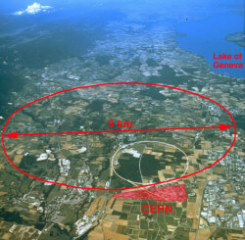
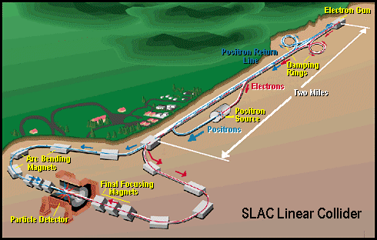
Some Other Important Accelerators (past):
LEP (at CERN):
  27 km in circumference
  - e+e-
  - Primarily at 2E=M_{Z} (90 GeV)
  - Pushed to E_{CM}=200GeV
  - L = 2E31
  - Highest energy circular e+e- collider that will ever be built.
  - Tunnel will house LHC
SLC (at SLAC):
  2 km long LINAC accelerated electrons AND positrons on opposite phases.
  - 2E=M_{Z} (90 GeV)
  - polarized
  - L = 3E30
  - Proof of principle for linear collider

Slide 30
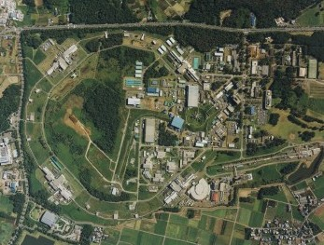
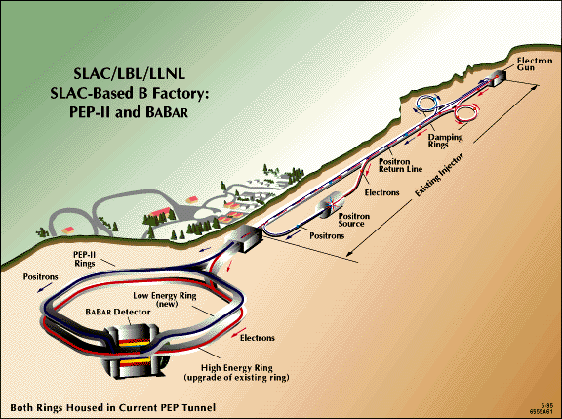
Major Accelerators: B-Factories
- B-Factories collide e+e- at E_{CM} = M(ϒ(4S)).
-Asymmetric beam energy (moving center of mass) allows for time-dependent measurement of B-decays to study CP violation.
KEKB (Belle Experiment):
- Located at KEK (Japan)
- 8GeV e- x 3.5 GeV e+
- Peak luminosity 1E34
PEP-II (BaBar Experiment)
- Located at SLAC (USA)
- 9GeV e- x 3.1 GeV e+
- Peak luminosity 0.6E34

Slide 31
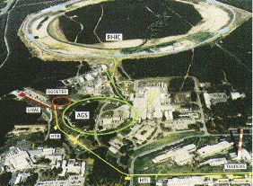
Major Accelerators: Relativistic Heavy Ion Collider
- Located at Brookhaven:
Can collide protons (at 28.1 GeV) and many types of ions up to Gold (at 11 GeV/amu).
Luminosity: 2E26 for Gold (??)
Goal: heavy ion physics, quark-gluon plasma, ??

Slide 32
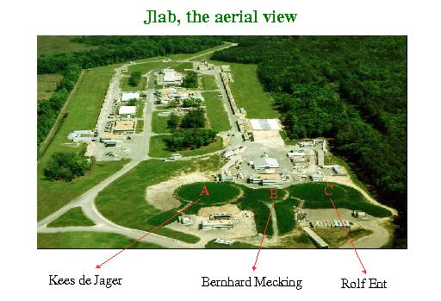
Continuous Electron Beam Accelerator Facility (CEBAF)
Locate at Jefferson Laboratory, Newport News, VA
6GeV e- at 200 uA continuous current
Nuclear physics, precision spectroscopy, etc

Slide 33
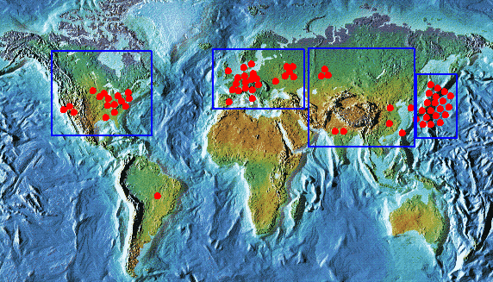
Light Sources: Too Many too Count
Put circulating electron beam through an “undulator” to create synchrotron radiation (typically X-ray)
Many applications in biophysics, materials science, industry.
New proposed machines will use very short bunches to create coherent light.

Slide 34
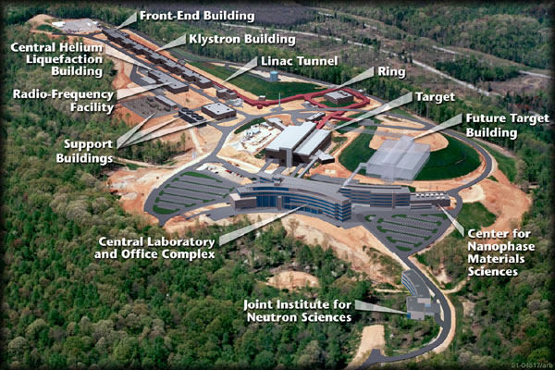
Future Machines: Spallation Neutron Source (SNS)
(Oak Ridge, TN)
A 1 GeV Linac will load 1.5E14 protons into a non-accelerating synchrtron ring.
These will be fast-extracted to a liquid mercury target.
This will happen at 60 Hz -> 1.4 MW
Neutrons will be used for biophysics, materials science, inductry, etc…
Turn-on in 2006

Slide 35
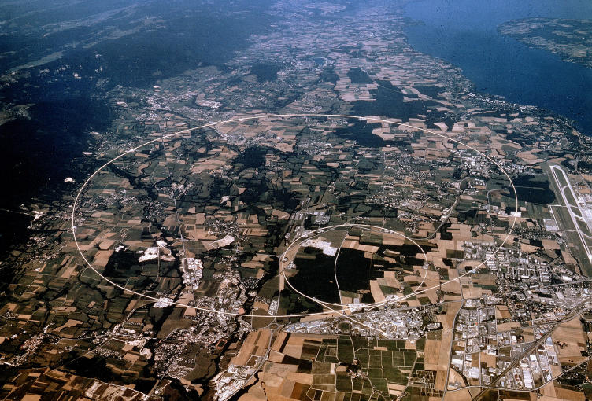
Future Machines: LHC
- Being built at CERN in the LEP tunnel (27 km circumference)
7 TeV p x 7 TeV p.
2 Collider experiments (CMS and ATLAS)
Turn-on in 2007
Design luminosity: 1E34
- Goal: Frontier physics – Higgs, SUSY, ???

Slide 36
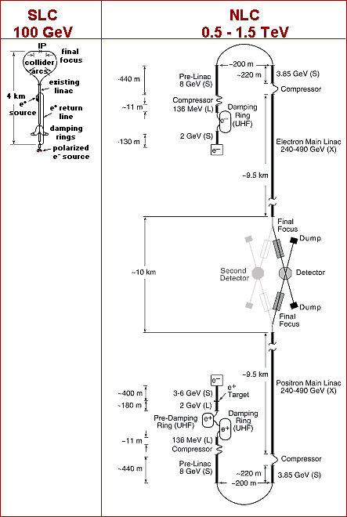
Future Accelerators (maybe): Next Linear Collider (NLC)/Tesla
Two long (10-20 km) linacs colliding e+e-
Proof of principle shown at SLC, BUT
Low crossing rate means need VERY small bunches (3 nm high!!!!)
Challenges:
  alignment
  synchrotron radiation issues
  beam-beam isssues
  cost management.
Not formally approved. Would probably not come online until ~2015 or so.
Physics Goals: Precision Higgs, electroweak, SUSY searches

Slide 37
Things I didn’t talk about
Medical accelerators
Unstable isotope accelerators
Free electron lasers (FEL’s)
Future and fringe ideas:
  Muon colliders/neutrino factories (a whole talk on its own).
  Wakefield accelerators.
  Molecular accelerators.
Lots of other stuff.

Slide 38
Accelerator Physics as a Career: Why Leave Particle Physics??
“I probably wouldn’t go into particle physics today. There are collaborations with 30 people, sometimes even more.”
  -Louis Alvarez, “Adventures of a physicist”
In 1983, UA1 always got a big laugh with their author list.
  It had 136 names.
MiniBooNE has half that and is now considered “tiny”.
The CDF and D0 collaborations have ~600 people each.
The LHC collaborations have ~2000 each already!!!
Timescales ~10-15 years or more.
That just can’t be fun.

Slide 39
Accelerator Physics as a Career: Why not?
Accelerator physics is not fundamental, in the sense that finding the Higgs or neutrino mass is.
Accelerator physics is a means to an end, not an end in itself.
Limited faculty opportunities (that may be changing).

Slide 40
Why Accelerator Physics can be Fun
Accelerators are very complex, yet largely ideal, physical systems. Fun to play with.
Accelerators allow a close interaction with hardware (this is a plus or minus, depending on your taste).
Can make contributions to a broad range of physics programs, or even industry.
Many people end up doing a wide variety of things in their careers.
Still lots of small scale, short time, interesting things to be done.

Slide 41
Challenges in the Field
Theoretical challenges:
  Beam stability issues
  Space charge
  Halo formation
Computational challenges:
  Accurate 3D space charge modeling
  Monitoring and control.
Instrumentation challenges:
  Correctly characterizing 6D phase space to compare to models.
Engineering challenges:
  Magnets
  RF
  Cryogenics
  Quality control/systems issues.

Slide 42
For further reference
Edwards and Syphers, “An Introduction to the Physics of High Energy Accelerators”: Standard reference, particularly at Fermilab.
S.Y. Lee, “Accelerator Physics”. Slightly more advanced. Available in paperback.
US Particle Accelerator School: www.uspas.gov
  Two week courses, twice a year.
  Very good, very intense.
  All the formal training most of us have had.

