Slide 1
Guidance from DOE
  $13M with a 6 month continuing resolution at 84%
    .5*.84*13+.5*13 = $11.96M
  Separate money ($1-2M) found for APL planning!
General breakdown (informed by Steve’s exit advice)
  Accelerator Systems: $2.9M
  Magnet Systems: $5.0M
  Program Management: $2.1M
    Includes LTV and Toohig Fellows (of which we have 4)
  Contingency: $2M
In then end, had to give up some continency to increase Program Management
E. Prebys - LARP Meeting

Slide 2
Luminosity monitor was expected to be complete by end of FY08
  Instead had significant overruns, and needs significant funds on FY09 (original request $1M -> $800k)
  Still consider it absolutely vital for lumi to work!
Rotating collimators still a big budget item
  Still consider it important to complete a prototype this year in time to at least be considered a solution by CERN.
Strong feeling that LARP should take a leading role in crab cavity development
  Led by Rama Calaga
  Support by CERN
  General feeling that “the train is leaving the station”.
Magnet program still has to funded at a level that will insure a working magnet for the LHC Phase II upgrade
E. Prebys - LARP Meeting

Slide 3
Accelerator Systems
  Iterative process, primarily involving Wolfram, Tom, Alex, and myself, to converge on the bottom line.
    Key component: relying on labs to contribute labor in accordance with their core competencies (i.e. not charged directly to LARP)*
  Key casualty: No real money for PS2, for which there was a great deal of excitement within LARP and at CERN
    Will continue with contributed labor while we decide what to do for next year.
Magnet Systems
  Much more monolithic than AS
  L1 and L2 managers worked to stay within the budget
*Will create “off-project” charge codes. Be sure to charge scientific time to them!
E. Prebys - LARP Meeting

Slide 4
Not much leeway
  Management costs determined by historical usage
  Need to honor commitments to LTV’s and Toohig fellows
  Only discretionary is Programmatic travel, which I have reduced by trying to include travel with the appropriate project.
E. Prebys - LARP Meeting

Slide 5
Original request: $700k
  Cavity design
  Cryomodule design
  LLRF
Budget: $300k
  Rely on “off books” help in cavity design from LBNL and Jlab
  Defer cryomodule and LLRF work
E. Prebys - LARP Meeting

Slide 6
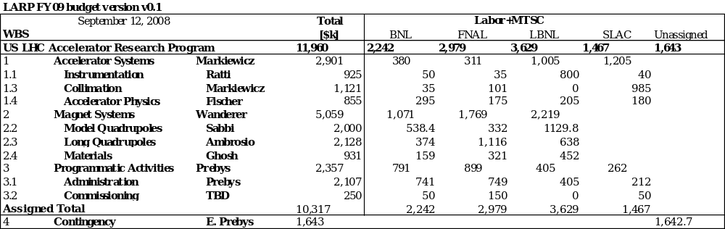
E. Prebys - LARP Meeting

Slide 7
LARP FY09 budget version v0.1
 | September 12, 2008 |  | Total |  | Labor+MTSC
WBS |  |  | [$k] | BNL | FNAL | LBNL | SLAC | Unassigned
US LHC Accelerator Research Program |  |  | 11,960 | 2,242 | 2,979 | 3,629 | 1,467 | 1,643
1 | Accelerator Systems | Markiewicz | 2,901 | 380 | 311 | 1,005 | 1,205
1.1 | Instrumentation | Ratti | 925 | 50 | 35 | 800 | 40
1.1.1 | Phase I
1.1.1.1 | Chromaticity feedback | Cameron | 0 | -15 | 15
1.1.1.2 | Luminometer | Ratti | 800 |  |  | 800
1.1.1.4 | Schottky monitor | Jansson | 20 |  | 20
1.1.1.5 | AC dipole | Kopp | 65 | 65
1.1.1.6 | LLRF | Fox | 40 |  |  |  | 40
1.3 | Collimation | Markiewicz | 1,121 | 35 | 101 | 0 | 985
1.3.2 | Phase II
1.3.2.1 | Rotatable Collimators | Markiewicz | 950 |  |  |  | 950
1.3.2.4 | Crystal collimation | Peggs
1.3.2.4.1 | T890 | Mokhov | 96 | 10 | 76 |  | 10
1.3.2.4.2 | CRYSTAL | Peggs | 75 | 25 | 25 |  | 25
1.4 | Accelerator Physics | Fischer | 855 | 295 | 175 | 205 | 180
1.4.1 | Studies
1.4.1.1 | Electron cloud | Pivi
1.4.1.2 | Simulations | Furman | 50 |  |  | 50
1.4.1.3 | Ecloud FB at SPS | Fox | 80 |  |  | 40 | 40
1.4.1.4 | Grooved Chambers | Markiewicz | 25 |  |  |  | 25
1.4.1.5 | Beam beam | Valishev
 | Simulation | Sen | 110 |  | 110
 | Wire compensation | Fischer | 50 | 50
 | Electron lens | Shiltsev | 40 | 20 | 20
1.4.1.6 | Crab cavities | Calaga | 300 | 200 | 20 | 40 | 40
 | PS2 Studies | Wienands | 100 |  |  | 50 | 50
 | discretionary |  | 100 | 25 | 25 | 25 | 25
2 | Magnet Systems | Wanderer | 5,059 | 1,071 | 1,769 | 2,219
2.2 | Model Quadrupoles | Sabbi | 2,000 | 538.4 | 332 | 1129.8
2.2.1 | HQ |  | 1,834 | 538.4 | 305.8 | 989.6
2.2.2 | TQ |  | 166 |  | 26.2 | 140.2
2.3 | Long Quadrupoles | Ambrosio | 2,128 | 374 | 1,116 | 638
2.3.1 | Subscale models |  | 0
2.4 | Materials | Ghosh | 931 | 159 | 321 | 452
3 | Programmatic Activities | Prebys | 2,357 | 791 | 899 | 405 | 262
3.1 | Administration | Prebys | 2,107 | 741 | 749 | 405 | 212
3.1.1 | Systems
3.1.1.1 | Management | Prebys | 1,032 | 266 | 474 | 130 | 162
3.1.1.3 | Programmatic Travel | Prebys | 275 | 75 | 75 | 75 | 50
3.1.1.4 | Toohig Fellowship | Prebys | 800 | 400 | 200 | 200
3.2 | Commissioning | TBD | 250 | 50 | 150 | 0 | 50
Assigned Total |  |  | 10,317 | 2,242 | 2,979 | 3,629 | 1,467
4 | Contingency | E. Prebys | 1,643 |  |  |  |  | 1,642.7
E. Prebys - LARP Meeting

Slide 8
Original plan
  $2.5M
  Finished in FY07
Currently
  Spent $3.6M
  Need to spend ~$800k more
  Finished in FY09??
Bottom line
  These sorts of overruns are not unusual in real projects!
  LARP contingencies are far from sufficient to cover overruns in significant deliverables.
Proposal: develop a standing relationship with APL
  Will be discussed in detail at CM11.
E. Prebys - LARP Meeting

Slide 9
We’re already doing way too much
  No new initiatives will be considered this year
The budget process must start sooner
  Beginning to chart next year’s budget will be a key goal of the CM11 meeting.
Working to standardize budget estimates
  Working with Ken Domann to put budget into a single MS Project, so different types of labor at different labs can be properly estimated.
E. Prebys - LARP Meeting

Slide 10
“Small” meeting
Goals
  Make decisions
  Set priorities
  Begin to form FY10 budget
Major topics
  lumi monitor status
  rotating collimator status and plans
  the future of crab cavities and larp's role in that future
  LARP's role in PS2
  ongoing relationship of LARP and APL
  The future of JIRS
  Crystal collimation efforts
“Invitation only”
E. Prebys - LARP Meeting

