Slide 1
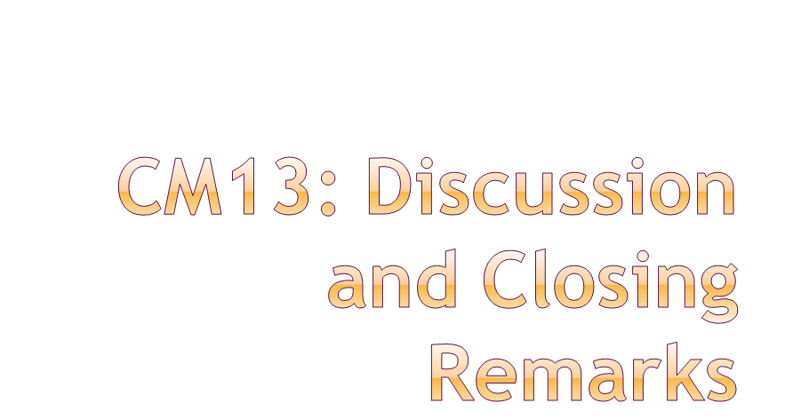
Eric Prebys
LARP Program Director
November 6, 2009

Slide 2
Peter Wanderer
  Overseeing conference arrangements
Diana Votruba
  Handling the details
David McChesney
  Technical end
All the speakers (except me) who stayed on time.
November 6, 2009

Slide 3
As they relate to crab cavities?
  Global vs. local?
  What really is the beam separation we can provide
    And what is the dependence on available length
  Safety issues?
As they relate to magnet program?
  Aperture, length
  Field quality requirements
What sort of organization within LARP would facilitate these discussions?
November 6, 2009

Slide 4
What should LARP’s role be in the overall crab program?
What is the DOE view of crab cavities in general?
November 6, 2009

Slide 5
How can we make the most of the opportunities during LHC commissioning
  LARP instrumentation?
  General assistance?
  LTV program?
  Toohig Fellowship?
  Remote access?
    a la LHC@FNAL
November 6, 2009

Slide 6
What sort of LARP related studies at the Tevatron could be useful?
  For example, can we really think about putting in a crab cavity?
November 6, 2009

Slide 7
What tests need to be done?
How much should LARP do vs. core magnet programs (question for DOE)?
November 6, 2009

Slide 8
What are the key questions for the Chamonix meeting?
November 6, 2009

Slide 9
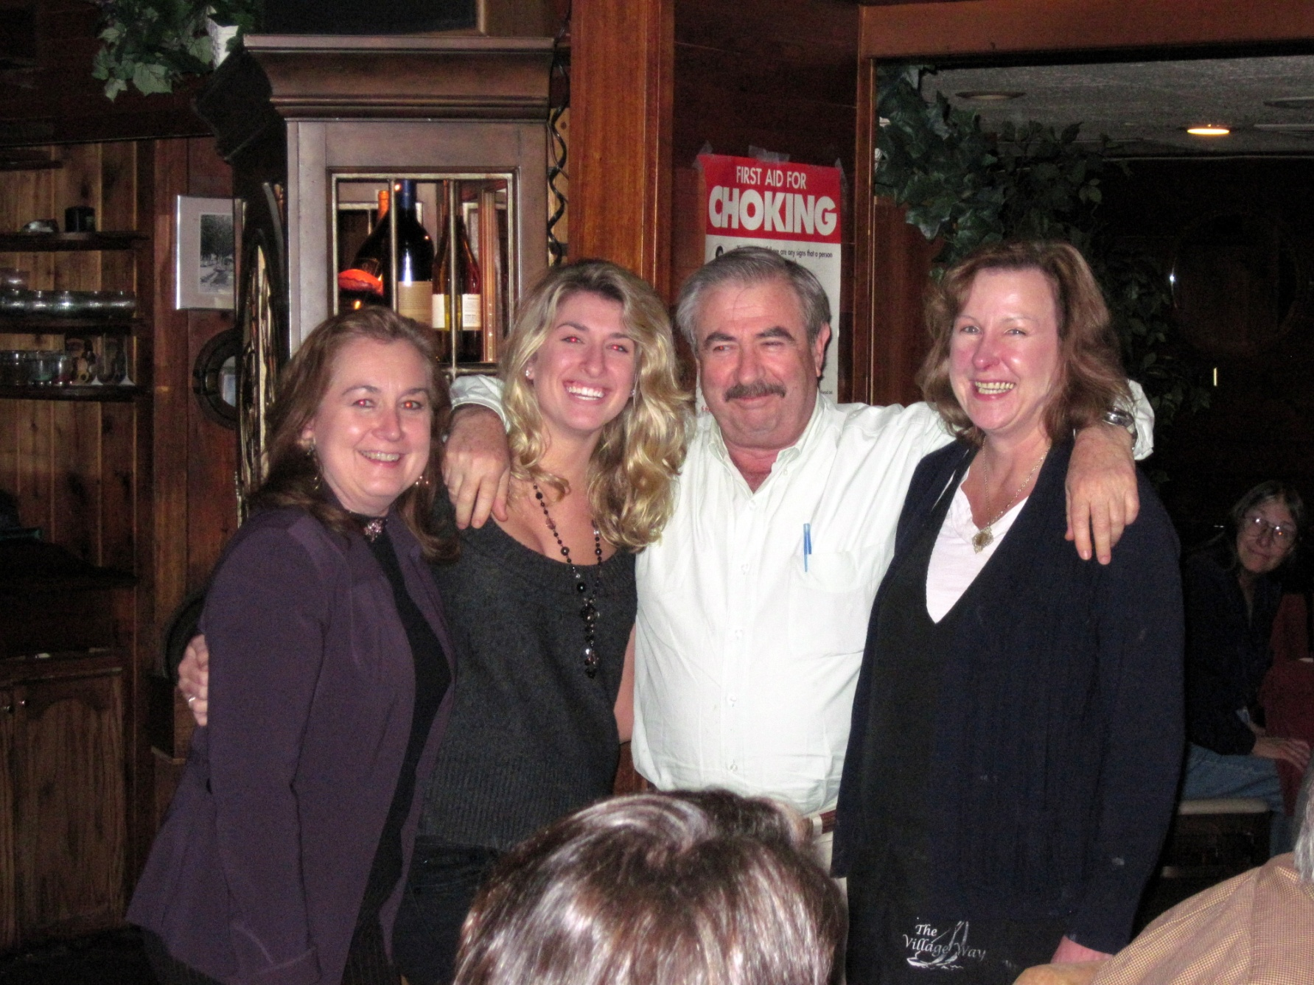
November 6, 2009

