Slide 1
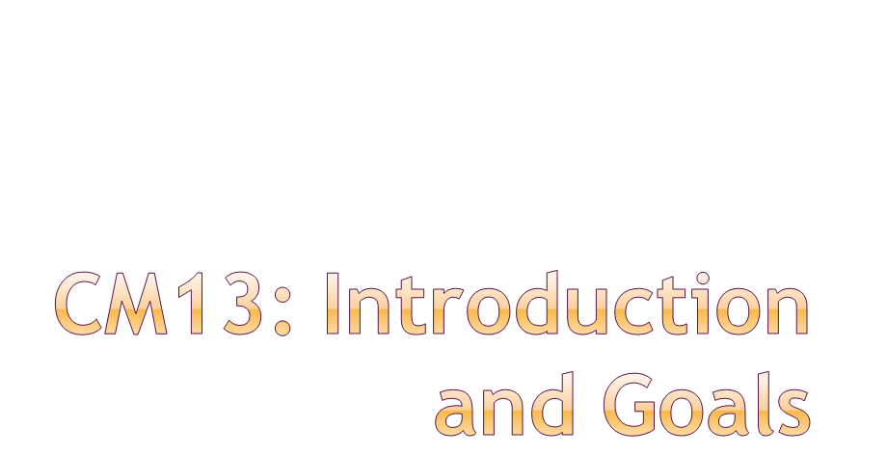
Eric Prebys
LARP Program Director
November 4, 2009

Slide 2
Introduction
FY10 budget
June review
Crab review
Goals for this meeting
Administrative details
E. Prebys, LARP CM13
November 4, 2009

Slide 3
Initial operation
  Ramp up to 1x10³⁴ cm⁻²s⁻¹
Collimation
  See next slide
Phase I upgrade
  After ~2 years of operation (~2013)
  Replace 70 mm triplet quads with 120 mm quads
    Includes APUL projects (superconducting separation dipoles, feedboxes, etc)
  β* goes from 50->25 cm
  Luminosity goes to 2.5x10³⁴ cm⁻²s⁻¹
Phase II Collimation upgrade
  Upgrade with a series of cryo-collimators and advanced secondary collimators that will handle the ultimate LHC luminosity.
Phase II upgrade
  Second half of next decade (nominally 2020)
  Luminosity goal: 1x10³⁵
  Details still under study
    New technology for larger aperture quads (Nb₃Sn)
    crab cavities?
    Improved injector chain (PS2 + SPL)?
E. Prebys, LARP CM13
November 4, 2009

Slide 4
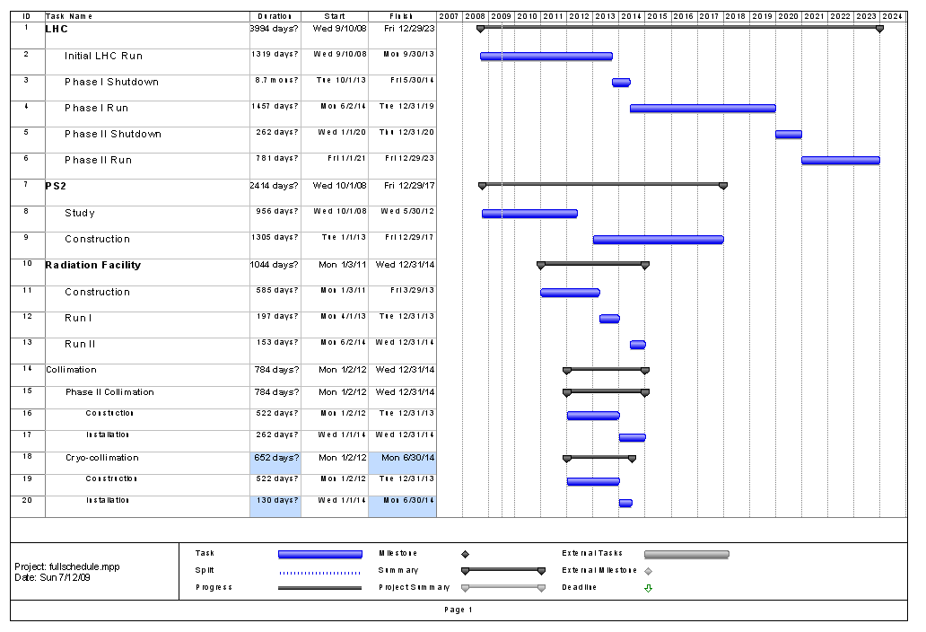
Collimation Schedule approximate
E. Prebys, LARP CM13
November 4, 2009

Slide 5
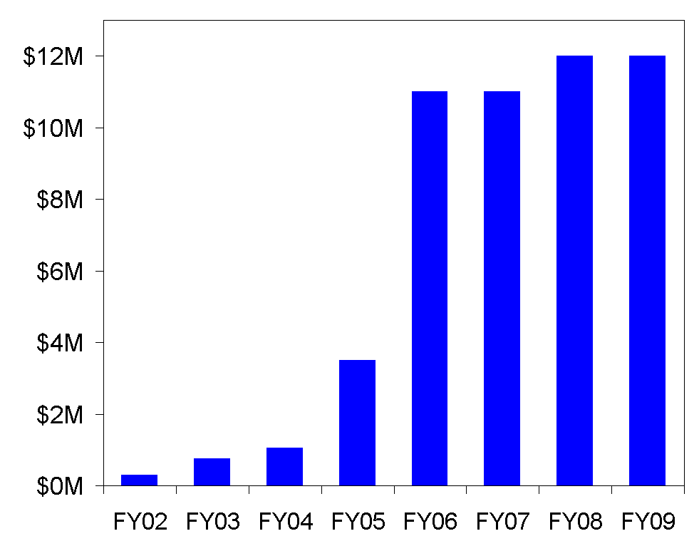
Actual FY09
From LARP proposal:
Future?
LARP had a period of rapid growth in the earlier yeas, which led to some over- optimism
LARP assumed to ramp down as APUL ramps up
E. Prebys, LARP CM13
November 4, 2009

Slide 6
From beginning through FY09
  Accelerator systems
    Great emphasis in finding new projects
  Magnet systems
    Lots of important work, but uncertainty made long term planning difficult
  In general
    Budgets and plans made FY by FY with little emphasis on long term structure.
From now into the future
  Magnet systems
    LARP must make a plan to demonstrate Nb₃Sn as a viable technology in time to allow a (separate) construction project for Phase II
  Accelerator systems
    Very important to understand how our various commitments and interests fit within a shrinking budget
E. Prebys, LARP CM13
November 4, 2009

Slide 7
LARP is largely defined by the magnet program, however, it’s important to remember that the ultimate time scale is very different
  The magnet program must demonstrate Nb₃Sn as a viable technology in time to allow for a construction project for the Phase II upgrades (5-6 years)
    APUL II?
  Even if we define Phase II upgrade plans as the “end” of LARP, many of the accelerator projects (and potential future accelerator projects) have a much shorter time scale
    Makes sense for LARP to continue, at some level at least, after the magnet program has ended.
Full expect new opportunities to present themselves after the LHC startup.
E. Prebys, LARP CM13
November 4, 2009

Slide 8
Lumi and rotatable collimator should ramp down considerably, allowing concentration on other significant commitments
Candidates:
  Crab cavity effort
    Crab cavities deflect the beam to compensate for crossing angle.
    Potential to dramatically increase luminosity under most likely Phase II upgrade scenario
  PS2 Activities
    CERN has requested LARP help in the design (white paper study) of the PS2, which will replace the PS for the phase II upgrade.
E. Prebys, LARP CM13
November 4, 2009

Slide 9
High Priority
  Finish what we started (Lumi, rotatable collimators)
  E-cloud feedback for SPS
  PS2!
  Hollow e-lens as collimator (relatively new)
  LLRF (after clarifying LARP role with Steve Myers)
Low Priority
  E-lens as beam-beam compensator
  H- activities
    Particularly laser emittance monitor
Limbo
  Crab Cavities
    Very important to CERN after September review
    LARP’s role uncertain
E. Prebys, LARP CM13
November 4, 2009

Slide 10
General
  The budget process for FY10 started at the beginning of FY09
  Emphasized long term planning
  Explicitly accounted for “off books” contributions from labs
Accelerator Systems
  Started with requests from CM12
  Iterative process, involving lots of work by Tom M.
  Lots of discussions with appropriate representatives at Labs to discuss on and off-book support
  Put a priority on making good on our promise to increase support for PS2
Magnet Systems
  As usual, much more monolithic than AS
  Emphasis on a “five year plan” to validate Nb₃Sn
  L1 and L2 managers worked diligently to stay within the bottom line while meeting the requirements of the plan
E. Prebys, LARP CM13
November 4, 2009

Slide 11
Not much leeway
  Management costs determined by historical usage
  Need to honor commitments to LTV’s and Toohig fellows
  Only discretionary is Programmatic travel, which I have reduced by trying to include travel with the appropriate project.
E. Prebys, LARP CM13
November 4, 2009

Slide 12
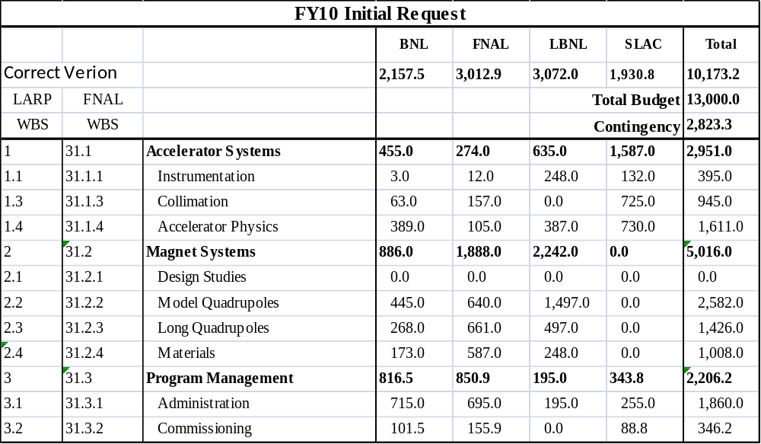
E. Prebys, LARP CM13
November 4, 2009

Slide 13
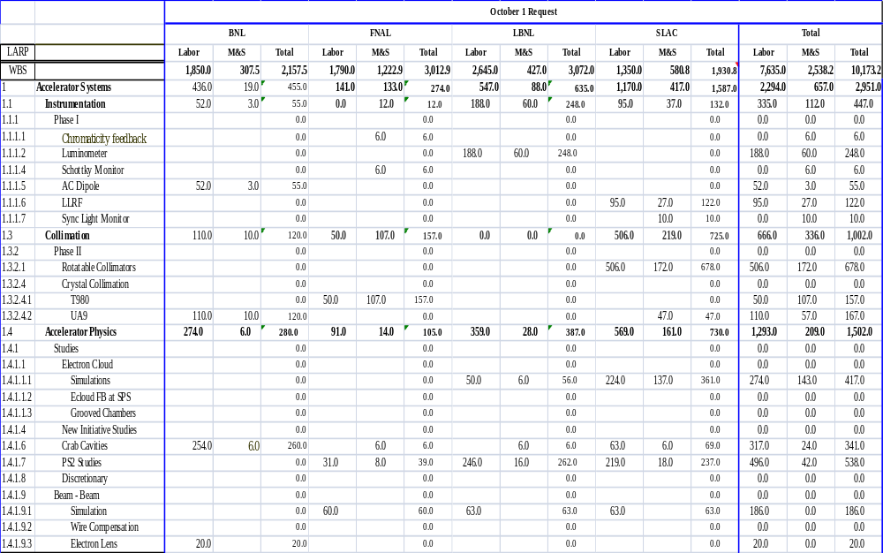
E. Prebys, LARP CM13
November 4, 2009

Slide 14
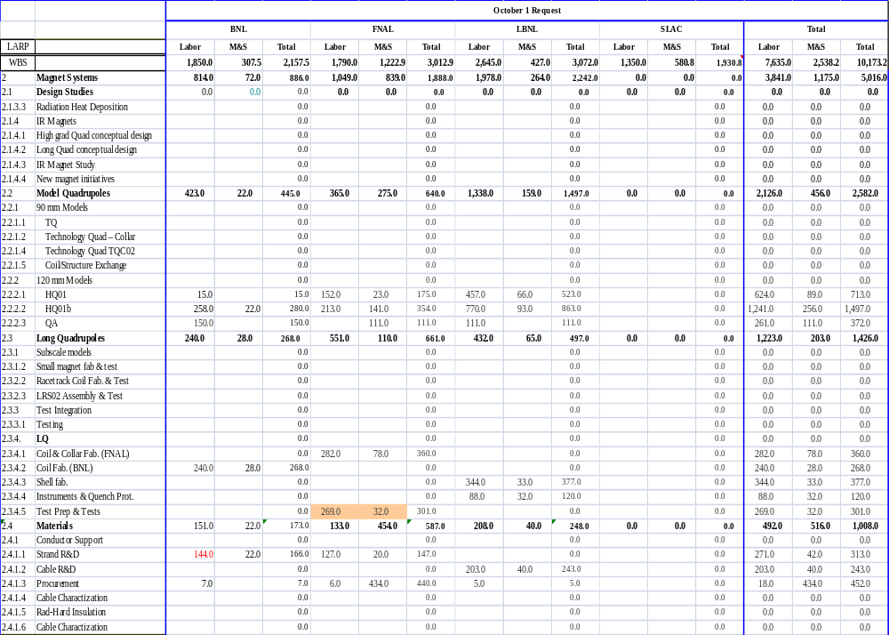
E. Prebys, LARP CM13
November 4, 2009

Slide 15
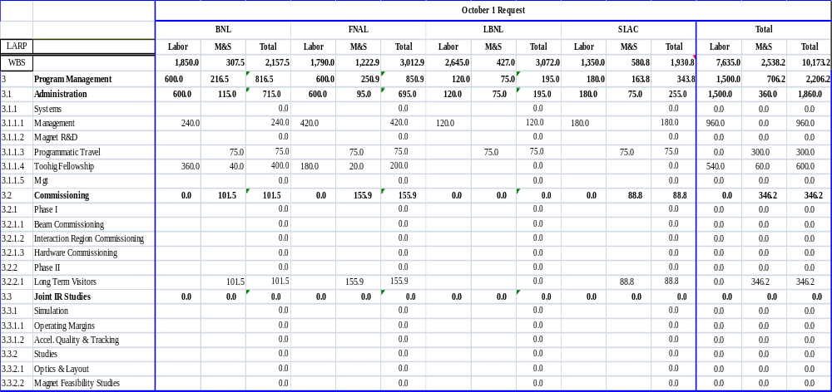
E. Prebys, LARP CM13
November 4, 2009

Slide 16
A DOE Review of the LARP program was held at Fermilab July 13-14, 2009. Evaluations were divided into three areas:
  Accelerator Systems
    Dave Rice, Cornell
    James Rosenzweig, UCLA
    Marion White, Argonne
  Magnet Systems
    Tim Antaya, MIT
    Peter McIntyre, Texas A&M
    George Biallas, Jlab
    Akira Yamamoto, KEK
  Management (no separate breakout)
    Tim Antaya, MIT
    James Rosenzweig, UCLA
    Marion White, Argonne
E. Prebys, LARP CM13
November 4, 2009

Slide 17
Over the next few years, LARP will be competing for funds with the APUL program.
  Straw man budget projection
    FY10: $12M
    FY11: $11M
    FY13: $10M
    …
The magnet program will after it transitions into a production program for Phase II
  ~2015 for a Phase II upgrade in 2020.
Important questions:
  What constitutes a legitimate demonstration of Nb₃Sn?
  Should the LARP program and when the magnet program is finished?
  Is it reasonable to ramp down funding as proposed?
Note:
  To date, we’ve only received the report from the Magnet Systems part
  Relying on closeout slides for AS and Programmatic
  Complete closeout can be found here:
  https://larpdocs.fnal.gov/LARP-public/DocDB/DisplayMeeting?conferenceid=68
E. Prebys, LARP CM13
November 4, 2009

Slide 18
General Findings:
  Impressed by progress, particularly turn-around of Lumi project
  Given the difference in R&D time scales, there is no reason to assume the Accelerator Systems task will end when the Magnet program does.
Selected comments/recommendations:
  General funding:
    No reason for AS effort to end when MS complete.
    Don’t be shy about asking for money (!!)
      New opportunities will certainly arise when the LHC turns on
      “LARP has proven itself”
    Establish internal criteria for transfer from LARP to separate project.
    Insert “placeholders” for future funding
*summarizing 32 page closeout presentation
E. Prebys, LARP CM13
November 4, 2009

Slide 19
Recommendations (cont’d)
  “Complete” Projects (Lumi, Schottky, AC Dipole)
    Work to exploit physics potential (engage Toohig Fellows?)
  PS2
    Good match to LARP
    Make design study chapters a “deliverable”
  Crab Cavities
    Lots of potential
    Too big for LARP
    Pursue as part of separate program
  Electron Cloud
    Clearly identify goals
  E-lens
    Exploit RHIC e-lens effort as effectively as possible
  Beam dynamics
    Coordinate beam dynamics effort
    Establish an independent evaluation of beam dynamics issues for the LHC
E. Prebys, LARP CM13
November 4, 2009

Slide 20
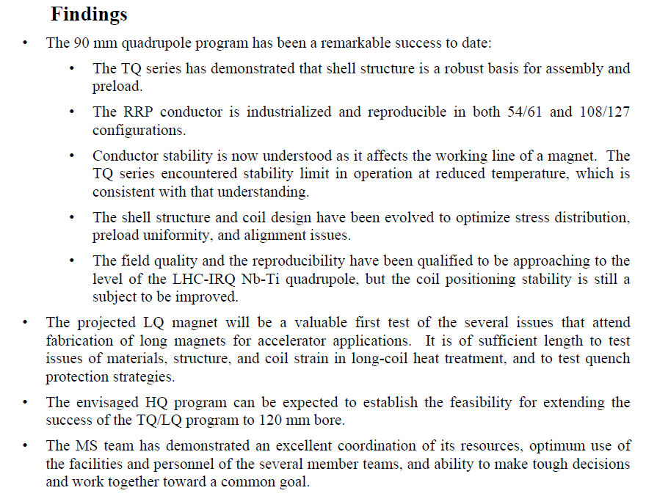
E. Prebys, LARP CM13
November 4, 2009

Slide 21
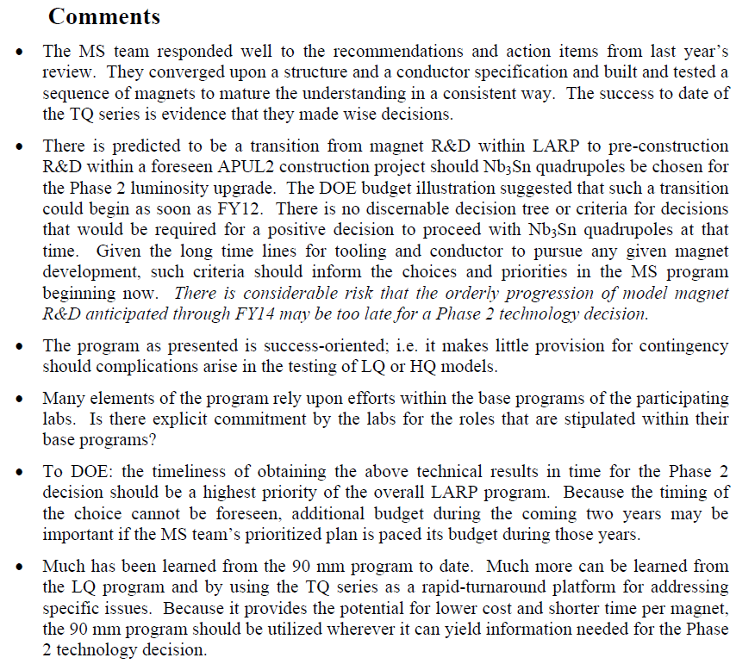
E. Prebys, LARP CM13
November 4, 2009

Slide 22
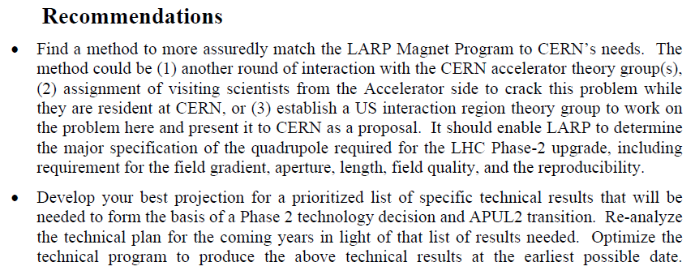
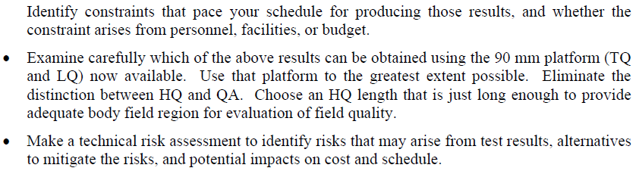
E. Prebys, LARP CM13
November 4, 2009

Slide 23
Base Program Contributions are now included explicitly in LARP planning / accounting and this is good (lowers programmatic risk, improves forecasting, identifies potential resource collisions...)
AS
  Significant progress in program definition and forward planning using CSCS methods that are adapted to an R&D Program spanning multiple labs (this is no mean feat)
  Credible effort to vet the program against CERN interests and priorities has been made
  Useful exercise undertaken to understand LUMI experience and not repeat it
MS
  Very responsive to review last year- program has been streamlined, is making good progress, and complex multi-lab effort is now bringing together key near term LQ and HQ tests
  Where possible CERN plans are inferred and efforts to find ways to tighten the loop with CERN are being made
E. Prebys, LARP CM13
November 4, 2009

Slide 24
AS
  The LUMI experience seems to be repeated (at a lower scale) in the SPS Roman Pot effort
  New interests (crab cavities, PS2) fall somewhere between: LARP, a base program activity, and a large formal project, and this is recognized
  The team seems to be reconsidering doing any work that has deliverables
MS
  The new 5 year magnet program with HQ/LQ ---> QA
    seems to be defined to meet available dollars
    does address feasibility to build IR quads for 2020 supply
    One must still ask if this plan is really consistent with programmatic goal of establishing an IR quad for Phase II Upgrade decision making, as the ultimate answer [QB] now comes programmatically very late
  LHC operational experience in 2010-2013 will likely alter CERN Phase II luminosity upgrade plans- settling the possibility of an Nb3Sn quad on the same time scale would be highly desirable
E. Prebys, LARP CM13
November 4, 2009

Slide 25
Be more proactive: establish independently a plausible luminosity upgrade path, for LARP use for Programmatic Guidance
  MS: should define now a quantitative deliverable Phase II IR Quad Design
  AS: provide an independent assessment of the LHC IR region beam-dynamics/optics as it evolves to provide quantitative guidance for the magnet team
AS Incubator activities versus prototype hardware fabrication?
  Ad Hoc initiatives with high intellectual content are good and match LARP as a program
  Building hardware 'closes the loop' and this is also good
  Introduce a mechanism for deciding when to make the transition from program to project:
    a greater than X$ cost threshold,
    or deliverables are involved
    or the activity has a fixed schedule
  When such tests are met for Ad Hoc studies then provide a project definition (cost, schedule, technical specs, milestones and deliverables)
E. Prebys, LARP CM13
November 4, 2009

Slide 26
MS
  Establish now (unilaterally if no CERN guidance is available) the answer:
    (a) a set of operational, performance and safety requirements for the US delivery of a Production IR Quadrupole for the LHC Phase II Luminosity Upgrade
    (b) a date for when this information must be established
  Then work backwards:
    Evaluate this set of performance requirements against the current technology limits that have been established by LARP
    Look at current HQ & LQ efforts and ask whether they can be used now, or adjusted in place, to settle the remaining open performance questions
  If HQ/LQ can't get there in the near term, establish a set of key milestones what is necessary for being able to reach a commitment for the supply of a Production IR Quad by 2013
  Reach a consensus with CERN separately when it is usefully possible to do so
E. Prebys, LARP CM13
November 4, 2009

Slide 27
Action Items
  AS-
    Look at making the PS2 effort a DOE project rather than a LARP study area
    Look at making the CRAB Cavities a base program effort now
  MS
    [Considering the recommendation on the last slide] Perform an exercise to determine if you have sufficient resources to demonstrate a commitment to supply Nb3Sn IR quads on a time scale [~2013] relevant to CERN selection
E. Prebys, LARP CM13
November 4, 2009

Slide 28
Significant and/or controversial recommendations
  General
    Strong message to DOE to maintain (or even increase) funding
    Take a more proactive role in defining Phase II optics
      Word “unilateral” was used – a complete reversal from last review.
  AS
    Continue to pursue physics opportunities of LARP hardware
      Nice sentiment, but requires $$
    Strong recommendation to DOE to support crab cavities separately.
  MS
    Focus on 90 mm LQ as test bed
      However, do NOT resurrect LQC
    Combine HQ and QA
    Better define handoff from LARP.MS -> APUL-II
      If it breaks, ask for more money
E. Prebys, LARP CM13
November 4, 2009

Slide 29
In September, the CC09 workshop was combined with a review of crab cavities at CERN.
The nominal goal was to down-select from among the prospective (800 MHz) cavities for the Phase I test.
General consensus:
  Crab cavities are very promising
    CERN should endorse them for the Phase II upgrade
  At this point, CERN cannot commit to the 800 MHz Phase I test in IR4
    Phase I test should be scrapped.
  R&D should focus on the final solution
    Compact 400 MHz, unless 800 MHz part of an ultimate global solution.
E. Prebys, LARP CM13
November 4, 2009

Slide 30
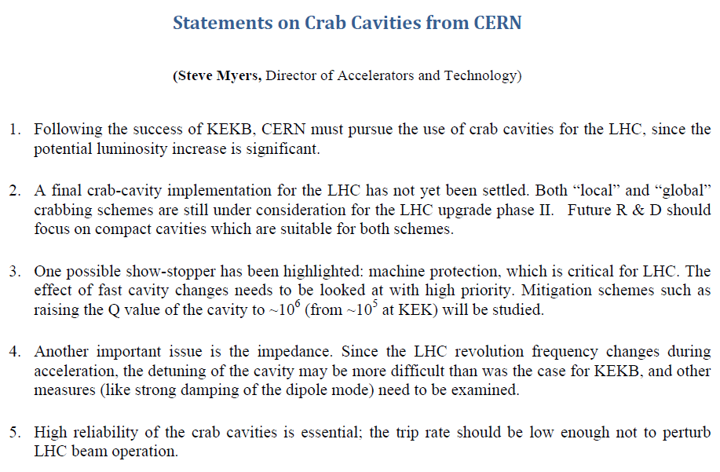
E. Prebys, LARP CM13
November 4, 2009

Slide 31
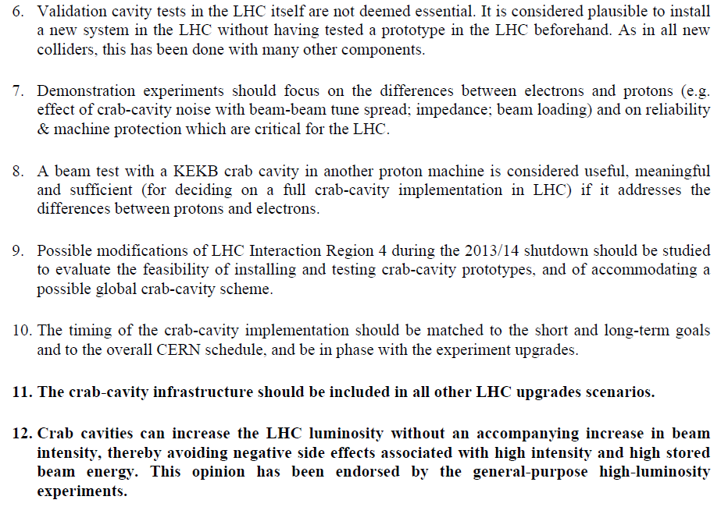
Kills Phase I Test
E. Prebys, LARP CM13
November 4, 2009

Slide 32
General
  Talk to people you don’t usually talk to
    Scheduled an extra plenary session to educate the collaboration.
  Address the substantive comments from the June review.
Accelerator Systems
  How can LARP contribute to initial LHC operation (and exploit the contributions we’ve already made)?
  What is the appropriate LARP role in the optical design for the LHC upgrades?
  What is our role in crab cavities in light of the September review?
  How is the PS2 effort shaping up and where is it going?
  Are our big standing commitments on track?
    Lumi
    Rotatable collimators
    SPS E-cloud
  What do we do about e-lens?
E. Prebys, LARP CM13
November 4, 2009

Slide 33
Magnet Systems
  Make sense out of review recommendations.
  Respond accordingly.
  Address whether we think we can really demonstrate Nb3Sn on an appropriate time scale.
E. Prebys, LARP CM13
November 4, 2009

Slide 34
Date | Time (EST) | Session | Location
Wed, Nov 4 | 900 | Opening Plenary | Diplomatic Room
 | 1330 | AS Parallel | Diplomatic Room
 |  | MS Parallel | Bayles Room
Thu, Nov 5 | 830 | AS Parallel | Diplomatic Room
 |  | MS Parallel | Bayles Room
 | 1330 | Plenary | Diplomatic Room
 | 1900 | Dinner | Village Way Restaurant*
Fri, Nov 6 | 900 | Closing Plenary | Diplomatic Room
*Please verify that your dinner information is correct at the website!
E. Prebys, LARP CM13
November 4, 2009

Slide 35
Some of these sessions are very tight, so it’s important we get the talks loaded beforehand.
  Upload them yourself (preferred), or
  Bring a stick
  No later than:
    8AM for the morning sessions
    Noon for the afternoon sessions
  Please use PDF or PowerPoint 2003 (.ppt) format
E. Prebys, LARP CM13
November 4, 2009

