Slide 1
Dennis and Co. want to see a plan for LARP over the next five (?) years, assuming that is the time scale of the magnet program.
Assume LARP budget will shrink as APUL budget grows
  Initial guidance $12M in FY10, shrinking by $1M every subsequent year.
  Not official, so plan to present $13M budget at review.
Still no charge for review, but am assuming they are looking for more of a “big picture” than in years past.
6/5/09

Slide 2
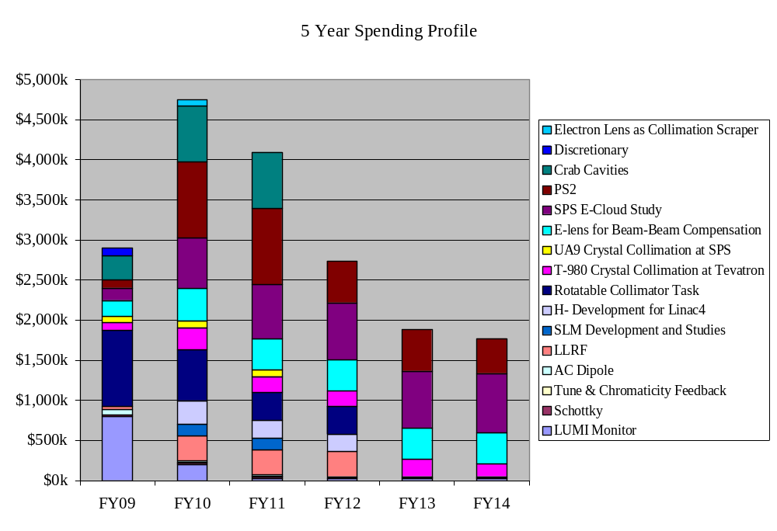
6/5/09

Slide 3
High Priority
  Finish what we started (Lumi, rotatable collimators)
  E-cloud feedback for SPS
  PS2!
  Sync light gap monitor (small)
  Hollow e-lens as collimator (relatively new)
Low Priority
  Crabs (pending fall review)
  LLRF (might be misunderstanding on S. Myers’ part)
  E-lens as beam-beam compensator
  H- activities (Linac 4 people might disagree)
6/5/09

Slide 4
Turned of H- development
Moved all T980 labor to FNAL
Reduce crabs to Rama + travel
Eliminated e-lens for beam beam
Increased e-lens as collimator to 1FTE for next three years.
Shifted a fractional FTE for next two years in PS2 effort
E-cloud at SPS: Moved 1FTE (LARP and contributed) from FY10 and FY11 to FY13 and FY14
6/5/09

Slide 5
Tom and I have been meeting with lab representatives to negotiate potential activities and “off books” contributions.
We (Tom mostly) has been working to scrub budget to get more detail and put everything on an equal footing, reality-wise.
Working with Ken Domann to incoporate all of LARP into an over-arching project format.
6/5/09

Slide 6
Had hoped to have the loaded project ready, but this will not happen.
Plan to have a reasonably detailed ($13M) draft budget and a project with most of the content, schedules, and logic complete.
  Suspect the subtlety will be lost on the reviewers.
  Still want to get everything into the project before the new FY.
Present at least draft plans for the next five years.
6/5/09

