Slide 1

Eric Prebys
Fermilab APC
LARP Program Director
Sept. 18, 2009

Slide 2
Proposed in 2003 to coordinate efforts at US labs
related to the LHC accelerator (as opposed to CMS or ATLAS)
  Originally FNAL, BNL, and LBNL
  SLAC joined shortly thereafter
  Some work (AC Dipole) supported at UT Austin
  Can consider new membership (Jlab?)
LARP Goals
  Advance International Cooperation in High Energy Accelerators
  Advance High Energy Physics
    By helping the LHC integrate luminosity as quickly as possible
  Advance U.S. Accelerator Science and Technology
LARP includes projects related to initial operation, but a significant part of the program concerns the LHC upgrades
LARP Support of Crab Effort, CC09
Sept. 18, 2009

Slide 3
Accelerator Systems (~$3M/year)
  Accelerator physics
  Instrumentation and other hardware
    Collimation
    LLRF
    Crab cavities?
Magnet Systems (~$5M/year)
  Goal: demonstrate Nb₃Sn as a viable technology for the ultimate upgrade of the LHC
Programmatic Activities (~2M/year)
  Program management, travel, meetings, etc
  Toohig Fellowship
  Long Term Visitor (LTV) program
Crab cavities would come out of this
+~$2M contingency divided among tasks as needed throughout year
LARP Support of Crab Effort, CC09
Sept. 18, 2009

Slide 4

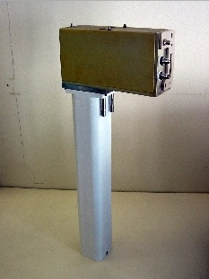
Schottky detector
  Used for non-perturbative tune measurements (+chromaticities, momentum spread and transverse emmitances)
Tune tracking
  Implement a PLL with pick-ups and quads to lock LHC tune
  Investigating generalization to chromaticity tracking
AC dipole
  US AC dipole to drive beam
  Measure both linear and non-linear
  beam optics
Luminosity monitor
  High radiation ionization detector
  integrated with the LHC neutral beam
  absorber (TAN) at IP 1 and 5.
LARP Support of Crab Effort, CC09
Sept. 18, 2009

Slide 5
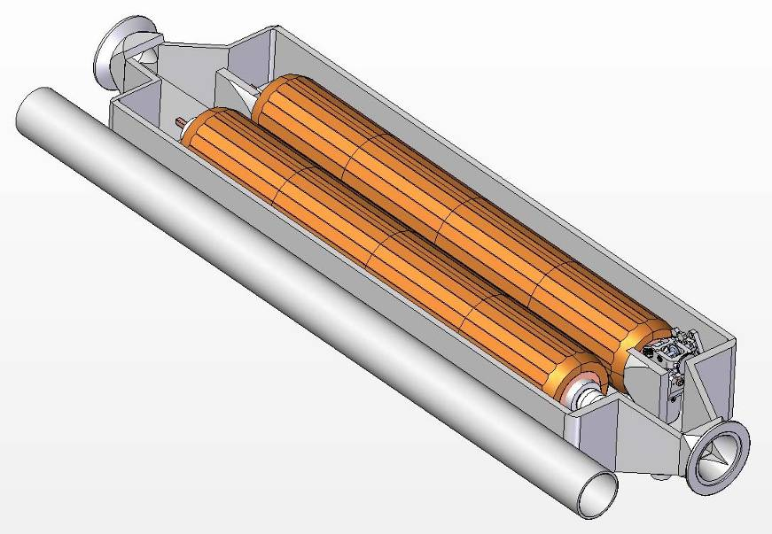
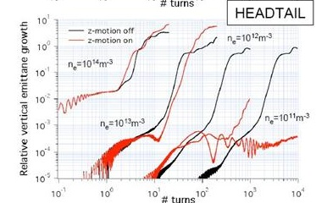
Rotatable collimators
  Can rotate different facets into
  place after catastrophic beam
  incidents
  Aim for prototype this year
Crystal Collimation (See Mokhov talk)
  CRYSTAL Collaboration
  T980
Beam-beam studies
  General simulation
  Electron lens (See Shiltsev talk)
  Wire compensation
Electron cloud studies
  Study effects of electron cloud in
  LHC and injector chain (see Furman
  talk)
LARP Support of Crab Effort, CC09
Sept. 18, 2009

Slide 6
Somewhere between US and European Rules
  LARP funds pay for materials and services (M&S), most technical and engineering labor, and some scientific labor
  Significant scientific labor and some engineering labor contributed out of lab core programs
That $3M/year is really more like $6M if we count everything (with all overhead).
  Remember that by US accounting rules, a “physicist” is about $250-300k/year.
LARP Support of Crab Effort, CC09
Sept. 18, 2009

Slide 7
LARP funds R&D.
  If technology looks promising, the hope is that it will be taken over by CERN or spun off as a separate project in the US
    eg, “Accelerator Projects for the Upgrade of the LHC” (APUL) magnet program, which is building D1 separators and feebboxes for the Phase I upgrade.
  Not really structured like a project, so try to avoid “hard deliverables”
    Got into some trouble with this with the Lumi monitors
Crab cavities (even just the US part) too big to fit within LARP
  Multi-M$
LARP can take a steering role in the US R&D, but if crab cavities take off, they will have to get dedicated funding from the DOE
  ie, don’t assume “LARP funding” is the same as “US funding”
  LK Len can say more about that than me.
LARP Support of Crab Effort, CC09
Sept. 18, 2009

Slide 8
Historically dominated by two projects
  Rotatable Collimator
  Lumi Monitor
  Together made up ~2/3 of Accelerator Systems Budget
As these ramp down, projects which are moving to take their place include
  R&D for PS2
    Lots of interest at CERN and in US
    Synergy with Project X
    Well matched to LARP
  E-cloud feedback in SPS
    Mostly SLAC and LBL
  Crab cavities
    Interesting, but no way LARP can support entire US end.
    Have taken a “wait and see” attitude
LARP Support of Crab Effort, CC09
Sept. 18, 2009

Slide 9
Initial FY10 budget: Total $337k
  BNL: $256k
    Mostly Rama
  FNAL: $6k
    Travel
  LBNL: $6k
    Travel
  SLAC: $69k
    Continue R&D on SLAC cavity design
Pending outcome of review
  Could potentially release ~few hundred k$ from contingency over course of year
LARP Support of Crab Effort, CC09
Sept. 18, 2009

Slide 10
Rotatable Collimator budget will ramp down further, which could free up money for crab cavities, however, overall budget expected to shrink as budget for Phase I magnet program (APUL) grows:
  Bottom line: LARP crab cavity support will probably stay in the range $300k-$600k/year.
  With a strong signal from CERN, it could go higher, but probably not to the $1M/year level.
Caveat:
  LARP will not continue to support efforts for a Phase I (IR4) test unless there is an unambiguous commitment from CERN to support such a test.
LARP Support of Crab Effort, CC09
Sept. 18, 2009

Slide 11
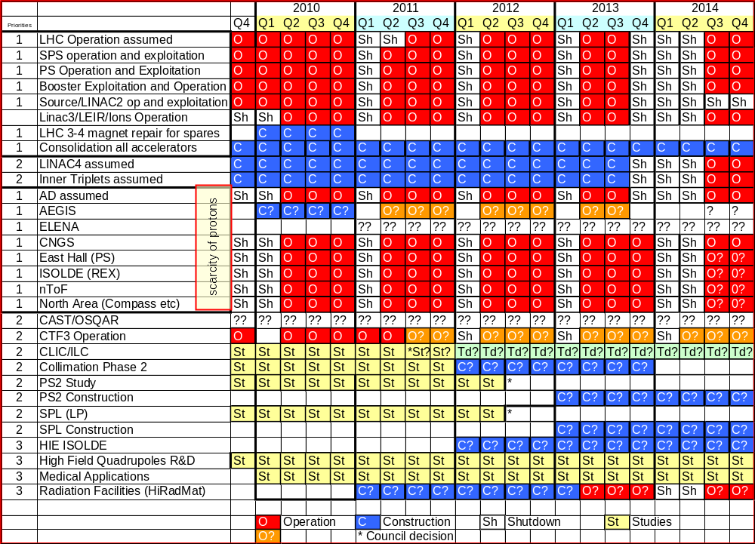
Potential Crab Cavity Installation?
Phase I Upgrades
Could CERN commit to a crab cavity test in IR4 in 2013?
  And could we meet that schedule?
LARP Support of Crab Effort, CC09
Sept. 18, 2009

Slide 12
The case for crab cavities has gotten very strong
At this point:
  Could possibly down-select from among 800 MHz elliptical designs
  Nowhere near the point to choose among compact designs.
However, elliptical cavities don’t appear feasible for the local solution.
This raises the question whether there is a point to developing the elliptical cavities at all:
  Still a question whether Phase I test will occur.
  Would it make more sense to put all our efforts into the final solution.
LARP Support of Crab Effort, CC09
Sept. 18, 2009

Slide 13
Can we get a commitment that a Phase I test can occur?
Can we meet that timescale?
What will “CERN” accept as evidence that crab cavities are a viable technology:
  Is a Phase I test in the LHC necessary?
  Does it tell us enough?
  Could we do a test in the SPS or elsewhere?
Can crab cavities me made “safe”?
  Potential show stopper
Can IR4 be modified to permanently accommodate elliptical cavities?
  If so, is a global scheme potentially the best solution?
LARP Support of Crab Effort, CC09
Sept. 18, 2009

