Slide 1
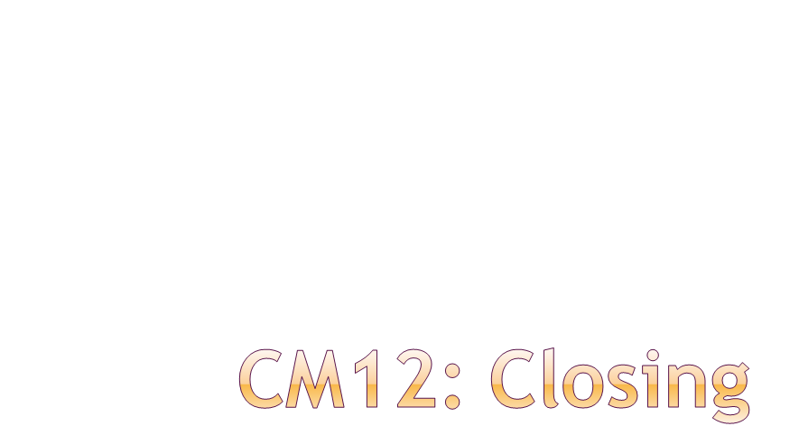
Eric Prebys
LARP Program Director
4/10/09

Slide 2
Lots of good work (too much)
  Many things that were not well defined before have become much better specified.
  I don’t really think LARP is “wasting time” on anything
Nevertheless, we simply don’t have the funds to support everything.
It’s very good that we’re starting this process earlier this year.
  FY09 budget discussion didn’t really start until about August in 2008.
  We’ve really been talking about FY10 and beyond since the beginning of FY09.
Goal: have a concrete plan by the review
  July?
E. Prebys,CM12 Closing
4/10/09

Slide 3
The LARP magnet program represents a world class effort to develop Nb3Sn into a viable accelerator quality technology.
Clearly at a crossroads now
  Must transition to a concrete plan which results in a technology demonstration that will satisfy CERN.
Peter has made a pass at defining the end product of the program.
Mike Lamm has attempted to tabulate the specifications which must be met.
This is a good start, but there is clearly a lot of disagreement within the magnet group about plans and priorities.
  Must present a united front at the July review.
E. Prebys,CM12 Closing
4/10/09

Slide 4
Remember:
  We’re not necessarily trying to design the ultimate Nb3Sn magnet
  We’re not trying to learn everything there is to know about Nb3Sn.
  We’re trying to establish a realistic proposal for Nb3Sn triplets that can be used, together with the luminosity network group, to decide the optics for the Phase II upgrade.
Big questions
  Collars or shell?
  Which conductor?
  Rad hardness?
  Thermal issues?
  Quench survival?
Plan must include decision points for these questions.
E. Prebys,CM12 Closing
4/10/09

Slide 5
General comments
  Because the players don’t realize they’re fighting for the same pot of money, discussions tend to be less lively (and therefore less productive) than the magnet systems.
  Tom has done an excellent job of putting everything together, so we can start to have the difficult conversations.
Big progress
  Lumi monitor now on solid ground for the 2009 run
    Handoff to CERN ~negotiated
  Much more concrete plan for rotatable collimators
    Almost guaranteed to have at least some in the LHC
  Significant progress in both crystal efforts
  PS effort has grown and defined itself
  Formerly “diffuse” efforts, like ecloud and LLRF, have focused themselves
  Crab cavities have grown into a large industry.
E. Prebys,CM12 Closing
4/10/09

Slide 6
No brainers
  Complete our commitments
    “service after sales” for AC dipole, tune tracker, and Schottky.
    Lumi
    Rotatable collimators
    UA9/T980
  Build up our PS2 effort
    Good for CERN, good for us.
    Uli has done an excellent job of organizing activity and defining goals.
Difficult and painful process to prioritize the rest
  Lots of good work going on
    Beam beam
    LLRF
    eCloud (move under PS2?)
  Tom has done an excellent job of showing the bottom line.
    Actually, it looks better than I expected
  Now the hard work starts
E. Prebys,CM12 Closing
4/10/09

Slide 7
Obviously, an exciting project, both intellectually and as a tool to increase LHC luminosity.
Way too big for LARP
  Even if we diverted all of our AS funds to it
Rama has done a good job of organizing activity, but must start pitching this directly to the DOE soon to get any significant US resources.
Any LARP involvement will be limited
  Player in the organization.
  Rama + epsilon.
E. Prebys,CM12 Closing
4/10/09

Slide 8
Continue the process of working with Ken Domann to put the things which were said at this meeting into a plan.
Schedule a “budget retreat” of L1 and L2 managers to make the plan fit into a flat (?) budget over the next few years.
  June?
Present our plan at the July review
Tweak as necessary to submit to DOE in time for FY10 budget
  September 1?
E. Prebys,CM12 Closing
4/10/09

