Slide 1
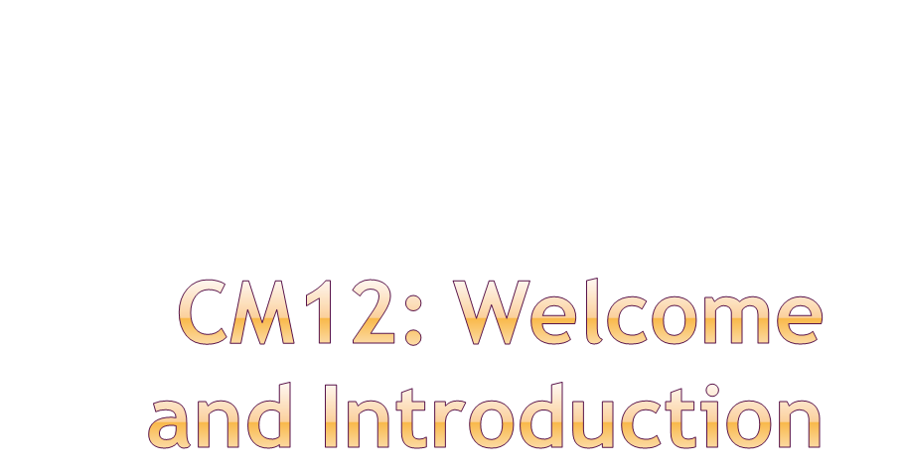
Eric Prebys
LARP Program Director
4/8/09

Slide 2
All meetings will take place in Chardonnay room (partitioned for parallel sessions).
Wireless available
  SSID: hhonors
  Login key with your check-in information (see me if you didn’t get it)
Speakers, please upload your talks to the web page prior to your session
  Instructions on the web site
  See me if you have problems
Evening discussion session (with refreshments) tonight, after afternoon meetings.
  Out in the “happy hour” area.
  Wear your conference badge!!!
Conference dinner tomorrow, here at Rings
  $40/pp in advance. See Allison about arrangements, if you haven’t done so already.
  See Sam about $15/pp bulk wine deal, if you’re interested.
Lunch
  Available through hotel for ~$10-$12/pp
  Many restaurants in the area, but please return on time!!
E. Prebys,CM12 Introduction
4/8/09

Slide 3
LARP continues to do good work, which is recognized by CERN
  3 invited orals + 3 contributed orals + 33 posters for PAC09
  Strong solicitation to help with PS2 work
Lumi monitor on track for 2009 start up
  Experience with lumi has shaped some future policy
Federal budget has restored full $13M to LARP!!!
  $1.6M -> $2.6M contingency
E. Prebys,CM12 Introduction
4/8/09

Slide 4
In the wake of the lumi situation
  Avoid large deliverables
  Implement better base line tracking for any deliverable
LARP is an “R&D” program
  The magnet program largely defines LARP, and should produce a “six year plan” which results in a prototype sufficient to be a viable choice for the LHC phase II upgrade.
  Other R&D LARP activities should plan around this time scale.
  At the end of this time, LARP will either be redefined or disappear into accelerator R&D core programs at the various labs.
Budget
  DOE views LARP+APUL as one pot
  The overall budget will grow, but they envisions the LARP component shrinking after the next year or so.
  The only way we might prevent this is to have a solid, defensible, multi-year plan.
E. Prebys,CM12 Introduction
4/8/09

Slide 5
Original plan
  $2.5M
  Finished in FY07
Currently
  Spent $3.6M
  FY09: ~$800k more
  Finished in FY09??
Bottom line
  These sorts of overruns are not unusual in real projects!
  LARP contingencies are far from sufficient to cover overruns in significant deliverables.
More about this shortly…
E. Prebys,CM12 Introduction
4/8/09

Slide 6
Guidance from DOE
  $13M with a 6 month continuing resolution at 84%
    .5*.84*13+.5*13 = $11.96M
  Separate money ($1-2M) found for APL planning!
General breakdown (informed by Steve’s exit advice)
  Accelerator Systems: $2.9M
  Magnet Systems: $5.0M
  Program Management: $2.1M
    Includes LTV and Toohig Fellows (of which we have 4)
  Contingency: $2M
In then end, had to give up some continency to increase Program Management
  Recovered when the budget went through, but will probably use it all.
E. Prebys,CM12 Introduction
4/8/09

Slide 7
Crab cavities
  Original request: $700k
    Cavity design
    Cryomodule design
    LLRF
  Budget: $300k
    Rely on “off books” help in cavity design from LBNL and Jlab
    Defer cryomodule and LLRF work
PS2
  Uli Wienands developed a number of plans under various funding scenarios
  In the end, budgeted $100K, primarily for travel and M&S, assuming that most scientific time would be contributed.
E. Prebys,CM12 Introduction
4/8/09

Slide 8
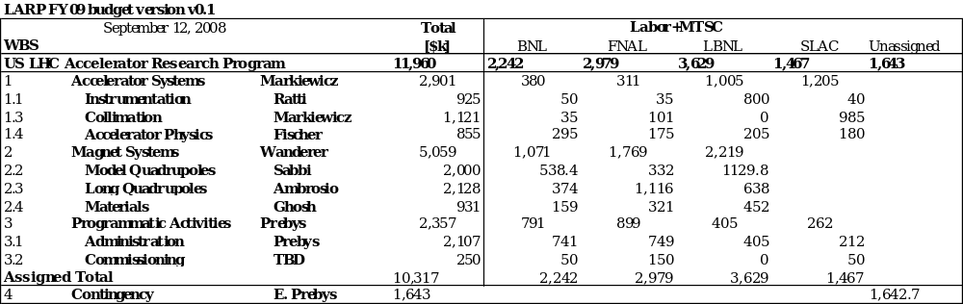
This number has increased by ~$1M
E. Prebys,CM12 Introduction
4/8/09

Slide 9
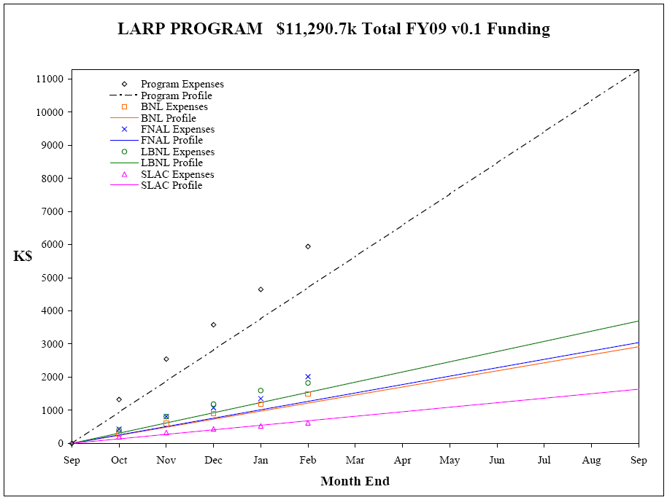
E. Prebys,CM12 Introduction
4/8/09

Slide 10
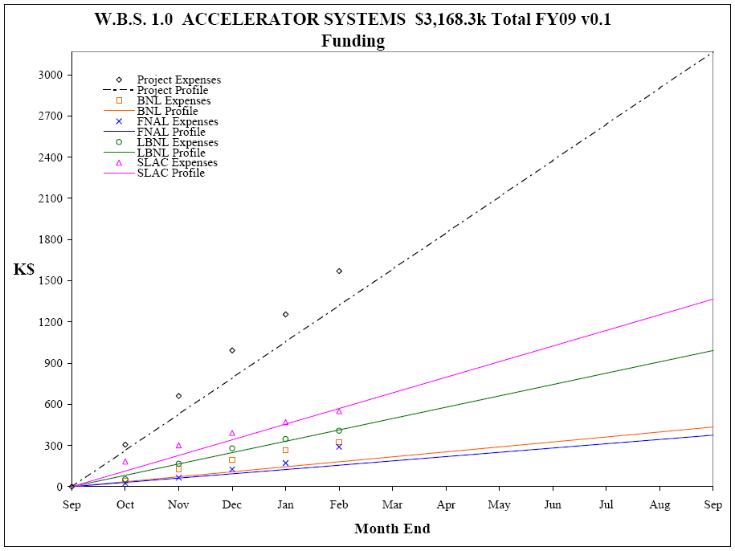
E. Prebys,CM12 Introduction
4/8/09

Slide 11
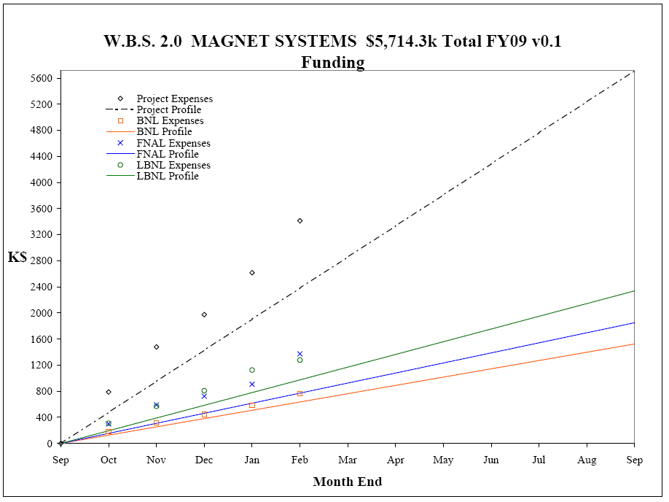
E. Prebys,CM12 Introduction
4/8/09

Slide 12
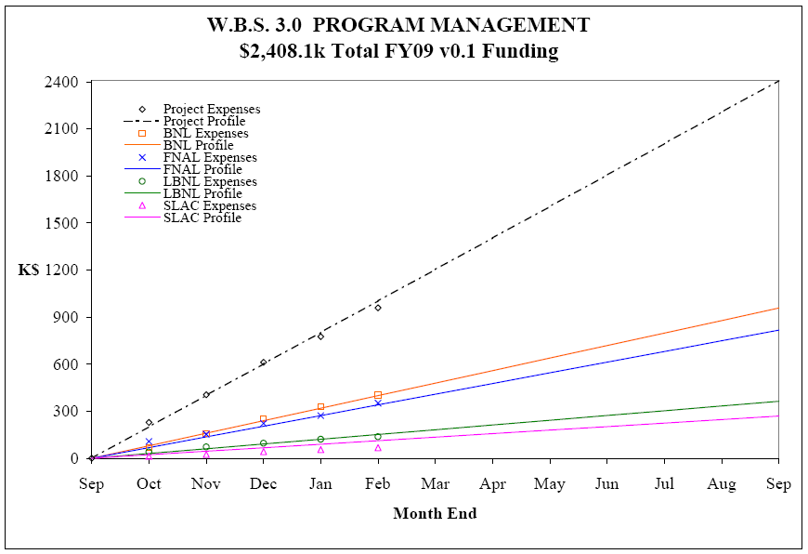
E. Prebys,CM12 Introduction
4/8/09

Slide 13
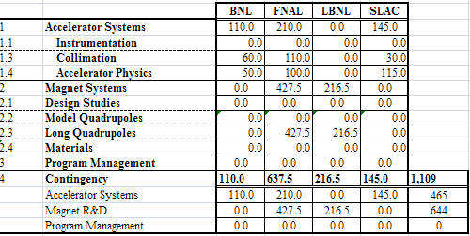
Primary input
  Reevaluation of magnet systems costs
  Shortfalls in crystal collimation program
  Labor overruns
  Taking advantage of incrased budget to relieve straing on SLAC’s core program
Working to make up for BNL overrun in next request
E. Prebys,CM12 Introduction
4/8/09

Slide 14
Lumi and rotatable collimator should ramp down considerably, allowing concentration on other significant commitments
Candidates:
  Crab cavity effort
    Crab cavities deflect the beam to compensate for crossing angle.
    Potential to dramatically increase luminosity under most likely Phase II upgrade scenario
  PS2 Activities
    CERN has requested LARP help in the design (white paper study) of the PS2, which will replace the PS for the phase II upgrade.
E. Prebys,CM12 Introduction
4/8/09

Slide 15
Pros
  Potentially a big impact on luminosity
  Lots of intellectual interest in US community
  Can be divided into well-defined tasks that are straightforward to monitor.
Cons
  Barring a budget windfall, LARP will not have the resources to take a significant role in construction, so must coordinate with multiple labs/countries/funding agencies.
  Current plan relies on SBIR grants
  If badly managed, potentially a black hole of resources that never accomplishes anything.
Bottom line:
  LARP’s role in crab cavities will necessarily be limited
  If crab cavities are to succeed, it must be through a significant coordinated effort.
E. Prebys,CM12 Introduction
4/8/09

Slide 16
Pros
  Lots of opportunities to make contributions
  Well aligned with US interests and expertise, particularly Project X
  Involvement “scalable”
  Our involvement both desired and assumed by CERN
Cons
  Activity and goals not as well defined
  Danger of funding a lot of people to “think about stuff”
Potential areas of focus
  Injection issues
  Electron cloud
  Laser stripping?
  We will handle this effectively like “new initiatives”
E. Prebys,CM12 Introduction
4/8/09

Slide 17
Assume flat-flat budget over next year or so
  Will work on this, but don’t expect miracles
  ~$12-$13M/yr
Lumi and Rotating collimators will ramp down
  Would be naïve to assume they go to zero
Several things positioning to take their place
  Existing efforts (Ecloud, beam beam, jirs)
  New things (PS2, crab cavities)
Either PS2 or crab cavities could easily use out AS budget
  And it would be well spent.
Have to make tough choices
  Can’t do everything we want
E. Prebys,CM12 Introduction
4/8/09

Slide 18
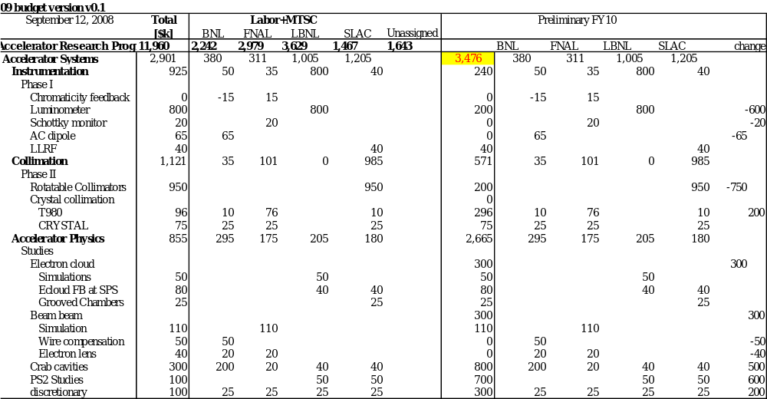
E. Prebys,CM12 Introduction
4/8/09

Slide 19
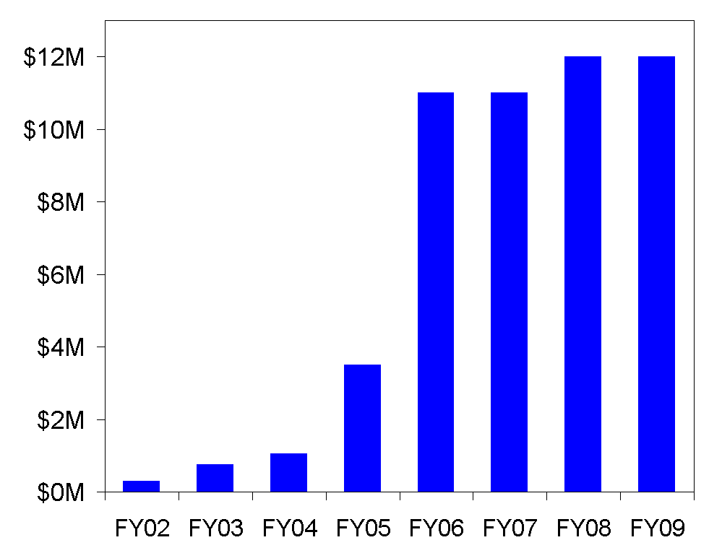
LARP had a period of rapid growth in the earlier yeas, which led to some over- optimism
E. Prebys,CM12 Introduction
4/8/09

Slide 20
Official LARP change control policies essentially ignored.
No consistent rules for dealing with burdens at different labs
Budget and schedule not integrated
  Earned value reporting must be done by hand, if it’s done at all
No systematic way of dealing with different types of contingency
  “deliverables” should have significant assigned contingency
  R&D projects should have “scope contingency”, possibly adjusted by an uncommitted unassigned contingency pool.
No formal accounting for “off books” contributions from member labs.
Developing future budget profile a nightmare.
E. Prebys,CM12 Introduction
4/8/09

Slide 21
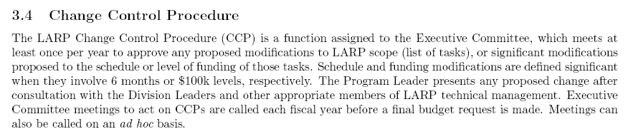
From LARP “Management Plan”:
Problem
  LARP doesn’t even have an informal base line
  Large changes can sneak in at the annual budget without being noticed
  Example: in order to see the budget and schedule problems with the lumi monitor, it’s necessary to forensically examine old task sheets.
E. Prebys,CM12 Introduction
4/8/09

Slide 22
Reminder: the entire AS + MS budget is $3M+$5M, which is ~10+20 FTE’s or so.
We get a significant amount of additional scientific effort contributed in two ways:
  Explicit LHC work supported through the unassigned “core” program
    ~6 FTE’s at SLAC
    ~6 FTE’s at FNAL
    Some CBP time from LBNL
  Time which benefits LARP through common interest
    ~2 FTE’s at BNL working on RHIC projects which benefit the LHC as well
This is primarily for the AS, for which it is a large part.
E. Prebys,CM12 Introduction
4/8/09

Slide 23
Put LARP budget and schedule into a single MS Project file
Define burdens and labor rates correctly for the four member labs
  Eg, “BNL engineer”, “SLAC scientist”, etc…
For every labor category, have an equivalent “off books” category with an appropriately PC name (“common effort”?), which is not included in the normal roll-up, but can be rolled up separately.
Progress is updated monthly by designated L2 and L3 managers.
Implement formal change control and change logging.
Project used to formulate long term plan and budget profile.
E. Prebys,CM12 Introduction
4/8/09

Slide 24
Ken Domann has translated the currrent WBS chart, as well as other information, into a fully loaded MS Project file.
Budget expenses will be charged against rolled project line items
  Need to identify FNAL person to do this once a month
For each subtask, a responsible person will be identified.
  Ken will email him an Excel spreadsheet each month on which he will report progress on his tasks and milestones
Ken will generate standard earned value reports on a monthly basis.
For schedule or budget changes beyond those specified on 3.4, we will generate proper CR’s which must be approved by the Executive Committee(?)
E. Prebys,CM12 Introduction
4/8/09

Slide 25
Get lumi monitor working prior to 2009 start up
  LARP reputation depends on it
Protect core magnet program
  Insure that LARP produces a prototype Nb₃Sn magnet on a time scale that makes it a viable choice for the Phase II upgrade.
Complete rotating collimator prototype
  This has been a significant LARP activity, and it’s important that we produce a prototype on a time scale that will allow it to be part of the collimation solution.
Continue to support Toohig Fellows and Long Term Visitors
  Very important link to CERN
  LARP supported visitors making significant and well received contributions.
Choose from remaining AS activities based on a risk reward analysis
E. Prebys,CM12 Introduction
4/8/09

Slide 26
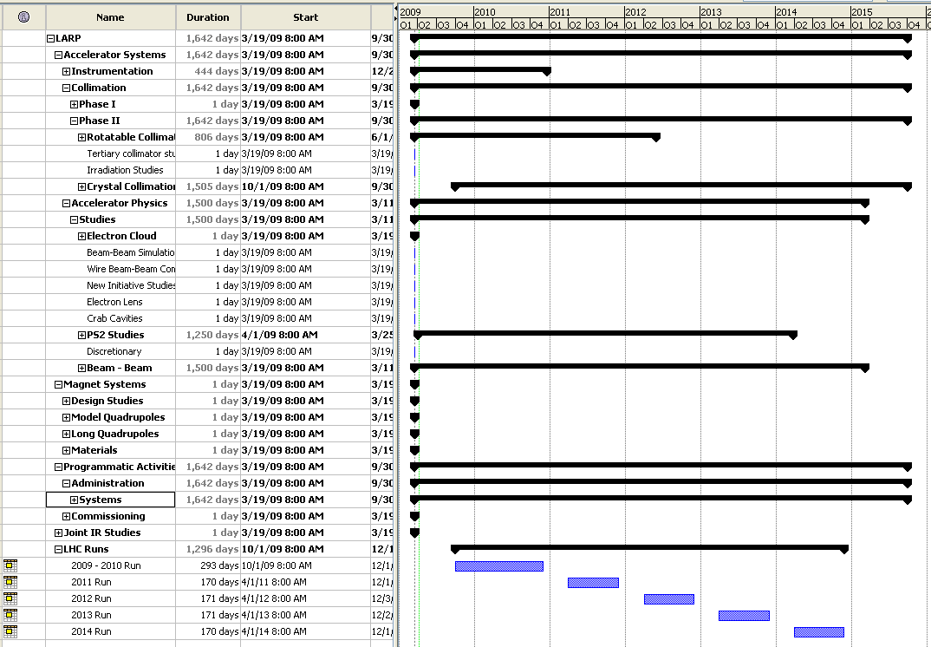
E. Prebys,CM12 Introduction
4/8/09

Slide 27
Our goal is to have a six year plan by our June DOE review, which will form the basis of our FY10 budget.
All discussion this week should focus on multi-year schedule and deliverables.
Immediately following this meeting, we will begin intense project planning sessions will Ken.
  Be ready
E. Prebys,CM12 Introduction
4/8/09

Slide 28
Sam Vanecek
Martha Condon
Joe Chew
Steve Gourlay
Allison, Sherri and the Embassy Suites staff
E. Prebys,CM12 Introduction
4/8/09

