Slide 1

Eric Prebys
Fermilab APC
LARP Program Director
March 2, 2010

Slide 2
Proposed in 2003 to coordinate efforts at US labs
related to the LHC accelerator (as opposed to CMS or ATLAS)
  Originally FNAL, BNL, and LBNL
  SLAC joined shortly thereafter
  Some work (AC Dipole) supported at UT Austin
  Can consider new membership (Jlab?)
LARP Goals
  Advance International Cooperation in High Energy Accelerators
  Advance High Energy Physics
    By helping the LHC integrate luminosity as quickly as possible
  Advance U.S. Accelerator Science and Technology
LARP includes projects related to initial operation, but a significant part of the program concerns the LHC upgrades
DOE Budget briefing
March 2, 2010

Slide 3
Accelerator Systems (currently ~$3M/year)
  Accelerator physics
  Instrumentation and other hardware
    Collimation
    LLRF
    Crab cavities?
    Injector chain?
Magnet Systems (currently ~$5M/year)
  Goal: demonstrate Nb₃Sn as a viable technology for the ultimate upgrade of the LHC
Programmatic Activities (currently ~2M/year)
  Program management, travel, meetings, etc
  Toohig Fellowship
  Long Term Visitor (LTV) program
+~$1.4M contingency divided among tasks as needed throughout year
DOE Budget briefing
March 2, 2010

Slide 4
Magnet Systems
  Current budget well matched to demonstrating Nb3Sn as a viable technology by end of FY2012.
  Assume, LARP will provide further R&D in support of a production program after that with the goal of having magnets available for installation in ~2020
Accelerator Systems
  Scope entirely limited by available resources.
    Choice and prioritization of subtasks based on US skills and interests, as well as the needs and interests of CERN.
  Includes significant contributions of scientific effort, funded by the core programs at the member labs, particularly SLAC and Fermilab.
  Many more interesting and useful projects to do, if funding were increased.
Programmatic Activities
  Management of other tasks (essentially “overhead”)
  Programmatic Travel
  Personnel programs (Toohig + Long Term Visitors)
DOE Budget briefing
March 2, 2010

Slide 5
Initial operation (now)
  Ramp up to 1x10³⁴ cm⁻²s⁻¹
Phase I upgrade
  After ~2 years of operation (~2014)
  Replace 70 mm triplet quads with 120 mm quads
  β* goes from 50->30 cm
  Linac4 to increase PSB injection energy to reduce space charge effects
  Luminosity goes to 2-3x10³⁴ cm⁻²s⁻¹
Phase II upgrade
  After Phase I triplet burns up (nominally ~2020)
  Peak luminosity goal: 1x10³⁵
  Details still under study
    New technology for larger aperture quads (Nb₃Sn)
    crab cavities?
    Improved injector chain (PS2 + SPL)?
Focus of APUL
No major changes to optics or IR’s
Possible Significant Changes
LARP Magnet Program
DOE Budget briefing
March 2, 2010

Slide 6
Energy
  Joints not reliable above 3.5 TeV
  Run at 3.5+3.5 for ~fb⁻¹ or roughly end of 2011
  Shut down for ~18 months to do all repairs to get to 7+7 (or as high as quench problem will allow).
Collimation
  Initial (Phase I*) collimation only good to a luminosity of a few 10³³.
  A plan is in place for collimation which is good to “ultimate” luminosity of a few 10³⁴.
    Schedule being worked out
    Will involve LARP collimators, if they survive tests.
Crab Cavities
  In a major shift from last year, crab cavities are now considered part of the base line plan for the Phase II upgrade
  LARP has played a major role in this
*note confusing inconsistent “phases” for collimation and triplet upgrade
DOE Budget briefing
March 2, 2010

Slide 7
In 2014, the LHC will optimistically accumulate ~10’s of fb⁻¹, and the luminosity will still be increasing.
  The lifetime of the existing triplet magnets is ~500 fb⁻¹
  Is it likely the experiments will want to stop for a year upgrade followed by a year of re-commissioning?
Consider two possibilities
  Delayed scenario
    Phase I upgrade delayed until ~2017
    Phase II upgrade delayed until ~2023
  Skip Phase I entirely
    Phase II still in 2020, or maybe even earlier
CERN is supposed to make a decision regarding the Phase I upgrade in about 6 weeks
  Need to start moving on magnet production if it’s really going to happen.
DOE Budget briefing
March 2, 2010

Slide 8
2010-2012: complete technology demonstration/qualification
  LQ addresses all length-related issues
  HQ addresses performance limits and accelerator features
2012 +: full scale prototypes and production
  Preparations (2010-2012):
    Converge on design specifications
    Project planning, infrastructure upgrades
  Nb₃Sn design options and timelines:
    120 mm aperture & <4 m length: ~2016
    Larger aperture & longer length: ~2018
Discussion: How does this match with CERN’s plans and expectations? (This makes sense, given the earliest conceivable Phase II date)
Eric Prebys - LARP Annual DOE Briefing
February 16, 2010

Slide 9
Baseline Magnet Plan
2010-2012: complete technology demonstration (original goal)
LQ to address all length-related issues (& fully reproduce TQ results):
  2010-2011: 2-3 additional tests using 54/61 coil series
  2010-2011: Fabricate 4-6 additional coils using 108/127
  2011(2012): ~2 tests with 108/127 coil series
HQ to address field/energy limits and accelerator quality
  2010-2011: 3-4 tests with 1 m models
  Progressively push performance
  2011-2012: Extend to 1.5 or 2 m length
  Use Phase 1 specifications as reference
2012-2014: fabricate and test IR Quad prototype
2015-2020: IR quad production for Phase 2 upgrade

Slide 10
Current status
New scenario emerging from Chamonix and post-Chamonix discussion:
  LHC design energy and luminosity is reached around 2014
  First upgrade around ~2018?
  1-year shutdown required for installation
  Additional time is required for achieving the 2-3 luminosity gain
  Experiments like integrated luminosity w/o long shutdowns
A single upgrade based on Nb₃Sn IR Quads may be the best strategy
The Nb₃Sn Quad development plan should be revised accordingly:
  Feasibility of installing Nb₃Sn IR Quads in LHC in ~2018
  Implications on technical plan, resources, schedule, cost
  Milestones/decision points, infrastructure requirements etc.

Slide 11
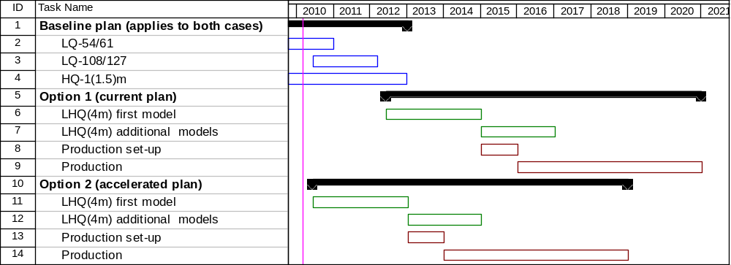
Schedule options
Option 2 makes sense in the context of:
  A determination that 120 mm aperture is a good choice for the upgrade
  A magnet R&D budget increase of ~6 M$ over 2010-12
  Additional resources for LARP in 2010-12 (from APUL)
Note: 1+5 years production schedule is just for illustration, could vary
considerably depending on specs, infrastructure, resources etc.

Slide 12
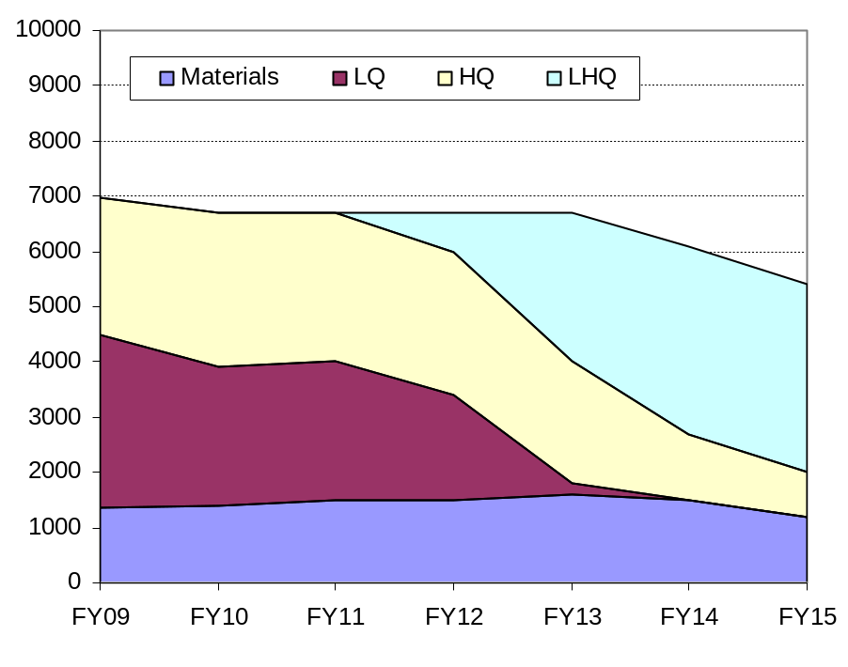
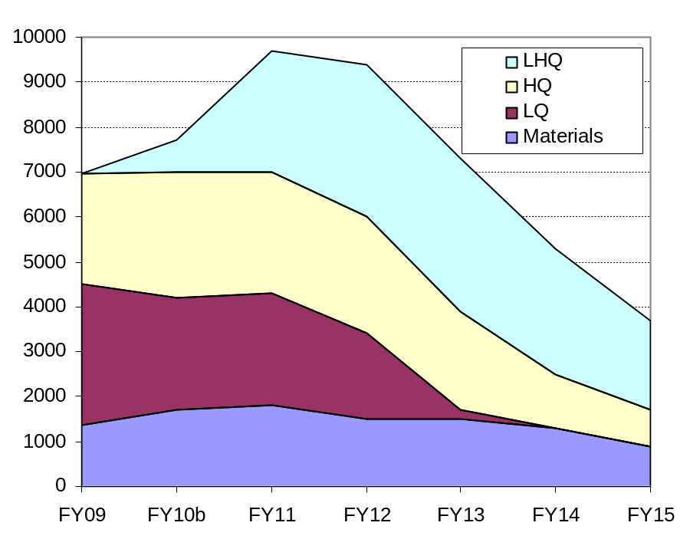
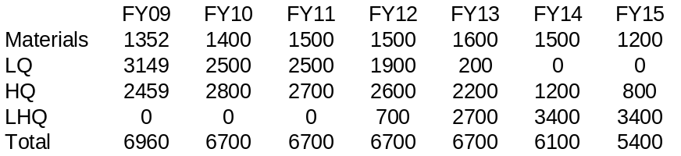
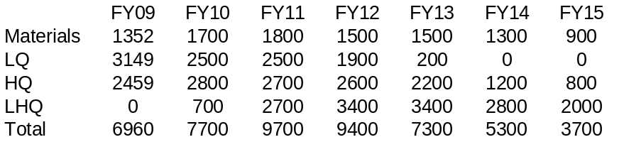
Magnet R&D Budget Profiles
Baseline (option 1)
Accelerated (option 2)

