Slide 1

Eric Prebys
LARP Program Director
1/8/09

Slide 2
Background
Summary of review findings
Partial response
  Coordination with CERN
  New initiatives
  Lumi situation
FY09 Budget
  Budgeting process
  Budget status
Planning for the future
  FY10 and beyond
  Base lining LARP
  crabs cavities?
  PS2?
  Relationship with APUL (or eq.)
E. Prebys, LARP DOE Meeting
1/8/09

Slide 3
This meeting will be both and update and an official response to the review of LARP which took place at LBNL in June 2008.
Although the report was only recently released, the contents are largely consistent with the closeout comments from the review, so there are no big surprises.
For the most part, we are in agreement with the recommendations, and feel we have taken significant steps to address them.
We have our annual LARP/CERN meeting at CERN on Jan. 14, and are interested in useful feedback for this meeting.
E. Prebys, DOE/LARP Meeting
1/8/09

Slide 4
Generally impressed with LARP progress on technical fronts.
  Particularly success of Schottky and tune tracker
As usual, reminded us that the Nb₃Sn magnet program is a world class effort which must be sufficiently supported.
  Some concern over convergence of the shell and collar efforts.
  Some specific comments on conductor choice.
Concern over communication with CERN
  Particularly regarding the JIRS work
Concern about managerial oversight
  Primarily regarding the lumi project, which was news at the time.
Although there was some frustration during the review about how LAUC (now “APUL”) was “thrown at them”, they generally felt it was a good idea and should be separately and sufficiently funded.
  The exact relationship between LARP and APUL will be one of the topics for discussion at this meeting.
E. Prebys, DOE/LARP Meeting
1/8/09

Slide 5
The bulk of the criticism in the report focused on the perceived “disconnect” between LARP and CERN regarding prioritization of LARP activities.
I believe this disconnect largely referred to activities related to the abortive attempt to get Nb₃Sn magnets into the Phase I proposal (specifically, the JIRS group).
  It's now realized this is not (and likely never was) realistic. We have suspended activities of the JIRS group, with the idea of restructuring it with an emphasis on the relationship between our magnet program and the phase II upgrade.
E. Prebys, DOE/LARP Meeting
1/8/09

Slide 6
General
  LARP Liaison: Oliver Bruening
    Serves as primary “sounding board” for LARP proposals
    De-facto veto power over LARP projects (No CERN interest= non-starter)
  US/CERN meeting
    Once a year (Coming up Jan 14)
    Discuss general priorities and strategy
    Should we do this more often?
  LTV/Toohig fellows
    Establish a significant body of “man on the street” impressions of CERN interest
E. Prebys, DOE/LARP Meeting
1/8/09

Slide 7
Specific
  Alex Ratti has been working closely with Enrico Bravin (responsible for LHC luminosity measurement) on the completion and handoff of the lumi monitor
  Rama Calaga is working closely with CERN people to coordinate crab cavity effort
  Tom Markiewicz is working closely with Ralph Assmann (head of LHC collimation) on the potential use of the rotatable collimators
  Uli Wienands has been working with Oliver Bruening and CERN in general to identify the best ways for LARP to contribute to the PS2 effort.
E. Prebys, DOE/LARP Meeting
1/8/09

Slide 8
In response to comments from the review committee and LARP members, Tom Markiewicz developed a more formal and transparent process for choosing among new initiatives.
  Proposals were weighted by a number of factors, including CERN interest (necessary), potential luminosity improvement, technical risk, and cost.
  LARP collaboration was emailed a prioritized list of approved activities along with an explanation of the procedure.
Improvements for the future
  All proposals should include a multi-year profile
Largely moot point this year
  Already badly overcommitted
  No possibility of new initiatives for FY10
E. Prebys, DOE/LARP Meeting
1/8/09

Slide 9
In spite of some missteps, LARP activities are closely coordinated with CERN.
CERN interest is a necessary condition for any LARP project.
As you will see, LARP is resource limited:
  In the absence of an unexpected funding windfall, there are more activities of interest to both LARP and CERN than we can possibly undertake.
CERN will probably be of limited use in further prioritizing LARP activities.
  We will need to make decisions based on our own risk analysis.
E. Prebys, DOE/LARP Meeting
1/8/09

Slide 10
Began bi-weekly meetings with Alex Ratti, LARP and LBL management, and Enrico Bravin (CERN) to stay up to closely monitor progress.
Working with the CERN controls group and LAFS on the software end.
  Draft requirements specification created.
Enrico and Alex working on document to formally specify the handoff to CERN.
Working with CMS luminosity group, who will contribute some manpower to do the deconvolution microcoding necessary for high intensity operation.
For more details on Lumi status, see Markiewicz talk
E. Prebys, LARP DOE Meeting
1/8/09

Slide 11
Original plan
  $2.5M
  Finished in FY07
Currently
  Spent $3.6M
  Need to spend ~$800k more
  Finished in FY09??
Bottom line
  These sorts of overruns are not unusual in real projects!
  LARP contingencies are far from sufficient to cover overruns in significant deliverables.
More about this shortly…
E. Prebys, LARP DOE Meeting
1/8/09

Slide 12
Guidance from DOE
  $13M with a 6 month continuing resolution at 84%
    .5*.84*13+.5*13 = $11.96M
  Separate money ($1-2M) found for APL planning!
General breakdown (informed by Steve’s exit advice)
  Accelerator Systems: $2.9M
  Magnet Systems: $5.0M
  Program Management: $2.1M
    Includes LTV and Toohig Fellows (of which we have 4)
  Contingency: $2M
In then end, had to give up some continency to increase Program Management
E. Prebys - LARP Meeting

Slide 13
Luminosity monitor was expected to be complete by end of FY08
  Instead had significant overruns, and needs significant funds on FY09 (original request $1M -> $800k)
  Still consider it absolutely vital for lumi to work!
Rotating collimators still a big budget item
  Still consider it important to complete a prototype this year in time to at least be considered a solution by CERN.
Strong feeling that LARP should take a leading role in crab cavity development
  Led by Rama Calaga
  Support by CERN
  General feeling that “the train is leaving the station”.
Magnet program still has to funded at a level that will insure a working magnet for the LHC Phase II upgrade
E. Prebys - LARP Meeting

Slide 14
Accelerator Systems
  Iterative process, primarily involving Wolfram, Tom, Alex, and myself, to converge on the bottom line.
    Key component: relying on labs to contribute labor in accordance with their core competencies (i.e. not charged directly to LARP)*
  Key casualty: No real money for PS2, for which there was a great deal of excitement within LARP and at CERN
    Will continue with contributed labor while we decide what to do for next year.
Magnet Systems
  Much more monolithic than AS
  L1 and L2 managers worked to stay within the budget
E. Prebys - LARP Meeting

Slide 15
Not much leeway
  Management costs determined by historical usage
  Need to honor commitments to LTV’s and Toohig fellows
  Only discretionary is Programmatic travel, which I have reduced by trying to include travel with the appropriate project.
E. Prebys - LARP Meeting

Slide 16
Crab cavities
  Original request: $700k
    Cavity design
    Cryomodule design
    LLRF
  Budget: $300k
    Rely on “off books” help in cavity design from LBNL and Jlab
    Defer cryomodule and LLRF work
PS2
  Uli Wienands developed a number of plans under various funding scenarios
  In the end, budgeted $100K, primarily for travel and M&S, assuming that most scientific time would be contributed.
E. Prebys - LARP Meeting

Slide 17
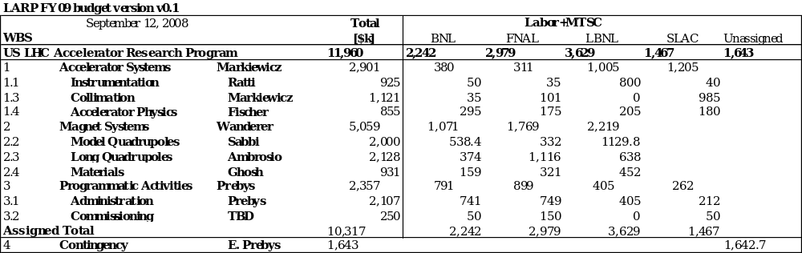
E. Prebys - LARP Meeting

Slide 18
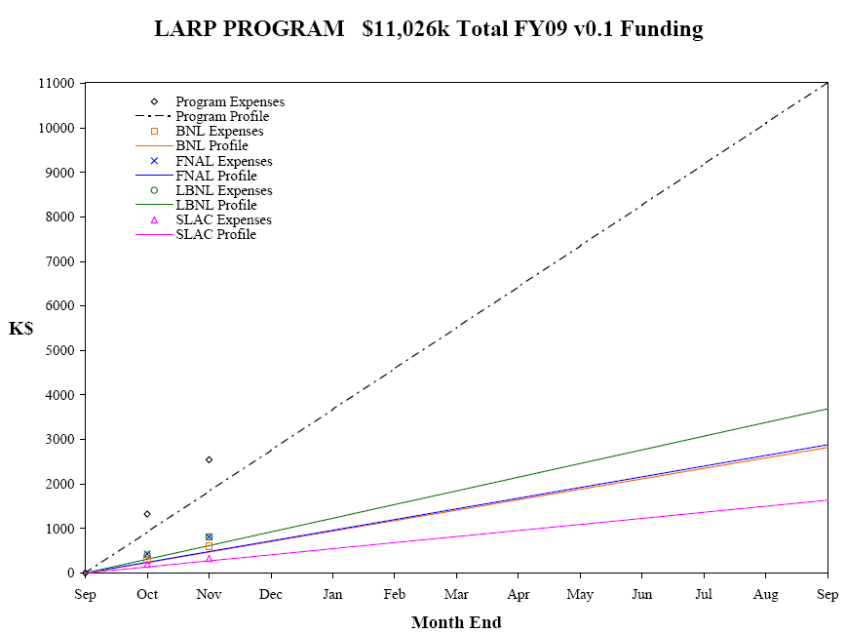
E. Prebys, LARP DOE Meeting
1/8/09

Slide 19
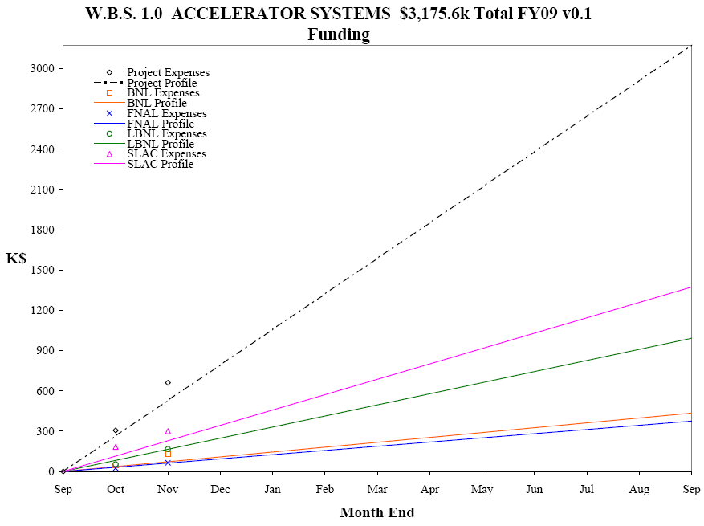
E. Prebys, LARP DOE Meeting
1/8/09

Slide 20
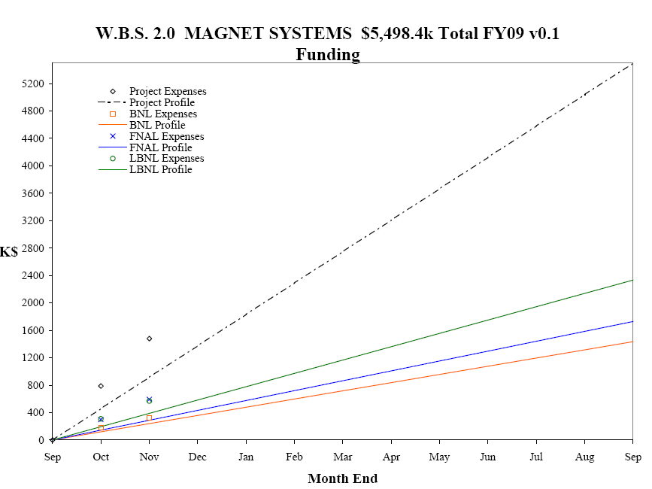
Had to make two more practice coils than planned. Fin plan in progress.
E. Prebys, LARP DOE Meeting
1/8/09

Slide 21
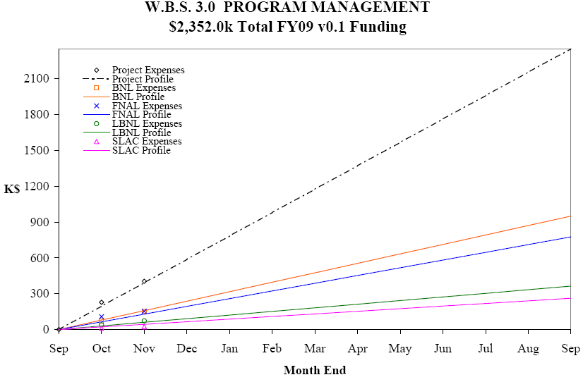
E. Prebys, LARP DOE Meeting
1/8/09

Slide 22
Lumi and rotatable collimator should ramp down considerably, allowing concentration on other significant commitments
Candidates:
  Crab cavity effort
    Crab cavities deflect the beam to compensate for crossing angle.
    Potential to dramatically increase luminosity under most likely Phase II upgrade scenario
  PS2 Activities
    CERN has requested LARP help in the design (white paper study) of the PS2, which will replace the PS for the phase II upgrade.
E. Prebys, LARP DOE Meeting
1/8/09

Slide 23
Pros
  Potentially a big impact on luminosity
  Lots of intellectual interest in US community
  Can be divided into well-defined tasks that are straightforward to monitor.
Cons
  Barring a budget windfall, LARP will not have the resources to take a significant role in construction, so must coordinate with multiple labs/countries/funding agencies.
  Current plan relies on SBIR grants
  If badly managed, potentially a black hole of resources that never accomplishes anything.
E. Prebys, LARP DOE Meeting
1/8/09

Slide 24
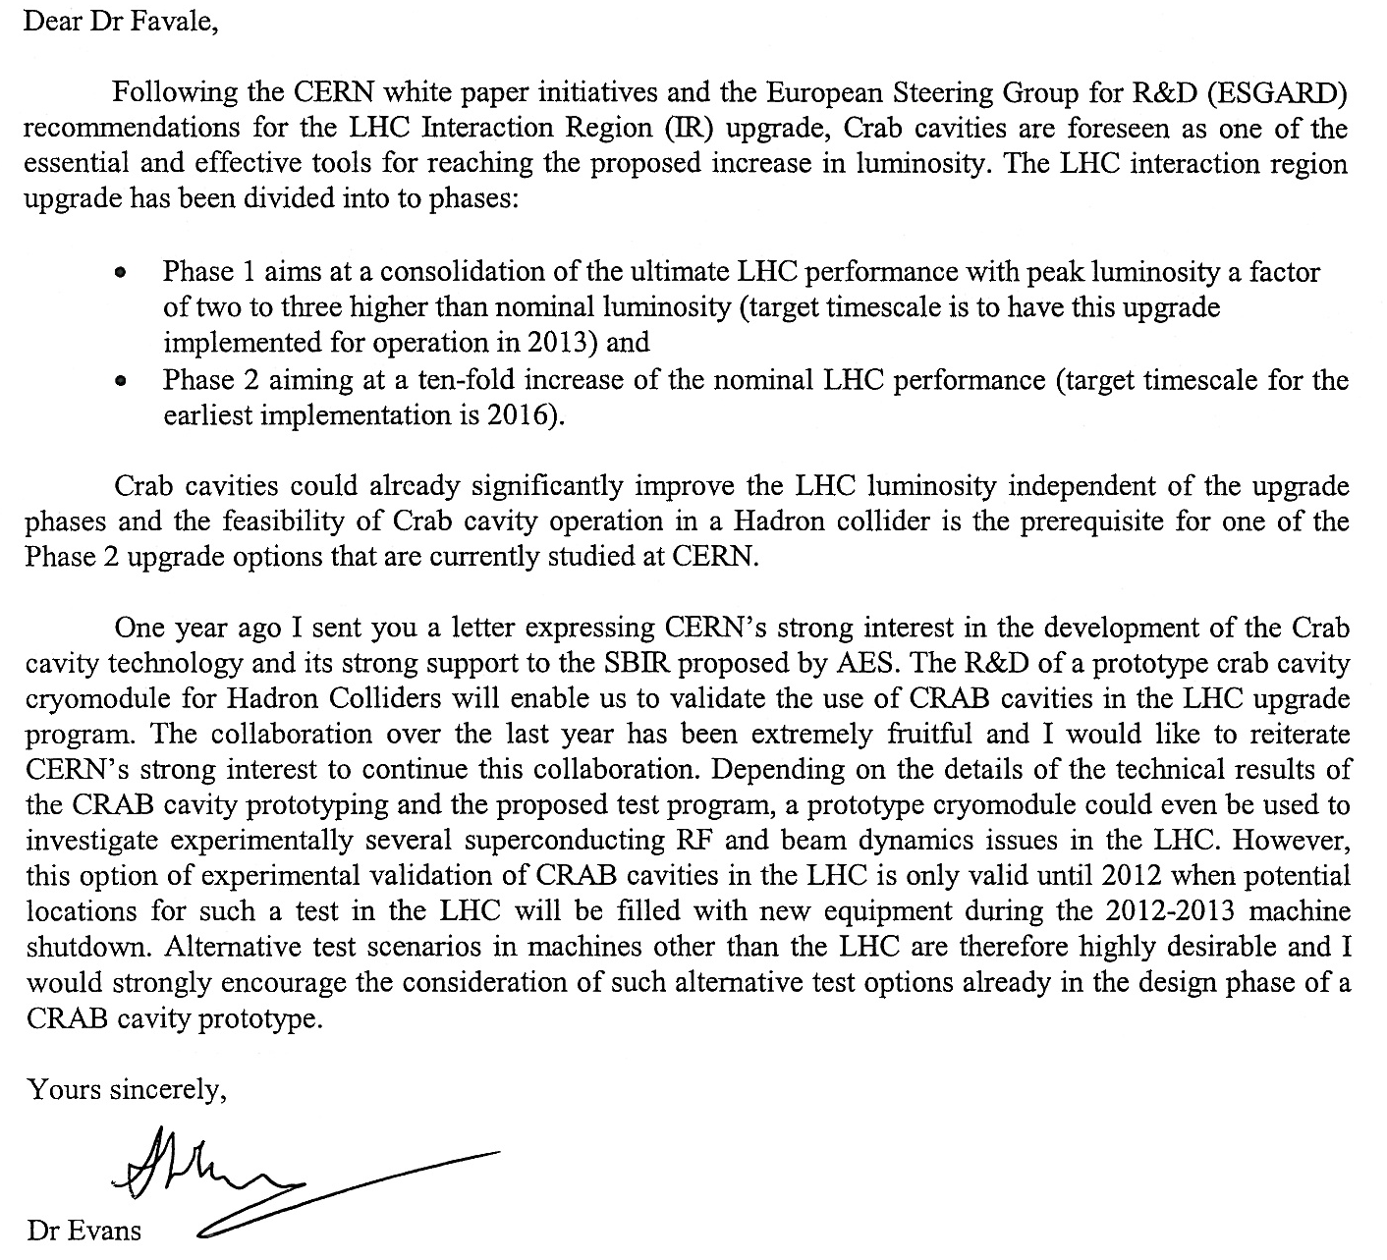
E. Prebys, LARP DOE Meeting
1/8/09

Slide 25
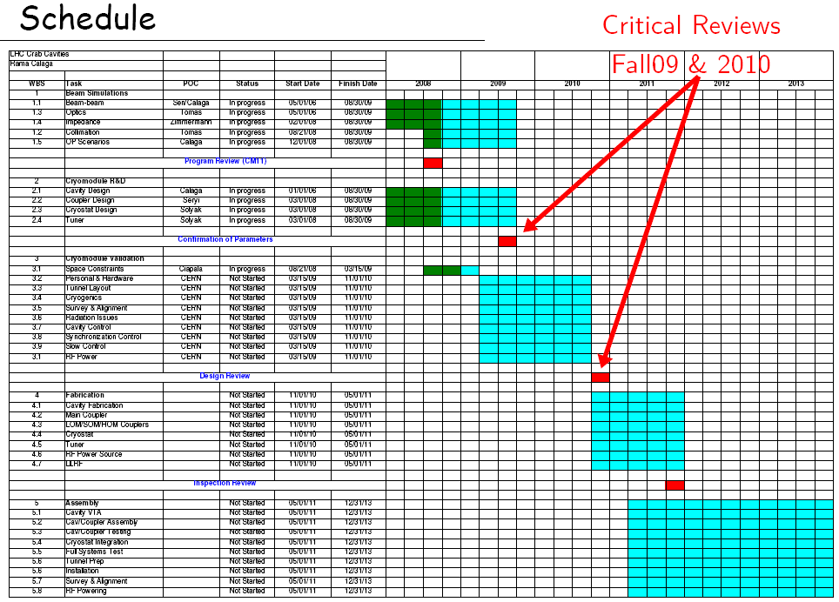
E. Prebys, LARP DOE Meeting
1/8/09

Slide 26
Pros
  Lots of opportunities to make contributions
  Well aligned with US interests and expertise, particularly Project X
  Involvement “scalable”
Cons
  Activity and goals not as well defined
  Danger of funding a lot of people to “think about stuff”
Potential areas of focus
  Injection issues
  Electron cloud
  Laser stripping?
E. Prebys, LARP DOE Meeting
1/8/09

Slide 27
Assume flat-flat budget over next year or so
  Will work on this, but don’t expect miracles
  ~$12-$13M/yr
Lumi and Rotating collimators will ramp down
  Would be naïve to assume they go to zero
Several things positioning to take their place
  Existing efforts (Ecloud, beam beam, jirs)
  New things (PS2, crab cavities)
Either PS2 or crab cavities could easily use out AS budget
  And it would be well spent.
Have to make tough choices
  Can’t do everything we want
  Strong pressure to shrink MS budget
E. Prebys, LARP PS2 Session DRAFT
10/28/2008

Slide 28
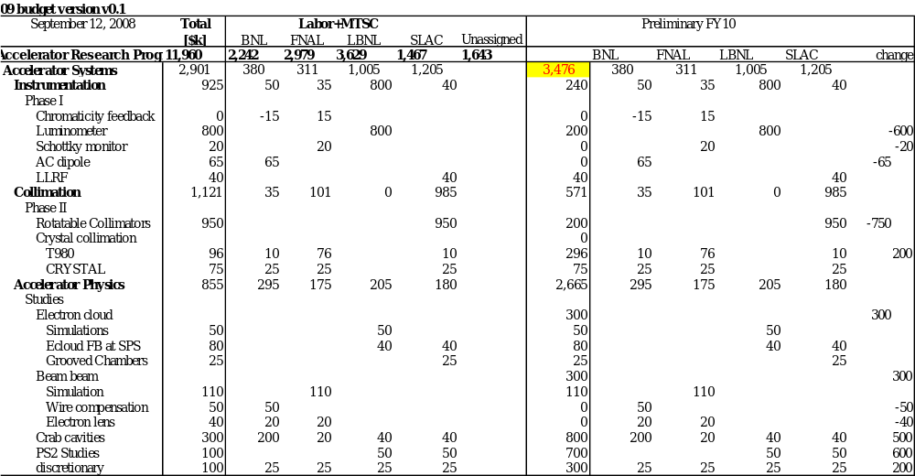
E. Prebys, LARP DOE Meeting
1/8/09

Slide 29
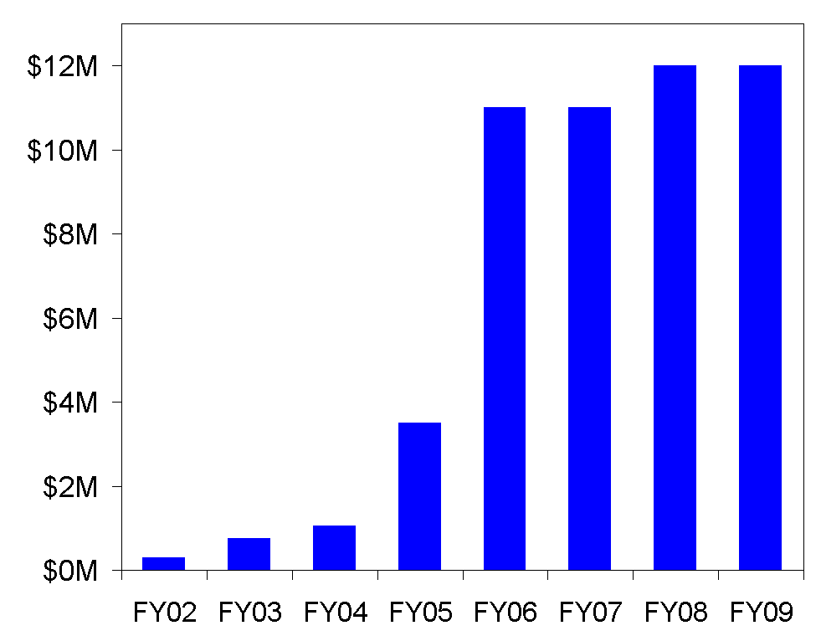
LARP had a period of rapid growth in the earlier yeas, which led to some over- optimism
E. Prebys, LARP DOE Meeting
1/8/09

Slide 30
Official LARP change control policies essentially ignored.
No consistent rules for dealing with burdens at different labs
Budget and schedule not integrated
  Earned value reporting must be done by hand, if it’s done at all
No systematic way of dealing with different types of contingency
  “deliverables” should have significant assigned contingency
  R&D projects should have “scope contingency”, possibly adjusted by an uncommitted unassigned contingency pool.
No formal accounting for “off books” contributions from member labs.
Developing future budget profile a nightmare.
E. Prebys, LARP DOE Meeting
1/8/09

Slide 31
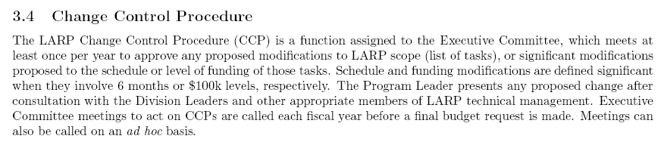
From LARP “Management Plan”:
Problem
  LARP doesn’t even have an informal base line
  Large changes can sneak in at the annual budget without being noticed
  Example: in order to see the budget and schedule problems with the lumi monitor, it’s necessary to forensically examine old task sheets.
E. Prebys, LARP DOE Meeting
1/8/09

Slide 32
Reminder: the entire AS + MS budget is $3M+$5M, which is ~10+20 FTE’s or so.
We get a significant amount of additional scientific effort contributed in two ways:
  Explicit LHC work supported through the unassigned “core” program
    ~6 FTE’s at SLAC
    ~6 FTE’s at FNAL
    Some CBP time from LBNL
  Time which benefits LARP through common interest
    ~2 FTE’s at BNL working on RHIC projects which benefit the LHC as well
This is primarily for the AS, for which it is a large part.
E. Prebys, LARP DOE Meeting
1/8/09

Slide 33
What is the model for “off books” contributions to LARP?
  None?
    In the absence increased funding, LARP would have to dramatically reduce its activities
  Ongoing?
    Could all scientific time be supported out of core budgets?
  “Venture capital”
    Could some amount of commitment out of the core program be expected to develop proposals to the point where LARP could fund them.
E. Prebys, LARP DOE Meeting
1/8/09

Slide 34
Put LARP budget and schedule into a single MS Project file
Define burdens and labor rates correctly for the four member labs
  Eg, “BNL engineer”, “SLAC scientist”, etc…
For every labor category, have an equivalent “off books” category with an appropriately PC name (“common effort”?), which is not included in the normal roll-up, but can be rolled up separately.
Progress is updated monthly by designated L2 and L3 managers.
Implement formal change control and change logging.
Project used to formulate long term plan and budget profile.
E. Prebys, LARP DOE Meeting
1/8/09

Slide 35
Ken Domann has agreed to translate the currrent WBS chart, as well as other information, into a fully loaded MS Project file.
Budget expenses will be charged against rolled project line items
  Need to identify FNAL person to do this once a month
For each subtask, a responsible person will be identified.
  Ken will email him an Excel spreadsheet each month on which he will report progress on his tasks and milestones
Ken will generate standard earned value reports on a monthly basis.
For schedule or budget changes beyond those specified on 3.4, we will generate proper CR’s which must be approved by the Executive Committee(?)
E. Prebys, LARP DOE Meeting
1/8/09

Slide 36
Currently translating budget into this format.
Have the tools fully in place by our April collaboration meeting.
  Use as a tool for real time budget discussion.
E. Prebys, LARP DOE Meeting
1/8/09

Slide 37
Get lumi monitor working prior to 2009 start up
  LARP reputation depends on it
Protect core magnet program
  Insure that LARP produces a prototype Nb₃Sn magnet on a time scale that makes it a viable choice for the Phase II upgrade.
Complete rotating collimator prototype
  This has been a significant LARP activity, and it’s important that we produce a prototype on a time scale that will allow it to be part of the collimation solution.
Continue to support Toohig Fellows and Long Term Visitors
  Very important link to CERN
  LARP supported visitors making significant and well received contributions.
Choose from remaining AS activities based on a risk reward analysis
E. Prebys, LARP DOE Meeting
1/8/09

Slide 38
LARP has done and continues to do good work
  eg, 3 invited talks and 36 contributions to PAC09
The scope has grown beyond where it can be effectively managed in the informal way in which it began.
We are taking steps to formalize the baseline and develop a credible long term plan.
E. Prebys, LARP DOE Meeting
1/8/09

