Slide 1

Eric Prebys
LARP Program Director
12/30/08

Slide 2
DOE “mini review”
  1/8/09, Germantown
US/CERN meeting
  1/14/09, CERN
Important Issues
  Response to recently released June review report
  Lumi monitor situation
  Status of magnet program
  Coordination with CERN
  Future activities
    Crab cavities?
    PS2?
  Schedule and budget oversight
E. Prebys, LARP Exectutive Meeting
12/30/08

Slide 3
Generally impressed with LARP progress on technical fronts.
  Particularly success of Schottky and tune tracker
As usual, reminded us that the Nb₃Sn magnet program is a world class effort which must be sufficiently supported.
  Some concern over convergence of the shell and collar efforts.
Concern over communication with CERN
  Particularly regarding the JIRS work
Concern about managerial oversight
  Primarily regarding the lumi project, which was news at the time.
Although there was some frustration during the review about how LAUC (now “APUL”) was “thrown at them”, they generally felt it was a good idea and should be separately and sufficiently funded.
E. Prebys, LARP Exectutive Meeting
12/30/08

Slide 4
The "disconnect" with CERN I believe largely referred to activities related to the abortive attempt to get Nb₃Sn magnets into the Phase I proposal (specifically,
the JIRS group).
  It's now realized this is not (and never was) realistic. We have suspended activities of the JIRS group, with the idea of restructuring it with an emphasis on the relationship between our magnet program and the phase II upgrade.
E. Prebys, LARP Exectutive Meeting
12/30/08

Slide 5
General
  LARP Liaison: Oliver Bruening
    Serves as primary “sounding board” for LARP proposals
    De-facto veto power over LARP projects (No CERN interest= non-starter)
  US/CERN meeting
    Once a year (Coming up Jan 14)
    Discuss general priorities and strategy
    Should we do this more often?
  LTV/Toohig fellows
    Establish a significant body of “man on the street” impressions of CERN interest
E. Prebys, LARP Exectutive Meeting
12/30/08

Slide 6
Specific
  Alex Ratti has been working closely with Enrico Bravin (responsible for LHC luminosity measurement) on the completion and handoff of the lumi monitor
  Rama Calaga is working closely with CERN people to coordinate crab cavity effort
  Tom Markiewicz is working closely with Ralph Assmann (head of LHC collimation) on the potential use of the rotatable collimators
  Uli Wienands has been working with Oliver Bruening and CERN in general to identify the best ways for LARP to contribute to the PS2 effort.
E. Prebys, LARP Exectutive Meeting
12/30/08

Slide 7
In response to comments from the review committee and LARP members, Tom Markiewicz developed a more formal and transparent process for choosing amongst new initiatives.
  Proposals were weighted by a number of factors, including CERN interest (necessary), potential luminosity improvement, technical risk, and cost.
  LARP collaboration was emailed a prioritized list of approved activities along with an explanation of the procedure.
Improvements for the future
  All proposals should include a multi-year profile
Largely moot point this year
  Already badly overcommitted
  No possibility of new initiatives for FY10
E. Prebys, LARP Exectutive Meeting
12/30/08

Slide 8
Began bi-weekly meetings with Alex Ratti, LARP and LBL management, and Enrico Bravin (CERN) to stay up to closely monitor progress.
Working with the CERN controls group and LAFS on the software end.
  Draft requirements specification created.
Enrico and Alex working on document to formally specify the handoff to CERN.
Working with CMS luminosity group, who will contribute some manpower to do the deconvolution microcoding necessary for high intensity operation.
E. Prebys, LARP Exectutive Meeting
12/30/08

Slide 9
Original plan
  $2.5M
  Finished in FY07
Currently
  Spent $3.6M
  Need to spend ~$800k more
  Finished in FY09??
Bottom line
  These sorts of overruns are not unusual in real projects!
  LARP contingencies are far from sufficient to cover overruns in significant deliverables.
Proposal: develop a standing relationship with APL
  Will be discussed in detail at CM11.
E. Prebys, LARP Exectutive Meeting
12/30/08

Slide 10
No consistent rules for dealing with burdens at different labs
Budget and schedule not integrated
  Earned value reporting must be done by hand, if it’s done at all
No systematic way of dealing with different types of contingency
  “deliverables” should have significant assigned contingency
  R&D projects should have “scope contingency”, possibly adjusted by an uncommitted unassigned contingency pool.
No formal accounting for “off books” contributions from member labs.
LARP change control policies pretty much ignored.
Developing future budget profile a nightmare.
E. Prebys, LARP Exectutive Meeting
12/30/08

Slide 11
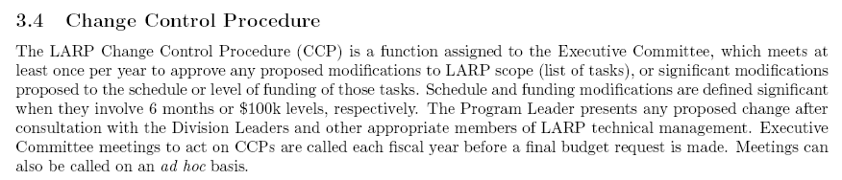
From LARP “Management Plan”:
Problem
  LARP doesn’t even have an informal base line
  Large changes can sneak in at the annual budget without being noticed
  Example: in order to see the budget and schedule problems with the lumi monitor, it’s necessary to forensically examine old task sheets.
E. Prebys, LARP Exectutive Meeting
12/30/08

Slide 12
Put LARP budget and schedule into a single MS Project file
Define burdens and labor rates correctly for the four member labs
  Eg, “BNL engineer”, “SLAC scientist”, etc…
For every labor category, have an equivalent “off books” category with an appropriately PC name (“common effort”?), which is not included in the normal roll-up, but can be rolled up separately.
Progress is updated monthly by designated L2 and L3 managers.
Implement formal change control and change logging.
Project used to formulate long term plan and budget profile.
E. Prebys, LARP Exectutive Meeting
12/30/08

Slide 13
Ken Domann has agreed to translate the currrent WBS chart, as well as other information, into a fully loaded MS Project file.
Budget expenses will be charged against rolled project line items
  Need to identify FNAL person to do this once a month
For each subtask, a responsible person will be identified.
  Ken will email him an Excel spreadsheet each month on which he will report progress on his tasks and milestones
Ken will generate standard earned value reports on a monthly basis.
For schedule or budget changes beyond those specified on 3.4, we will generate proper CR’s which must be approved by the Executive Committee(?)
E. Prebys, LARP Exectutive Meeting
12/30/08

Slide 14
Begin translating our existing budget into this format immediately
  Be able to show something at our Jan 8 DOE meeting
Have the tools fully in place by our April collaboration meeting.
  Use as a tool for real time budget discussion.
E. Prebys, LARP Exectutive Meeting
12/30/08

Slide 15
Get lumi monitor working prior to 2009 start up
  LARP reputation depends on it
Protect core magnet program
  Insure that LARP produces a prototype Nb3Sn magnet on a time scale that makes it a viable choice for the Phase II upgrade.
Complete rotating collimator prototype
  This has been a significant LARP activity, and it’s important that we produce a prototype on a time scale that will allow it to be part of the collimation solution.
Continue to support Toohig Fellows and Long Term Visitors
  Very important link to CERN
  LARP supported visitors making significant and well received contributions.
E. Prebys, LARP Exectutive Meeting
12/30/08

Slide 16
Lumi and rotatable collimator should ramp down considerably, allowing concentration on other significant commitments
Candidates:
  Crab cavity effort
    Crab cavities deflect the beam to compensate for crossing angle.
    Potential to dramatically increase luminosity under most likely Phase II upgrade scenario
  PS2 Activities
    CERN has requested LARP help in the design (white paper study) of the PS2, which will replace the PS for the phase II upgrade.
E. Prebys, LARP Exectutive Meeting
12/30/08

Slide 17
Pros
  Potentially a big impact on luminosity
  Lots of intellectual interest in US community
  Can be divided into well-defined tasks that are straightforward to monitor.
Cons
  Barring a budget windfall, LARP will not have the resources to take a significant role in construction, so must coordinate with multiple labs/countries/funding agencies.
  Current plan relies on SBIR grants
  If badly managed, potentially a black hole of resources that never accomplishes anything.
E. Prebys, LARP Exectutive Meeting
12/30/08

Slide 18
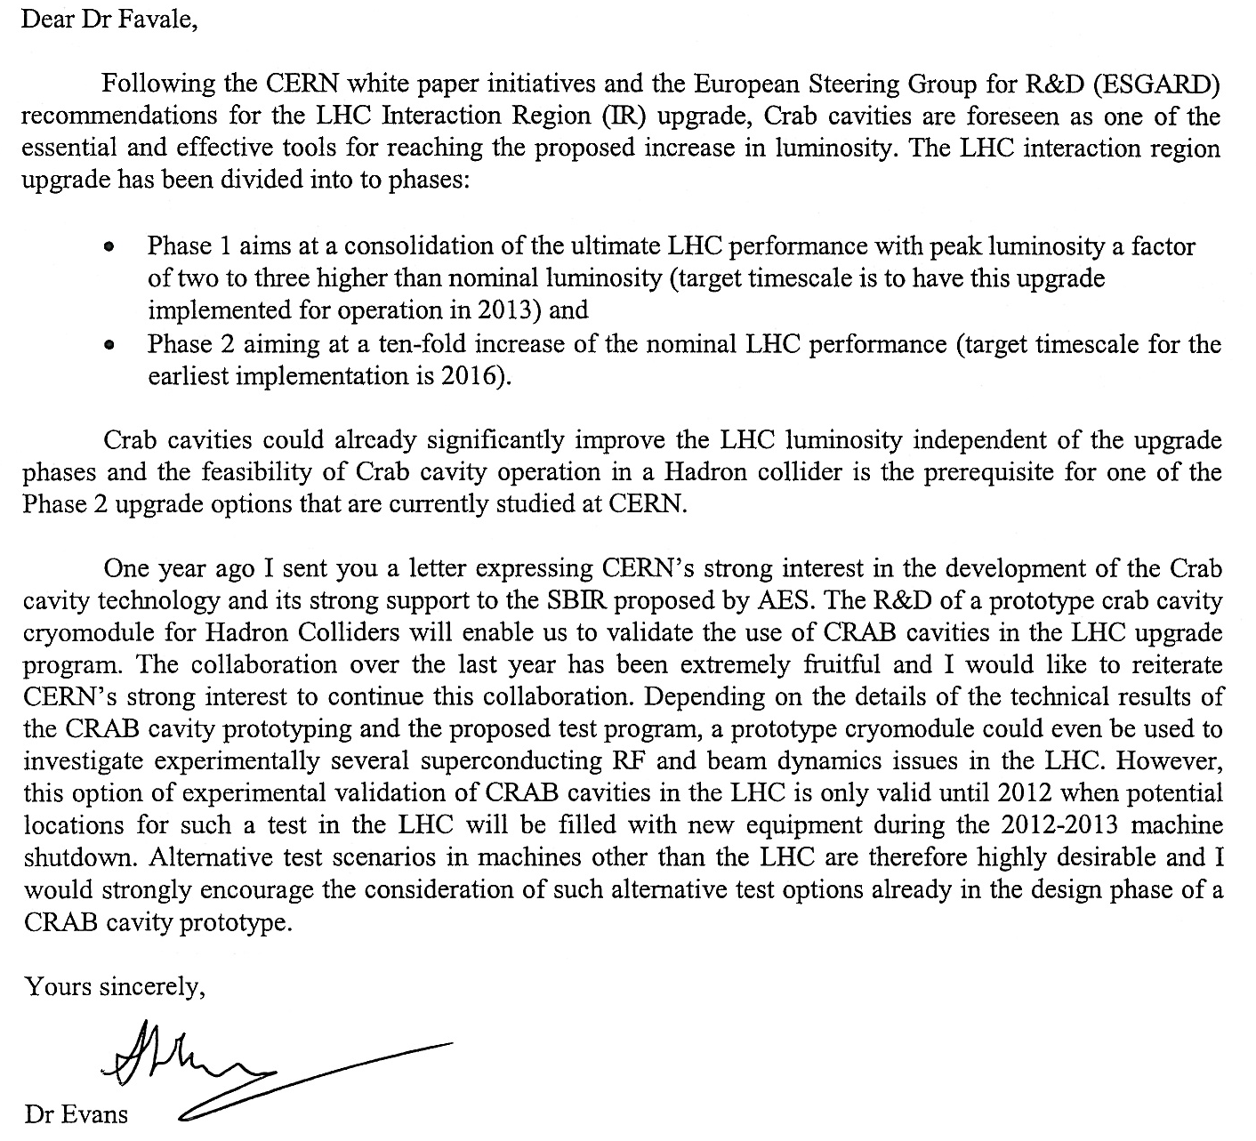
E. Prebys, LARP Exectutive Meeting
12/30/08

Slide 19
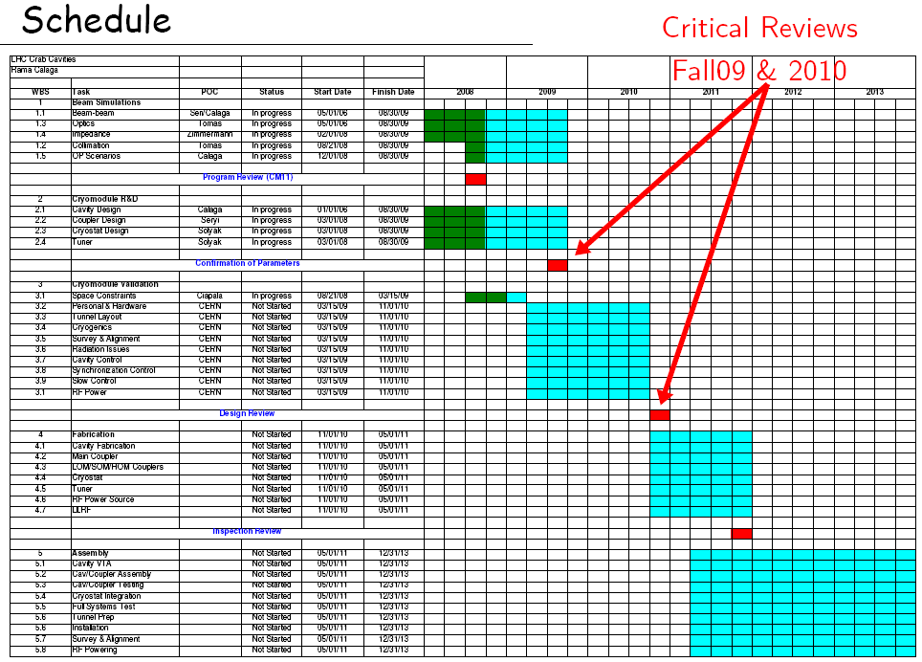
E. Prebys, LARP Exectutive Meeting
12/30/08

Slide 20
Pros
  Lots of opportunities to make contributions
  Well aligned with US interests and expertise, particularly Project X
  Involvement “scalable”
Cons
  Activity and goals not as well defined
  Danger of funding a lot of people to “think about stuff”
Potential areas of focus
  Injection issues
  Electron cloud
  Laser stripping?
E. Prebys, LARP Exectutive Meeting
12/30/08

Slide 21
LARP activities are limited only by resources
  There is more interest both within the collaboration and at CERN than we can possibly support
  Everything we are working on is already of interest to CERN, so they will probably be of little use In further prioritizing our efforts.
  We must evaluate the magnet program to determine whether it can meet it’s goals within the projected funding profile (ie flat).
    We will support the magnet program at the expense of some AS activities, if necessary.
This will be a year of difficult choices
We are trying to put a more formal structure in place to help us make informed decisions and to provide better oversight.
E. Prebys, LARP Exectutive Meeting
12/30/08

Slide 22

E. Prebys, LARP Exectutive Meeting
12/30/08

Slide 23
LARP research in Nb3Sn magnets is regarded as one of the most important developments in U.S. accelerator technology. The panel felt that LARP has been highly effective as an incubator of new ideas. The research activities, which leverage U.S. expertise, were found to be interesting, relevant, and professionally executed.
E. Prebys, LARP Exectutive Meeting
12/30/08

Slide 24
The reviewers expressed disappointment in the delay of ~12 months in the delivery of the luminosity monitors to CERN, which may be an indication of an organizational/management weakness in the current LARP model.
The failure to have delivered the luminosity monitors to CERN on time reflects poorly on LARP’s reputation, and certainly points to a potential weakness in the LARP system.
The work on rotatable beam collimators is continuing and the design appears ready to go, but CERN’s goals, requirements and overall schedule are unclear.
E. Prebys, LARP Exectutive Meeting
12/30/08

Slide 25
LARP’s relationship with CERN, as result of its ad hoc arrangement, is potentially problematic. The research planning of LARP and of CERN appear to be somewhat disjointed
if LARP research activities were not properly prioritized, there would not be sufficient resources available to study the issue of coil variability in detail, which could adversely impact the HQ effort to achieve accelerator-quality magnets.
The LARP accelerator program consists of many diverse activities, and, as indicated above, the transparency of the process that leads to the selection topics for research is a concern.
E. Prebys, LARP Exectutive Meeting
12/30/08

