Slide 1
Familiarize Executive Committee with our plans to prepare the budget and 5 year plan for the July 13-14 review
Begin the dialog regarding requests for “off books” labor contributions from labs.
6/5/09

Slide 2
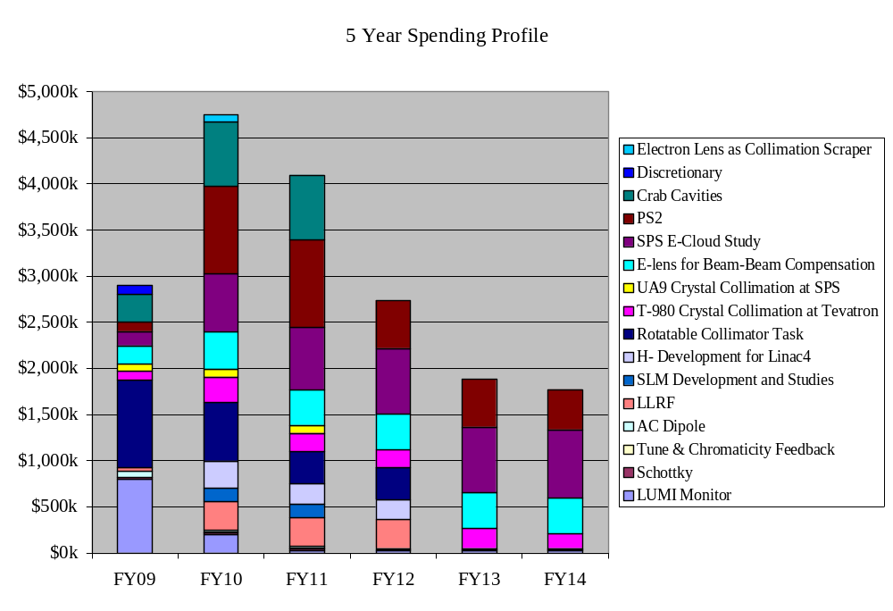
6/5/09

Slide 3
High Priority
  Finish what we started (Lumi, rotatable collimators)
  E-cloud feedback for SPS
  PS2!
  Sync light gap monitor (small)
  Hollow e-lens as collimator (relatively new)
Low Priority
  Crabs (pending fall review)
  LLRF (might be misunderstanding on S. Myers’ part)
  E-lens as beam-beam compensator
  H- activities (Linac 4 people might disagree)
6/5/09

Slide 4
Turned of H- development
Moved all T980 labor to FNAL
Reduce crabs to Rama + travel
Eliminated e-lens for beam beam
Increased e-lens as collimator to 1FTE for next three years.
Shifted a fractional FTE for next two years in PS2 effort
E-cloud at SPS: Moved 1FTE (LARP and contributed) from FY10 and FY11 to FY13 and FY14
6/5/09

Slide 5
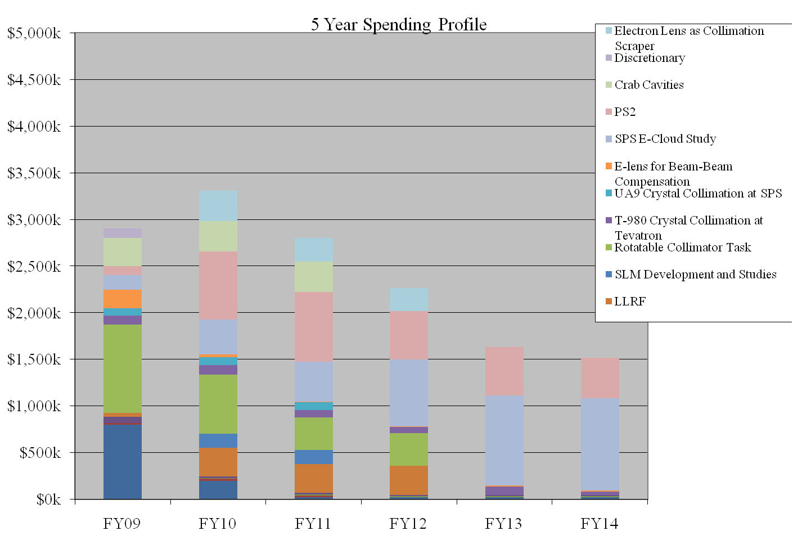
6/5/09

Slide 6
Much progress in defining LARP program to “demonstrate technology”
General plan
  Complete existing LQ (90 mm, 4 m) magnet (s?) and HQ (130 mm)
  Build ~4 120 mm x 2 m 200 T/m “QA” magnets to study field quality.
Budget being determined
Big questions:
  Exactly what should be demonstrated by QA magnets (working on spec sheet)
  How far to go with collar design
    Lots of pressure from DOE to halt now
    Strong statement from CERN that they’d like to see the LQC
    Maybe compromise?: buy tooling and wait and see.
6/5/09

Slide 7
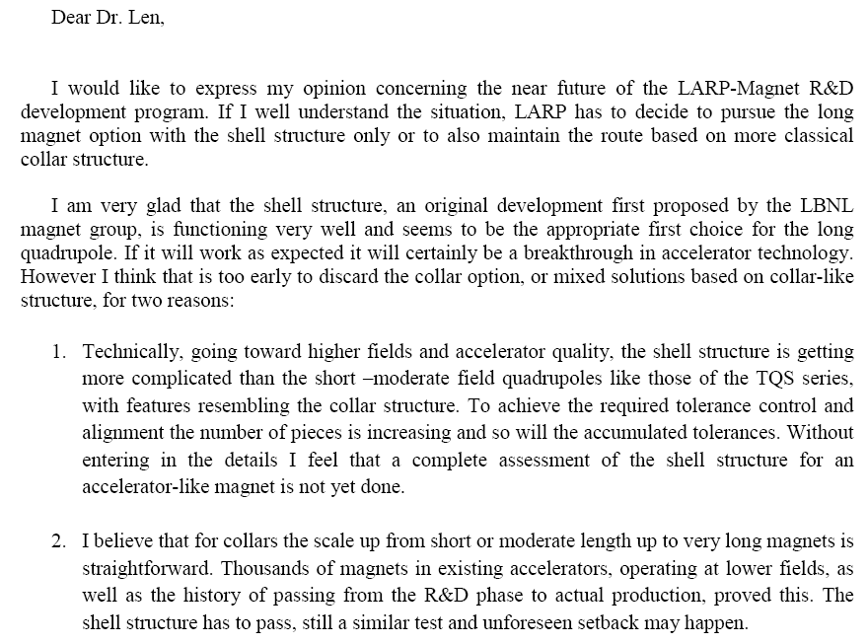
6/5/09

Slide 8
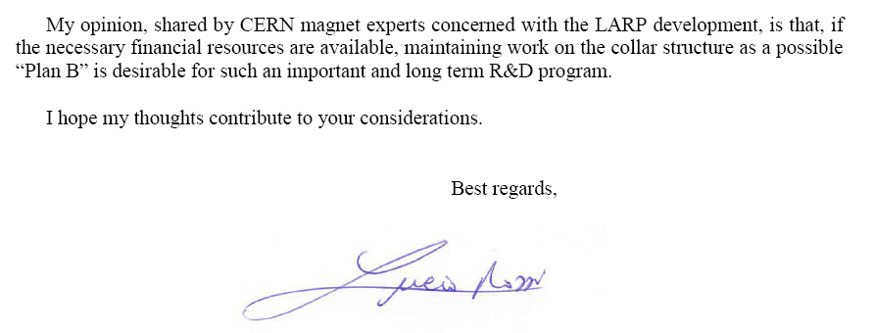
6/5/09

