Slide 1

Eric Prebys
LARP Program Director
5/13/09

Slide 2
Proposed in 2003 to coordinate efforts at US labs
related to the LHC accelerator (as opposed to CMS or ATLAS)
  Originally FNAL, BNL, and LBNL
  SLAC joined shortly thereafter
  Some work (AC Dipole) supported at UT Austin
LARP Goals
  Advance International Cooperation in High Energy Accelerators
  Advance High Energy Physics
    By helping the LHC integrate luminosity as quickly as possible
  Advance U.S. Accelerator Science and Technology
LARP includes projects related to initial operation, but a significant part of the program concerns the LHC upgrades
This talk will use LARP to frame the discussion of LHC accelerator research, but will included topics which are outside of LARP
E. Prebys, New Directions Workshop
5/13/09

Slide 3
Initial operation
  Ramp up to 1x10³⁴ cm⁻²s⁻¹
Phase I upgrade
  After ~2 years of operation (~2013)
  Replace 70 mm triplet quads with 120 mm quads
  β* goes from 50->25 cm
  Luminosity goes to 2.5x10³⁴ cm⁻²s⁻¹
Phase II upgrade
  Second half of next decade (nominally 2018)
  Luminosity goal: 1x10³⁵
  Details still under study
    New technology for larger aperture quads (Nb₃Sn)
    crab cavities?
    Improved injector chain (PS2 + SPL)
E. Prebys, New Directions Workshop
5/13/09

Slide 4
Proton flux / Beam power
50 MeV
Linac2
Linac4
160 MeV
1.4 GeV
PSB
SPL’
RCPSB
SPL
~ 5 GeV
26 GeV
PS
PS2 (PS2+)
Linac4: PSB injector (160 MeV)
SPL: Superconducting Proton Linac (~ 5 GeV)
SPL’: RCPSB injector
(0.16 to 0.4-1 GeV)
RCPSB: Rapid Cycling PSB
(0.4-1 to ~ 5 GeV)
PS2: High Energy PS
(~ 5 to 50 GeV – 0.3 Hz)
PS2+: Superconducting PS
(~ 5 to 50 GeV – 0.3 Hz)
SPS+: Superconducting SPS
(50 to1000 GeV)
DLHC: “Double energy” LHC
(1 to ~14 TeV)
40 – 60 GeV
Output energy
450 GeV
SPS
SPS+
1 TeV
LHC
DLHC
7 TeV
~ 14 TeV
M. Benedikt, R. Garoby, CERN DG
E. Prebys, New Directions Workshop
5/13/09

Slide 5
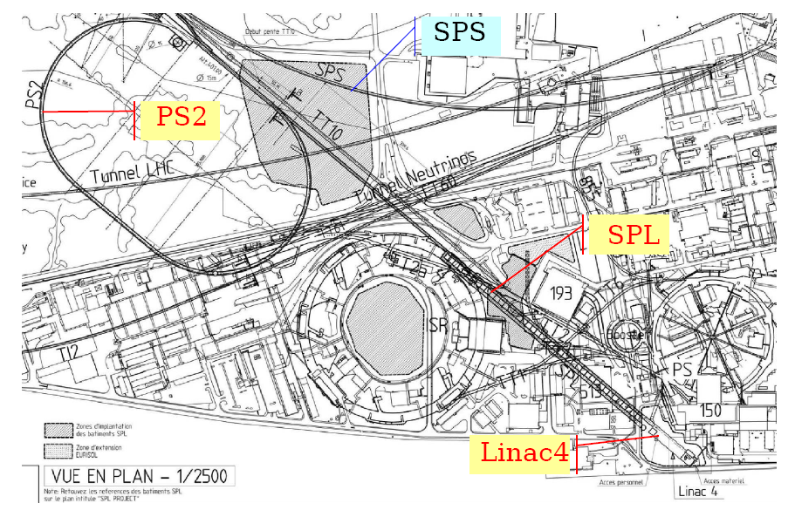
E. Prebys, New Directions Workshop
5/13/09

Slide 6
Accelerator Systems
  Accelerator physics
  Instrumentation and other hardware
    Collimation
    LLRF
    Crab cavities?
Magnet Systems
  Goal: demonstrate Nb₃Sn as a viable technology for the ultimate upgrade of the LHC
Programmatic Activities
  Program management, travel, meetings, etc
  Toohig Fellowship
  Long Term Visitor (LTV) program
E. Prebys, New Directions Workshop
5/13/09

Slide 7
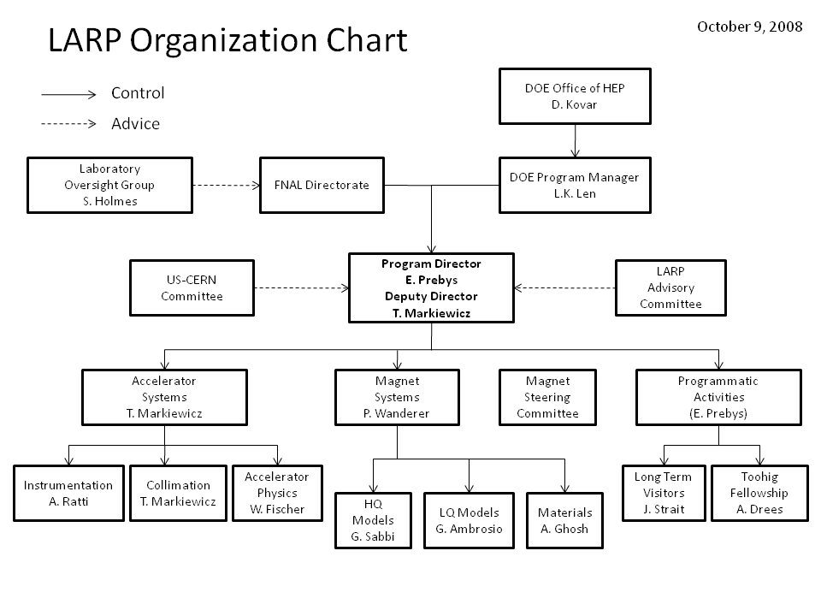
E. Prebys, New Directions Workshop
5/13/09

Slide 8
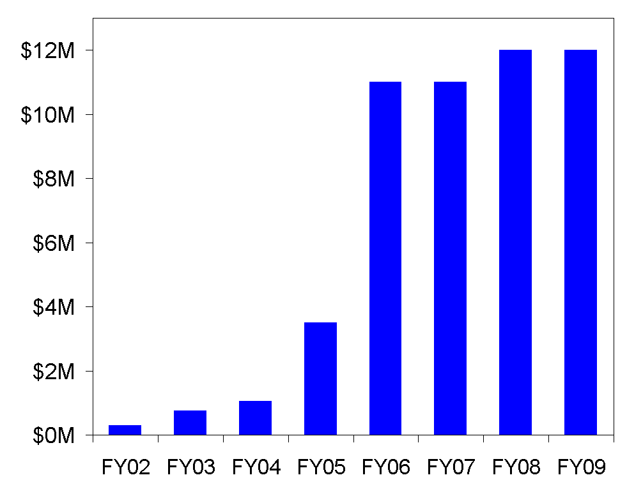
Supported at a similar level by core programs at laboratories
E. Prebys, New Directions Workshop
5/13/09

Slide 9

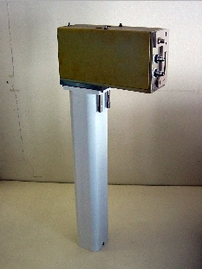
Schottky detector
  Used for non-perturbative tune measurements (+chromaticities, momentum spread and transverse emmitances)
Tune tracking
  Implement a PLL with pick-ups and quads to lock LHC tune
  Investigating generalization to chromaticity tracking
AC dipole
  US AC dipole to drive beam
  Measure both linear and non-linear
  beam optics
Luminosity monitor
  High radiation ionization detector
  integrated with the LHC neutral beam
  absorber (TAN) at IP 1 and 5.
E. Prebys, New Directions Workshop
5/13/09

Slide 10
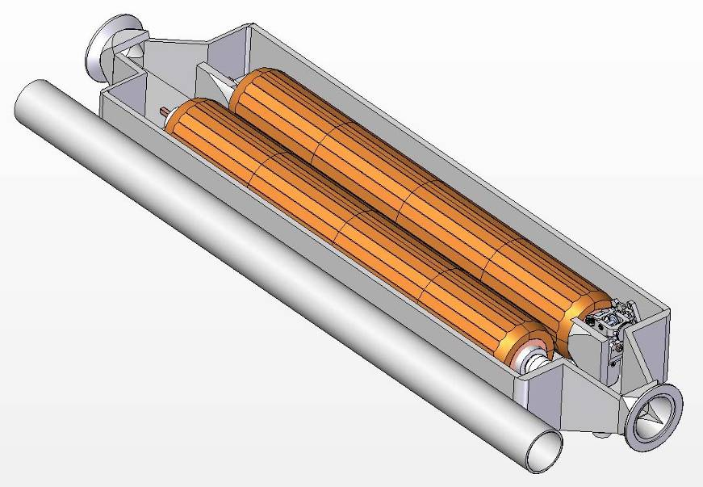
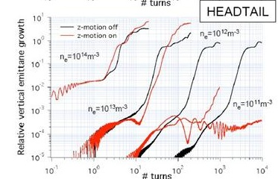
Rotating collimators
  Can rotate different facets into
  place after catastrophic beam
  incidents
  Aim for prototype in FY09
Crystal Collimation (See Mokhov talk)
  CRYSTAL Collaboration
  T980
Beam-beam studies
  General simulation
  Electron lens (See Shiltsev talk)
  Wire compensation
Electron cloud studies
  Study effects of electron cloud in
  LHC and injector chain (see Furman
  talk)
E. Prebys, New Directions Workshop
5/13/09

Slide 11
Magnet groups at FNAL, BNL, and LBNL working to demonstrate Nb₃Sn magnet appropriate for use in the LHC Phase II upgrade.
Currently pushing all parameters
  Long Quad (LQ): 4m quad with 90 mm aperture
  High field Quad (HQ): 1m quad with 130 mm aperture
“Deliverable” will be ~4 “accelerator quality” magnets (QA) matched to LHC Phase I aperture
  Length: 2 m
  Aperture: 120 mm
  Gradient: >200 T/m
Accelerator physics questions:
  Optical design
  Field quality requirements
  Beam loss/heat loading issues
  Radiation damage.
E. Prebys, New Directions Workshop
5/13/09

Slide 12
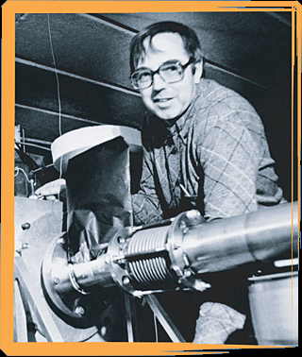
Long Term Visitors program
  Pay transportations and living expenses for US scientists working at CERN for extended periods (at least 6 months/year)
  Extremely successful at integrating people into CERN operations
  Interested parties coordinate with a CERN sponsor and apply to the program (Jim Strait)
Toohig Fellowship
  Named for Tim Toohig
  Open to recent PhD’s
  Successful candidates divide their
  time between CERN and one of
  the four host labs.
  Currently 3 Toohig Fellows in
  program
E. Prebys, New Directions Workshop
5/13/09

Slide 13
Beam-beam
  Continue simulations
  Electron lenses? (see Shiltsev talk)
Electron cloud
  Work traditionally focused on SPS, in the context of developing parametrized description for LLRF feedback (see Furman talk)
  Now applied to PS2 (more about that in a minute)
Collimation
  Crystal collimation (see Mokhov talk)
  Hollow electron beams (Shiltsev talk)
  Collimation in general
    Existing system known to be inadequate.
    Lots to learn with first beam to inform further plans
*mostly covered in other talks
E. Prebys, New Directions Workshop
5/13/09

Slide 14

NB: The reward for success in LARP is a termination of funding
  Expected that projects will be taken over by someone else
Lots of interesting measurements to be made with LARP systems at the LHC
  Schottky detector: Installed and working, including versatile interface for CCC
  AC Dipole: Precision measurement of linear and nonlinear optics
  Lumi detector
    LARP (LBNL) responsibility ends with relative bunch by bunch luminosity. Still interested in:
      Absolute luminosity (working with CMS lumi group)
      Crossing angle analysis.
E. Prebys, New Directions Workshop
5/13/09

Slide 15
Energy deposition issues for the Nb₃Sn magnets
  Heat load
  Radiation damage
  Fits naturally into FNAL energy deposition expertise
Issues related to Phase II optics design
  Aperture requirements
  Field quality and stability requirements
    e.g. effects of Nb₃Sn “flux-jump” problems.
E. Prebys, New Directions Workshop
5/13/09

Slide 16
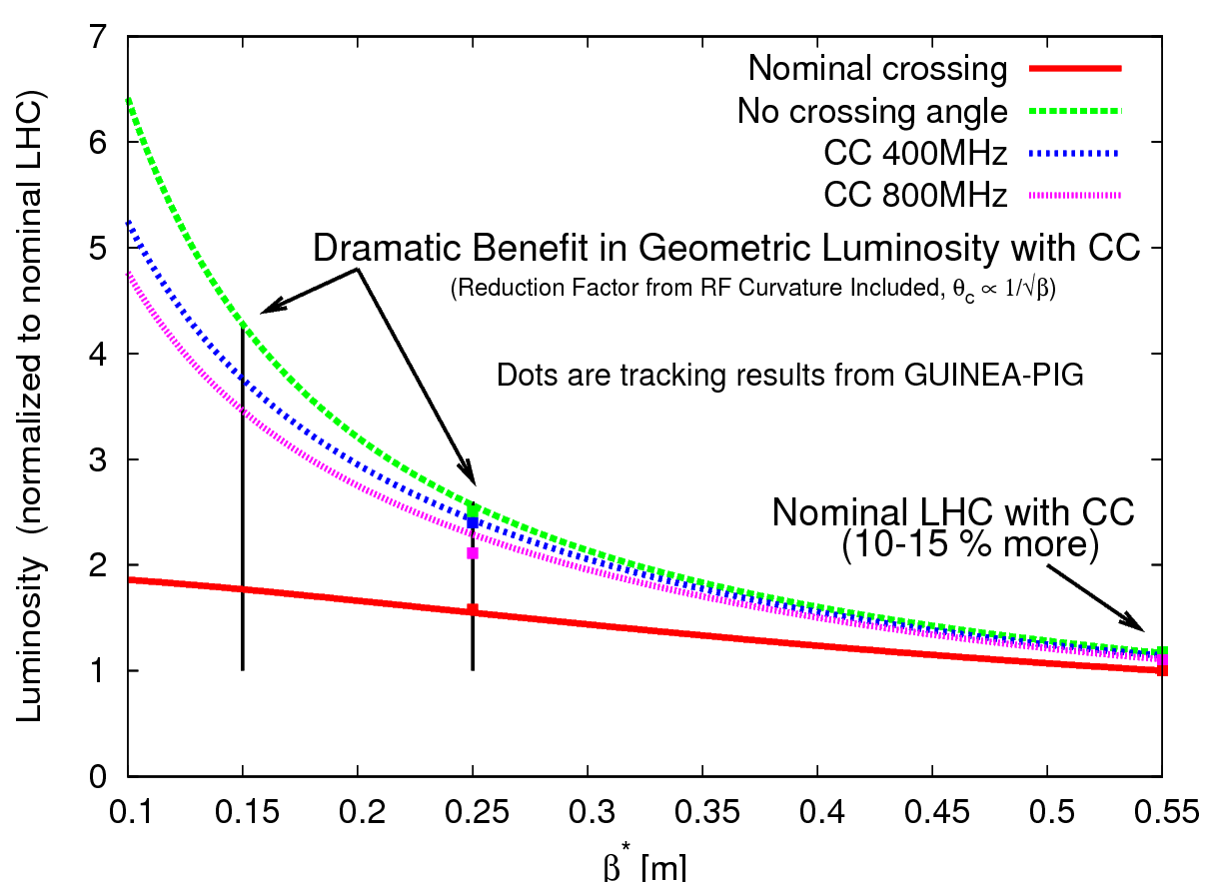
Crab cavities
  Transverse fields rotate bunches to
  compensate for crossing angle in
  final upgrade
  Goal: one cavity in Phase I upgrade,
  2 (global) or 4 (local) in Phase II
  Significant opportunity
  Collaboration with KEK, CERN, and
  Daresbury
  But big job, lots of $$
PS2 opportunities
  Significant synergy with Project X
  Ecloud
  Injection, collective instabilities
  Laser stripping
  RF
E. Prebys, New Directions Workshop
5/13/09

Slide 17
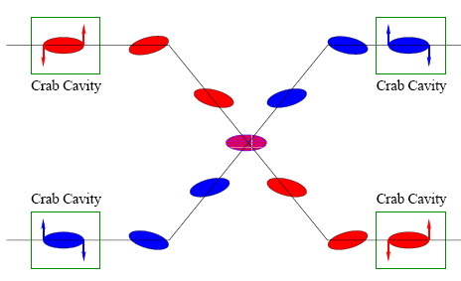
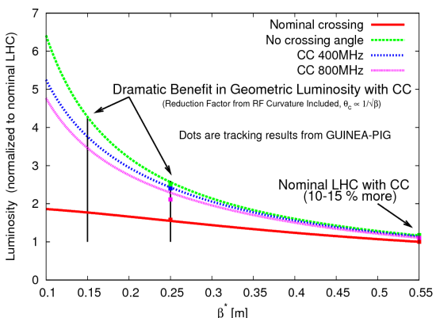
Goals
  1 or 2 cavities in global scheme for phase I upgrade
  Full 8 for Phase II
Main Technical question
  Space constraints -> 800 MHz elliptical (simple) versus 400 MHz “weird”.
Critical review at CERN in September
If crabs go ahead, beyond the scope of LARP
E. Prebys, New Directions Workshop
5/13/09

Slide 18
Parameter | PS2 | MI (now) | MI (Project X)
Circumference (m) | 1346.4 | 3319.42
Injection Energy (GeV) | 4 | 8
Extraction Energy (GeV) | 50 | 120 (150 max)
γ_{T} | 35i | 21.8
RF Freq. (MHz) | 40 | 53
Tune (x/y) | 13.25/8.2 | 26.425/25.415
Max. protons | 1e14 | 4.6e13 | 1.6e14
Cycle Time (s) | 2.4 | 2.2 | 1.4
Clearly significant synergy between PS2 and MI in Project X era
E. Prebys, New Directions Workshop
5/13/09

Slide 19
Space charge studies
  Exlploit ongoing work in SciDAC group
Electron cloud studies and mitigation
  Exploit expertise already developed in LARP
Impedance, instabilities and feedback
  Expect lots of interaction with CERN
Laser stripping
  Very interesting
  Lots of interest for SNS
  Probably useful for Project X/MI in high power mode
  Only needed at PS2 for highest energy fixed target program (maybe)
    Not really LARP’s mandate
*Coordinated by Uli Wienands, SLAC
E. Prebys, New Directions Workshop
5/13/09

Slide 20

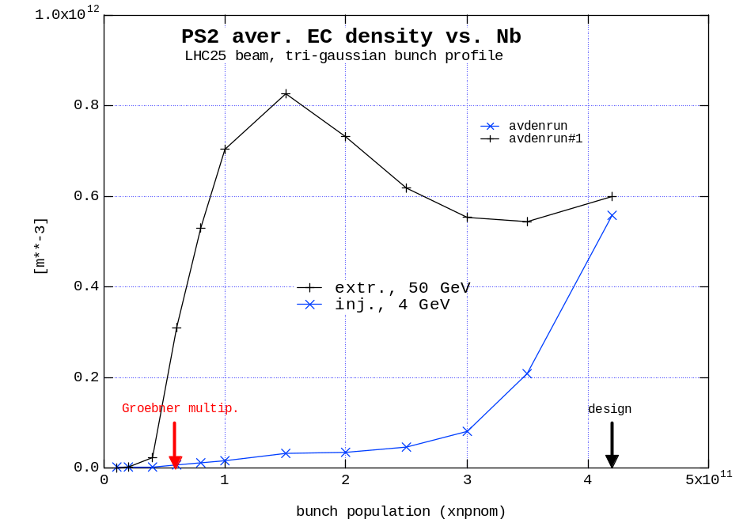
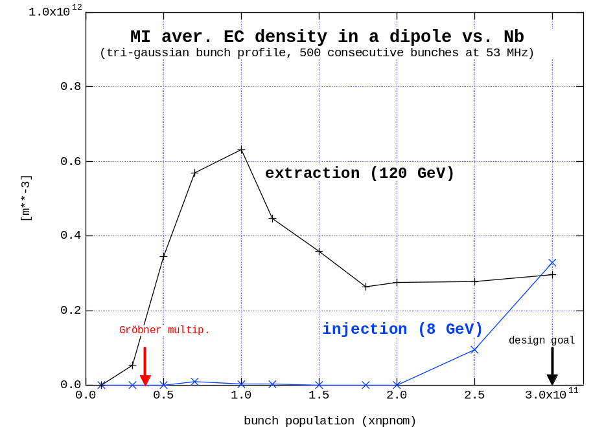
PS2
MI upgrade
Similar ecloud features in both machines
  PS2 stands to profit from current ecloud program at MI
*M. Furman, LARP CM12
E. Prebys, New Directions Workshop
5/13/09

Slide 21
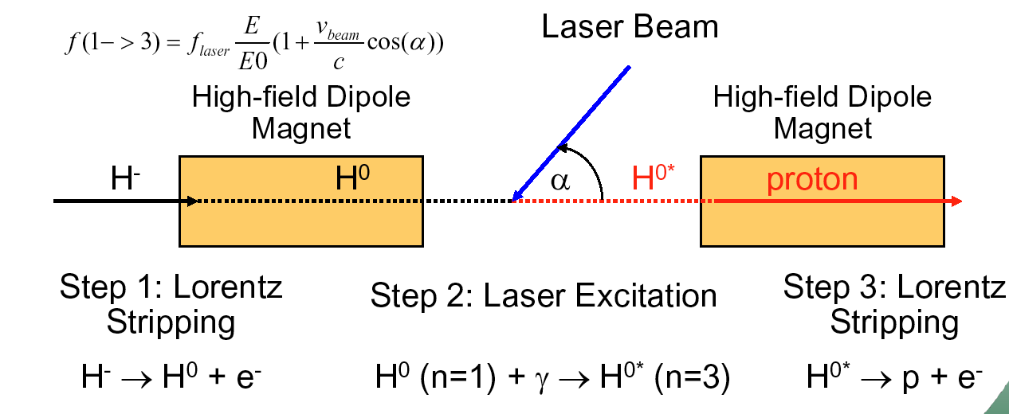
Three-step laser stripping*
Biggest challenges
  Peak laser power: 1-2 MW (requires local resonator)
  Long macropulse: 1 ms > τ of amplification medium
*V. Danilov, et al, PRSTAB 6, 053501
E. Prebys, New Directions Workshop
5/13/09

Slide 22
A review of the Linac4->PSB charge exchange injection upgrade strongly recommended two laser wire emittance measurements of the beam:
  Use laser as “virtual slit” by measuring intensity and distribution of H⁰’s.
Everyone agrees it’s a good idea, but so far no money to develop and build it
  Similar prototype being built for SNS
  Proposals from BNL and LBNL
Could be tested (and even used) in Fermilab Linac
E. Prebys, New Directions Workshop
5/13/09

Slide 23
LARP is funded at $13M for FY09
Making plans for a program which ends at the end of the magnet program (~6 years)
Tentatively assuming LARP budget will ramp down by ~1M/year as funding ramps up for the Accelerator Projects for the LHC (APUL) program
  primarily D1 separators for LHC phase I upgrade
Possibility to maintain funding level with good performance and good new ideas.
E. Prebys, New Directions Workshop
5/13/09

Slide 24
Lots of important accelerator physics needed to make the LHC reach its potential
CERN has openly requested US help
Opportunities limited only by imagination
  … and $$, of course
E. Prebys, New Directions Workshop
5/13/09

