Slide 1
No consistent rules for dealing with burdens at different labs
Budget and schedule not integrated
  Earned value reporting must be done by hand, if it’s done at all
No systematic way of dealing with different types of contingency
  “deliverables” should have significant assigned contingency
  R&D projects should have “scope contingency”, possibly adjusted by an uncommitted unassigned contingency pool.
No formal accounting for “off books” contributions from member labs.
LARP change control policies pretty much ignored.
Developing future budget profile a nightmare.
E. Prebys, LARP Project meeting
12/15/08

Slide 2
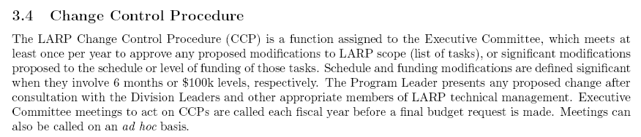
E. Prebys, LARP Project meeting
12/15/08

Slide 3
Put LARP budget and schedule into a single project file
Define burdens and labor rates correctly for the four member labs
  Eg, “BNL engineer”, “SLAC scientist”, etc…
For every labor category, have an equivalent “off books” category with an appropriately PC name (“common effort”?), which is not included in the normal roll-up, but can be rolled up separately.
Progress is updated monthly by designated L2 and L3 managers.
Implement formal change control and change logging.
Project used to formulate long term plan and budget profile.
E. Prebys, LARP Project meeting
12/15/08

Slide 4
Begin translating our existing budget into this format immediately
  Be able to show something at our Jan 8 DOE meeting
Have the tools fully in place by our April collaboration meeting.
  Use as a tool for real time budget discussion.
E. Prebys, LARP Project meeting
12/15/08

