Slide 1
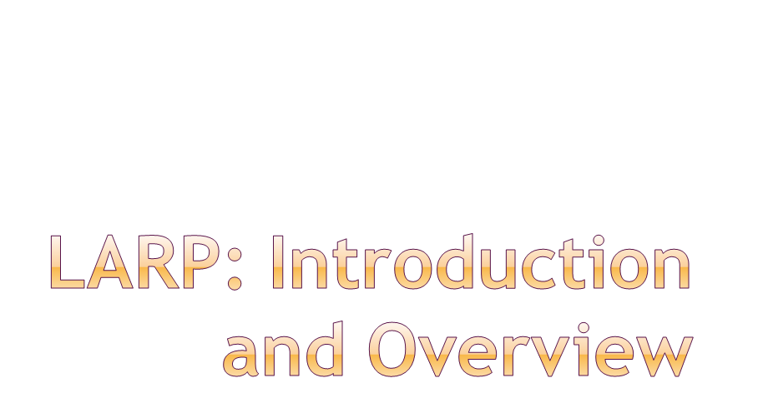
Eric Prebys
LARP Program Director
7/13/09

Slide 2
Background
Summary of findings from last review
Partial response
  Coordination with CERN
  New initiatives
  Lumi situation
FY09 Budget
  Budgeting process
  Budget status
Progress and Highlights
  Accelerator Systems
  Magnet Systems
  Programmatic Activities
Future planning and this Review
E. Prebys, DOE Review, FNAL
7/13/09

Slide 3
Since last review
  LARP is under new management (Peggs->Prebys 8/1/08)
  The LHC has started…sort of
  New reviewers since last time:
    Peter McIntyre, Texas A&M
    George Biallas, JLAB (was on committee in 2006)
    David Rice, Cornell
E. Prebys, DOE Review, FNAL
7/13/09

Slide 4
Proposed in 2003 to coordinate efforts at US labs
related to the LHC accelerator (as opposed to CMS or ATLAS)
  Originally FNAL, BNL, and LBNL
  SLAC joined shortly thereafter
  Some work (AC Dipole) supported at UT Austin
LARP Goals
  Advance International Cooperation in High Energy Accelerators
  Advance High Energy Physics
    By helping the LHC integrate luminosity as quickly as possible
  Advance U.S. Accelerator Science and Technology
LARP includes projects related to initial operation, but a significant part of the program concerns the LHC upgrades
E. Prebys, DOE Review, FNAL
7/13/09

Slide 5
Accelerator Systems
  Accelerator physics
  Instrumentation
    Lumi monitor
    Schottky
    Tune tracker
    AC Dipole
  Other hardeware
    Collimation
    Crab cavities?
Magnet Systems
  Goal: demonstrate Nb₃Sn as a viable technology for the ultimate upgrade of the LHC
  ~half the program
Programmatic Activities
  Program management, travel, meetings, etc
  Toohig Fellowship
  Long Term Visitor (LTV) program
E. Prebys, DOE Review, FNAL
7/13/09

Slide 6
Initial operation
  Ramp up to 1x10³⁴ cm⁻²s⁻¹
Collimation
  See next slide
Phase I upgrade
  After ~2 years of operation (~2013)
  Replace 70 mm triplet quads with 120 mm quads
    Includes APUL projects (superconducting separation dipoles, feedboxes, etc)
  β* goes from 50->25 cm
  Luminosity goes to 2.5x10³⁴ cm⁻²s⁻¹
Phase II Collimation upgrade
  Upgrade with a series of cryo-collimators and advanced secondary collimators that will handle the ultimate LHC luminosity.
Phase II upgrade
  Second half of next decade (nominally 2020)
  Luminosity goal: 1x10³⁵
  Details still under study
    New technology for larger aperture quads (Nb₃Sn)
    crab cavities?
    Improved injector chain (PS2 + SPL)
E. Prebys, DOE Review, FNAL
7/13/09

Slide 7
Proton flux / Beam power
50 MeV
Linac2
Linac4
160 MeV
1.4 GeV
PSB
SPL’
RCPSB
SPL
~ 5 GeV
26 GeV
PS
PS2 (PS2+)
Linac4: PSB injector (160 MeV)
SPL: Superconducting Proton Linac (~ 5 GeV)
SPL’: RCPSB injector
(0.16 to 0.4-1 GeV)
RCPSB: Rapid Cycling PSB
(0.4-1 to ~ 5 GeV)
PS2: High Energy PS
(~ 5 to 50 GeV – 0.3 Hz)
PS2+: Superconducting PS
(~ 5 to 50 GeV – 0.3 Hz)
SPS+: Superconducting SPS
(50 to1000 GeV)
DLHC: “Double energy” LHC
(1 to ~14 TeV)
40 – 60 GeV
Output energy
450 GeV
SPS
SPS+
1 TeV
LHC
DLHC
7 TeV
~ 14 TeV
M. Benedikt, R. Garoby, CERN DG
E. Prebys, DOE Review, FNAL
7/13/09

Slide 8
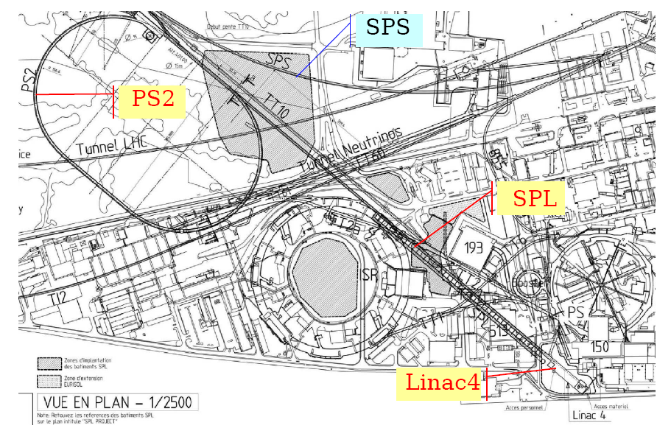
E. Prebys, DOE Review, FNAL
7/13/09

Slide 9
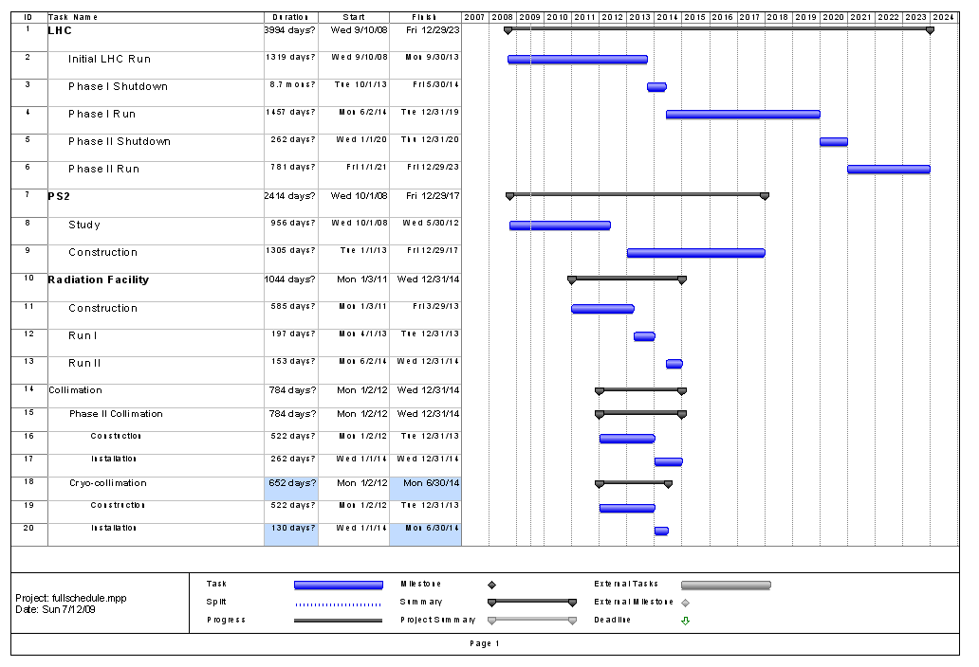
Collimation Schedule approximate
E. Prebys, DOE Review, FNAL
7/13/09

Slide 10
Generally impressed with LARP progress on technical fronts.
  Particularly success of Schottky and tune tracker
As usual, reminded us that the Nb₃Sn magnet program is a world class effort which must be sufficiently supported.
  Some concern over convergence of the shell and collar efforts.
  Some specific comments on conductor choice.
Concern over communication with CERN
  Particularly regarding the JIRS work
Concern about managerial oversight
  Primarily regarding the lumi project, which was news at the time.
Although there was some frustration during the review about how LAUC (now “APUL”) was “thrown at them”, they generally felt it was a good idea and should be separately and sufficiently funded.
  APUL will NOT be discussed in any detail at this review
*full report: LARP-DOC-897 (http://larpdocs.fnal.gov/LARP-public/DocDB/ShowDocument?docid=897
E. Prebys, DOE Review, FNAL
7/13/09

Slide 11
The bulk of the criticism in the report focused on the perceived “disconnect” between LARP and CERN regarding prioritization of LARP activities.
I believe this disconnect largely referred to activities related to the abortive attempt to get Nb₃Sn magnets into the Phase I proposal (specifically, the JIRS group).
  It's now realized this is not (and likely never was) realistic. We have suspended activities of the JIRS group, with the idea of restructuring it with an emphasis on the relationship between our magnet program and the phase II upgrade.
E. Prebys, DOE Review, FNAL
7/13/09

Slide 12
General
  LARP Liaison: Oliver Bruening
    Serves as primary “sounding board” for LARP proposals
    De-facto veto power over LARP projects (No CERN interest= non-starter)
  US/CERN meeting
    Once a year (~January)
    Discuss general priorities and strategy
    Should we do this more often?
  LTV/Toohig fellows
    Establish a significant body of “man on the street” impressions of CERN interest
    Both programs considered a great success.
  We have also begun a set of meetings to coordinate our magnet program with the CERN decision/production process for the Stage II upgrade (more in a moment).
E. Prebys, DOE Review, FNAL
7/13/09

Slide 13
Specific
  Alex Ratti has been working closely with Enrico Bravin (responsible for LHC luminosity measurement) on the completion and handoff of the lumi monitor
  Rama Calaga is working closely with CERN people to coordinate crab cavity effort
  Tom Markiewicz is working closely with Ralph Assmann (head of LHC collimation) on the potential use of the rotatable collimators
  Uli Wienands has been working with Michael Benedikt and CERN in general to identify the best ways for LARP to contribute to the PS2 effort.
E. Prebys, DOE Review, FNAL
7/13/09

Slide 14
In response to comments from the review committee and LARP members, Tom Markiewicz developed a more formal and transparent process for choosing amongst new initiatives.
  Proposals were weighted by a number of factors, including CERN interest (necessary), potential luminosity improvement, technical risk, and cost.
  LARP collaboration was emailed a prioritized list of approved activities along with an explanation of the procedure.
Improvements for the future
  Have stressed that all projects new and ongoing present a multi-year profile
Largely moot point this year
  Already badly overcommitted
  Exceptions
    Activities within PS2 treated much like “new initiatives”
    Considering redirecting electron lens effort from beam-beam compensation (little interest at CERN) to developing electron lenses as primary collimators (lots of interest at CERN).
E. Prebys, DOE Review, FNAL
7/13/09

Slide 15
The magnet program is central to LARP
It’s realized that a “prototype” is beyond the scope of LARP, but the program should aim to demonstrate the technology at a level that CERN would authorize a construction program
  Either in the US or Europe
  Almost certainly with some R&D component at the beginning
Range of scenarios (my view):
  Failure: the LHC does not adopt Nb₃Sn for the Phase II upgrade
    Unlikely. What else is there?
  Complete success: the LHC adopts a design very similar to the LARP models.
    Most likely the key and bladder “shell design”
  Partial (mostly) success: the LHC adopts Nb₃Sn, but based on a different design
    LARP has still contributed significantly to the overall program.
We have begun a dialog with CERN representatives to make sure we are on the same page with our plans
  First meeting at CERN 5/20/09: Peter Wanderer, Lucio Rossi, Edzio Todesco, Guis De Rijk, me (by phone)
  Generally approve of our plan, but still some trepidation about shell approach (more from Peter W.)
E. Prebys, DOE Review, FNAL
7/13/09

Slide 16
In spite of some missteps, LARP activities are closely coordinated with CERN.
CERN interest is a necessary condition for any LARP project.
As you will see, LARP is resource limited:
  In the absence of an unexpected funding windfall, there are more activities of interest to both LARP and CERN than we can possibly undertake.
We anticipate new opportunities to arise once LHC operation starts in earnest.
E. Prebys, DOE Review, FNAL
7/13/09

Slide 17
Began bi-weekly meetings with Alex Ratti, LARP and LBL management, and Enrico Bravin (CERN) to stay up to closely monitor progress.
Working with the CERN controls group and LAFS on the software end.
  Draft requirements specification created.
Enrico and Alex working on document to formally specify the handoff to CERN.
Working with CMS luminosity group, who will contribute some manpower to do the deconvolution microcoding necessary for high intensity operation.
For more details on Lumi status, see Ratti talk
E. Prebys, DOE Review, FNAL
7/13/09

Slide 18
Original plan
  Very difficult even to figure out what the budget was
    Estimates range from $2.5-3.5M
  Finished in FY07
Currently
  Spent $4.1M so far
  Need to spend ~$300k more
  Finished in FY09
Bottom line
  These sorts of overruns are not that unusual in real projects!
  LARP contingencies are far from sufficient to cover overruns in significant deliverables.
  LARP should concentrate on R&D and avoid “hard deliverables”
More about this shortly…
E. Prebys, DOE Review, FNAL
7/13/09

Slide 19
Guidance from DOE
  $13M with a 6 month continuing resolution at 84%
    .5*.84*13+.5*13 = $11.96M
  Separate money ($1-2M) found for APL planning!
General breakdown (informed by Steve’s exit advice)
  Accelerator Systems: $2.9M
  Magnet Systems: $5.0M
  Program Management: $2.1M
    Includes LTV and Toohig Fellows (of which we have 4)
  Contingency: $2M
In then end, had to give up some continency to increase Program Management
Lesson learned: this process started way too late.
Note: budget later increased to $13M, which proved necessary.
E. Prebys, DOE Review, FNAL
7/13/09

Slide 20
Luminosity monitor was expected to be complete by end of FY08
  Instead had significant overruns, and needs significant funds on FY09 (original request $1M -> $800k)
  Still consider it absolutely vital for lumi to work!
Rotating collimators still a big budget item
  Still consider it important to complete a prototype this year in time to at least be considered a solution by CERN.
(Initially) strong feeling that LARP should take a leading role in crab cavity development
  Led by Rama Calaga
  Support by CERN
  General feeling that “the train is leaving the station”.
Magnet program still has to funded at a level that will insure a working magnet for the LHC Phase II upgrade
E. Prebys, DOE Review, FNAL
7/13/09

Slide 21
Accelerator Systems
  Iterative process, primarily involving Wolfram, Tom, Alex, and myself, to converge on the bottom line.
    Key component: relying on labs to contribute labor in accordance with their core competencies (i.e. not charged directly to LARP)*
  Key casualty: No real money for PS2, for which there was a great deal of excitement within LARP and at CERN
    Will continue with contributed labor while we decide what to do for next year.
Magnet Systems
  Much more monolithic than AS
  L1 and L2 managers worked to stay within the budget
E. Prebys, DOE Review, FNAL
7/13/09

Slide 22
Not much leeway
  Management costs determined by historical usage
  Need to honor commitments to LTV’s and Toohig fellows
  Only discretionary is Programmatic travel, which I have reduced by trying to include travel with the appropriate project.
E. Prebys, DOE Review, FNAL
7/13/09

Slide 23
Crab cavities
  Original request: $700k
    Cavity design
    Cryomodule design
    LLRF
  Budget: $300k
    Rely on “off project” help from BNL, FNAL, and SLAC
    Defer cryomodule and LLRF work
PS2
  Uli Wienands developed a number of plans under various funding scenarios
  In the end, budgeted $100K, primarily for travel and M&S, assuming that most scientific time would be contributed.
E. Prebys, DOE Review, FNAL
7/13/09

Slide 24
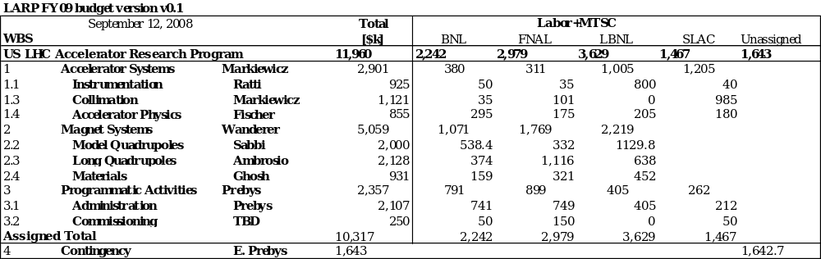
E. Prebys, DOE Review, FNAL
7/13/09

Slide 25
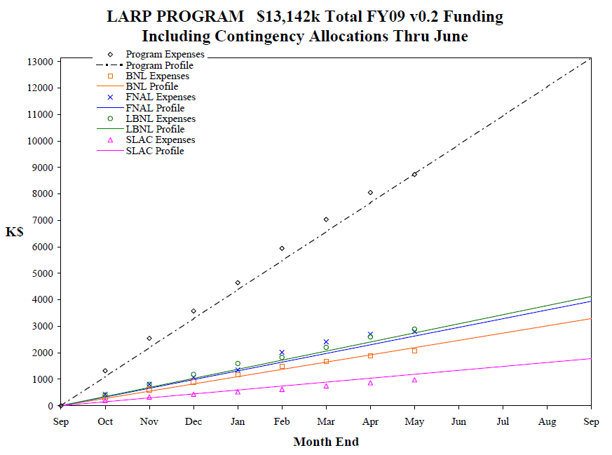
Initial: 10,318
Carry Forward: 948
Allocated Contingency: 1,846
Total: 13,142
Remaining Contingency: 667
E. Prebys, DOE Review, FNAL
7/13/09

Slide 26
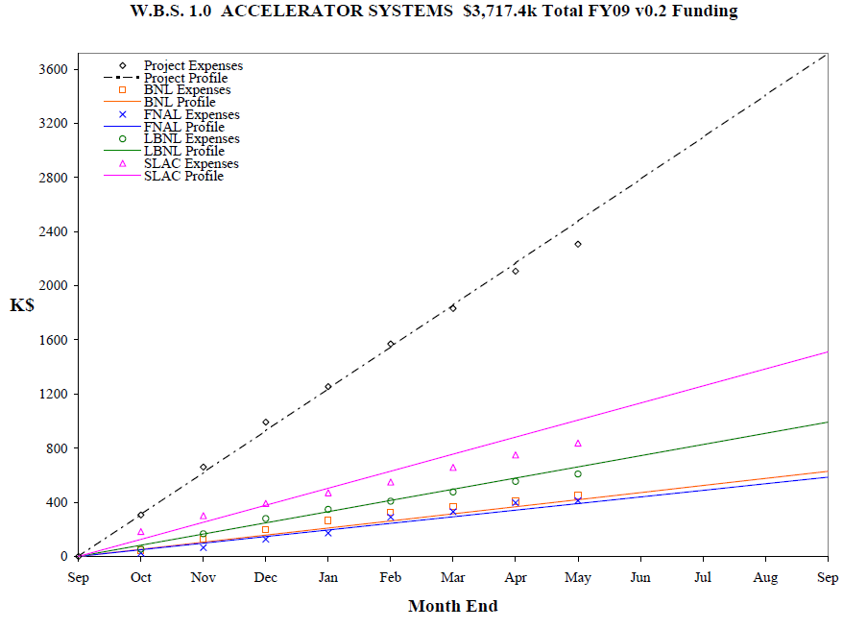
E. Prebys, DOE Review, FNAL
7/13/09

Slide 27
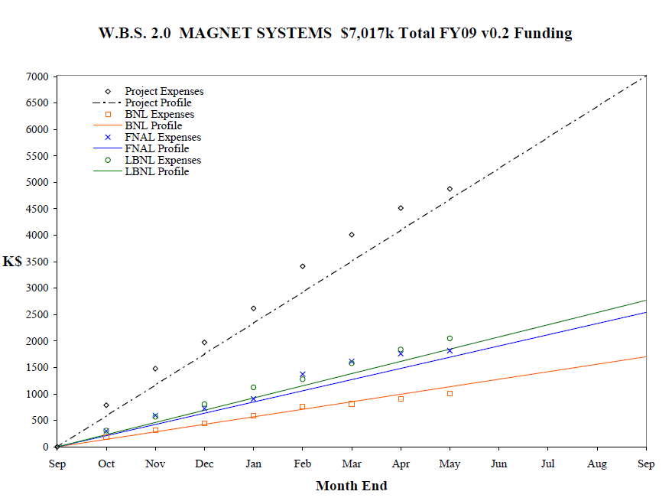
E. Prebys, DOE Review, FNAL
7/13/09

Slide 28
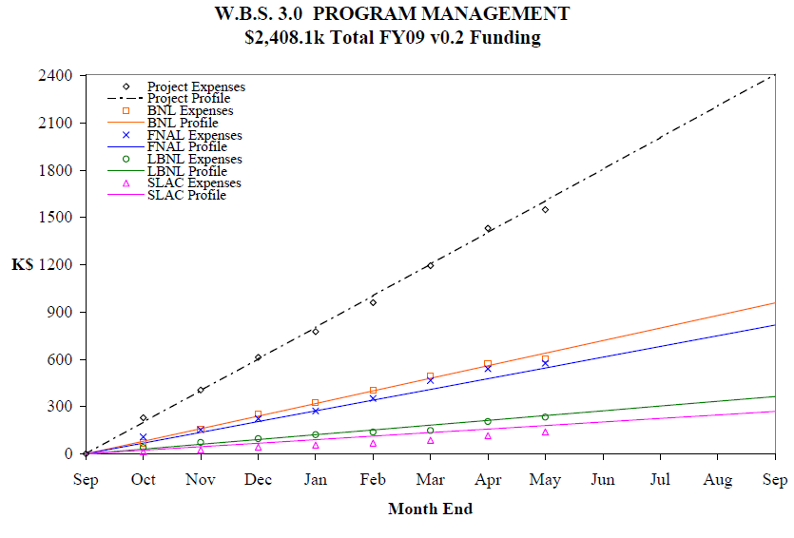
E. Prebys, DOE Review, FNAL
7/13/09

Slide 29
LARP relies heavily on contributions to form core programs, for which LARP is not directly charged.
BNL does not charge to these B&R codes, but contributes 2-3 FTE in “common interest” research
Clearly, LARP could not function without these contributions
Assume that arrangement will continue
  But need to explicitly account for it better
B&R KA 11 01 02, KA 15 01 02, and KA 15 02 01-1
Estimated
 | FY07 | FY08 | FY09 | FY10 | FY11
FNAL | 7,284.57 | 6,463.68 | 5,930.59 | 5,400.80 | 4,737.28
LBL | 1,419.00 | 1,627.00 | 1,880.00 | 2,280.00 | 2,315.00
SLAC | 0.00 | 330.00 | 1,419.61 | 1,013.83 | 1,045.00
Total | 8,703.57 | 8,420.68 | 9,230.20 | 8,694.63 | 8,097.28
E. Prebys, DOE Review, FNAL
7/13/09

Slide 30
Instrumentation
  All systems in and ready for beam
Luminosity Monitor:
  All hardware is at CERN and all hardware that can be installed is installed
Rotatable Collimator:
  First prototype jaw passes thermal mechanical tests
  Majority of hardware for 3 more jaws (2 full collimators) in hand
PS2
  5 year plan involving 4 labs coordinated with CERN & LARP; early results
SPS Ecloud
  SPS measurements during 3 MD periods show effects that can be simulated; RF modelling to control instabilities has begun
E. Prebys, DOE Review, FNAL
7/13/09
Slide n° <number> / 26

Slide 31
Crab Cavity
  Baseline design of cavity/coupler and SBIR to fabricate
  Multinational, multilab effort working/meeting regularly to develop plan
Other
  Crystal experiments UA9 and T980 installed full-time & taking data regularly
  E-lenses for RHIC approved & feedback for LHC expected
  LLRF model used to commission LHC system without beam; beam commissioning planned
  HW commissioning for Schottky, AC Dipole & Tune/Chromaticity FB complete
  New Synchrotron Light Monitor designed, assembled & installed with LARP effort
E. Prebys, DOE Review, FNAL
7/13/09

Slide 32
Lumi and rotatable collimator should ramp down considerably, allowing concentration on other significant commitments
Candidates:
  Crab cavity effort
    Crab cavities deflect the beam to compensate for crossing angle.
    Potential to dramatically increase luminosity under most likely Phase II upgrade scenario
  PS2 Activities
    CERN has requested LARP help in the design (white paper study) of the PS2, which will replace the PS for the phase II upgrade.
E. Prebys,CM12 Introduction
4/8/09

Slide 33
Pros
  Potentially a big impact on luminosity
  Lots of intellectual interest in US community
  Can be divided into well-defined tasks that are straightforward to monitor.
Cons
  Barring a budget windfall, LARP will not have the resources to take a significant role in construction, so must coordinate with multiple labs/countries/funding agencies.
  Current plan relies on SBIR grants
Bottom line:
  LARP’s role in crab cavities will necessarily be limited
  If crab cavities are to succeed, it must be through a significant coordinated effort.
E. Prebys,CM12 Introduction
4/8/09

Slide 34
Pros
  Lots of opportunities to make contributions
  Well aligned with US interests and expertise, particularly Project X
  Involvement “scalable”
  Our involvement both desired and assumed by CERN
  I think we can be very effective
Cons
  Seen by some as being outside the LARP mandate
    LARP management disagrees
Potential areas of focus which were considered
  Injection issues
  Electron cloud
  Laser stripping?
  We will handle this effectively like “new initiatives”
  (see Wienands talk for details of down select)
E. Prebys,CM12 Introduction
4/8/09

Slide 35
High Priority
  Finish what we started (Lumi, rotatable collimators)
  E-cloud feedback for SPS
  PS2!
  Hollow e-lens as collimator (relatively new)
Low Priority
  Crabs
    Seen as too big for LARP
    pending fall review
  LLRF
    Although currently re-negotiating LLRF goals with Steve Myers
  E-lens as beam-beam compensator
  H- activities
    Particularly laser emittance monitor
6/5/09

Slide 36
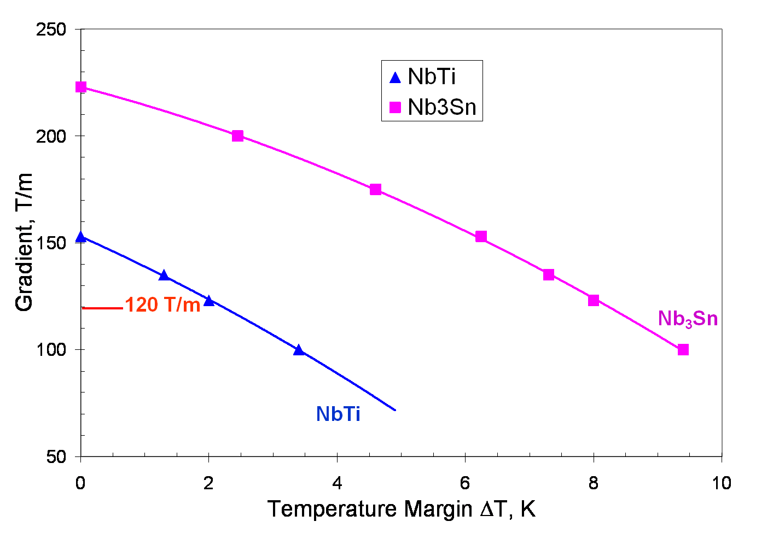
Establish Nb₃Sn as a viable technology for the LHC Phase II upgrade
E. Prebys, DOE Review, FNAL
7/13/09

Slide 37
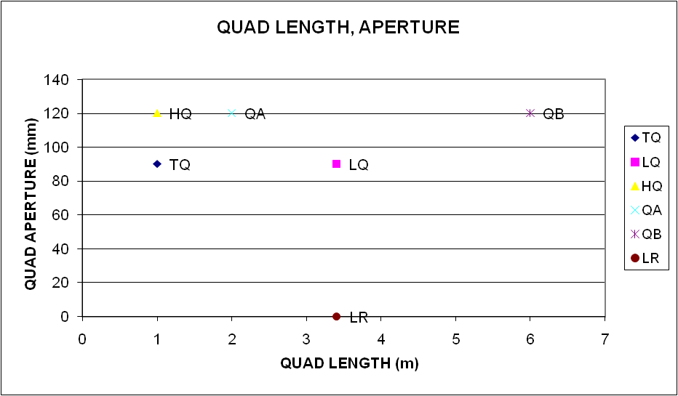
True prototype. Probably beyond the scope of LARP (APUL-II?)
Newly defined goal of LARP (aka HQ-2)
E. Prebys, DOE Review, FNAL
7/13/09

Slide 38
Materials –
  strand and cable available when needed (as usual)
  strand development (heat treatment schedule) for HQ coils
  strand testing – critical currents, stability at temps between 4.5 K and 1.9 K
  strand – critical current as a function of strain
  cable testing at NHFML
  cable development for HQ
LQ
  Coils - Development of production procedures
  Shell support structure – build, and test with dummy coils at 300 K and 77 K
E. Prebys, DOE Review, FNAL
7/13/09

Slide 39
HQ
  Design completed, most parts on order
  Practice coil #1 completed through reaction
  Practice coil #2 underway
TQ test bench
  TQS02 – quench tests of 54/61 material between 1.9 K and 4.5 K, observation of quench current decrease below 2.6 K
  TQS03 – construction with 108/127 coils completed, now at CERN for cold test
  TQ mirror (single coil test) – measured magnet thermal margin, quench test of 108/127 coil from 1.9 K to 4.5 K
  All training quenches above 200 T/m in optimized models Maximum gradient 231 T/m
E. Prebys, DOE Review, FNAL
7/13/09

Slide 40
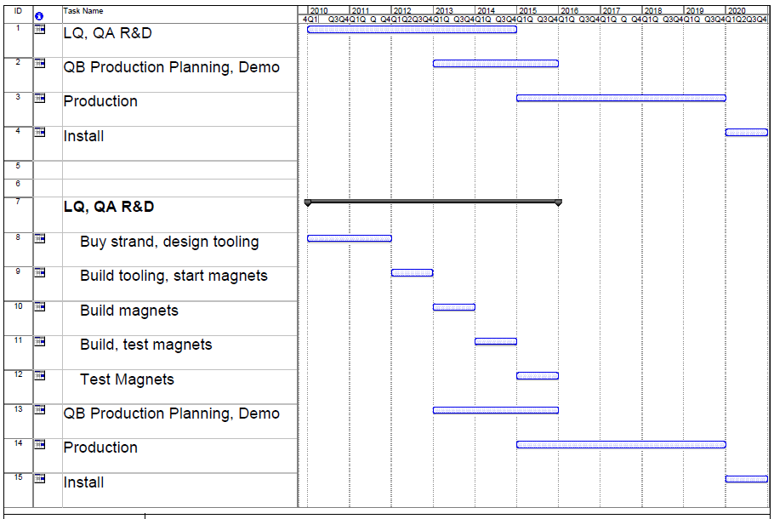
Work to finalize the magnet plan and demonstrate the technology in the context of the Phase II upgrades
Even if Phase-II is in 2020, there will have to be overlap between production and R&D
E. Prebys, DOE Review, FNAL
7/13/09

Slide 41
There’s a somewhat rocky history of “outsiders” getting involved in accelerator projects.
The LARP program has had impressive success integrating US scientists into LHC activities
  Toohig Fellowship
    2-3 year PostDoctoral position
    Successful candidates choose their host lab
    Spend ~50% of their time at host lab and 50% at CERN
  Long Term Visistor (LTV) program
    LARP provides support for advanced postdocs or scientists to spend extended periods at CERN, working on predetermined projects.
      Built on the model of very successful stays by Peter Limon, Jim Kerby, et al, involved with the triplet installation.
E. Prebys, DOE Review, FNAL
7/13/09

Slide 42
Alumni
  Rama Calaga
    Did important, and appreciated, studies on SPS
    Has been coordinating crab effort
    Now a BNL staff, soon LTV
  Helene Felice
    Did valuable work on magnet program
    Now a LBNL staff
Current
  Ryoichi Miyamoto (BNL)
    Former FNAL Joint Accelerator PhD student (w/ Sacha Kopp)
    Working with AC Dipole and Lumi
  Riccardo De Maria (BNL)
    Working on SPS e-cloud feedback, PS2 studies and diagnostics
  Dariusz Bocian (FNAL)
    Working on beam loading issues on Nb₃Sn magnets
E. Prebys, DOE Review, FNAL
7/13/09

Slide 43
Current
  Jim Strait (FNAL)
    Went to CERN to work on machine protection
    Got involved with analysis of “incident”
    Gave two talks at the Chamonix workshop
  Steve Peggs (BNL)
    Working on UA9 Experiment
  Alan Fisher (SLAC)
    Has led the effort to improve the synchrotron light abort gap monitor (very important)
  Eliana Gianfelice-Wendt (FNAL)
    Beam commissioning
    Deferred when machine broke
Future
  Approved
    Rama Calaga (BNL, former Toohig): crabs, beam commissioning
    Uli Wienands (SLAC): PS2
  Pending
    Chandra Bhatt (FNAL): flat bunches in SPS
    Mai Bai (BNL): machine protection
E. Prebys, DOE Review, FNAL
7/13/09

Slide 44
The Office of HEP wants to see a plan for LARP over the next five (?) years, assuming that is the time scale of the magnet program.
Assume LARP budget will shrink as APUL budget grows
  Initial guidance $12M in FY10, shrinking by $1M every subsequent year.
  First draft shifted by 1 years (FY10: $13M, FY11: $12M, etc)
Long term planning has been a major priority this year
  CM11, October 2008
    Presented general budget situation to collaboration
  CM12, April 2009
    Subgroups submitted drafts of multi-year plans
  This review
    Rough draft of budget for FY10 and sketch of plan for subsequent years.
6/5/09

Slide 45
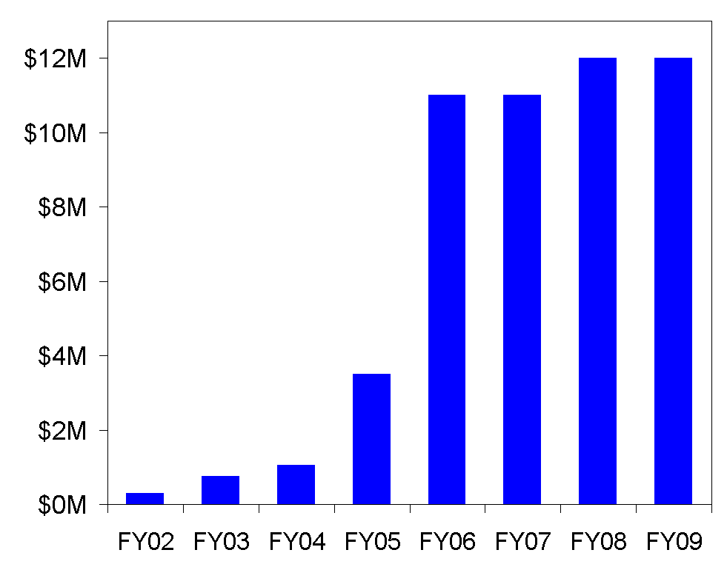
Actual FY09
From LARP proposal:
Future?
LARP had a period of rapid growth in the earlier yeas, which led to some over- optimism
LARP assumed to ramp down as APUL ramps up
E. Prebys, DOE Review, FNAL
7/13/09

Slide 46
From beginning through FY09
  Accelerator systems
    Great emphasis in finding new projects
  Magnet systems
    Lots of important work, but uncertainty made long term planning difficult
  In general
    Budgets and plans made FY by FY with little emphasis on long term structure.
From now into the future
  Magnet systems
    LARP must make a plan to demonstrate Nb₃Sn as a viable technology in time to allow a (separate) construction project for Phase II
  Accelerator systems
    Very important to understand how our various commitments and interests fit within a shrinking budget
E. Prebys, DOE Review, FNAL
7/13/09

Slide 47
LARP is largely defined by the magnet program, however, it’s important to remember that the ultimate time scale is very different
  The magnet program must demonstrate Nb₃Sn as a viable technology in time to allow for a construction project for the Phase II upgrades (5-6 years)
    APUL II?
  Even if we define Phase II upgrade plans as the “end” of LARP, many of the accelerator projects (and potential future accelerator projects) have a much shorter time scale
    Makes sense for LARP to continue, at some level at least, after the magnet program has ended.
Full expect new opportunities to present themselves after the LHC startup.
E. Prebys, DOE Review, FNAL
7/13/09

Slide 48
In a change from previous reviews, we are emphasizing long term planning and budget considerations over technical details.
  Nevertheless, the technical progress of LARP has been impressive
    Eg, PAC09
      3 invited talks
      3 contributed talks
      33 posters
We are significantly further along than at this point in previous years
  Have already been scrubbing the FY10 budgets in both the AS and MS subprograms
  Have met with key lab representatives to explicitly discuss off project contributions.
E. Prebys, DOE Review, FNAL
7/13/09

