Slide 1

Eric Prebys
LARP Program Director
July 14, 2009

Slide 2
Guidance: LARP funding decreases $1M/yr
Assume: $13 M LARP total for FY10
Assume: Magnet fraction constant, ~ 38%, w/o contingency
Contingency has been ~ 20%
Fiscal Year | FY09 | FY10 | FY11 | FY12 | FY13 | FY14
LARP total | $13M | $13M | $12M | $11M | $10M | $9M
Magnet | $5M | $5M | $4.615M | $4.230M | $3.840M | $3.46M
July 14, 2009
LARP FY10 and Beyond - E. Prebys

Slide 3
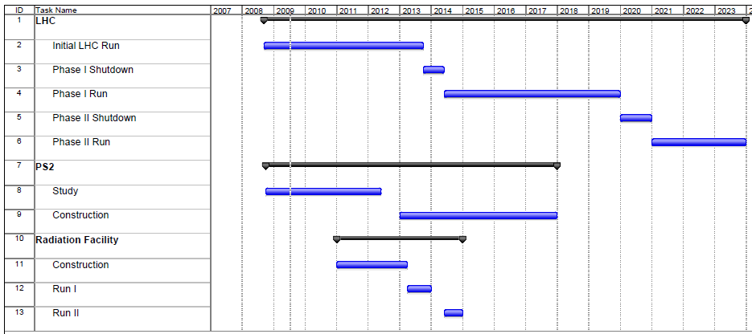
LARP FY10 and Beyond - E. Prebys
July 14, 2009

Slide 4
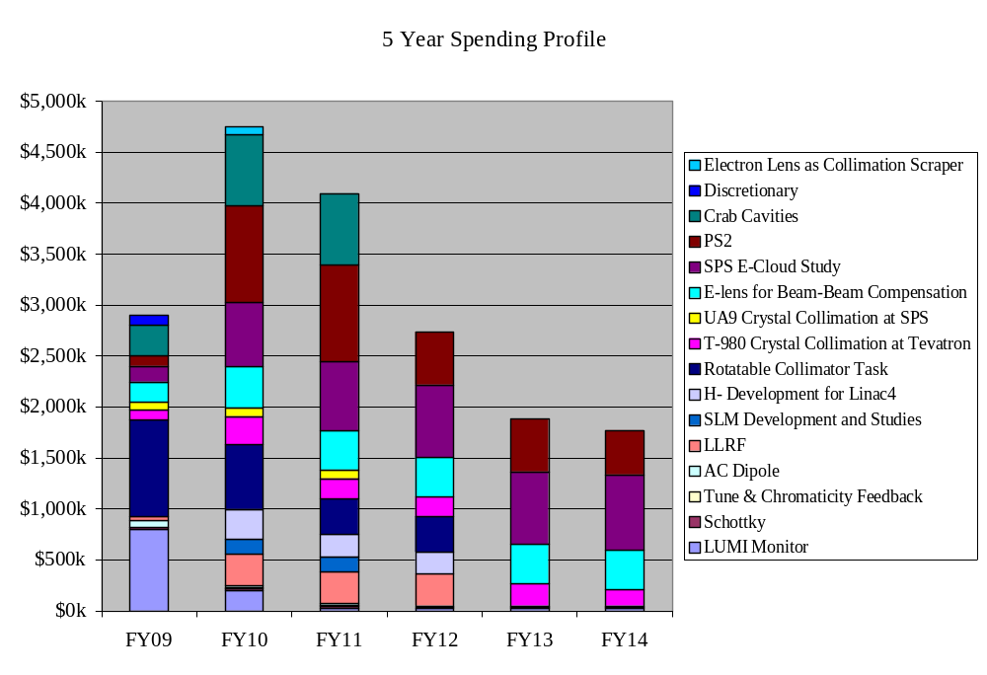
Taken verbatim from subtask presentations
LARP FY10 and Beyond - E. Prebys
July 14, 2009

Slide 5
High Priority
  Finish what we started (Lumi, rotatable collimators)
  E-cloud feedback for SPS
  PS2!
  Hollow e-lens as collimator (relatively new)
Low Priority
  Crabs
    Seen as too big for LARP
    pending fall review
  LLRF
    Although currently re-negotiating LLRF goals with Steve Myers
  E-lens as beam-beam compensator
  H- activities
    Particularly laser emittance monitor
LARP FY10 and Beyond - E. Prebys
July 14, 2009

Slide 6
Turned of H- development
Moved all T980 labor to FNAL
Reduce crabs to Rama + travel
Eliminated e-lens for beam beam
Increased e-lens as collimator to 1FTE for next three years.
Shifted a fractional FTE for next two years in PS2 effort
E-cloud at SPS: Moved 1FTE (LARP and contributed) from FY10 and FY11 to FY13 and FY14
LARP FY10 and Beyond - E. Prebys
July 14, 2009

Slide 7
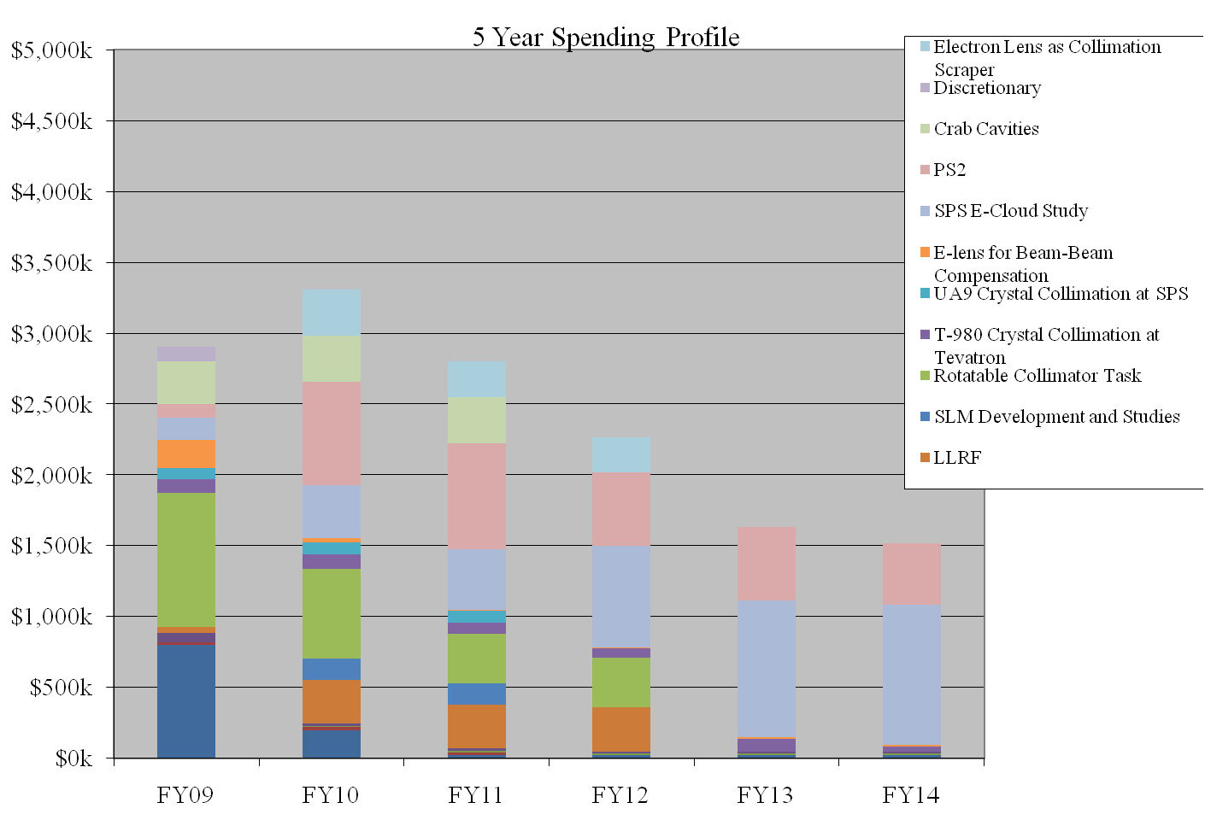
Work in Progress
LARP FY10 and Beyond - E. Prebys
July 14, 2009

Slide 8
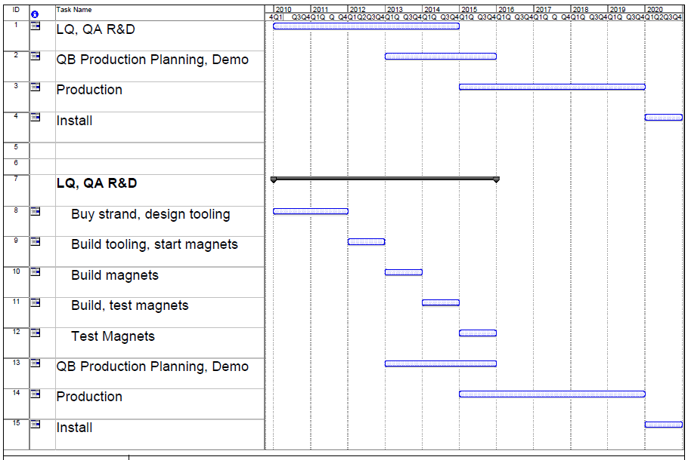
LARP FY10 and Beyond - E. Prebys
July 14, 2009

Slide 9
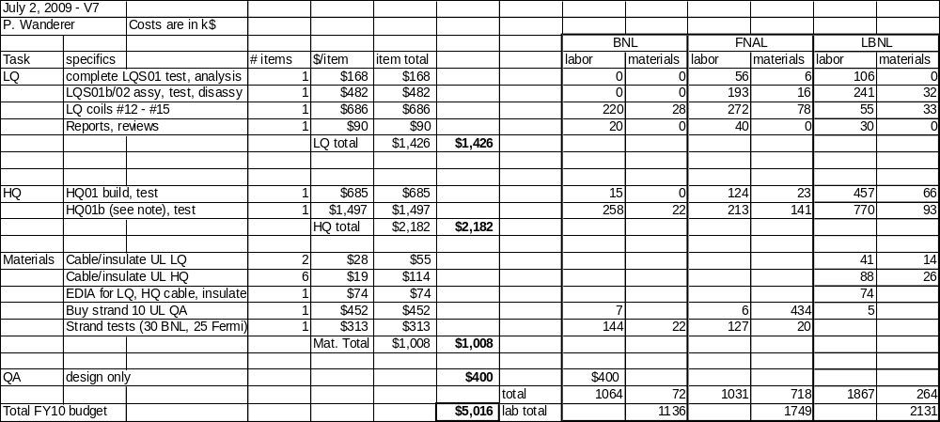
LARP FY10 and Beyond - E. Prebys
July 14, 2009

Slide 10
Original plan
  Very difficult even to figure out what the budget was
    Estimates range from $2.5-3.5M
  Finished in FY07
Currently
  Spent $4.1M so far
  Need to spend ~$300k more
  Finished in FY09
Bottom line
  These sorts of overruns are not that unusual in real projects!
  LARP contingencies are far from sufficient to cover overruns in significant deliverables.
  LARP should concentrate on R&D and avoid “hard deliverables”
More about this shortly…
LARP FY10 and Beyond - E. Prebys
July 14, 2009

Slide 11
Official LARP change control policies essentially ignored.
No consistent rules for dealing with burdens at different labs
Budget and schedule not integrated
  Earned value reporting must be done by hand, if it’s done at all
No systematic way of dealing with different types of contingency
  “deliverables” should have significant assigned contingency
  R&D projects should have “scope contingency”, possibly adjusted by an uncommitted unassigned contingency pool.
No formal accounting for “off project” contributions from member labs.
Developing future budget profile a nightmare.
LARP FY10 and Beyond - E. Prebys
July 14, 2009

Slide 12
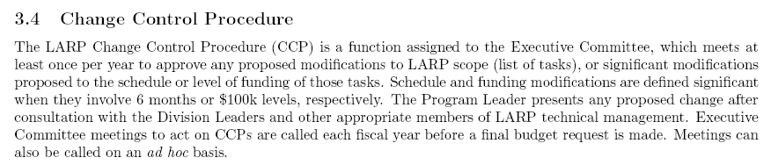
From LARP “Management Plan”:
Problem
  LARP doesn’t even have an informal base line
  Large changes can sneak in at the annual budget without being noticed
  Example: in order to see the budget and schedule problems with the lumi monitor, it’s necessary to forensically examine old task sheets.
LARP FY10 and Beyond - E. Prebys
July 14, 2009

Slide 13
BNL: 2-3 FTE
In order to understand LARP activities, and justify core budgets, we need to explicitly account for these efforts.
B&R KA 11 01 02, KA 15 01 02, and KA 15 02 01-1
Estimated
 | FY07 | FY08 | FY09 | FY10 | FY11
FNAL | 7,284.57 | 6,463.68 | 5,930.59 | 5,400.80 | 4,737.28
LBL | 1,419.00 | 1,627.00 | 1,880.00 | 2,280.00 | 2,315.00
SLAC | 0.00 | 330.00 | 1,419.61 | 1,013.83 | 1,045.00
Total | 8,703.57 | 8,420.68 | 9,230.20 | 8,694.63 | 8,097.28
LARP FY10 and Beyond - E. Prebys
July 14, 2009

Slide 14
Put LARP budget and schedule into a single MS Project file
Define burdens and labor rates correctly for the four member labs
  Eg, “BNL engineer”, “SLAC scientist”, etc…
For every labor category, have an equivalent “off projects” category with an appropriately PC name (“common effort”?), which is not included in the normal roll-up, but can be rolled up separately.
Progress is updated monthly by designated L2 and L3 managers.
Implement formal change control and change logging.
Project used to formulate long term plan and budget profile.
LARP FY10 and Beyond - E. Prebys
July 14, 2009

Slide 15
We have been working with Ken Domann to render the LARP program as a fully loaded project
  Will be able to roll up both on and off project expenses
Budget expenses will be charged against rolled project line items
  Need to identify FNAL person to do this once a month
For each subtask, a responsible person will be identified.
  Ken will email him an Excel spreadsheet each month on which he will report progress on his tasks and milestones
Ken will generate standard earned value reports on a monthly basis.
For schedule or budget changes beyond those specified on 3.4, we will generate proper CR’s which must be approved by the Executive Committee(?)
LARP FY10 and Beyond - E. Prebys
July 14, 2009

Slide 16
Currently translating budget into this format.
Structure and logic in place
Schedule approximately correct
Beginning to load resources
Will have in place for new FY
LARP FY10 and Beyond - E. Prebys
July 14, 2009

Slide 17
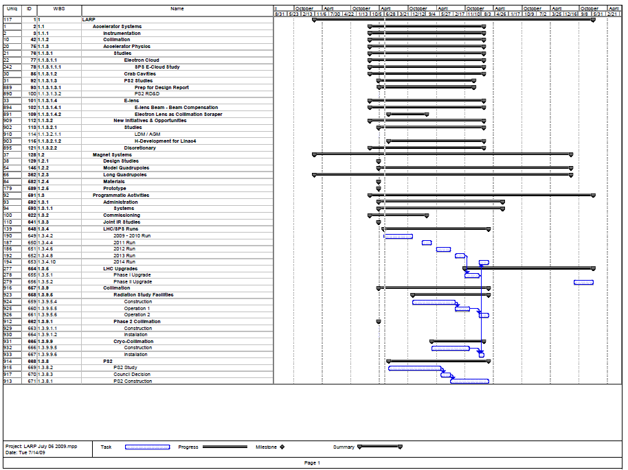
LARP FY10 and Beyond - E. Prebys
July 14, 2009

