Slide 1

Eric Prebys
LARP Program Director
January 14, 2009

Slide 2
US LHC Accelerator Research Program (LARP)
  Coordinates US R&D for the LHC
    FNAL, BNL, LBNL, SLAC, and some UT Austin
  Some instrumentation deliverables for initial operation
  R&D for future luminosity upgrades
  Major effort to develop Nb3Sn magnets for Phase II upgrades
Accelerator Projects for the Upgrade of the LHC (APUL)*
  Created partially in response to the problem with the lumi project (ie, large “hard deliverables”)
  New program to coordinate larger scale construction projects for the LHC
  Currently being organized around several phase-I activities
  Peter Wanderer recently named head.
  Exact scope and nature being determined
*formerly knows as “LAUC”
E. Prebys, LARP US/CERN meeting
January 14, 2009

Slide 3
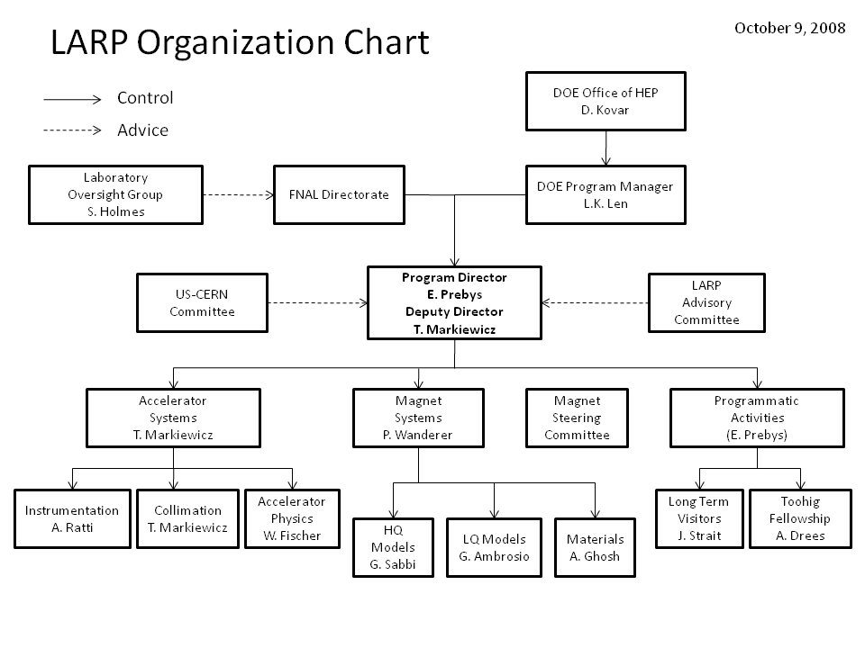
E. Prebys, LARP US/CERN meeting
January 14, 2009

Slide 4
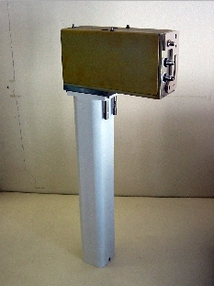
Schottky detector (ready)
  Used for non-perturbative tune measurements (+chromaticities, momentum spread and transverse emmitances)
Tune tracking (ready)
  Implement a PLL with pick-ups and quads to lock LHC tune
  Investigating generalization to chromaticity tracking
AC dipole (ready)
  US AC dipole to drive beam
  Measure both linear and non-linear
  beam optics
Luminosity monitor
  High radiation ionization detector
  integrated with the LHC neutral beam
  absorber (TAN) at IP 1 and 5.
  Will be ready
E. Prebys, LARP US/CERN meeting
January 14, 2009

Slide 5
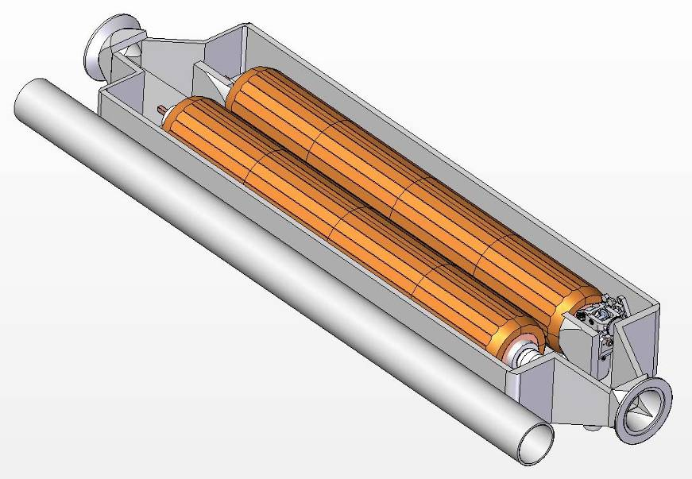
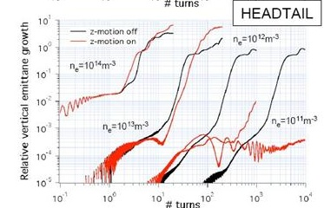
Rotating collimators
  Can rotate different facets into
  place after catastrophic beam
  incidents
  Aim for prototype in FY09
Crystal Collimation
  CRYSTAL Collaboration
  T980
Beam-beam studies
  General simulation
  Electron lens
  Wire compensation
Electron cloud studies
  Study effects of electron cloud in
  LHC and injector chain
E. Prebys, LARP US/CERN meeting
January 14, 2009

Slide 6
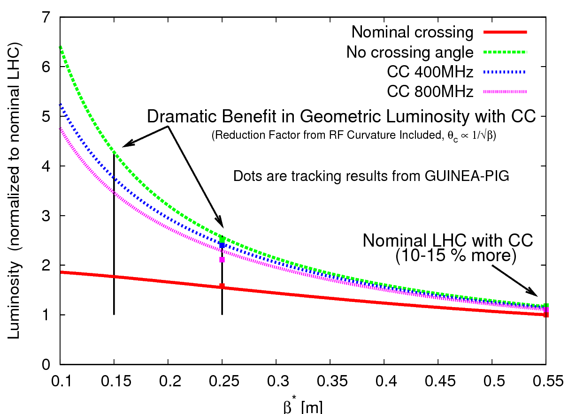
Crab cavities
  Transverse fields rotate bunches to
  compensate for crossing angle in
  final upgrade
  Goal: one cavity in Phase I upgrade,
  2 (global) or 4 (local) in Phase II
  Significant opportunity
  Collaboration with KEK, CERN, and
  Daresbury
  But big job, lots of $$
PS2 opportunities
  Significant synergy with Project X
  Ecloud
  Injection, collective instabilities
  Laser stripping
  RF
E. Prebys, LARP US/CERN meeting
January 14, 2009

Slide 7
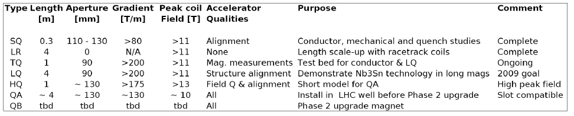
Magnet groups at FNAL, BNL, and LBNL working to develop 4m Nb3Sn magnet appropriate for use in the LHC Phase II upgrade.
Currently pushing all parameters
  Long Quad (LQ): 4m quad with 90 mm aperture
  High field Quad (HQ): 1m quad with 130 mm aperture
Plan first accelerator quality prototype (QA) to be plug compatible with Phase I NbTi magnets
  Nb₃Sn would give larger termperature margin
Parameters of final prototype (QB) will be determined by Phase II optics decisions
E. Prebys, LARP US/CERN meeting
January 14, 2009

Slide 8
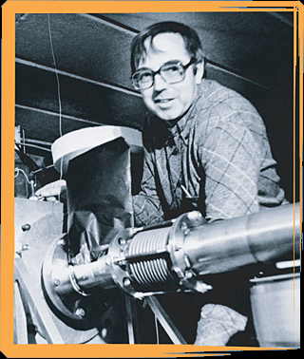
Long Term Visitors program
  Pay transportations and living expenses for US scientists working at CERN for extended periods (at least 6 months/year)
  Interested parties coordinate with a CERN sponsor and apply to the program (Jim Strait)
  Plan to support 4 in FY09
Toohig Fellowship
  Named for Tim Toohig
  Open to recent PhD’s
  Successful candidates divide their
  time between CERN and one of
  the four host labs.
  Currently 4 Toohig Fellows in
  program
E. Prebys, LARP US/CERN meeting
January 14, 2009

Slide 9

LARP is not really equipped to deal with large deliverables
  Primarily an R&D organization
  Insufficient contingency
APL is being developed to handle larger projects with hard deliverables.
Initially comprises projects for the Phase I upgrade.
Considering an ongoing relationship where LARP R&D feeds into APL projects.
More about this from Peter
E. Prebys, LARP US/CERN meeting
January 14, 2009

Slide 10
4/08, LARP CM10 collaboration meeting, Port Jefferson
6/08, LARP review, LBL
8/08, LARP management changes (Peggs->Prebys)
9/08, LHC starts up, for a bit
10/08, LARP CM11 collaboration meeting, FNAL
11/08, “APUL” project officially starts, aimed at hard deliverables for Phase I (primarily SC D1 separator dipoles)
1/09, LARP “mini-review”, DOE
1/09, CERN management changes (Aymar->Heuer)
1/09, Peter Wanderer named head of APUL
1/09, here we are
E. Prebys, LARP US/CERN meeting
January 14, 2009

Slide 11
There were comments at both the April LARP collaboration meeting and the June review to the effect that LARP was not communicating well with CERN about projects and priorities.
The bulk of the criticism in the report focused on the perceived “disconnect” between LARP and CERN regarding prioritization of LARP activities.
I believe this disconnect largely referred to activities related to the abortive attempt to get Nb₃Sn magnets into the Phase I proposal (specifically, the JIRS group).
  It's now realized this is not (and likely never was) realistic. We have suspended activities of the JIRS group, with the idea of restructuring it with an emphasis on the relationship between our magnet program and the phase II upgrade.
E. Prebys, LARP US/CERN meeting
January 14, 2009

Slide 12
General
  LARP Liaison: Oliver Bruening
    Serves as primary “sounding board” for LARP proposals
    De-facto veto power over LARP projects (No CERN interest= non-starter)
  US/CERN meeting
    Once a year
    Discuss general priorities and strategy
    Should we do this more often?
  LTV/Toohig fellows
    Establish a significant body of “man on the street” impressions of CERN interest
E. Prebys, LARP US/CERN meeting
January 14, 2009

Slide 13
Specific
  Alex Ratti has been working closely with Enrico Bravin (responsible for LHC luminosity measurement) on the completion and handoff of the lumi monitor
  Rama Calaga is working closely with CERN people to coordinate crab cavity effort
  Tom Markiewicz is working closely with Ralph Assmann (head of LHC collimation) on the potential use of the rotatable collimators
  Uli Wienands has been working with Oliver Bruening and CERN in general to identify the best ways for LARP to contribute to the PS2 effort.
E. Prebys, LARP US/CERN meeting
January 14, 2009

Slide 14
In the absence of a big surprise from the DOE, LARP will be resource limited for the foreseeable future.
We hope that in areas of accelerator systems, CERN can help us apply our resources in the most effective manner among the possible activities, including:
  Ongoing work
    Ecloud
    Beam beam (including electron lens)
    Crystal collimatoin
    Optics (Phase I and Phase II)
  New activities
    Crab cavities
    PS2
In the area of magnet systems, we hope CERN can help us establish a time line for delivery of a viable Nb3Sn prototype.
E. Prebys, LARP US/CERN meeting
January 14, 2009

