Slide 1

Eric Prebys
LARP Program Director
Jaunary 14, 2009

Slide 2
This year’s budget
FY10 and beyond
Making tough choices
E. Prebys, LARP US/CERN meeting
Jaunary 14, 2009

Slide 3
Guidance from DOE
  $13M with a 6 month continuing resolution at 84%
    .5*.84*13+.5*13 = $11.96M
  Separate money ($1-2M) found for APUL planning!
General breakdown (informed by Steve’s exit advice)
  Accelerator Systems: $2.9M
  Magnet Systems: $5.0M
  Program Management: $2.1M
    Includes LTV and Toohig Fellows (of which we have 4)
  Contingency: $2M
In then end, had to give up some continency to increase Program Management
E. Prebys, LARP US/CERN meeting
Jaunary 14, 2009

Slide 4
These budgets use US accounting rules, where labor is “fully loaded”
  FTE ~ $300k/year
We get significant contributions “off the books” in the form of scientific labor, particularly from the SLAC and FNAL core programs.
  Nevertheless, it eventually costs money to pay people to “think about stuff”
E. Prebys, LARP US/CERN meeting
Jaunary 14, 2009

Slide 5
Luminosity monitor was expected to be complete by end of FY08
  Instead had significant overruns, and needs significant funds on FY09 (original request $1M -> $800k)
  Still consider it absolutely vital for lumi to work!
Rotating collimators still a big budget item
  Still consider it important to complete a prototype this year in time to at least be considered a solution by CERN.
Strong feeling that LARP should take a leading role in crab cavity development
  Led by Rama Calaga
  Support by CERN
  General feeling that “the train is leaving the station”.
Magnet program still has to funded at a level that will insure a working magnet for the LHC Phase II upgrade
E. Prebys, LARP US/CERN meeting
Jaunary 14, 2009

Slide 6
Accelerator Systems
  Iterative process, primarily involving Wolfram, Tom, Alex, and myself, to converge on the bottom line.
    Key component: relying on labs to contribute labor in accordance with their core competencies (i.e. not charged directly to LARP)*
  Key casualty: No real money for PS2, for which there was a great deal of excitement within LARP and at CERN
    Will continue with contributed labor while we decide what to do for next year.
Magnet Systems
  Much more monolithic than AS
  L1 and L2 managers worked to stay within the budget
E. Prebys, LARP US/CERN meeting
Jaunary 14, 2009

Slide 7
Not much leeway
  Management costs determined by historical usage
  Need to honor commitments to LTV’s and Toohig fellows
  Only discretionary is Programmatic travel, which I have reduced by trying to include travel with the appropriate project.
E. Prebys, LARP US/CERN meeting
Jaunary 14, 2009

Slide 8
Crab cavities
  Original request: $700k
    Cavity design
    Cryomodule design
    LLRF
  Budget: $300k
    Rely on “off books” help in cavity design from LBNL and Jlab
    Defer cryomodule and LLRF work
PS2
  Uli Wienands developed a number of plans under various funding scenarios
  In the end, budgeted $100K, primarily for travel and M&S, assuming that most scientific time would be contributed.
E. Prebys, LARP US/CERN meeting
Jaunary 14, 2009

Slide 9
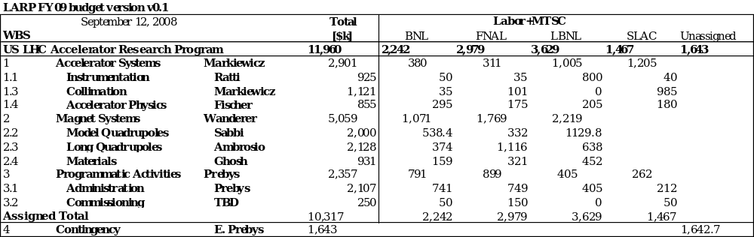
E. Prebys, LARP US/CERN meeting
Jaunary 14, 2009

Slide 10
Lumi and rotatable collimator should ramp down considerably, allowing concentration on other significant commitments
Candidates:
  Crab cavity effort
    Crab cavities deflect the beam to compensate for crossing angle.
    Potential to dramatically increase luminosity under most likely Phase II upgrade scenario
  PS2 Activities
    CERN has requested LARP help in the design (white paper study) of the PS2, which will replace the PS for the phase II upgrade.
E. Prebys, LARP US/CERN meeting
Jaunary 14, 2009

Slide 11
Pros
  Potentially a big impact on luminosity
  Lots of intellectual interest in US community
  Can be divided into well-defined tasks that are straightforward to monitor.
Cons
  Barring a budget windfall, LARP will not have the resources to take a significant role in construction, so must coordinate with multiple labs/countries/funding agencies.
  Current plan relies on SBIR grants
  If badly managed, potentially a black hole of resources that never accomplishes anything.
E. Prebys, LARP US/CERN meeting
Jaunary 14, 2009

Slide 12
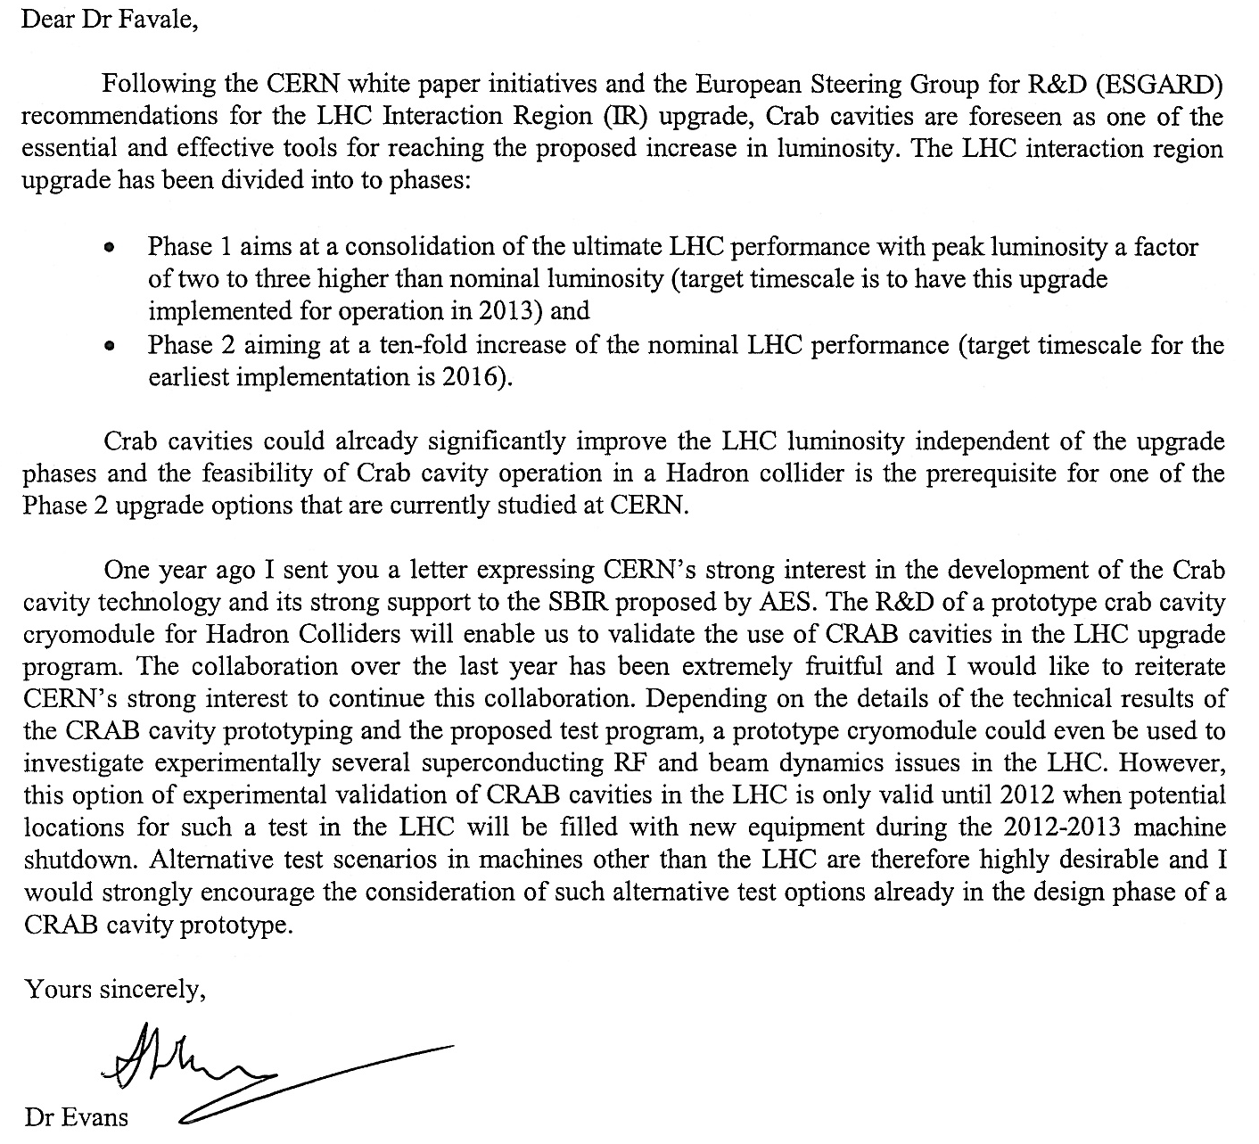
E. Prebys, LARP US/CERN meeting
Jaunary 14, 2009

Slide 13
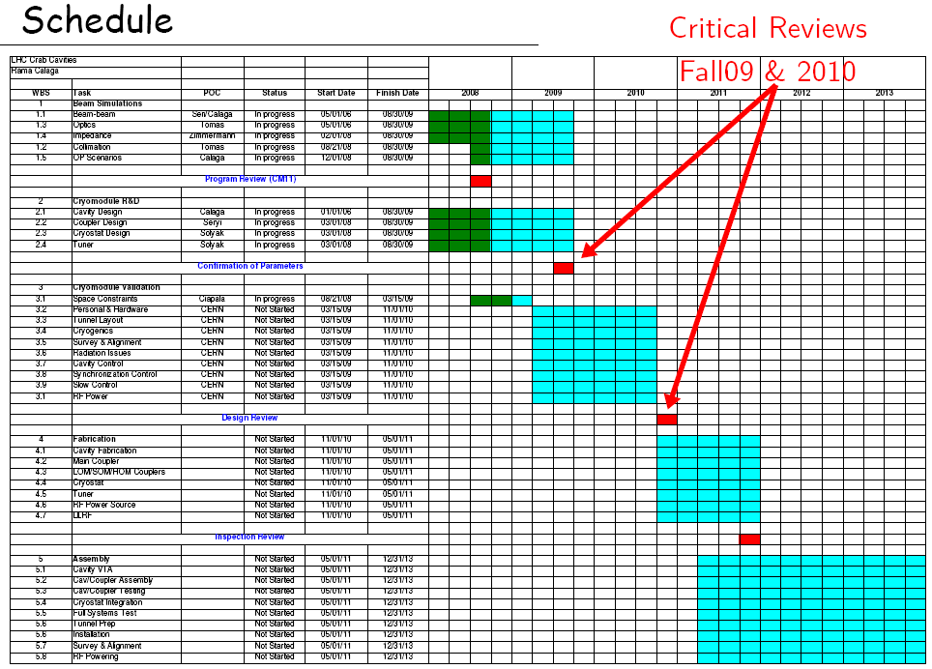
E. Prebys, LARP US/CERN meeting
Jaunary 14, 2009

Slide 14
Pros
  Lots of opportunities to make contributions
  Well aligned with US interests and expertise, particularly Project X
  Involvement “scalable”
Cons
  Activity and goals not as well defined
  Danger of funding a lot of people to “think about stuff”
Potential areas of focus
  Injection issues
  Electron cloud
  Laser stripping?
E. Prebys, LARP US/CERN meeting
Jaunary 14, 2009

Slide 15
Assume flat-flat budget over next year or so
  Will work on this, but don’t expect miracles
  ~$12-$13M/yr
Lumi and Rotating collimators will ramp down
  Would be naïve to assume they go to zero
Several things positioning to take their place
  Existing efforts (Ecloud, beam beam, jirs)
  New things (PS2, crab cavities)
Either PS2 or crab cavities could easily use out AS budget
  And it would be well spent.
Have to make tough choices
  Can’t do everything we want
  Probably can’t shrink MS budget and stay viable
E. Prebys, LARP US/CERN meeting
Jaunary 14, 2009

Slide 16
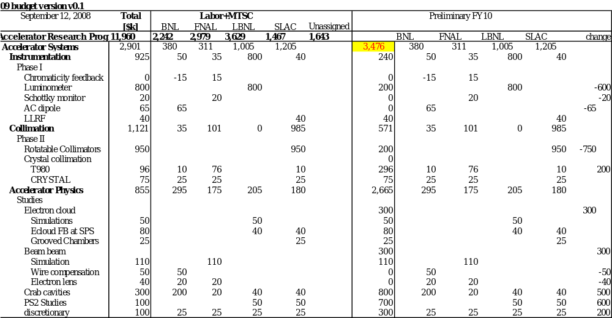
E. Prebys, LARP US/CERN meeting
Jaunary 14, 2009

Slide 17
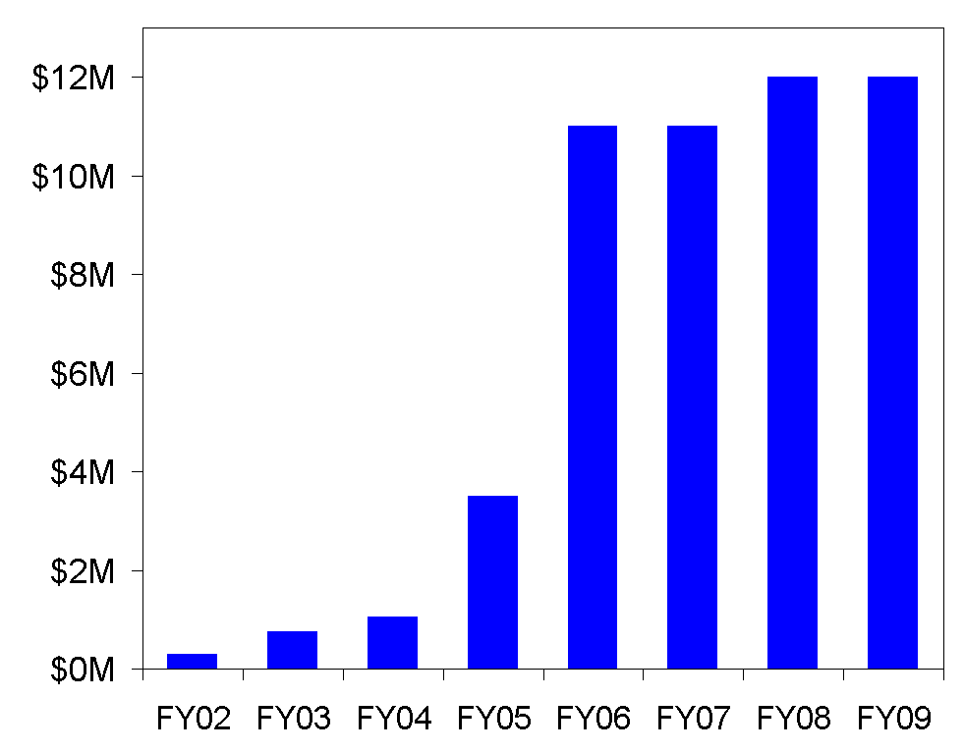
LARP had a period of rapid growth in the earlier yeas, which led to some over- optimism
E. Prebys, LARP US/CERN meeting
Jaunary 14, 2009

Slide 18
Get lumi monitor working prior to 2009 start up
  LARP reputation depends on it
Protect core magnet program
  Insure that LARP produces a prototype Nb₃Sn magnet on a time scale that makes it a viable choice for the Phase II upgrade.
Complete rotating collimator prototype
  This has been a significant LARP activity, and it’s important that we produce a prototype on a time scale that will allow it to be part of the collimation solution.
Continue to support Toohig Fellows and Long Term Visitors
  Very important link to CERN
  LARP supported visitors making significant and well received contributions.
We need some help in prioritizing the rest!
E. Prebys, LARP US/CERN meeting
Jaunary 14, 2009

Slide 19
Projects like the Schottky, AC Dipole, and tune tracker were a great success because LARP did R&D and then someone else (CERN in this case) contributed much of the actual hardware.
  Try to follow this model in the future.
Avoid deliverables as large as the lumi monitor
  Once the R&D is done, they should be separately proposed or included in other construction packages.
The life of LARP will logically end when the magnet group produces a viable prototype for Phase II
  Need advice from CERN about the probable time scale for this.
  Make our other plans accordingly, with mutli-year budget profiles.
E. Prebys, LARP US/CERN meeting
Jaunary 14, 2009

Slide 20
The lumi and rotatable collimator objectives must be met, but as these ramp down significant – but not unlimited resources – will be freed up.
How best should LARP allocate these resources among
  Ongoing tasks
    Ecloud
    Beam beam (including electron lens)
    Various LLRF projects
    Crystal collimation
    Optics and commissioning (present, phase I, phase II)
  New initiatives
    How realistic are crab cavities?
    How useful is our help in PS2
E. Prebys, LARP US/CERN meeting
Jaunary 14, 2009

