Slide 1
ORBUMP Power Supply
ORBUMP steers beam out through stripping foil during injection
Pulse Forming Network (PFN) - looks like a very slow transmission line. Flat top ~ (10 usec)*(number of cells).
Controller
Charging SCR
.
.
.
16x3 SCR’s
Reduced to 6 cells some time ago.
Reduced to 4 last Thursday
Step-up transformer
To magnets
30 kA

Slide 2
Recent Problems
Last Thursday, a cooling hose broke.
  HV bus bar broke down
  Tuning rod melted
Took advantage of the “opportunity”
  Reduced PFN from 6 to 4 cells (should reduce heating of magnets).
  Replaced all water hoses.
  Removed unused inductors.
When powering back up…
  An SCR and some associated electronics blew
  Replaced, happened again.
  Disconnected all 48 SCR’s and verified all connections. Found some minor problems. Power came up after that, but…
New PFN impedance changed V to I ratio.
  When we attempted to raise V to compensate, ORBUMP started missing triggers, causing huge period 1 losses (which had nothing to do with LLRF!!)
  Problems tracked down (after several days) to transient noise on the firing card.
  Works now (?!?!?)

Slide 3
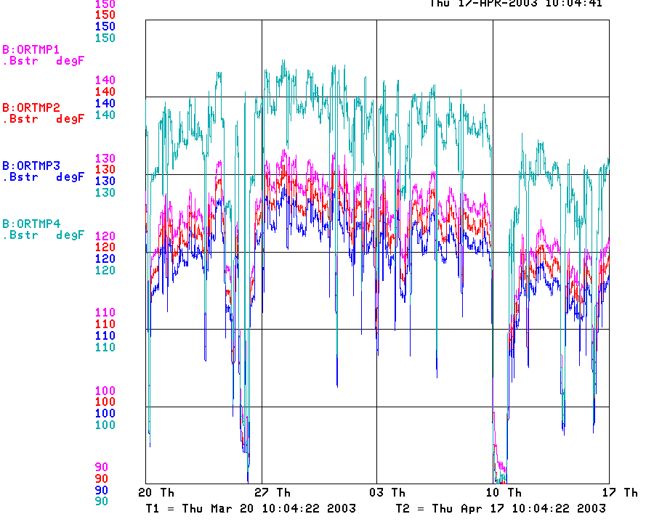
Effect of Shorter Pulse
ORBUMP Temperatures

Slide 4
Plans for ORBUMP
Immediate future (next week or so)
  Improved water distribution (new manifold, some different plumbing).
  Replace inductors with rebuilt spares.
  Lucite tuning rods -> G10 (won’t melt).
Longer term.
  Buy new capacitors ($1K each)
  Replace (48) SCR network with modern (4 or 8) network.
    On the table for a while
    Just got bumped up in priority. Goal to be in by summer.
  New controller? Possibly use MP02 design directly?

Slide 5
RF Cavity Update
All university fabrication under way or complete.
Parts have started to arrive. All look OK so far.
Assembly fixtures being constructed at MI-60.
Still looks good for summer shutdown.

Slide 6
Collimators
Dust still settling from review, but seems to have passed.
Design more or less complete.
Working out details of installation logistics.
Still looks good for the summer shutdown.

Slide 7
Dogleg Replacement
Kicked Beam
Just before Extraction
Pulsed Magnet
Pulsed Magnet
Pulsed “anti-septum”
Circulating Beam
Meeting next week to work out details of design.
Important to understand field quality requirements.

