Slide 1
Joint Argonne/Fermilab Venture
  Under auspices of virtual “Illinois Accelerator Institute”
  ~5 students at each lab
  Joint selection process, after which program administered separately at the two labs
Program
  Nominally matches SULI/IPM program
    Includes two weeks at the US Particle Accelerator School (USPAS):
      June 15-26, Albuquerque
  Student works closely with a mentor on a predetermined project involving accelerator physics or related technology
  Includes:
    Transportation to/from lab
    Lodging and daily transportation to work
    $450/wk stipend (including time at USPAS)
    Transportation, tuition, and board for USPAS
Eligible
  Physics, Math, Engineering, or Computer Science majors at U.S. Universities (not necessarily U.S. citizens)
  Juniors or outstanding Sophomores
E. Prebys – Lee Teng Summary
1/30/09

Slide 2
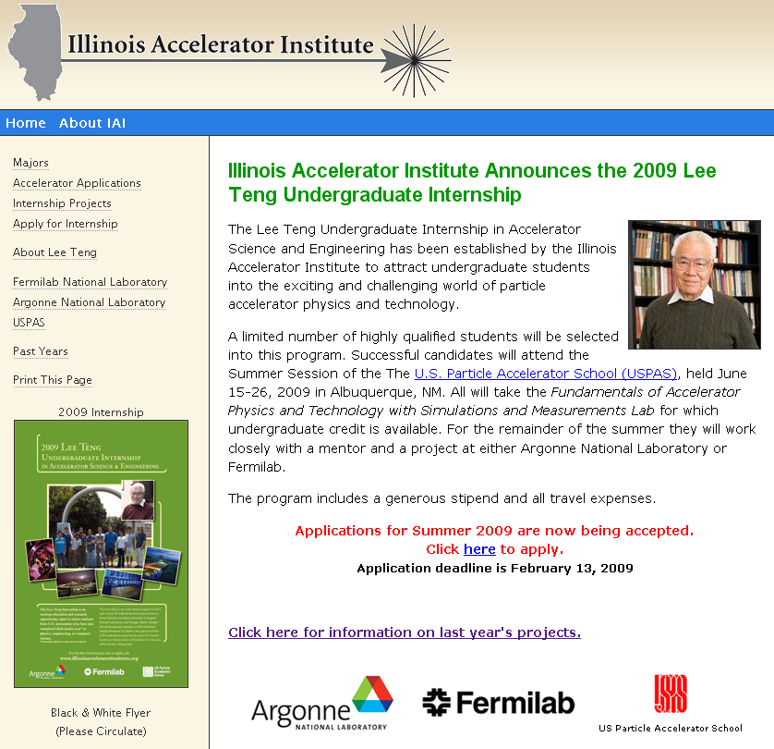
E. Prebys – Lee Teng Summary
1/30/09

Slide 3
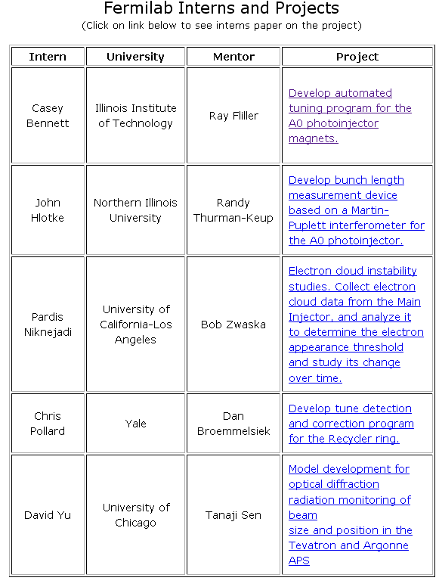
E. Prebys – Lee Teng Summary
1/30/09

