Slide 1
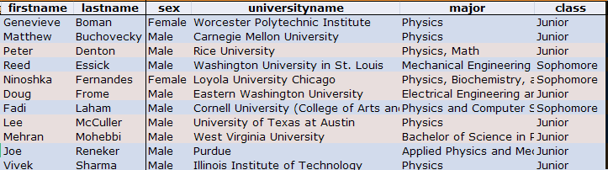
 | FNAL
 | ANL
 | 2008 | 2009
Total Applicants | 35 | 45
Total Slots | 11 | 11
Argonne | 6 | 6
FNAL | 5 | 5
Total offers | 13 | 14
Rejections | 2 | 3
Males | 10 | 9
Females | 1 | 2
non-US | 3 | 2
Illinois schools | 5 | 2
Sophomores | 1 | 3
Juniors | 10 | 8
Lee Teng Follow-up Meeting
9/9/09

Slide 2
(Fermilab) Interaction with HR much better
  All thanks to Carol Angarola
Set up process (ID’s, computer accounts, etc) more streamlined, particularly at FNAL
Papers and presentations more organized from the beginning
USPAS
  Definitely better than last year.
  Still a few complaints, particularly about the labs.
A little more structure to connect students at labs and between labs.
Other feedback?
  Linda?
Lee Teng Follow-up Meeting
9/9/09

Slide 3
Create a 2009 section on the website.
  Upload papers
  Upload pictures
  Anita?
Anything else?
Lee Teng Follow-up Meeting
9/9/09

Slide 4
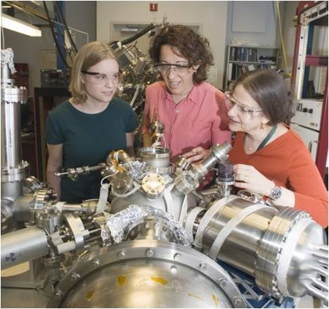
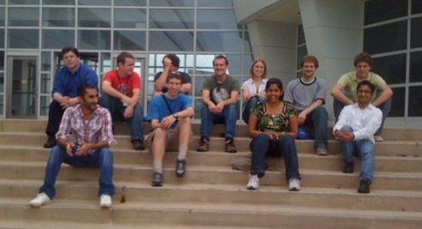
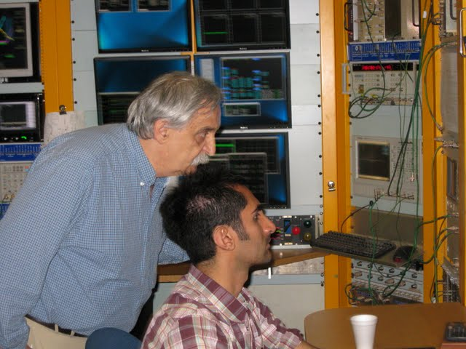
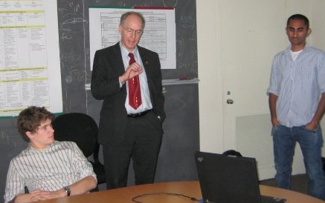
9/9/09

Slide 5
It’s clear the selection process still has a pretty big random component
  Significant disconnect between our rankings and the selections of mentors.
  Propose we don’t leave selection entirely to mentors, but rather do some pre-matching and present each mentor with a short-short list
  More work for us, but…
Other?
Lee Teng Follow-up Meeting
9/9/09

Slide 6
Dates
  USPAS (Boston): June 14-25, 2009
  I think SULI/IPM is August 31 (two week before)
  Propose we match that again
    Do we want to try to coordinate some students two weeks later to accommodate trimesters?
Materials
  I’d like to get the posters and website updated by about ~10/1
    Shouldn’t be too hard
  Distribute like last year?
Application
  Use IPM system again?
  Rumor has it it’s drastically improved for this year.
Lee Teng Follow-up Meeting
9/9/09

