Slide 1
Linac Status and Plans (Incomplete)
Eric Prebys
FNAL Accelerator Division

Slide 2
General Comments
The linac is not currently a performance bottleneck for the complex when it is running stably.
There are ongoing longevity and reliability concerns in the linac
  General state of instrumentation is inadequate to characterize linac behavior
  The 7835 tubes from Burle continue to be a major concern, although the situation is better than it was a year ago.
  There are new worries about the klystrons, which we formerly believed were not an issue.

Slide 3
Outline
Recent Projects
7835 Situation
Klystron situation
400 MeV line work

Slide 4
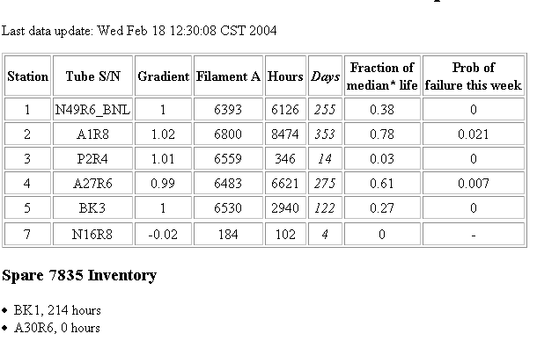
7835 Status
Lots of interaction between the lab (Czarapata) and Burle to help them improve their reliability.
They seem to remember how to make tubes again.
Present inventory:
+ one ready to be tested

Slide 5
Christmas Klystron Woes
As of Dec. 1, we believed 800 MHz klystrons were not a worry.
  Only two had failed
  We had six spares
A few days before Christmas, the klystron in station one failed.
  Three spares turned out to be bad
  Tracked down to vacuum problem (and a flaw in our measurement technique).
Plan
  We’ve pulled one good spare from the MuCool project
  Ralph Pasquinelli put in charge of investigating and acting
  We think we understand the problem and will work with L3 to address it.
Current stock
  Two good spares.
  One “gassy” tube, probably bad
  Three bad tubes at L3, one ready to be repaired (no good estimate)
  Two more bad tubes which will either be shipped or analyzed here.

Slide 6
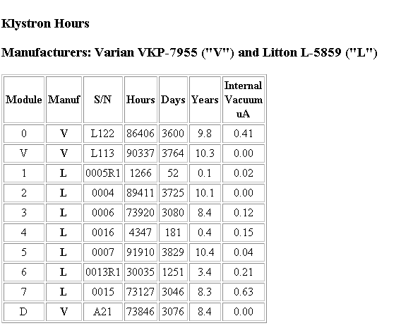
Klystron Status
3 in since new linac built!!

Slide 7
400 MeV Line Work
A new Lambertson was installed during the shutdown to steer beam from the Linac to the Booster
Although the field qualities of this magnet were vastly superior to the old one, it was a major effort to tune for it.
This highlighted our lack of understanding of the “400 MeV Line”.
A major effort has gone into studying and optimizing this line.
(more slides to be added).

