Slide 1
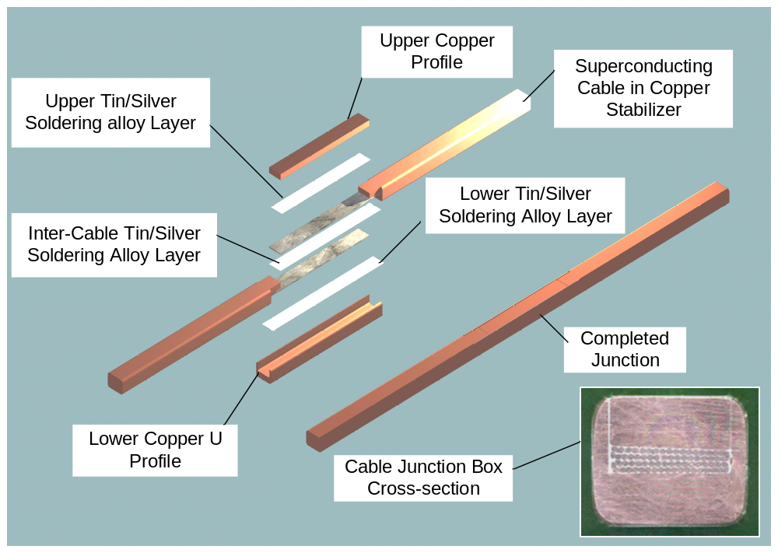
*see talk by Arjan Verweij, Tuesday PM
Eric Prebys - Fermilab Summer Student Lecture
7/27/09

Slide 2
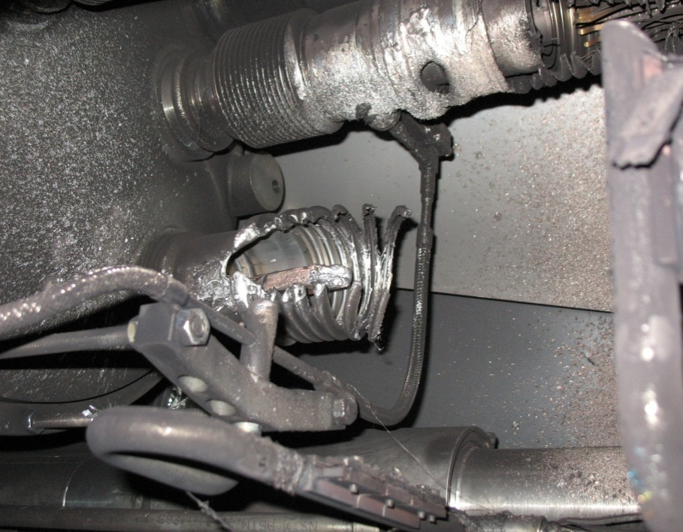
Theory: A resistive joint of about 220 nΩ with bad electrical and thermal contacts with the stabilizer
No electrical contact between wedge and U-profile with the bus on at least 1 side of the joint
No bonding at joint with the U-profile and the wedge
Loss of clamping pressure on the joint, and between joint and stabilizer
Degradation of transverse contact between superconducting cable and stabilizer
Interruption of longitudinal electrical continuity in stabilizer
Problem: this is where the evidence used to be
A. Verweij
Eric Prebys - Fermilab Summer Student Lecture
7/27/09

