Slide 1
Linac Status
Eric Prebys
DOE Review, Proton Source Breakout Session
July 21,2003

Slide 2
Linac Performance
The existing linac is not a limit to run II performance… when running nominally:
  It could easily supply at least several times the protons the booster can currently accept*
  This is plenty for the collider, MiniBooNE, NuMI, and SY 120.
  There are, however, some stability problems which do affect performance.
Our chief concern continues to be the vulnerability 201 MHz system, particularly the 7835 triode power tubes
  This is a significant vulerability of the entire lab
  This was addressed in a pre-review question.
  Paul Czarapata has address this issue in detail in his plenary talk.
*some external radiation issues would have to be addressed

Slide 3
Loss/activation Issues
When the linac is running well, radiation levels just outside the 400 MeV labyrinth are not far below their trip point.
Linac mis-steering can and does cause trips here.
If the planned shutdown improvements to the booster have the desired effect, this radiation loss will become a limiting factor.
We are planning to install a new Lambertson at the end of the linac which should solve, or at least dramatically ameliorate, this problem.
Activation at other points may become an issue at full MiniBooNE+NuMI intensities

Slide 4
Stability Issues
Linac energy (time-of-flight) variations:
  Dramatically affect Booster injection efficiency
  Seem to be related to line voltage (affects filament current)
  Have added an active velocity feedback control
  We’re looking into ways to stabilize the filament current.
We have occasionally had stability problems when pushing 7835 tubes to the end of their life (sometimes because we’re waiting for a spare)
400 MeV line problems
  Loss problems:
    Should be ameliorated by new Lambertson
  Malfunctioning power supplies
    We’ve replaced two
    We’re installing beam line tuning software to stabilize beam position.
  New Lambertson should facilitate 400 MeV line tuning.
New monitoring software should help identify sources of instability in the future.
  Discussed in instrumentation breakout

Slide 5
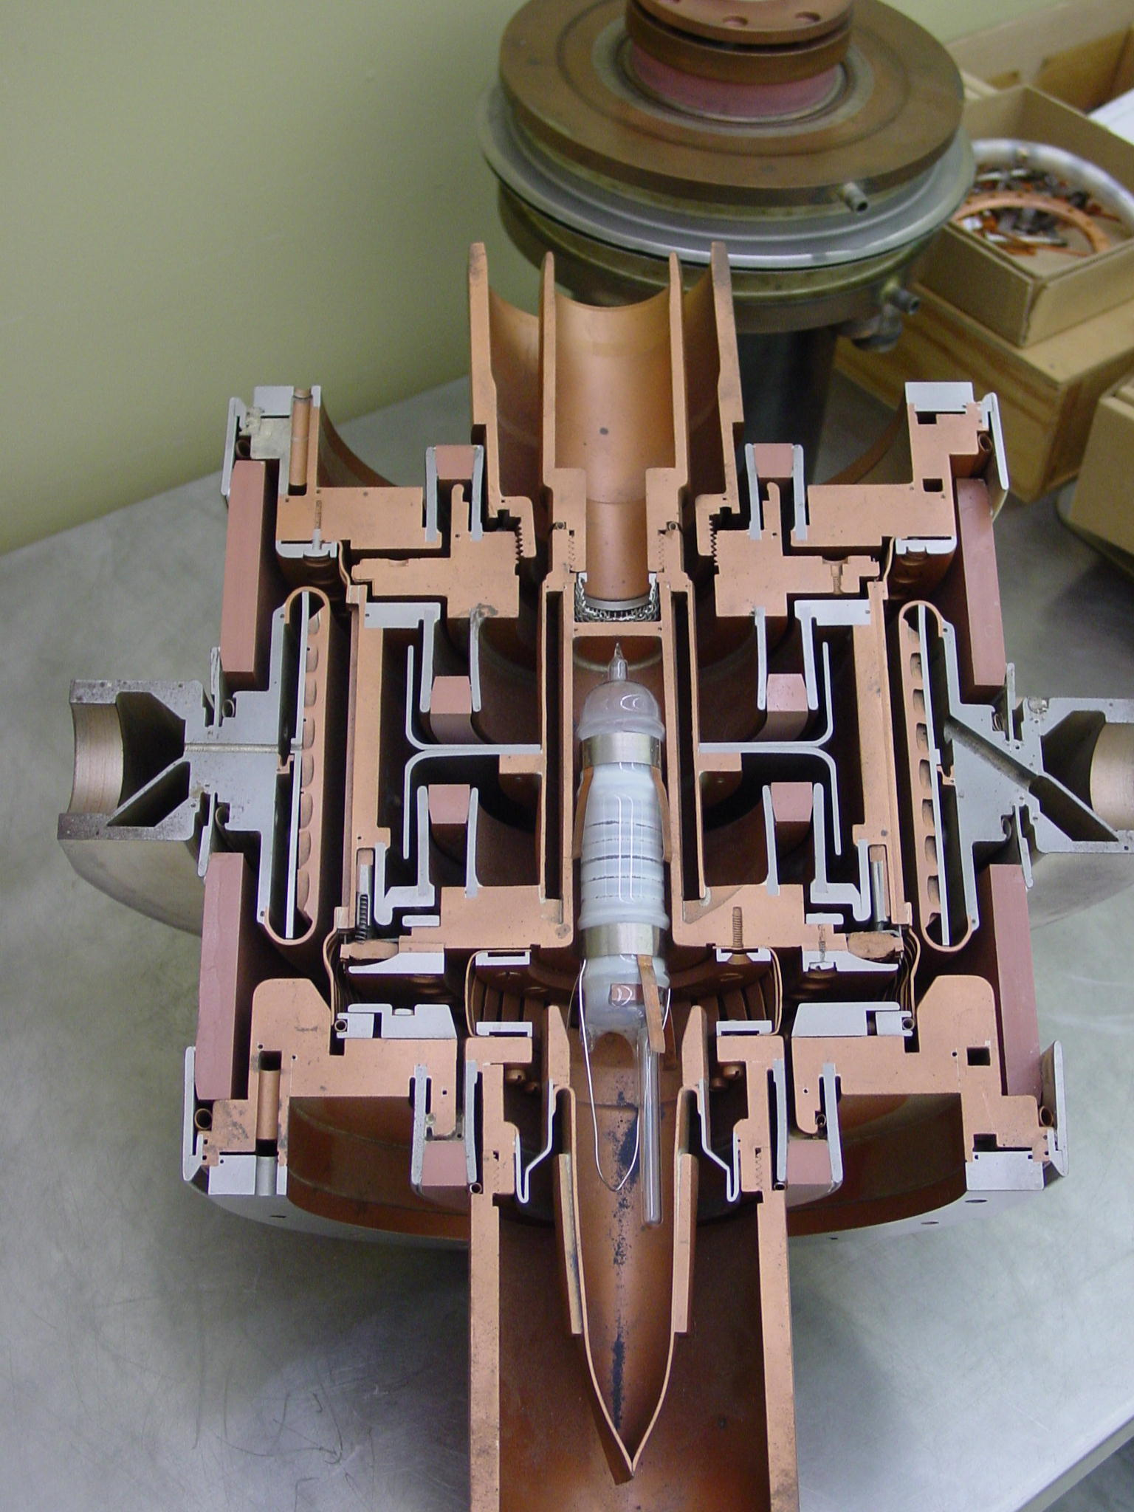
The 7835 Power Triode – Our BIG Worry
Very complex technology
  RF, material science, vacuum, chemistry
Similar to other tubes made by Burle
  4616 & 4617
7835 only used in the scientific community.
  One military user for 4617
Quality varies from decade to decade

Slide 6
Tube Throughput with Burle
Median lifetime: 16 months
  Recent lifetime: Less! (possibly related to vacuum problems)
We need about 3.41 tubes/year to maintain
  Assuming historical median
  With present tubes: twice that.
Burle now can make/rebuild ~20/year
  Critical path: Final bakeout; two stands, 3-5 weeks bakeout
  Also of concern: Supplier delivery time (e.g., ceramics, cathode)
  Recently had four failures for one success!!
Delivery time: ~8 months,
  But, often 12 months!
This is obviously a worry.

Slide 7
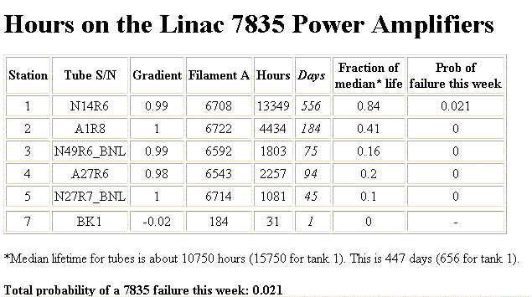
Present 7835 Power Tube Situation
We’ve received 5 tubes since the last review
  Only two delivered from Burle, after numerous failures
  Two borrowed from BNL
  One borrowed from Argonne
  We now have one spare; we have frequently had zero; we have never had two.
  Next one due “in August”.

Slide 8
Solutions to the 7835 Problem
Short term:
  Work with Burle to increase yield and lifetime - already paying off.
  Coordinate our needs with other labs – already doing this, but so far FNAL is the only one benefiting.
Longer term possibilities:
  Find someone else to make/rebuild the tubes – not a lot of interest.
  Learn to rebuild tubes – some hope at BNL.
  Find a drop-in substitute – No other 5MW triodes.
  Identify a substitute tube (or possibly pair) –
    Promising work at LANL with Thales 628 Diacrode
    Major upgrade to maintain 1970 performance.
  Replace the whole 116MeV linac as part of a global upgrade plan (e.g. cut and past SNS front end).

Slide 9
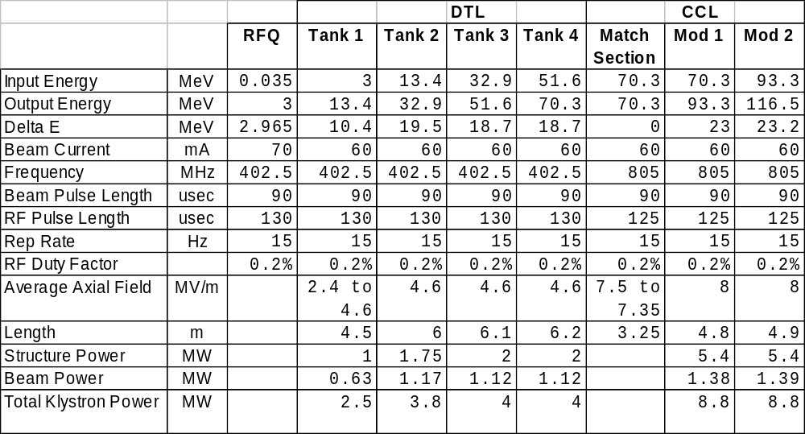
Example: 402 MHz Parameters from Young
Price tag: About $40 x 10⁶.

Slide 10
Other (selected) Linac Longevity Issues
Addressed by Elliott McCrory in “Getting the Proton Source to 2010”, Dec. 20, 2002
  http://mccrory.fnal.gov/memos/PS_to_2010.ppt
High Voltage Modulator
  Switch tubes no longer made
    We have enough to last ~7 years
    Econco can probably rebuild
  Will need to be replaced anyway if we go to a different type of power tube
7835 Filament power supplies
  Old and hard to maintain
  Sensitive to line voltage
  Looking into upgrades
Tank 1:
  Originally a prototype
  If it fails, could take months to repair/replace
HV Water system: Upgraded in FY03.
How long do klystrons really last??
  Will they all fail at once?

Slide 11
Linac Summary
The current linac specifications are adequate to meet all the demands expected in the next few years
  Working to improve stability
  Investigating radiation/activation issues
7835 tubes remain our primary worry
  A major lab vulnerability
  No easy fix
  The final solution depends on the future direction of the lab.

