Slide 1

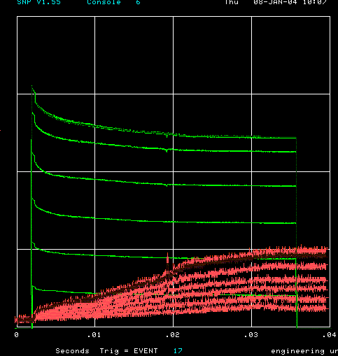
How far have we come?
Before MiniBooNE
Now (same scale!!)
Charge through Booster cycle
Time (s)
Energy Lost
Note less pronounced injection and transition losses

