Slide 1
Output of Project X
  1 “blast” = 9mA*1ms = 5.6e13 (protons)/(1.4 s cycle)
  = 4e13 p/s on average (!!)
  = 50 kW average beam power
  = 8e20/yr (2e7 seconds)
  4 blasts available during 120 GeV operation
Compare to “intermediate program” (Accumulator/Debuncher)
  6*4e12 protons/(1.33 s NOvA cycle) = 1.8e13 p/s on average
  = 23 kW average beam power = 3.6e20
Modes of operation considered
  All “extra” blasts, extracted one at a time
    1 blast in 200 ms (sharing) = 14% duty factor = 360 kW peak
    4 in 800 ms = 57% duty factor = 360 kW peak
    2 blasts in 800 ms (timeline hog) = 57% duty factor, 50% “usage factor” = 180 kW peak
    1 blast in 800 ms (super hog) = 57% duty factor, 25% usage factor = 90 kW peak
*From my talk on 5/2
5/23/08

Slide 2
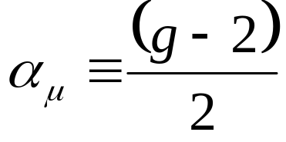
To lowest order, the muon magnetic moment (g) is 2
g is perturbed by contributions from virtual loops, from both the Standard Model and (possibly) beyond.
The calculation and measurement of the “anomalous magnetic moment”
stands as one of the most precise tests of the Standard Model
E. Prebys - MEISG Meeting
5/23/2008

Slide 3
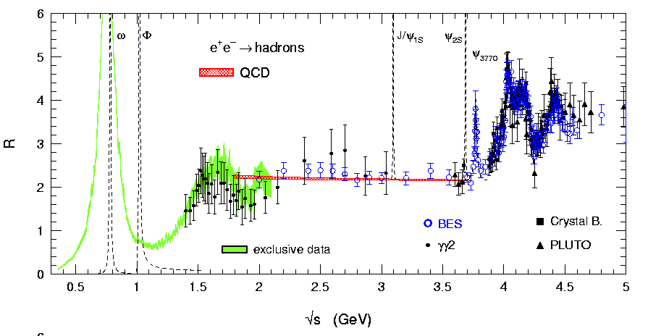
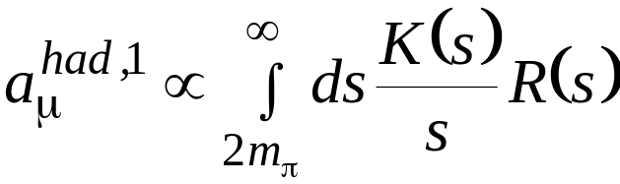
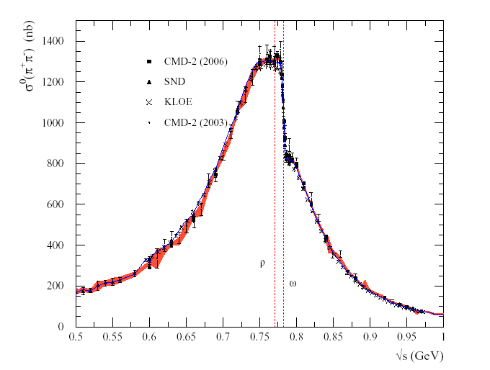
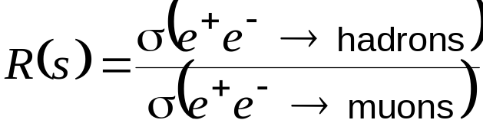
π
π
μ
γ
μ
Z
π
π
B
Weak
Had VP
Had LbL
QED
Had VP
2006 plot
KEY REGION
E. Prebys - MEISG Meeting
5/23/2008

Slide 4
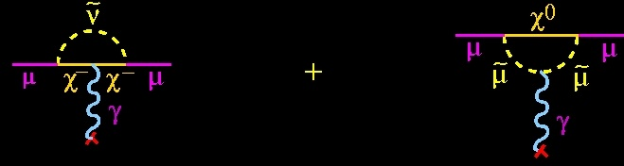
R-parity conserving Supersymmetry (vertices have pairs)
And the diagrams are amplified by powers of tanβ (here linearly)
E. Prebys - MEISG Meeting
5/23/2008

Slide 5
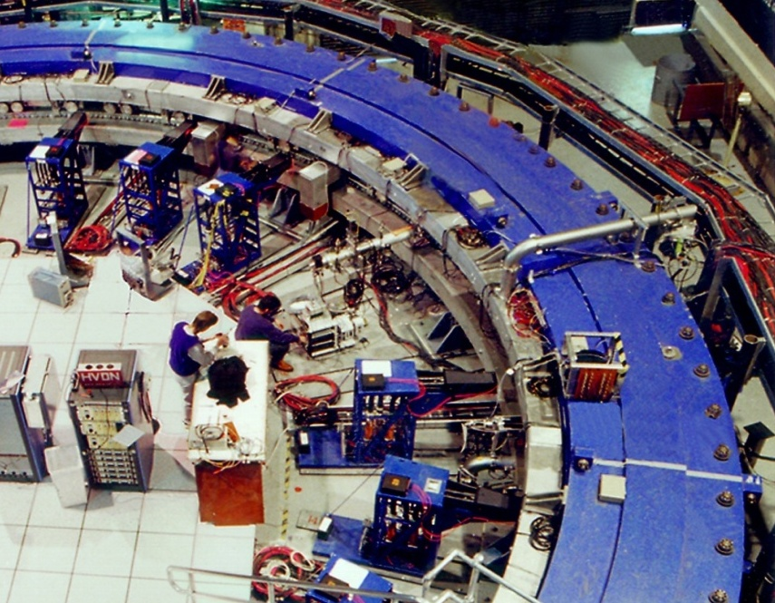
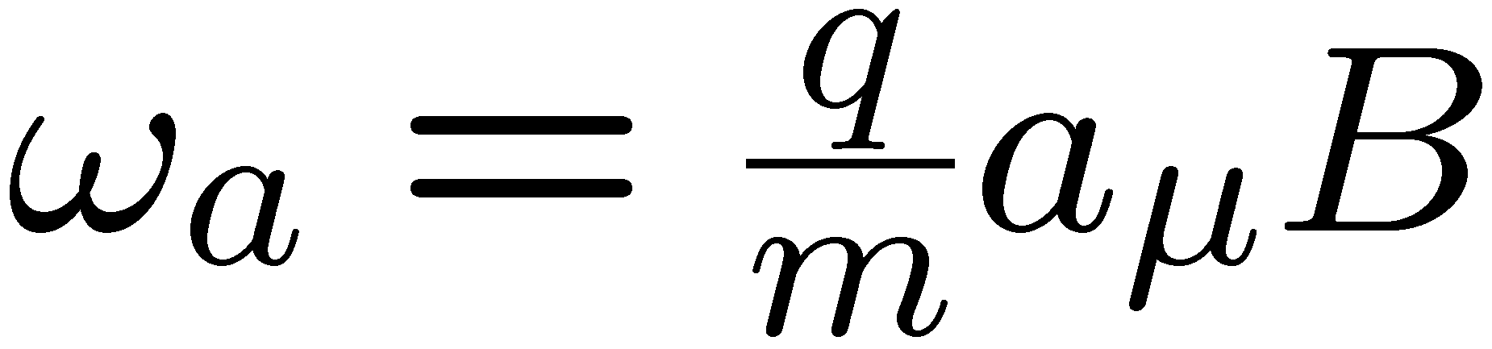
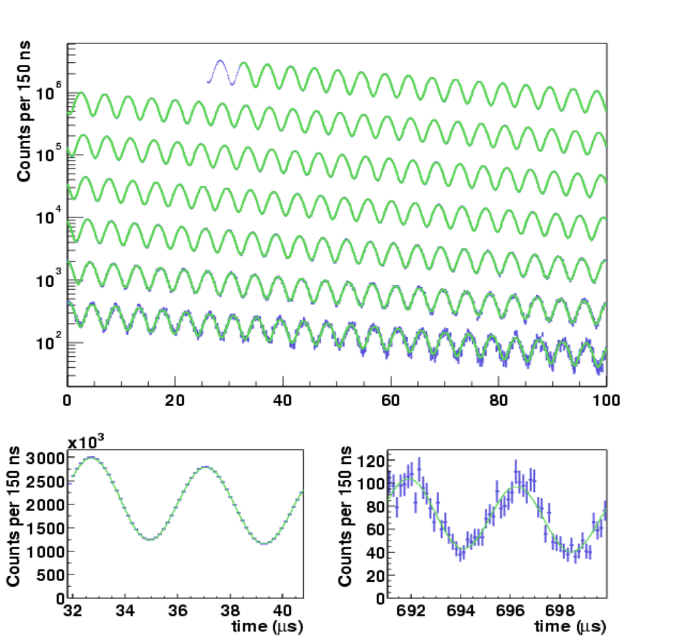
e
Momentum
Spin
α_{μ} is determined from the ratio of the muon precession frequency (ω_{a}) and the magnetic field (B).
ω_{a}
E. Prebys - MEISG Meeting
5/23/2008

Slide 6
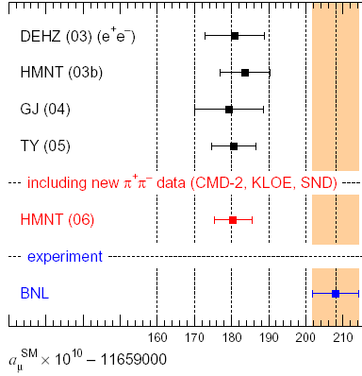
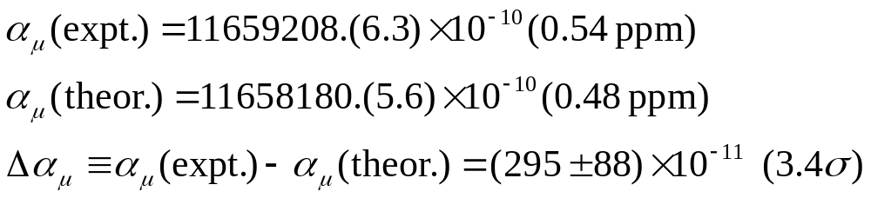
Theory+exp. input
TIME
Compare
K. Hagiwara, A.D. Martin, Daisuke Nomura, T. Teubner
Rep.Prog.Phys. 70, 795 (2007).
E. Prebys - MEISG Meeting
5/23/2008

Slide 7
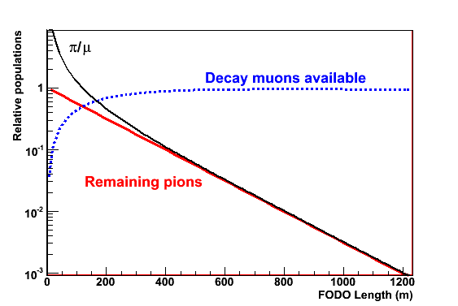
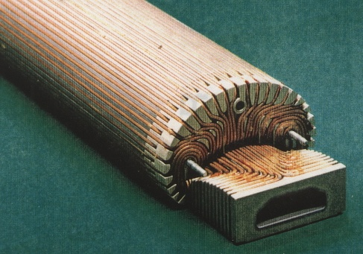
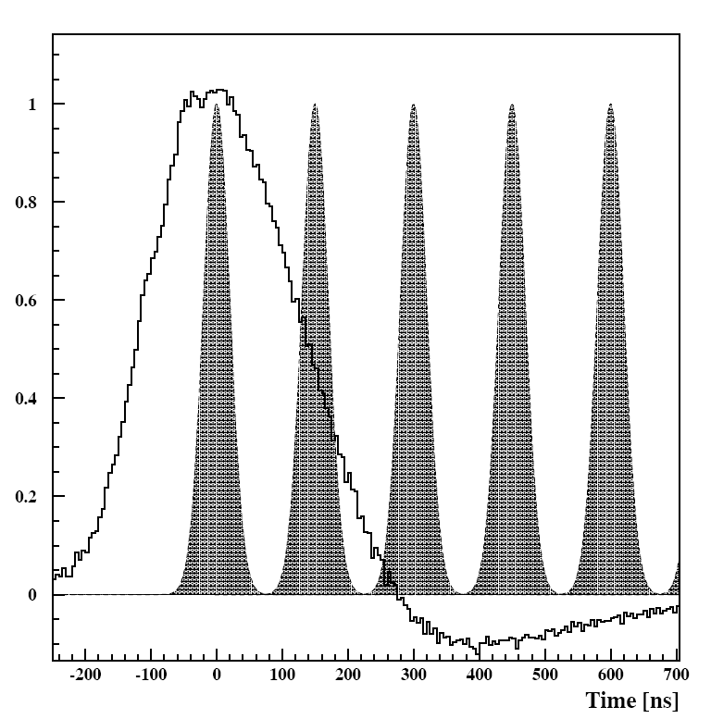
Increase muon flux with better beam optics
Decrease π contamination with long transport channel
Improve injection kicker to increase number of stores
E. Prebys - MEISG Meeting
5/23/2008

Slide 8
Maximum rate
  20-25 ns bunch
  5e12 bunches MAX
  10 ms bunch spacing (Can we really do this?)
  ~640 kW max
    ~2 x max project X max intensity (1 blast in 200 ms)
    i.e duty factor not an issue
  ~10e21/year
However, for a .1 ppm measurement (statistical+systematic), need
  4e20 protons for μ⁺
  6e20 for μ⁻
  1e21 total
    ~1/3 of a Project X year.
    ~3 years for an intermediate program
Bottom line
  g-2 physics program could be completed in very short time with a project X beam, regardless of the duty factor
*Lee Roberts, private communication
E. Prebys - MEISG Meeting
5/23/2008

Slide 9
σ_{systematic} | 1999 | 2000 | 2001 | Future
Pile-up | 0.13 | 0.13 | 0.08 | 0.04
AGS Background | 0.10 | 0.10 | 0.015*
Lost Muons | 0.10 | 0.10 | 0.09 | 0.04
Timing Shifts | 0.10 | 0.02 | 0.02
E-Field, Pitch | 0.08 | 0.03 | 0.06* | 0.05
Fitting/Binning | 0.07 | 0.06 | 0.06*
CBO | 0.05 | 0.21 | 0.07 | 0.04
Beam Debunching | 0.04 | 0.04 | 0.04*
Gain Change | 0.02 | 0.13 | 0.13 | 0.03
total | 0.3 | 0.31 | 0.21 | ~0.09
E. Prebys - MEISG Meeting
5/23/2008

Slide 10
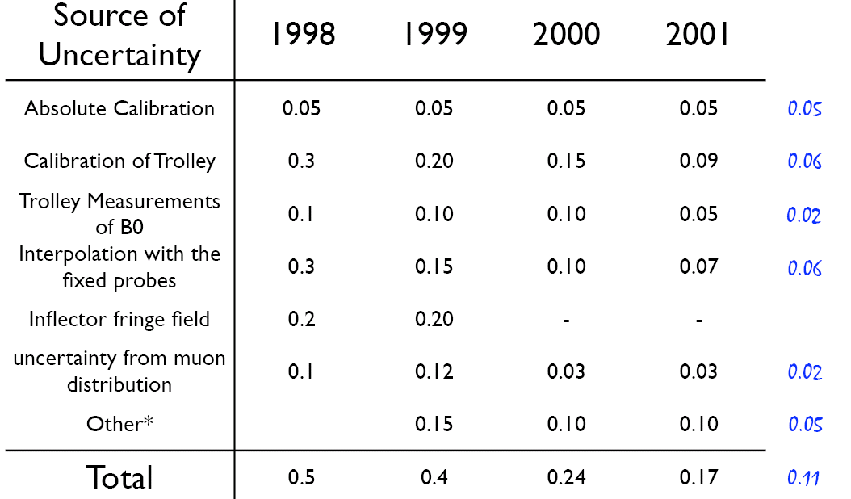
Future
E. Prebys - MEISG Meeting
5/23/2008

