Slide 1
Proton Plan
Eric Prebys
FNAL Accelerator Division

Slide 2
Disclaimers
The “Proton Plan” extends through the end of the collider program (2009 or 2010)
  Provides for 1-2e20 protons per year to the 8 GeV (BNB) line.
The (proposed) NOvA/ANU upgrades would send ~all of these protons to the Main Injector for NuMI
We have some confidence we can maintain an 8 GeV capability at the ~few 10²⁰ p/yr in this era, BUT
  There is as yet no lab mandate to support an 8 GeV program in the post-collider era
  Projections and estimates have not been vetted in any way
  There might be competing users for 8 GeV protons

Slide 3
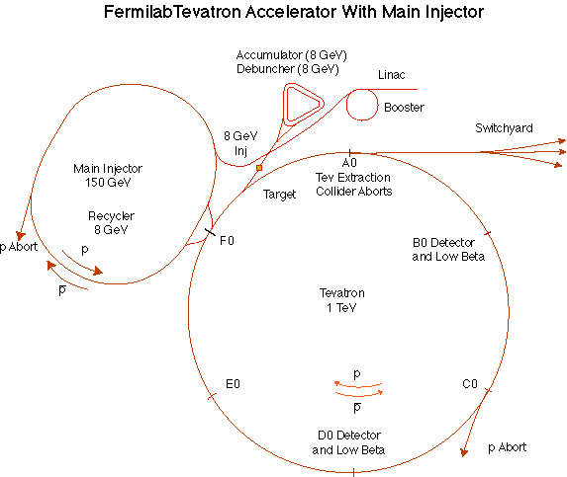
The Fermilab Accelerator Complex
MinBooNE
NUMI
=Proton Plan System
=Proton Plan Customer

Slide 4
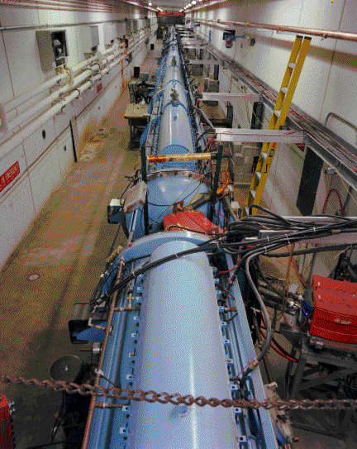
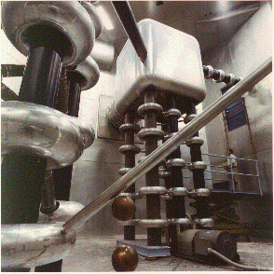
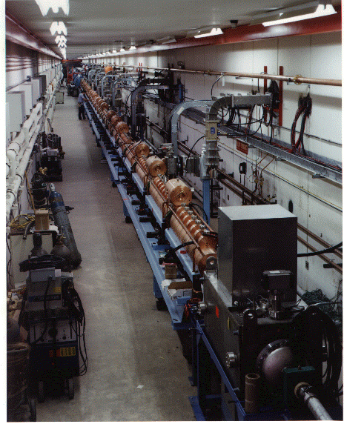
Preac(cellerator) and Linac
“New linac” (HEL)- Accelerate H- ions from 116 MeV to 400 MeV
“Preac” - Static Cockroft-Walton generator accelerates H- ions from 0 to 750 KeV.
“Old linac”(LEL)- accelerate H- ions from 750 keV to 116 MeV

Slide 5
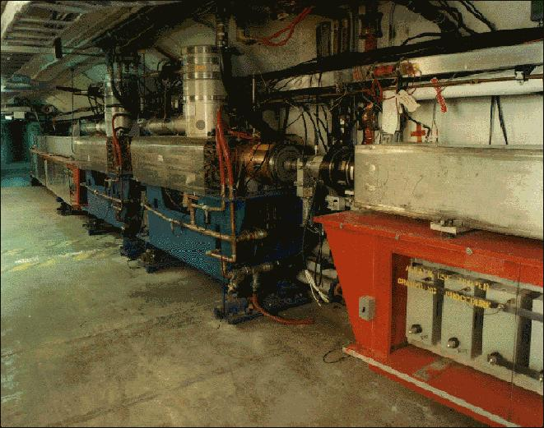
Booster
Accelerates the 400 MeV beam from the Linac to 8 GeV
  Operates in a 15 Hz offset resonant circuit
  Sets fundamental clock of accelerator complex
From the Booster, beam can be directed to
  The Main Injector
  MiniBooNE (switch occurs in the MI-8 transfer line)
  A dump.
More or less original equipment

Slide 6
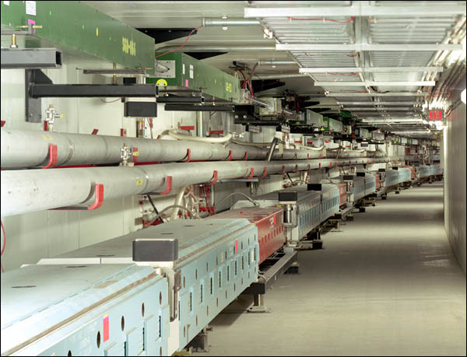
Main Injector
The Main Injector can accept 8 GeV protons OR antiprotons from
  Booster
  The anti-proton accumulator
  The Recycler (which shares the same tunnel and stores antiprotons)
It can accelerate protons to 120 GeV (in a minimum of 1.4 s) and deliver them to
  The antiproton production target.
  The fixed target area.
  The NUMI beamline.
It can accelerate protons OR antiprotons to 150 GeV and inject them into the Tevatron.

Slide 7
Limits to Proton Intensity
Total proton rate from Proton Source (Linac+Booster):
  Booster batch size
    ~4-5E12 protons/batch, depending on beam quality required.
  Booster repetition rate
    15 Hz instantaneous
    Currently ~9Hz, limited by RF system.
  Beam loss
    Damage and/or activation of Booster components
    Above ground radiation
Total protons accelerated in Main Injector:
  Maximum main injector load
    Six “slots” for booster batches (3E13)
    Up to ~11 with slip stacking (4.5-5.5E13)
    Beam stability (RF issues)
    Beam loss concerns
  Cycle time:
    1.4s + loading time (1/15s per booster batch)
Historically our biggest worry
Critical path for NuMI/MINOS

Slide 8
Some Handy Rules of Thumb
1 Booster Hz @ 5E12 protons
  ~1E20 protons/year
  ~6KW at 8 GeV
  ~100 kW at 120 GeV
Considerations
  <5E12 for slip stacked batches or low losses
  Realistic up times and intensity ramp - ups

Slide 9
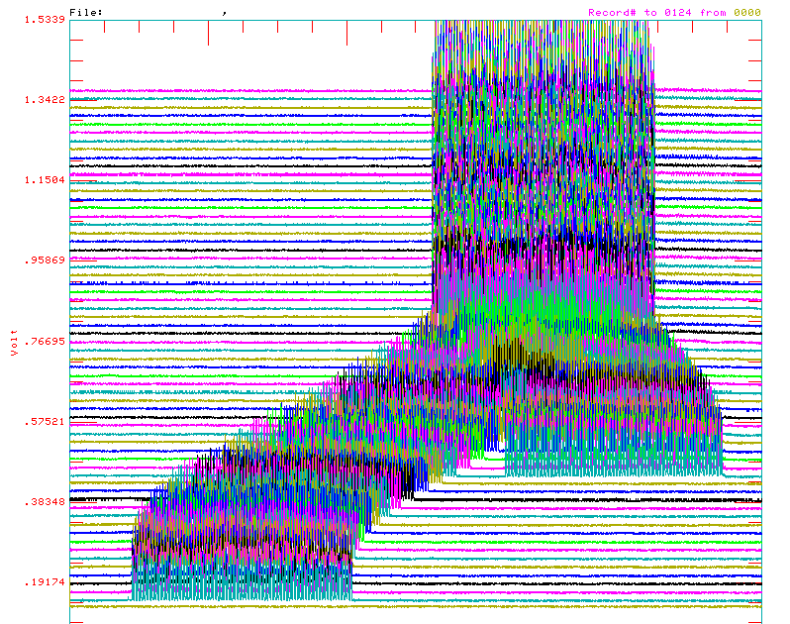
Review: Main Injector Loading
The Main Injector has six usable “slots”, into which Booster batches may be placed.
More batches may be loaded, using “slip stacking”, in which an initial batch in the Main Injector is accelerated such that a subsequent batch will be at a slightly different energy.
The two will then drift together and can be captured as a single batch (with at least twice the longitudinal emittance).
This will be done in the Rycler in the NOvA/ANU era

Slide 10
NuMI Operating Modes
Initial NuMI operation (“2+5”):
  Two batches slip stacked for antiproton production.
  Five more batches loaded for NuMI
  All will be accelerated together.
  This is the current standard operation.
Ultimate NuMI operation (“2+9”):
  Five batches will be loaded into the Main Injector, leaving one empty slot.
  Six more batches will be loaded and slipped with the first to make two for antiproton production and 9 for NuMI.
  This will begin after 2007 shutdown
NOvA Operation (2010 +?)
  Slip stacking will be done in Recycler to eliminate loading time

Slide 11
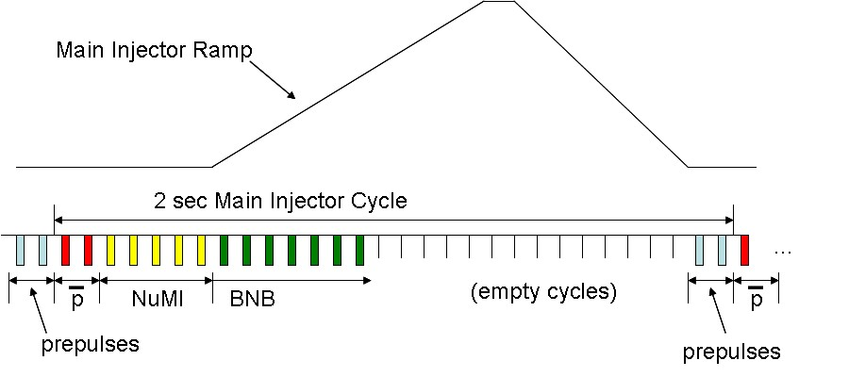
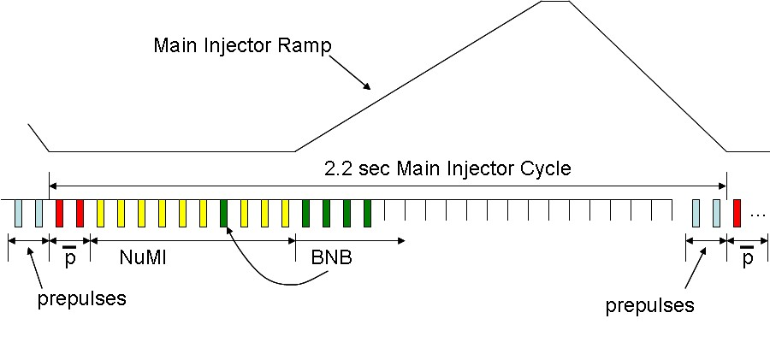
Time Line
“2+5”
This time will be eliminated by preloading in Recycler after collider program (ANU)
“2+9”

Slide 12
Staged Neutrino Program: What’s in a Name?
Current Proton Plan
  A combination of Main Injector RF improvements and operational loading initiatives will increase the NuMI intensity to 4-5E13 protons to NuMI per 2.2 second cycle (~3E20 p/yr).
  Ultimately 320 kW to NuMI (400 kW w/o pBar)
  Runs through end of collider program
ANU (“Accelerator NuMI Upgrades”, combined with NoVA as per DOE directive)
  Retask Recycler as a preloader to save proton loading time to the Main Injector
  ~700 kW to NoVA
  Presently being formalized and baselined
  Up to 35 kW (~5E20/yr) of excess 8 GeV protons, IF the Booster runs at 15 Hz
SNuMI (formerly “SNuMI II”)
  Use pBar accumulator to momentum stack protons prior to boxcar stacking in the Recycler
  Ultimately ~1.2 MW to NuMI
  NO excess 8 GeV capacity
“Project X” (formerly “Proton Driver”, “HINS”, “Foster’s Folly”…)
  New 8 GeV proton Linac to Main Injector
  Exploit synergy with ILC
  Lots of enthusiasm for this project!!!
  ~2 MW to NuMI
  Up to 200 kW (3E21/yr) of excess 8 GeV beam, but might be complicated to get it to BNB line (from Recycler)
Only official part

Slide 13
Proton Plan Charge
Develop a plan for a reasonable set of improvements and operational initiatives to maximize proton delivery to NuMI and the Booster Neutrino Beam (BNB) over the next ten years or so.
Estimate the budget and timeline for these improvements.
Estimate proton delivery to both beam lines if the Plan proceeds on schedule.
Very important

Slide 14
Summary: Significant Elements of Plan
Linac
  Stockpile two year supply of spare 200 MHz power amplifier tubes (7835’s), in the event of an interruption in supply
  Characterize and improve Low Energy Linac Low Level RF
Booster:
  Replace and reconfigure injection bump (ORBUMP) system.
  Relocate 8 GeV dump from Booster tunnel to MI-8 transfer line
  Make Booster robust to 9 Hz, and understand requirements to go to 15 Hz
  Design, build, and install new corrector system
    Install half of longs in 2007 shutdown
    Rest of longs in 2008
    Shorts ??
Main Injector:
  Replace seven quadrupoles with increased aperture versions, to reduce injection and extraction losses.
  Operationally develop multi-batch and multi-batch slip stacked operation
  Design and install collimation system, both in the MI-8 line and in the MI ring
  Modify injection kicker to allow multi-batch slip stacked operation
  Characterize and improve to RF system, to support high intensity operation.
Red = complete, Green = complete in this shutdown, Blue = to do

Slide 15
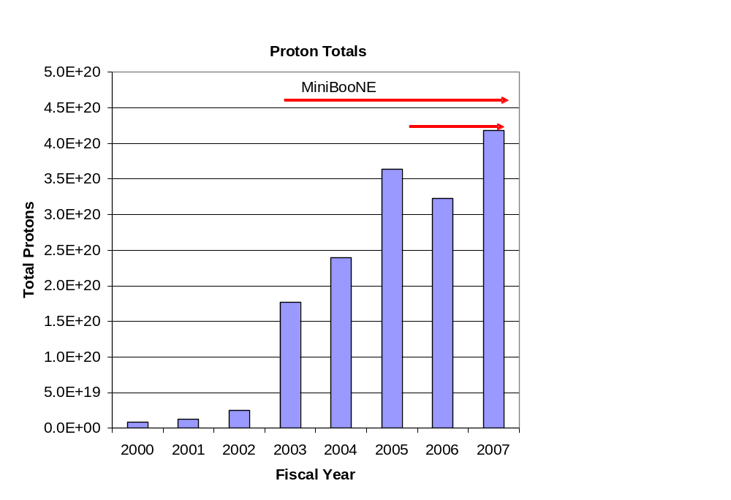
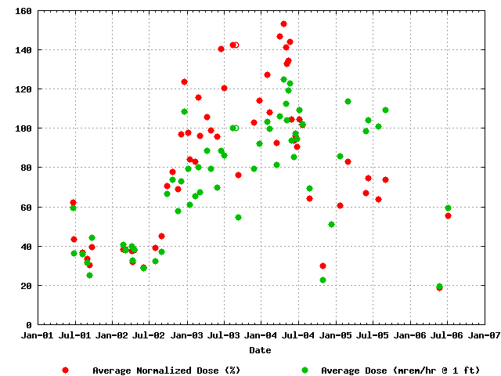
Proton Delivery
Average Booster Activation
MiniBooNE
NuMI
Factor of 15 increase in protons

Slide 16
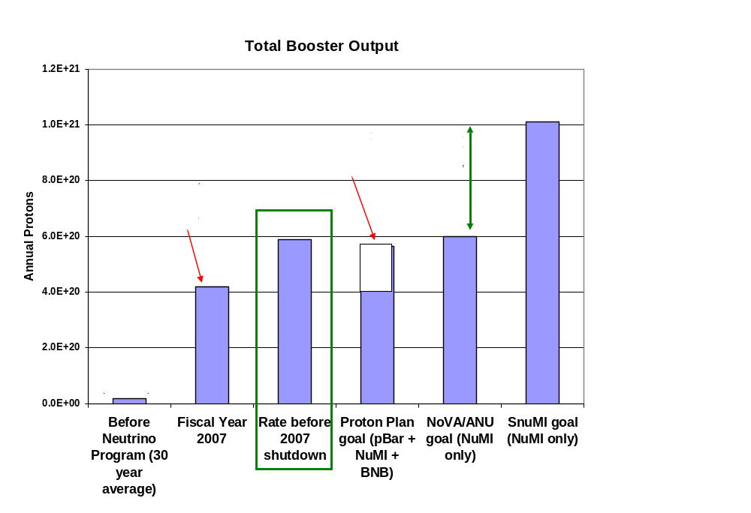
Total Booster Output

Slide 17
After the 2007 Shutdown
After the 2007 shutdown, the remaining Proton Plan Projects will he
  Rest of Booster Correctors
    In the 12 remaining long sections.
    In the 24 short straight sections.
  Upgraded gamma-t jump system in Booster (maybe)
    Capable of running at required repetition rate
    Must be installed along with correctors
  Booster chopper notcher
    Reduce losses when creating extraction loss
These are all currently scheduled for the 2008 shutdown
We allow a year after this to achieve the ultimate benefits
  Proton plan will officially end in mid to late 2009
It is likely that the plan will absorb some scope to enable full 15 Hz operation.
  Refurbish RF anode supply
  Retrofit half the RF bias supplies
  Recommission RF cavity tuner cooling
  Not necessary for NuMI

Slide 18
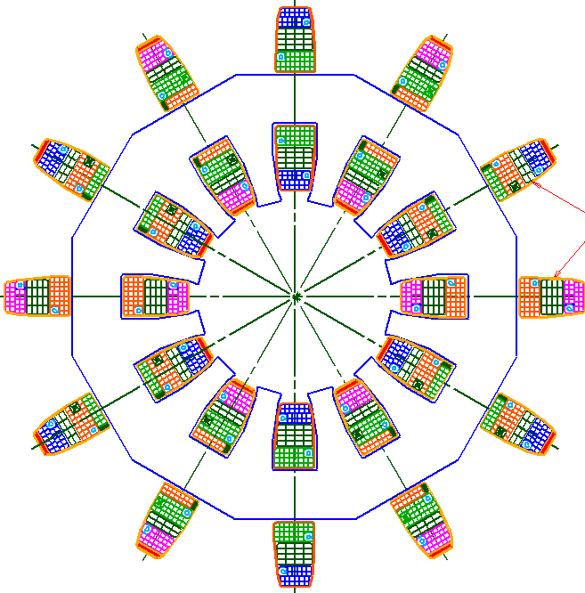
Booster Corrector System
Biggest single project in plan
Replace all 48 (original) Booster corrector packages.
  Unique new design
Six independent multipoles
  Stronger H and V dipoles
    ±1cm beam motion throughout cycle
  Stronger quad
    Arbitrary tune working point throughout cycle
  Skew quad
    Coupling, same strength as before.
  Sextupole and skew sextupole at every period.
    Less emittance blowup
    More control of harmonic resonances.
Integrated BPM
  Saves space
~16”

Slide 19
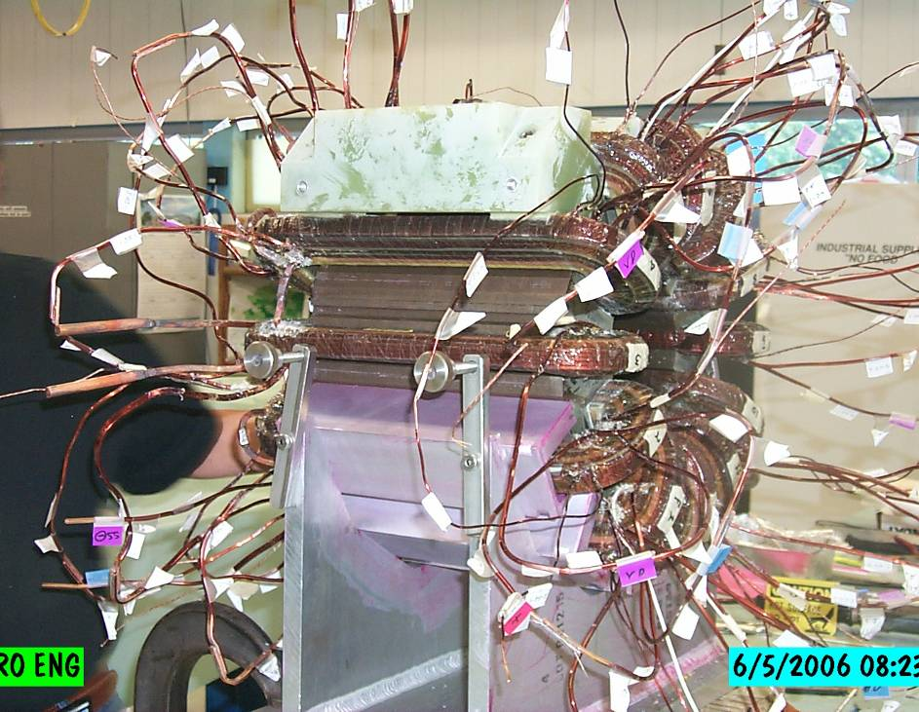
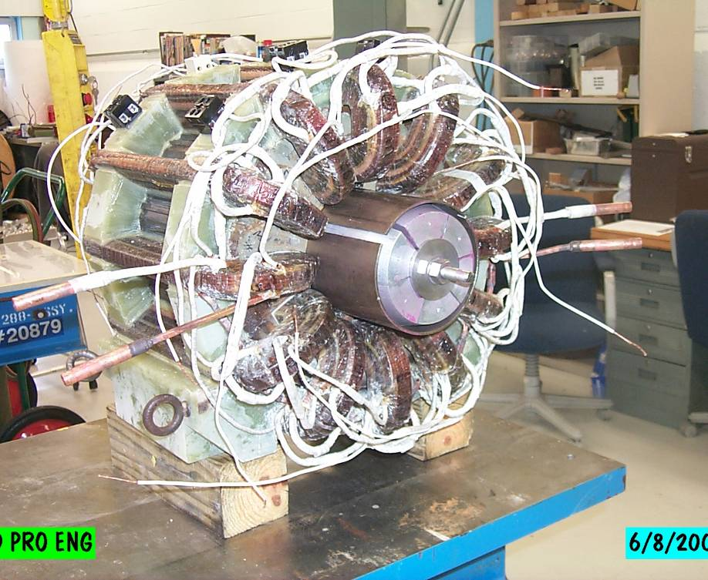
Corrector Prototype
Bad hair day
Ready for testing

Slide 20
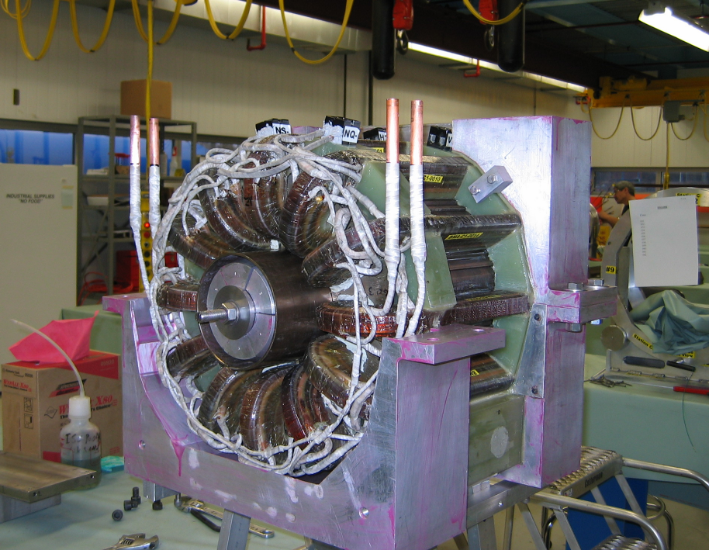
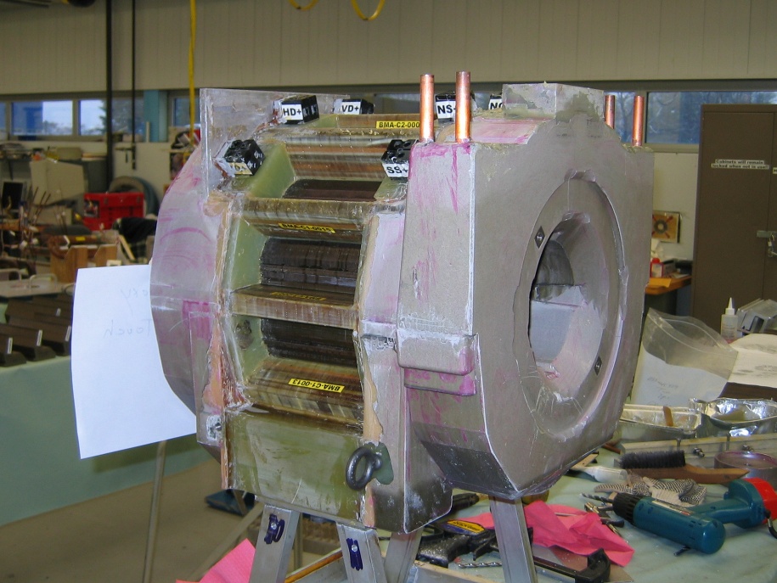
Potting

Slide 21
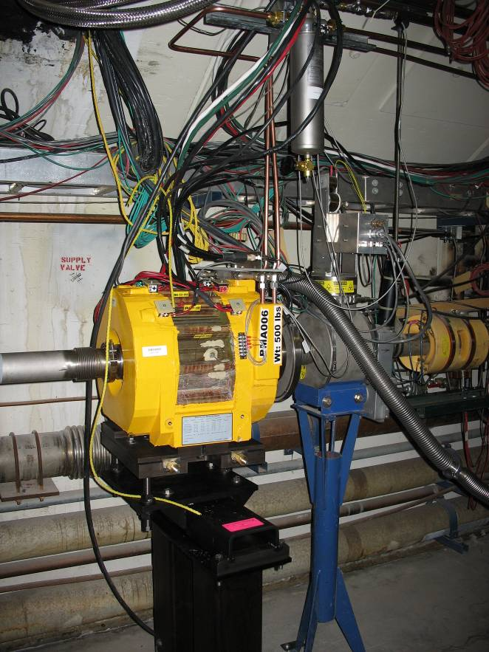
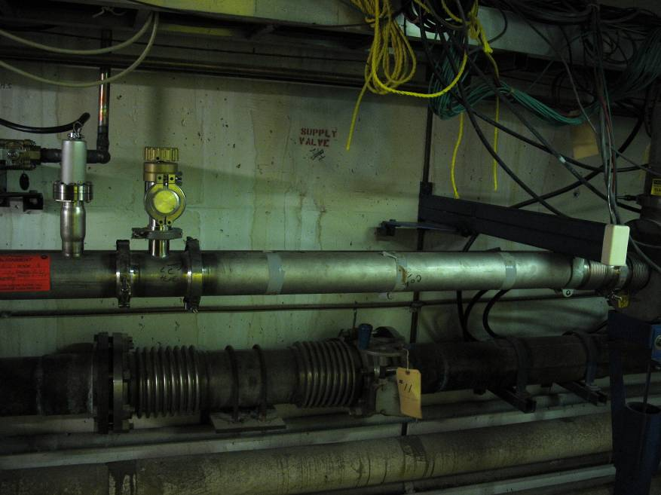
Prototype Installation
All power supplies and water connected
Pulsing (hard) on beam off cycles
Proceeding with beam tests

Slide 22
Proton Plan Projections
Proton Plan represents the first ever attempt to accurately predict total proton output from Booster.
Determining Booster output capacity is challenging. Our procedure is to:
  Evaluate the potential of particular improvements based on effective aperture increase or uncontrolled beam loss reduction:
    For example, if something reduces uncontrolled loss by 10%, it has the potential to allow us to send 10% more beam.
  Consider the following scenarios:
    “Design”: After one year of tuning, we realize half of the potential benefit.
    “Fallback”: After one year of tuning, we realize one quarter of the potential benefit.

Slide 23
Factors Considered in Projections
Linear ramp-up to see benefit of improvements
Slip stacking efficiency
Different Booster efficiency for cogged (pBar+NuMI) cycles and uncogged (BNB) cycles.
  Added in for 2006 review
Annual shutdowns (assume 2 mo/yr)
  Overall asymptotic ramp-up after shutdown (improved for FY06)
Uptimes: based on MiniBooNE 2004 and NuMI 2005
  Modified for 2006
Peak to average corrections
  Accounts for non-optimal running

Slide 24
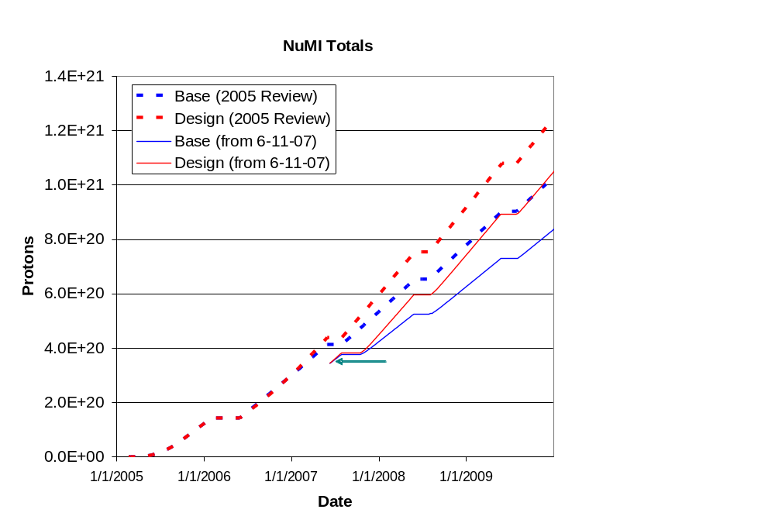
NuMI Long Term Projections
3.2E20 p/yr
2.2E20 p/yr

Slide 25
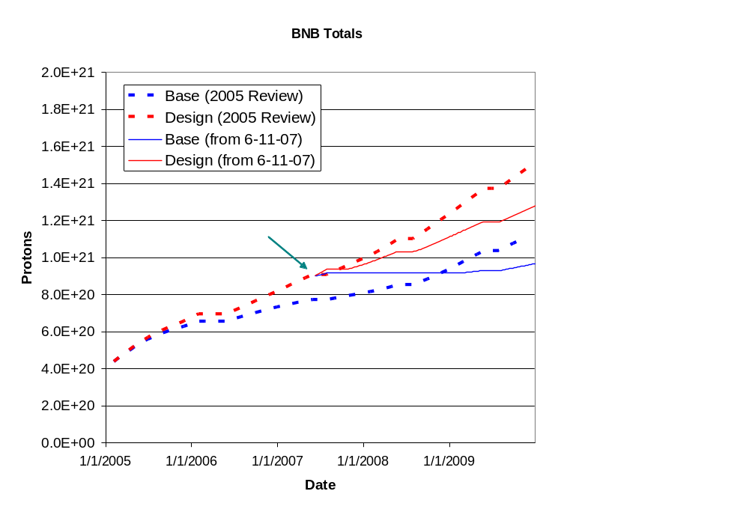
BNB Long Term Projections
1.8E20 p/yr
0.7E20 p/yr

Slide 26
After Collider Program Ends
Protons now going to pBar production will go to NuMI
  NuMI line goes from 320-400 kW
  Won’t affect 8 GeV program
8 Month shutdown for NOvA upgrades
  Currently scheduled for Oct. 1, 2010
  NuMI line will still be limited to 400 kW
  At least 2E20 p/yr of excess 8 GeV protons after this era
3 month shutdown for NuMI upgrades
  Scheduled for April 1st, 2012
  8 GeV line should continue to run during this period with intense protons
After upgrades, NuMI will take 700kW of protons
  8 GeV availability depends on excess booster capacity
    Increased repetition rate
    Reduced losses

Slide 27
Booster Repetition Rate
The magnetic lattice elements in the Booster operate in a 15 Hz resonant circuit.
  Pulsed magnetic elements and RF system only operate when beam is present (plus conditioning pre-pulses)
Over the last few years all magnetic elements have been upgraded to enable 15 Hz operation
As Booster losses are reduced, Proton Plan assumes we will go from being loss limited to limited by the 9Hz limit of the RF system
  Half of the RF modulators
  RF tuning cones
  Anode supply tranformers
NOvA will require 10.5Hz averate repetition rate
  Requires tests
  If modifications are needed, go to full 15 Hz capability
One way or another, plan to go to 15 Hz capability by NOvA era
  Cost scale ~few $100K
  Presently considered and “operational upgrade”
    Not part of Proton Plan or ANU

Slide 28
Booster Losses
We have demonstrated a total Booster output consistent with the needs of the Proton Plan (NuMI + 8 GeV) or NOvA (w/o 8 GeV)
This without the new corrector system or improved “notcher”
  i.e. if we can’t improve on this, the corrector system is a waste of money.
Calculations indicate that the closed orbit control provided by the new corrector system, together with the reduced losses of a new “notcher”, will allow us to eventually run the Booster at a full 15 Hz with acceptable losses.
  If fully successful, this would provide ~5E20 p/yr to an 8 GeV program

Slide 29
Summary and Conclusions
The Proton Plan has done a good job providing and estimating delivery of protons over the last few years.
We have demonstrated the proton capacity for the rest of the decade, and for the NOvA program (alone)
If we take the steps to increase Booster rep. rate, and the corrector project is effective at all, we should have some excess Booster capacity even in the NOvA era
  At the level of a few 10²⁰

