Slide 1
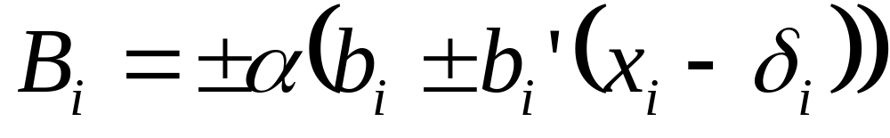
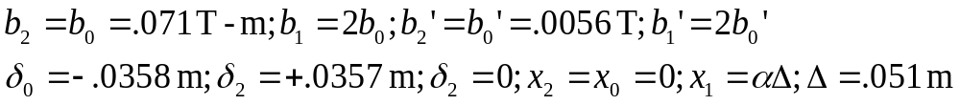
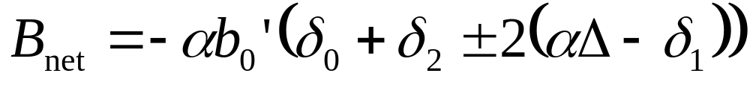
Net Dipole
Fraction of max current
Max quad term for i
Field seen by beam at magnet i
Max central field at i
Position at i
Mag i offset
Polarity
Orientation
Nonlinear in α !!

Slide 2
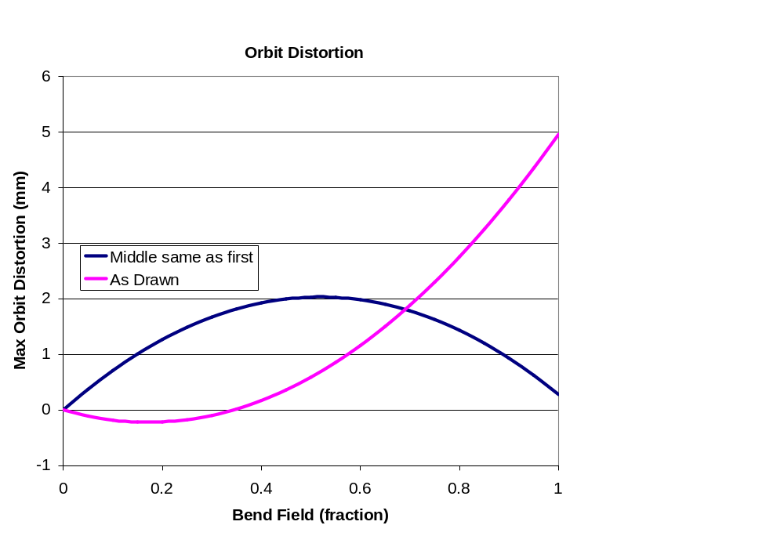
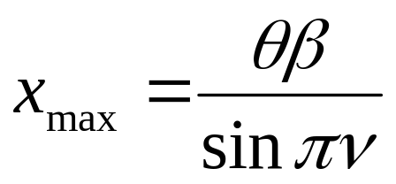
Effect of Distortion

