Slide 1
30 Hz/Gamma-t Mini Review
Agenda:
  Background – E. Prebys
  Simulations and Conclusions – J. Maclachlan
  Technical Issues and Plans – E. Prebys

Slide 2
Background

Slide 3
Booster Gamma-t System
Specifications:
  12 pulsed quadrupoles located in every other short straight section of the Booster
  Capable of 1 unit of gamma-t reduction (probably too much)
  Installed in late 80’s
Problems:
  Difficult to align
    Pulsing system results in beam motion
  Works too well
    Historically, reducing longitudinal emittance exacerbated coupled bunch oscillations after transition
    Probably better with current damping system
  Rate
    Some issues running at current rate
Never really used operationally
Might be necessary to go to higher batch intensity
Must coordinate with corrector system
  Existing design incompatible with new corrector system
  Must either remove system or replace magnets in ~2007

Slide 4
30 Hz Harmonic
Lattice magnets run in 15 Hz offset resonant circuit.
No control over ramp rate
By adding capacitors and a choke, we could add a 30 Hz component to the cycle, with adjustable amplitude and phase.
Dramatically increase control over ramp rate
Compensate for Booster impedance and optimize bucket area through cycle.
Decreases dE/dt
  Effectively increases RF voltage, BUT
  Slows transition crossing
  -> 30 Hz harmonic and gamma-t jump probably go together

Slide 5
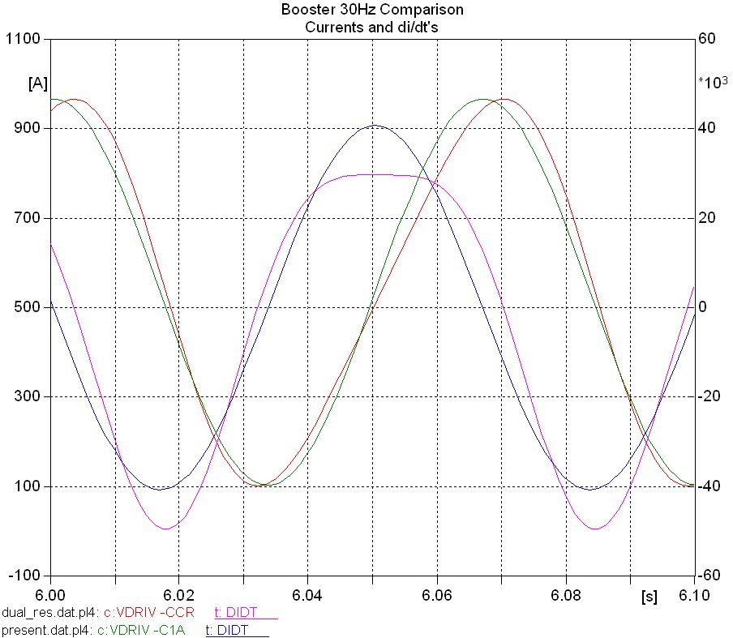
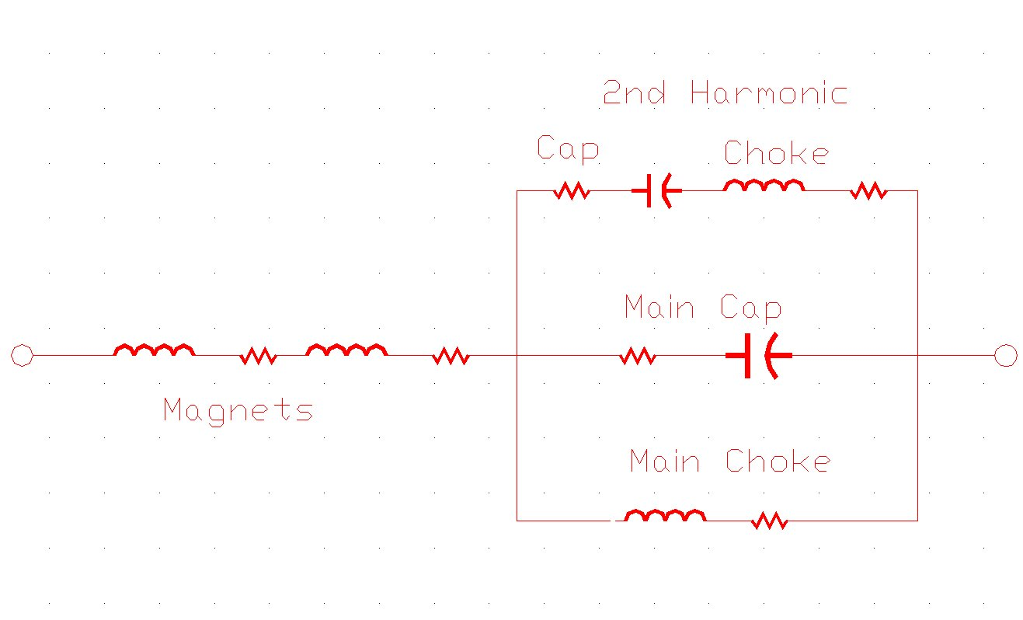
30 Hz Concept
I(t)
dI/dt

Slide 6
History of Decision Process
Both 30 Hz and gamma-t “talked about” for a long time
Discussed separately as part of the “Proton Plan”
An internal review of the Plan (7/05) recommended dropping the 30 Hz option and continuing to study the gamma-t option.
The first Director’s review (8/05) recommended continuing to study both options together, and to have a milestone for a decision.
This meeting is to satisfy that milestone
  Because we are recommending to drop the 30 Hz option, we don’t feel this requires a full-blown “review”
  This is more a presentation of our thought process.

Slide 7
Technical Issues

Slide 8
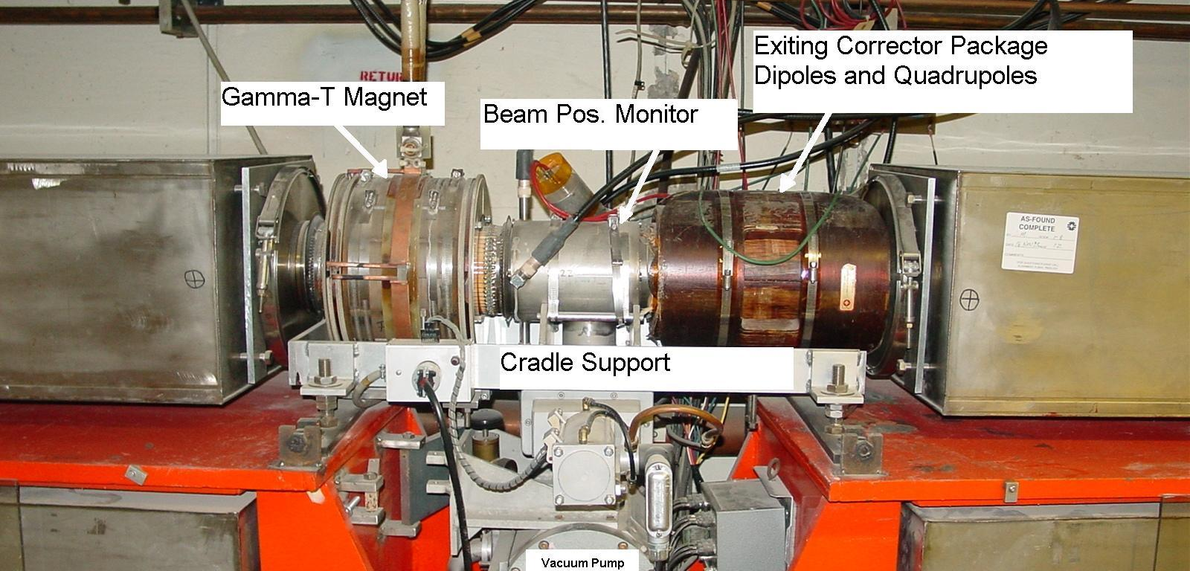
Issues
  The existing gamma-t magnets will have to be removed as part of the corrector upgrade (scheduled for summer 2007)
  They have many nylon parts, and will almost certainly not survive the operation.
  Must build new magnets:
    Also can add better alignment hardware
    Do not need to be as strong as existing magnets (although that may be the simplest)

Slide 9
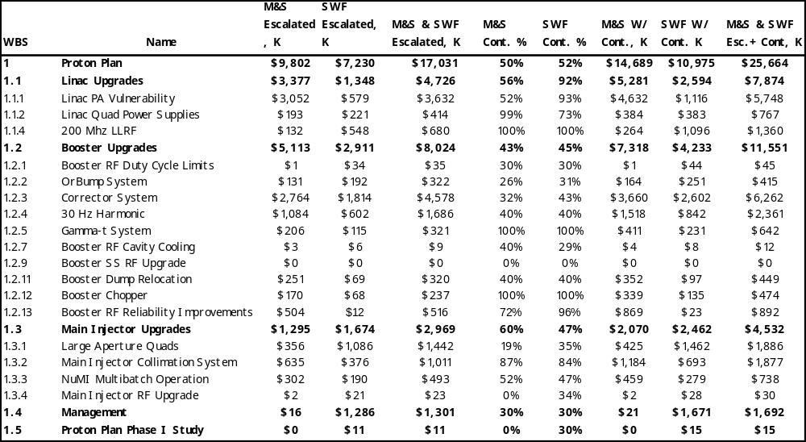
Cost Implications
30 Hz harmonic will disappear
Gamma-t replacement already in plan, based on cost of original magnets
Net savings to Proton Plan: ~$1.7M

Slide 10
Plans
Cease activity related to 30 Hz harmonic
Pursue investigation of gamma-t, with emphasis on machine studies
Work with TD to develop a plan for replacing the pulsed quads during the corrector upgrade
  Craig Drennan will coordinate installation along with the correctors
Look into miscellaneous issues
  Pulse supply capability
  Stripline integrity
  Small on the scale of things.

