Slide 1
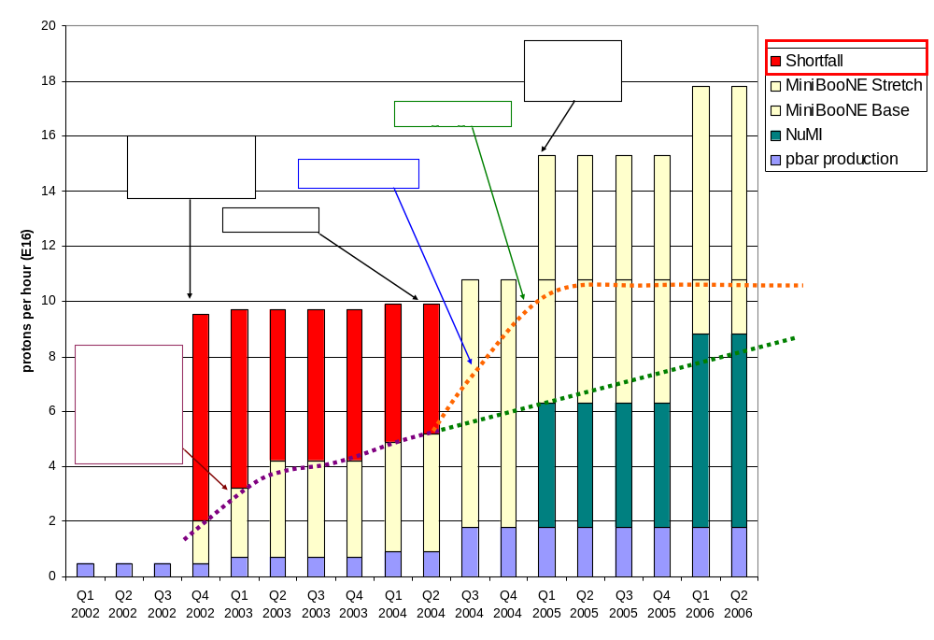
Making Projections
Optimistic
Conservative

Slide 2
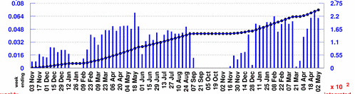
Projecting to MiniBooNE
Rather than use the instantaneous rate, will scale from typical weekly MiniBooNE totals:
Baseline Scenario:
  Improvements compensate for increased protons to pBar -> Continue to average 5.5E18/wk
  MBooNE shuts OFF 1/05
Optimistic Scenario:
  MBooNE rate increases more or less linearly to 10E18/wk at 1/05
  5.5E18/wk after NuMI turns on.
Typically 5.5E18/wk

Slide 3
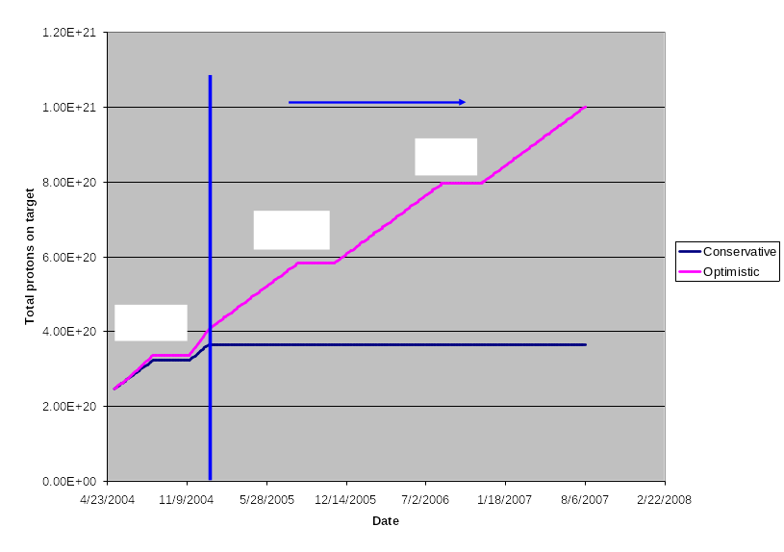
Protons to MiniBooNE

