Slide 1
Background
The turn-on of the LHC at CERN (France/Switzerland) in ~2007 will mark the end of the Fermilab Tevatron’s unprecedented 20+ year reign as the world’s highest energy collider.
The Tevatron program is scheduled to be terminated in 2009.
The lab has a strong commitment to the International Linear Collider, but physics results are at least 15 years away.
Neutrino physics will be the centerpiece of Fermilab science for at least a decade.
  The success of the neutrino program is vital to the lab
  The projects you’re working on are vital to the neutrino program.

Slide 2
Neutrinos
What are neutrinos?
  Neutrinos are almost not there at all
  The were “invented” in 1930 to explain missing energy in nuclear decay, but were not observed directly for another 26 years!
  The come from nuclear and particle reactions
    The sun
    Nuclear reactors
    High energy physics interactions and decays
  Billions of neutrinos are passing through us right now!
    Most pass through us without doing anything at all.
Why are they interesting?
  Lots of mysteries remain about their exact nature
    Mass?
    Interactions?
    Matter/Antimatter

Slide 3






Producing Neutrinos At an Accelerator
8 GeV Proton beam
Target
Mostly pions
neutrino
The Problem:
  Because so few neutrinos interact, you need to make a LOT of them to study a very few
  This means you have to start with a LOT of protons
    In the three years since the current neutrino program started, it has used significantly more protons that all other experiments in the 30 years before combined!
    It’s still not enough.
    We would like to increase our total proton rate by between 50 and 100% over the next few years.

Slide 4
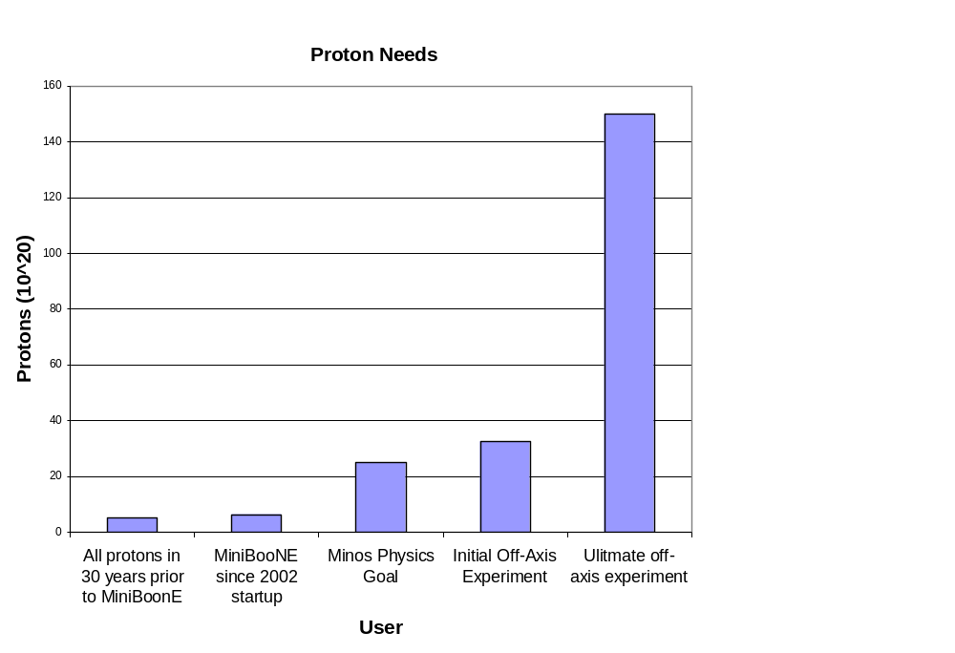
Proton Demands (in Perspective)
Highest number I could find on a plot

Slide 5
Limits to Proton Intensity from the Proton Source
Booster batch size
  Typical ~5E12 protons/batch
Booster repetition rate
  15 Hz instantaneous
  Currently 7.5Hz average (limited by injection bump and RF cooling)
Beam loss
  Damage and/or activation of Booster components
  Above ground radiation
Your projects address these

Slide 6
The Importance of Your Projects
400 MeV Line/ORBUMP
  Problems with the existing system
    Will overheat and get damaged if run > 7.5 Hz on average
    Doesn’t quite “line up” the injected beam, so beam moves around, resulting in beam loss and radiation
  The new system fixes both of these problems
MI-8 Line
  The Booster has two extraction regions
    The main one (long 3), which takes beam to the Main Injector and the 8 GeV neutrino line
    The one which originally went to the “main ring” (long 13), which is now used for test pulses and “short batches”
  Steering the beam around two extraction regions during acceleration is complicated and results in beam loss/activation
  By moving the Long 13 extraction out side the Booster to the MI-8 line, we should significantly reduce losses
Water work
  There will be ongoing water work to prepare the water system for the next big project: a new corrector system to better control the beam position during acceleration (to be installed in 2007 and 2008)

