Slide 1
Answer to Question: time structure
22 cycles = 1467 ms
Booster Batches
NEUTRINO PROGRAM
MUONS
4.6×10¹² p/batch
Accumulator
(NuMI +Muons)
Recycler
56 ×10¹² p/sec
(NuMI)
Debuncher
(Muons)
4×4.6×10¹² p/1467ms = 12.5 ×10¹² p/sec
0.1s
1.367s

Slide 2
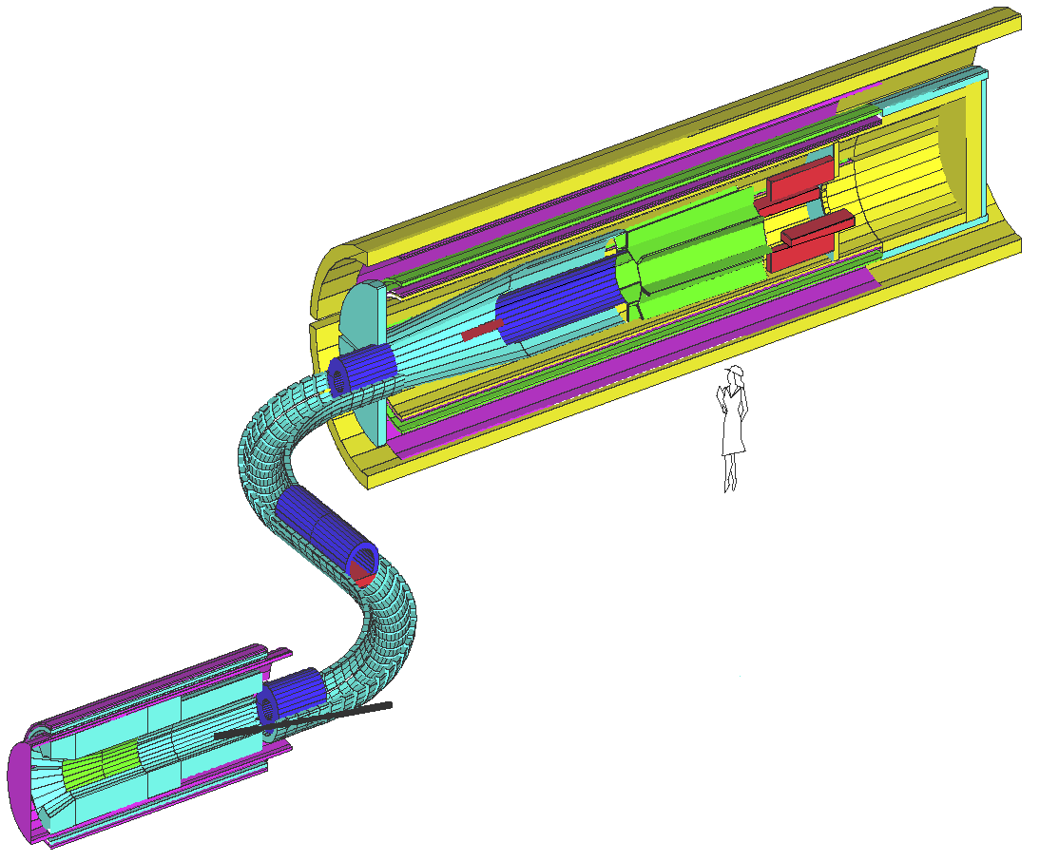
RECENT HISTORY – MECO PROPOSAL
Stop muons in a thin target and look
for a single mono-energetic electron
Muon Beam Stop
Straw Tracker
Muon Stopping Target
4 × 10²⁰ primary protons
at 8 GeV yield 1 × 10¹⁸
stopping muons
Well developed
design,
reviewed for
cost & feasibility
Crystal Calorimeter
Decay Channel
Momentum
& sign
selection
SC Detector Solenoid
(2.0 T – 1.0 T)
Pion production
& capture
SC Transport Solenoid (2.5 T – 2.1 T)
8 GeV
PROTONS
SC Solenoid
containing production target (5.0 T – 2.5 T)

Slide 3
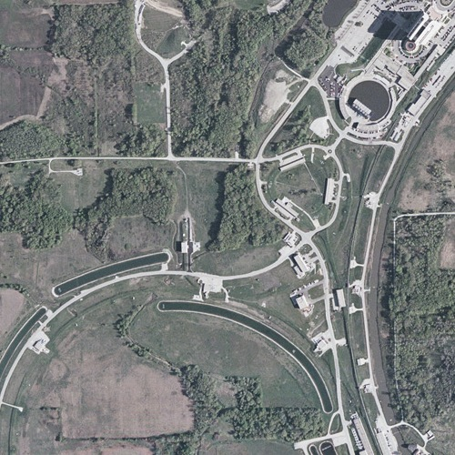
Possible Locations
Greenfield site
Use/modify
AP0

Slide 4
Pros/cons
AP0
  Pros
    Existing building/services
    Existing beam tunnel
    Might well be the cheapest option.
  Cons:
    Building/beamline will need significant modification
    Most likely configuration (target underground, detector in hall) might have some issues.
    Likely only compatible with this experiment
Green field site
  Pros:
    Can do whatever we want
  Cons:
    Have to start from scratch
    Cross wetland
Plan
  Obtain detailed drawings of AP0 and the MECO detector and have FESS work up ballpark figures for both options.

