Slide 1
Radiation and Slow Extraction Issues*
(work in progress)
Eric Prebys, FNAL/AD

Slide 2
Scale of the Problem
Present anti-proton rate in pBar tunnel
  ~15e10 pbar/hr
Proton rate for SNuMI II
  ~2.3-2.5e17 protons/hr
Mu2e protons
  Additional 15%
  Total protons 15Hz*5e12*3600 = 2.7e17 pph =96 kW
Bad news
  This is almost 2 million times the current antiproton rate in this enclosure!
  An uncontrolled beam loss of 1W/m => 99.5% efficiency!
Good news
  Mu2e represents a fairly small perturbation on SNuMI
  Would definitely implement solution for full 15 Hz Booster output anyway as part of SNuMI II
  There “appears to be a solution” for SNuMI II

Slide 3
Comparison of Booster to pBar
All protons going to pBar ring will have gone through Booster
Booster:
  Good
    At least 13.5’ of Earth shielding at all points
  Bad
    13.5’ still well short of passive shielding requirements (more about this later)
    High occupancy areas on surface. All areas kept below 5 mRem/hr
pBar ring:
  Bad
    Berm areas 13’ of earth
    Buildings only 10’
      Should be factor 10 less shielding
      Measurements more like factor 100 (gravel fill?)
  Good
    Should be more efficient than Booster
    Can control access to area
      Entire area can be made “Radiation Area” if necessary (buys factor 20)
      Buildings can be interlocked (although this would be undesirable)

Slide 4
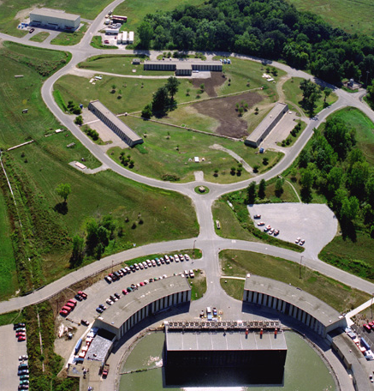
Booster and pBar
13’ shielding on berm
Location for big fence?? (note lack of cars)
pBar
10’ shielding under enclosures
Booster gallery
(+ offices)
Booster tower office space
Booster

Slide 5
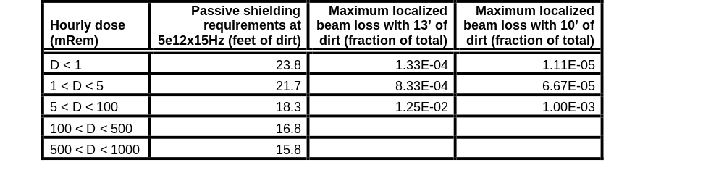
Passive Shielding
Fermilab Dugan/Cossairt criteria based on continuous, total, localized beam loss
  If they are satisfied, you can do “whatever you want”
  The pBar ring is far short of these for SNuMI
This is what a simple e-berm (in-out) would have to detect to keep the areas within “Radiation Area” limits

Slide 6
How we do it in the Booster
The Booster is also well short of the passive shielding requirements
Normally, interlocked radiation detectors are tied to specific operating conditions
  Very limiting
In the Booster, we have a system of 52interlocked radiation detectors (“chipmunks”)
  Also, have detailed studies showing that no physical beam configuration could result in a surface radiation situation that did not trip a chipmunk.
  Result: chimpmunk system fully protects Booster.

Slide 7
Application to pBar
A system similar to Booster should work for the accumulator and debuncher
  Energies, sizes, and lattices not all that different
It’s a lot of work
  The Booster shielding assessment and supporting documentation fills seven volumes and 1.5 feet of shelf space
  Need to start worrying about it soon, particularly if additional shielding is needed.
SNuMI II work will necessarily cover total proton rate, but there will be special issues for mu2e, but..
  Have to separately validate chipmunk coverage for beam in debuncher
  Must deal with significant resonant extraction losses

Slide 8
Resonant Extractions Basics
Excite a harmonic resonance
  Typically either a second (quads+octupole) or third (sextupoles)
Adjust tune near resonance
Use fast quad system to sweep tune toward resonance
  Amplitude of phase space separatrix will decrease
  High amplitude particles become unstable
Extract high amplitude particles with electrostatic septum/lambertson combination
Feedback extraction rate to control tune sweep.
  Might be a variation involving acceleration+chromaticity rather than tune sweeping

Slide 9
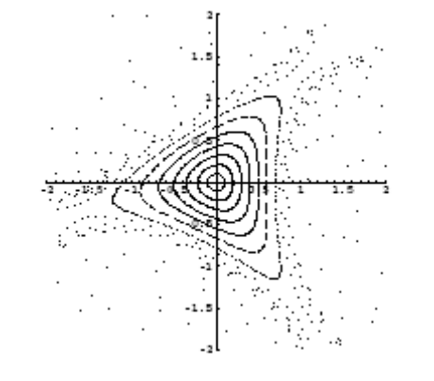
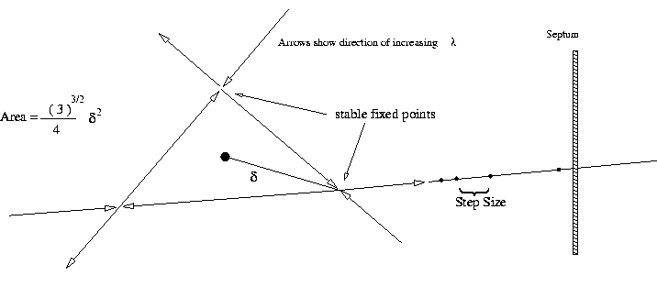
Third Order Resonance Extraction
Pros
  Textbook case
  Easy to calculate
  Most common worldwide
Cons
  As separatrix shrinks, tricky to get last bit of beam in controlled way

Slide 10
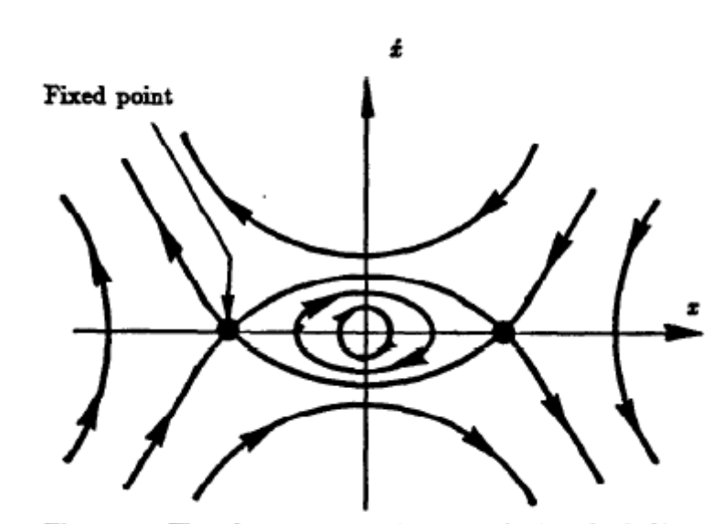
Half Integer Resonance Extraction
Pros
  Easy to extract last beam in controlled way
  The “standard” at FNAL (see D. Edwards, FNAL-TM-0842)
Cons
  Hard to calculate (See J. Johnstone, BEAMS-DOC-92v2)
  Because it’s a linear resonance, must introduce octupoles (amplitude dependent tune) to create separatrix
septum

Slide 11
Common Features
Unstable beam motion in N(order) turns
Extraction Field
Lost beam
Septum
Minimum loss ~(septum width)/(extraction gap)
Use electrostatic field generated by thin (100 μm) wire plane
Follow with magnetic Lambertson ~90 degrees later in phase

Slide 12
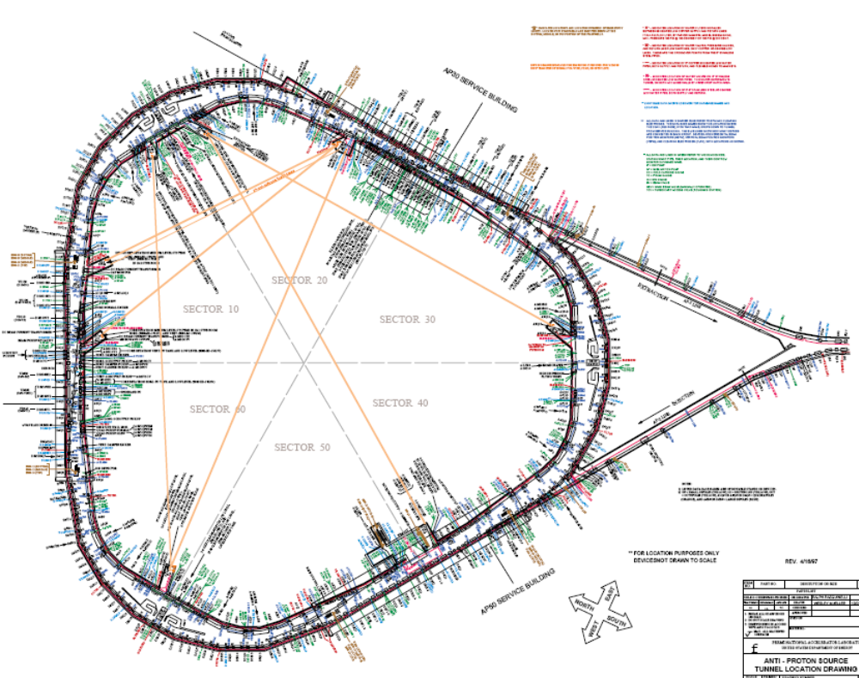
Candidate Locations

Slide 13
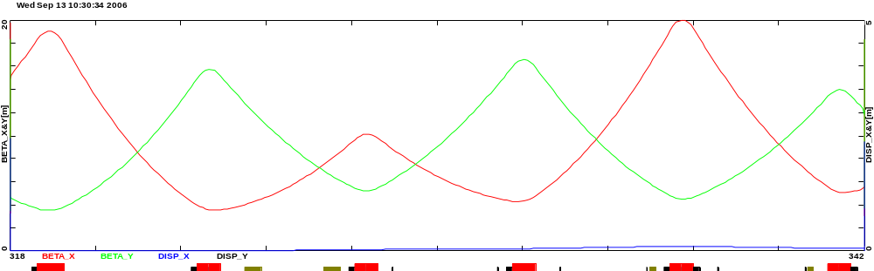
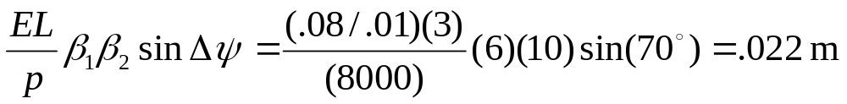
Details
= existing element (to be removed)
= proposed new element
Inj. sept
inj. kick
DRF 1-3
Q502
Q405
Q404
Q403
Q402
Q501
Ext. sept.
Ext. Lamb.
MI Septum Parameters
Deflection at Lambertson
In extraction area, need ~.8T over 3m to clear next quad (short MI style Lambertson + big C magnet)

Slide 14
Worries
Haven’t started thinking about details of resonance
Ideally, should be in a parallel region
  Needs study
  Possibly requires lattice modifications
Beam loss!!!
  ~20kW beam (maybe higher when SNuMI not running)
  Best resonant extraction schemes lose ~2-3% of the beam
  ~500 Watts of (localized) beam loss
  This is on the same order as the entire beam loss in the Booster!
  Must consider very early in design.
  Good news: problem was ~20 times worse back in Main Ring days
    But life was cheap then

Slide 15
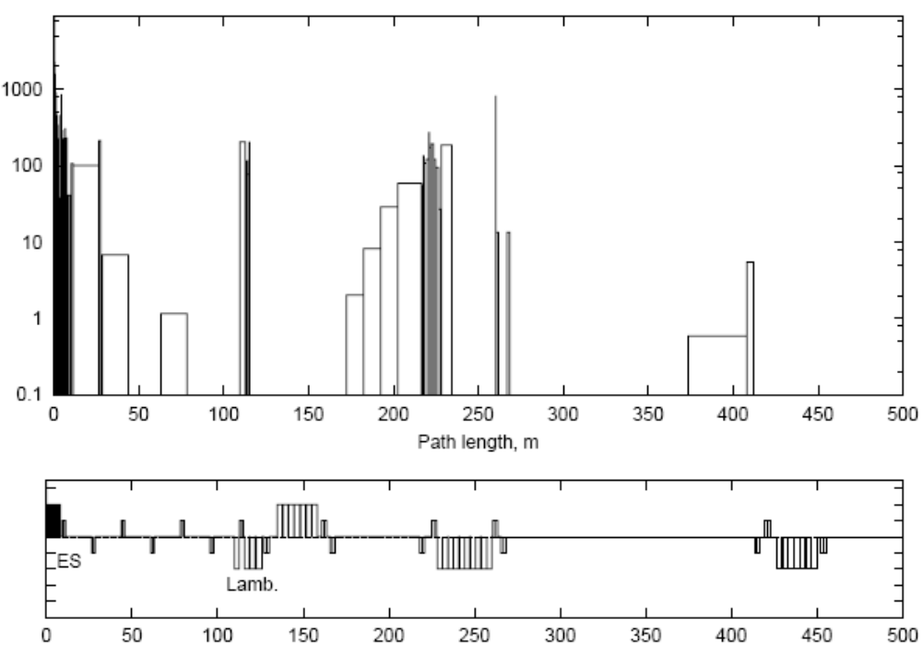
Beam Loss From Proposed NuMI Slow Extraction*
Beam loss in accelerator and beamline
W/m
Ruled unworkable for NuMI
Factor ~40 less energy and more localized for mu2e
  Sounds good, but 40 is a lot less than the shielding difference!
Still must be planned for early
*Drozhdin, Lucas, Mokhov, Moore, Striganov, PAC99, WEP163

Slide 16
Conclusions
Putting this much beam into the pBar tunnel is a big worry
Luckily, a lot of the work will be done for SNuMI II, but mu2e has some special problems which must be addressed
  Beam in debuncher
  Extraction losses
It appears putting a resonant extraction scheme in the debuncher will not present any significant problems, but much more work needs to be done.
  Also, consider more elegant schemes that may help with extinction.

