Slide 1
Slow Extraction Update (work in progress)
Eric Prebys

Slide 2
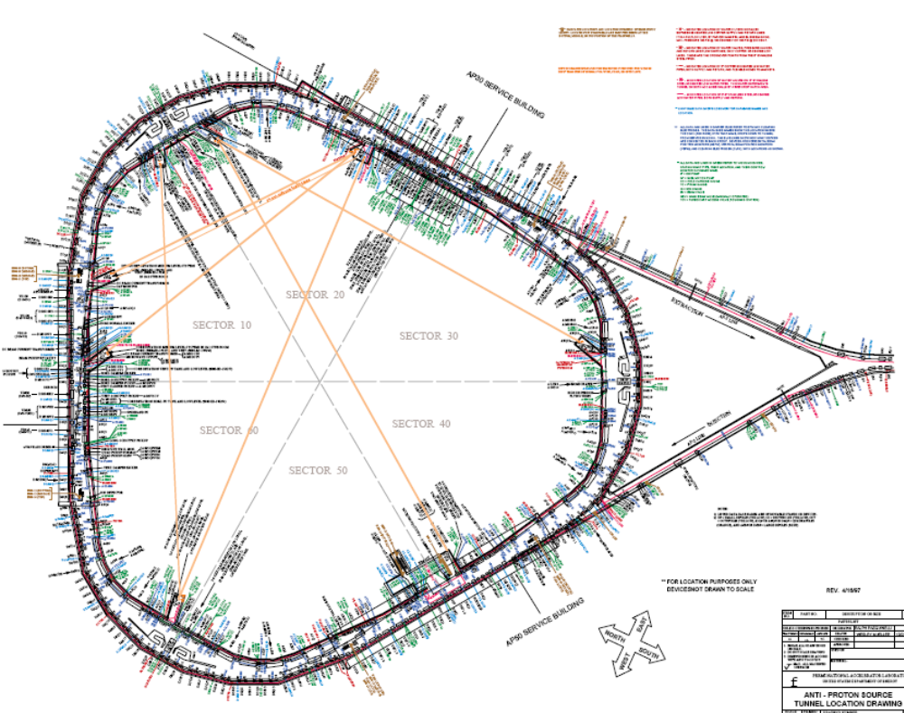
Basic Debuncher parameters (now)
Circumference: 505m
Tunes
  ν_{x} = 9.673
  ν_{y} = 9.752
Symmetry: 6-fold (mirror)

Slide 3
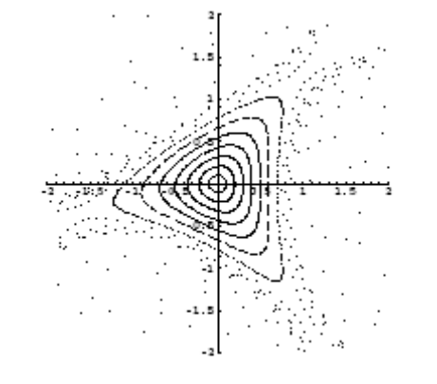
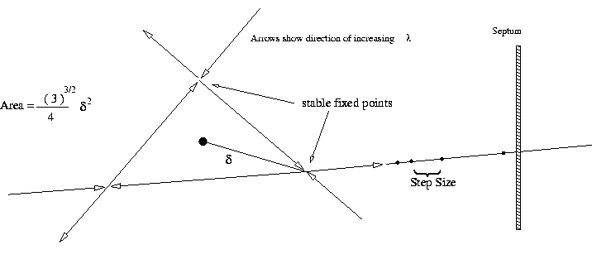
Third Order Resonance Extraction
Pros
  Textbook case
  Easy to calculate
  Most common worldwide
  Could be driven with existing sextupoles (??)
    Have to check this
Cons
  As separatrix shrinks, tricky to get last bit of beam in controlled way

Slide 4
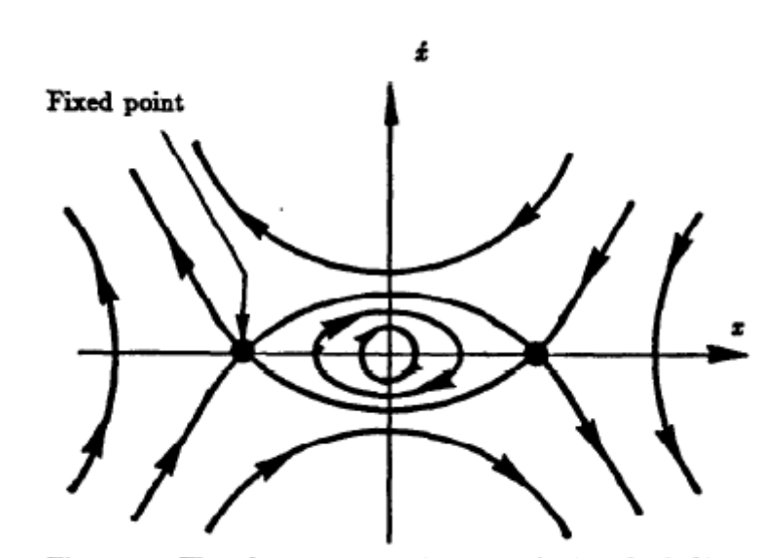
Half Integer Resonance Extraction
Cons
  Hard to calculate Because it’s a linear resonance, must introduce octupoles (amplitude dependent tune) to create separatrix
Pros
  Easy to extract last beam in controlled way
  The “standard” at FNAL (see D. Edwards, FNAL-TM-0842)
    Lots of experience
  Extensively analyzed for MI (See J. Johnstone, BEAMS-DOC-92v2)
    Can largely appropriate this analysis verbatim
  Investigating this as a first try
septum

Slide 5
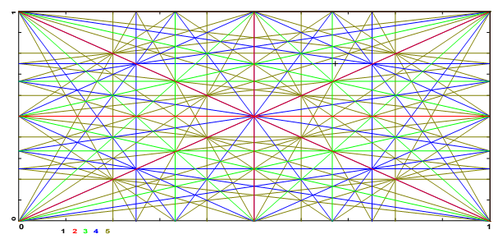
Extraction Proposal
Move working point to below 9.5
Drive 19/2 (half integer resonance) resonance
  Lots of experience at the lab
  Can appropriate the analysis done for the MI

Slide 6
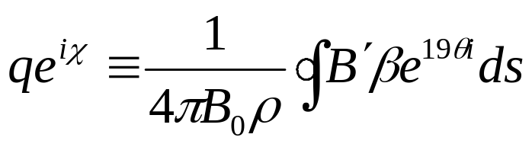
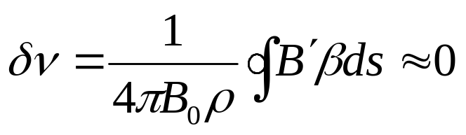
Procedure
Use lattice quads to move ν_{x} to 9.5-δ, where δ~.02
Add harmonic quads to drive resonance term:
Constraint: do not introduce tune shift
-> place opposite polarity quads at symmetric beta points
Add octupoles to create amplitude dependent separatrix
Drive harmonix quads to increase half-integer stop band
  Feed back extracted intensity to control rate

Slide 7
Quad placement
Two in each straight section, run as opposite polarity pairs
Relative strength of three pairs will control amplitude and phase () at septum point

Slide 8
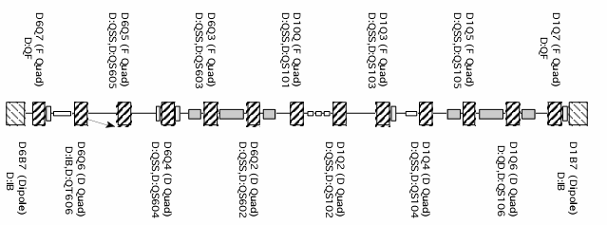
Quad placement (cont’d)
Potential (high beta) harmonic quad locations

Slide 9
Beam Extraction
Unstable beam motion in N(order) turns
Extraction Field
Lost beam
Septum
Minimum loss ~(septum width)/(extraction gap)
Use electrostatic field generated by thin (100 μm) wire plane
Follow with magnetic Lambertson ~90 degrees later in phase

Slide 10
Candidate Locations

Slide 11
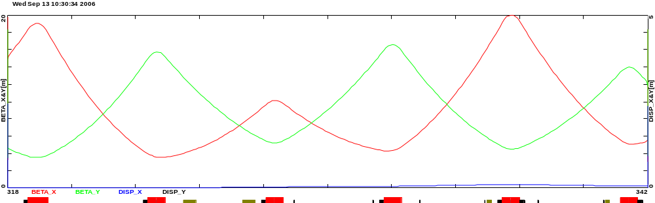
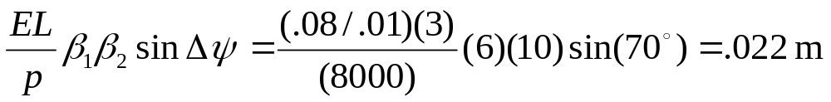
Details
= existing element (to be removed)
= proposed new element
Inj. sept
inj. kick
DRF 1-3
Q502
Q405
Q404
Q403
Q402
Q501
Ext. sept.
Ext. Lamb.
MI Septum Parameters
Deflection at Lambertson
In extraction area, need ~.8T over 3m to clear next quad (short MI style Lambertson + big C magnet)

Slide 12
Status
Now:
  Working with Debuncher lattice file to select optimum location for harmonic quads.
    Will then calculate required strength
  Will go into pBar ring to photograph potential locations to make sure I’m not missing anything.
Next:
  Introduce octupoles
    (0th order driver, so not as many constraints)
  Modify MI analysis for Debuncher parameters
    General trade off: extracted efficiency vs. extracted emittance
  Put new elements in Optim model and simulate extraction.

