Slide 1
Updates
Toured pBar tunnel
  Once cooling hardware is removed, there will be lots of room for any sort of resonance or extinction hardware we want.
Working on optimum harmonic magnet placement
  Still assuming half integer extraction
Looking at JParc extraction scheme
  Thanks to Kevin Brown for Sending Material

Slide 2
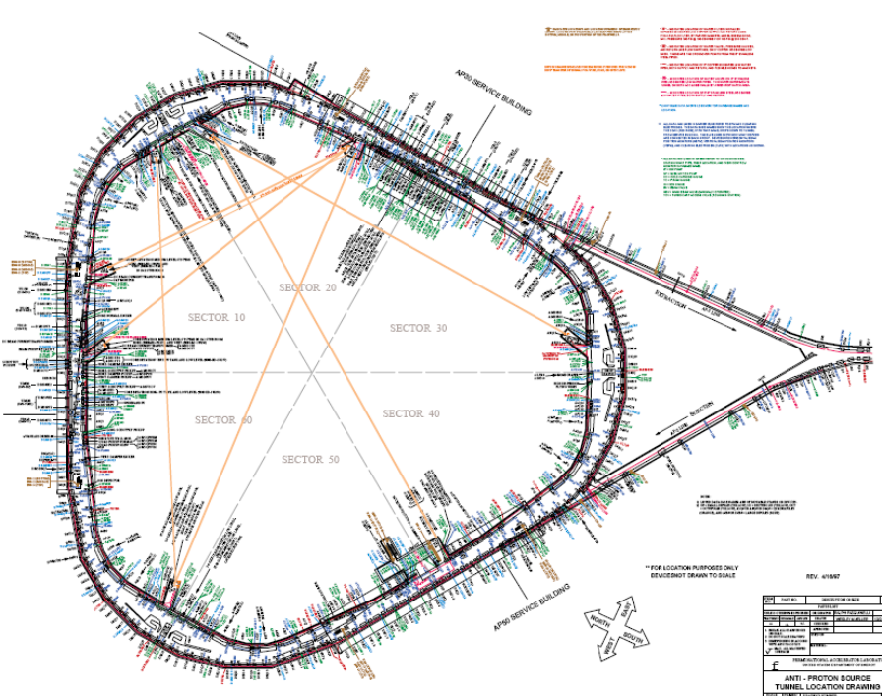
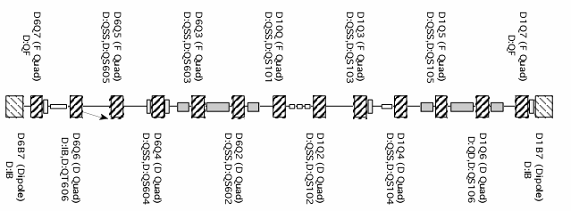
Beamline availability
Debuncher has three identical dispersion-free straight sections
  13 quads each
  One filled with cooling pick-ups
  One filled with cooling kickers
  One filled with RF
Once cooling goes away, it will free up lots of space
  Assume RF may be more distributed

Slide 3
Resonance driver placement
Consideration
  Want to arrange driving quads in pairs of opposite sign to cancel overall tune shift.
  Want pairs for which driving term (19θ) is an odd number of π appart, so they add.
Choose
  Six locations just inside of the ’07 quads at the ends of the straight sections
Pairs indicated by color

Slide 4
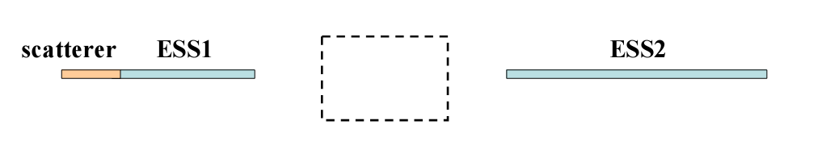
JParc Scheme
Technical Design Report
  Drive 67/3 resonance from below with two families of 36 sextupoles each
  Extract with an electrostatic septum of 170 kV/25mm made out of 100 micron wire @ 1.25 mm spacing over 1.5 m
  Inefficiency of
    2.5% with fixed bump
    1% with dynamic bump
Upgraded proposal
  30 micron ribbon + prescatterer
  Inefficiency of << 1% (Talk claims .1%)
  Are they building this?
  Should work for us

Slide 5
Plans
Continue to pursue half integer resonance
Hopefully have it into Optim model by next meeting.

