Slide 1
Mu->e at Fermilab (from Milorad)
What has to be done
Injection to Recycler from 8GeV line at MI-10
This will be done for MI operations, new set of permanent magnets
MI-52 Extraction from Recyler to P1 line for u-e
Beam to P1-P2-AP1-AP2-Accumulator
Accumulator will need work to exchange injection and extraction hardware for momentum stacking
Beam to Debuncher

Slide 2
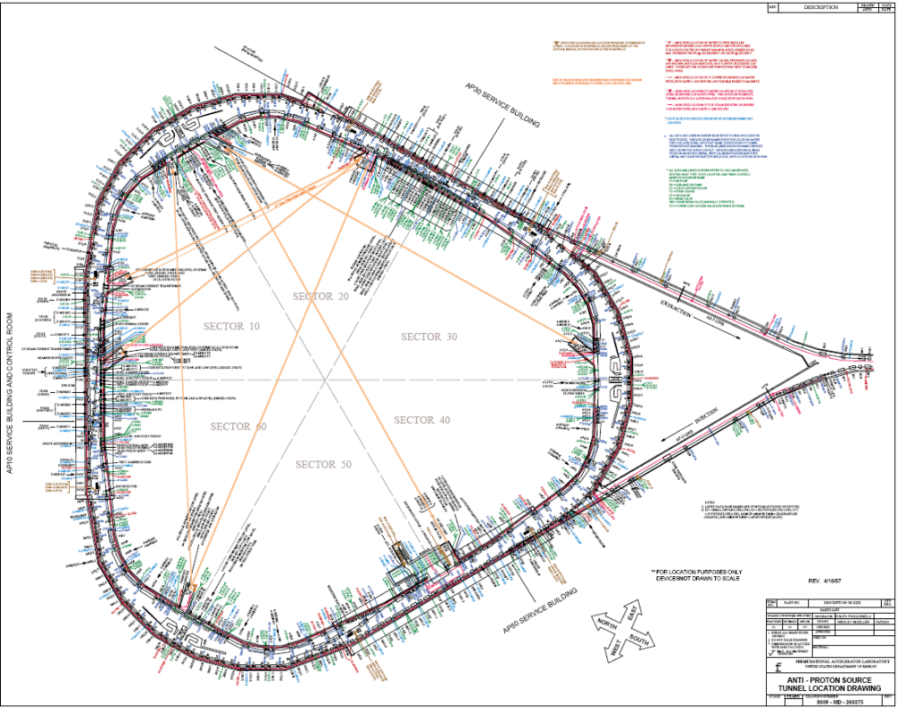
Mu->e at Fermilab
Injection in Accumulator
Injection Line
Injection in Debuncher

Slide 3
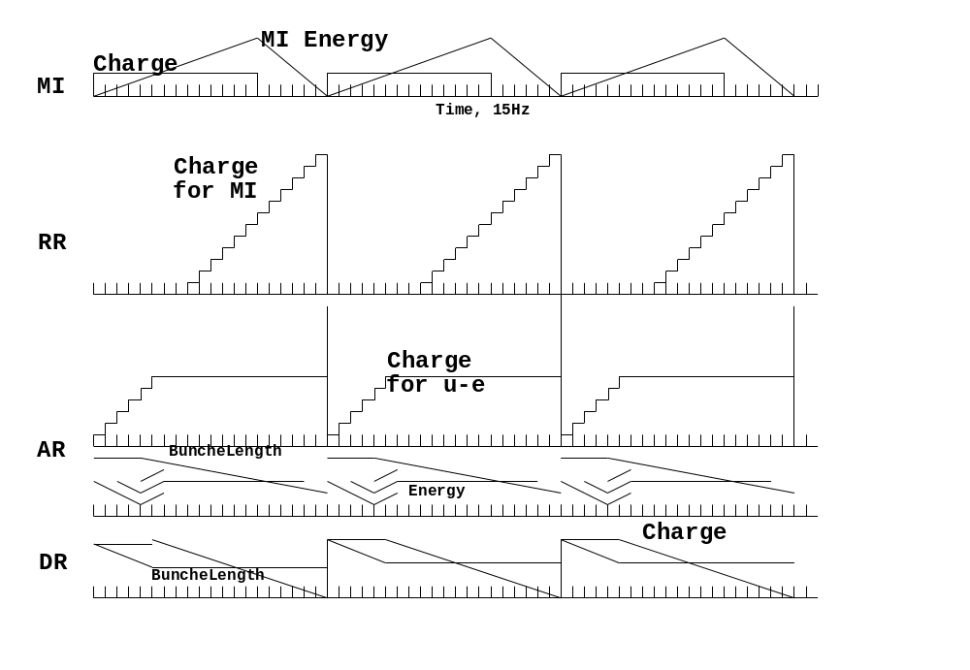
MI 1.33sec=20 Booster Pulses

Slide 4
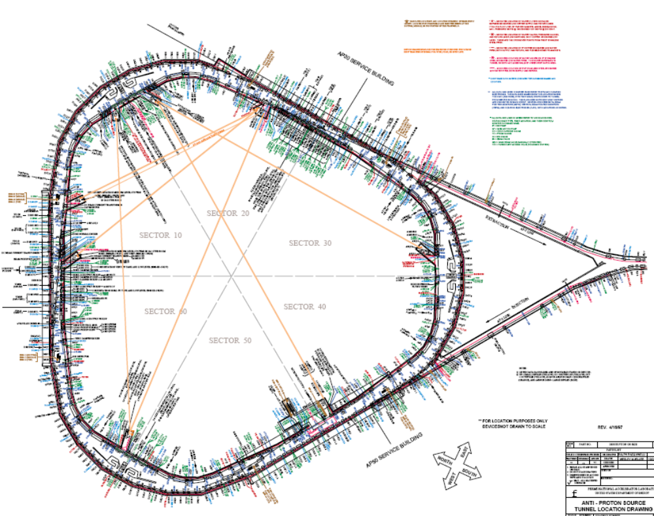
Slow Extraction

Slide 5
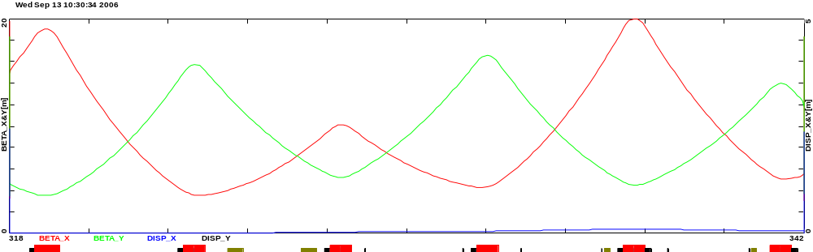
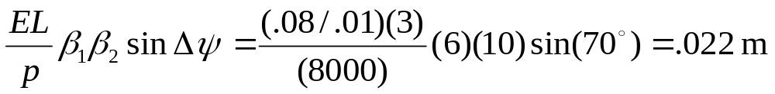
Details
= existing element (to be removed)
= proposed new element
Inj. sept
inj. kick
DRF 1-3
Q502
Q405
Q404
Q403
Q402
Q501
Ext. sept.
Ext. Lamb.
MI Septum Parameters
Deflection at Lambertson
In extraction area, need ~.8T over 3m to clear next quad (short MI style Lambertson + big C magnet)

Slide 6
Numbers
Protons per batch: up to 3E13
Protons per second: up to 2.3E13
Loss at extraction septum: ~1-2%
  ~4E11 protons/sec = 500W
    = entire beam loss in Booster!!
Questions:
  What loss can we live with with a chipmunk system like the Booster, if we fence of the entire pBar area?
  What intensity can we run and still be allowed in the buildings?
  Can we be in the buildings with even a single full (3E13) batch in the machine?

