Slide 1
Resonant Extraction Update
Eric Prebys

Slide 2
Resonant Extraction Update
Switched focus from half-integer to third-integer resonance
  Closer to present working point
  Plenty of examples with high intensity, high momentum spread beams.
  Some interesting concepts about raising efficiency for such extraction
Switch working point
  ν_{x}: 9.764 -> 29/3±ε

Slide 3
Comparison with the AGS
 | AGS | Debuncher
Energy [GeV] | 25.5 | 8
Intensity [10¹²] | 76 | 15-30
Bunch Area [eV-s] | 10.0 | 32.0
Δp/p [%] | ~1 | ~1
Working Point | 8.667/8.78 | 9.667/9.785
Chromaticity [Δν/(Δp/p)] | -21.6* | ~-.8
Inefficiency | 2-3% | Better?
*need to check this

Slide 4
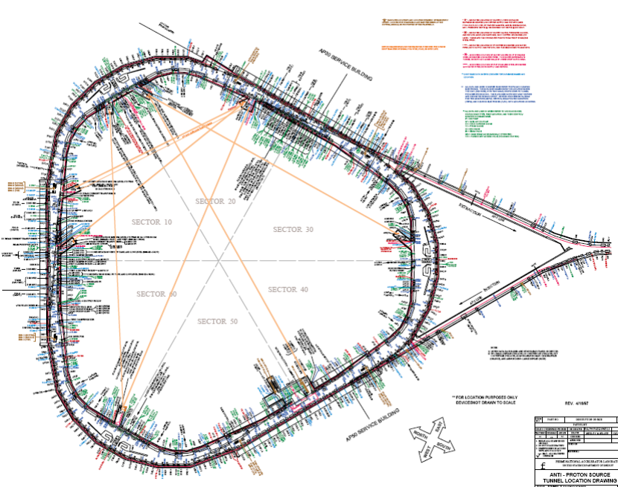
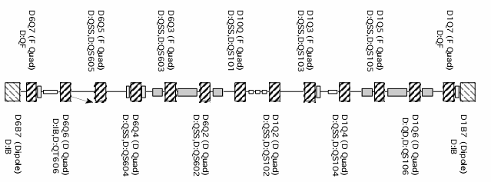
Resonance driver placement
Consideration
  Want to arrange drivers in groups, with the magnets in each group separated by ~multiples of π in 27θ.
  Really only need two groups, but for the moment will work with three because of the natural symmetry of the Debuncher.
Choose
  Six locations just inside of the ’07 quads at the ends of the straight sections
Pairs indicated by color

Slide 5
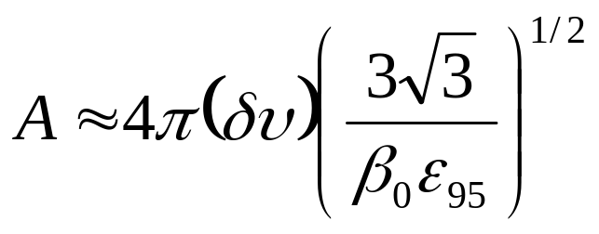
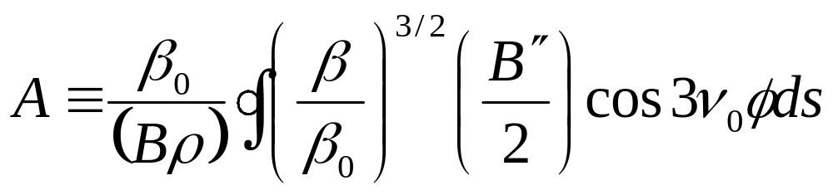
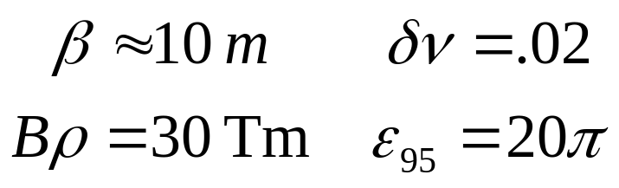

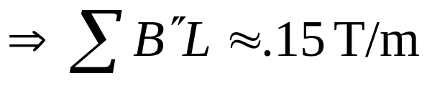
Driving Strength
Driving term:
Use:
Assuming optimal phasing
very modest

Slide 6
Modeling
The Debuncher already has an extremely detailed OptiM model.
Modifications:
  Moved tune to new working point
  Added harmonic driving elements
  Beam parameters set to approximately the same as Dave Neuffer’s rebunched beam.
Simulating resonance
  Drive harmonic elements and observe phase space evolution at extraction region
Problems
  Observing some fallout in simulation when I go to the full intensity even without harmonic drivers.
  Working to understand

Slide 7
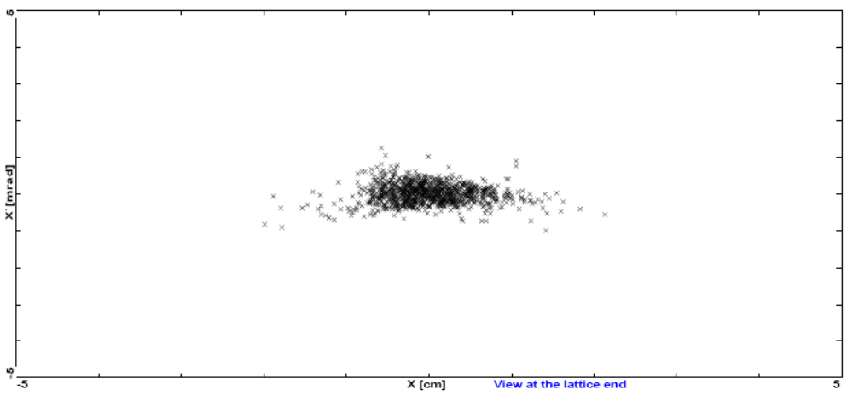
Resonant Phase Space
Note: overdriving resonance top make it visible in a limited number of turns

Slide 8
Next step
Now that mechanics work, focus on fine tuning flow rate.
Try to understand non-resonant beam fallout.
Investigate lattice modifications to optimize efficiency.

