Slide 1
AC Dipole optimization*
Eric Prebys
*written up in BEAM-DOCS-2925-v1

Slide 2
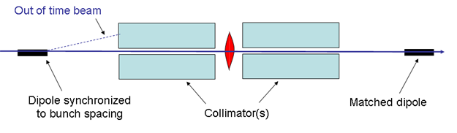
Concept
Considerations
  High frequency: 1/(2*1.7 μsec) ~ 300 kHz
  Minimize power supply cost and complexity
    Optimize stored energy
    Maximize Q

Slide 3
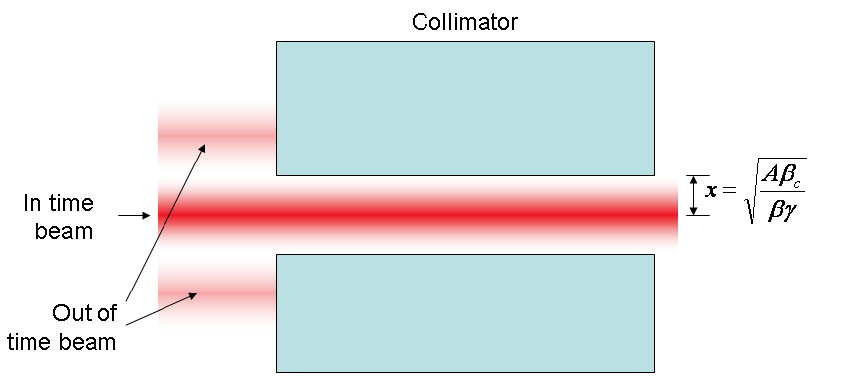
Amplitude requirement
At collimator:

Slide 4
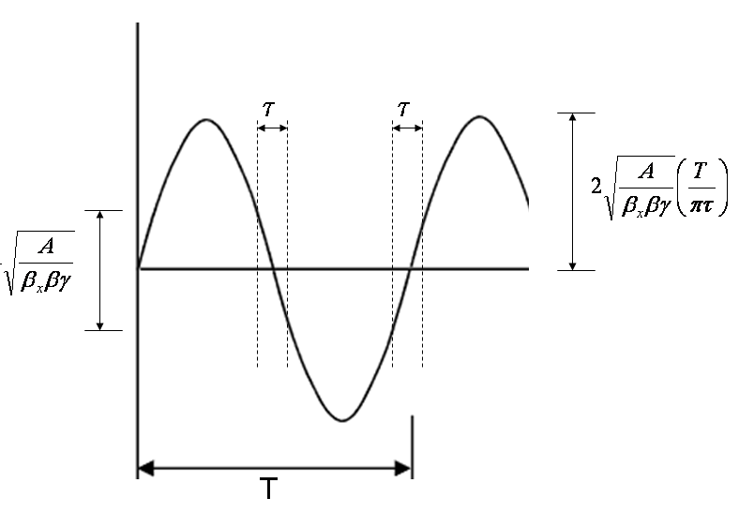
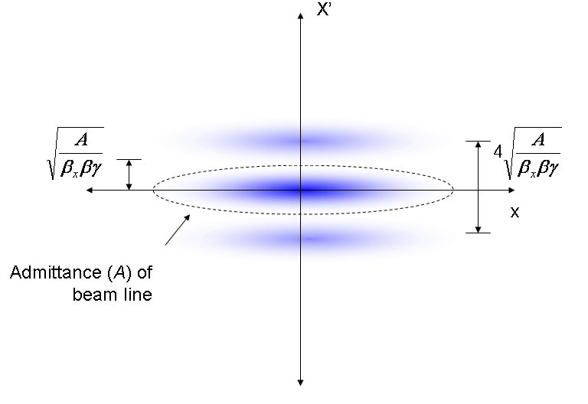
At magnet
Phase space (live window τ):
Full amplitude:

Slide 5
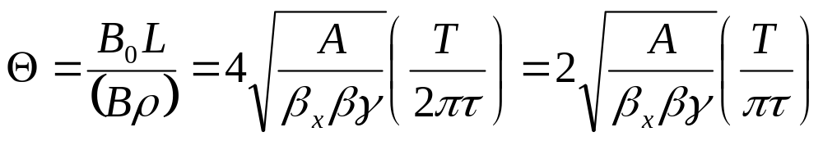
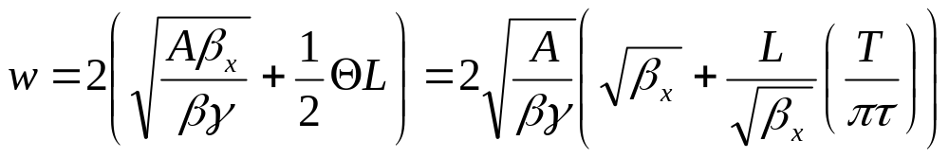
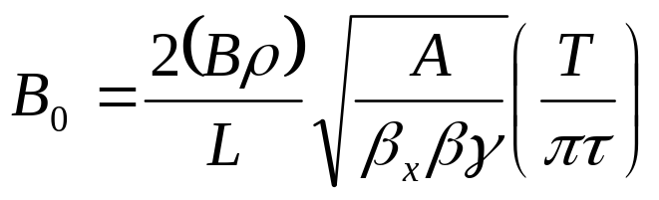
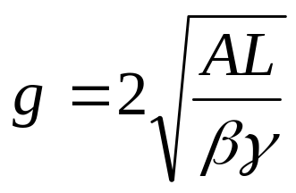
Magnet Parameters
Angular amplitude:
Width:
Field:
Gap (minimum waist):

Slide 6
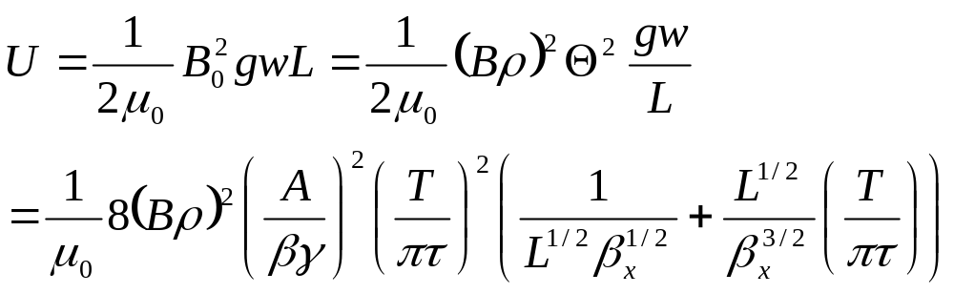
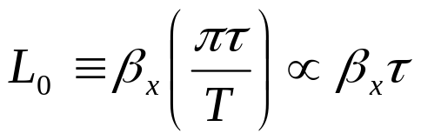
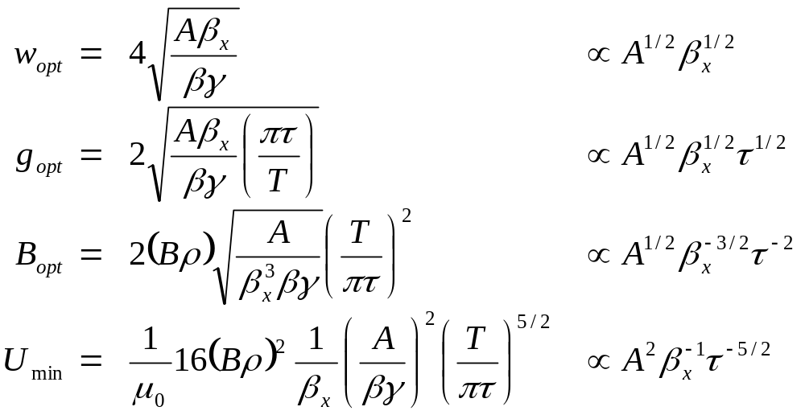
Minimizing Stored Energy
Falls with β_{x}
For a particular β_{x}, there is an optimum length L₀:
For which the optimized parameters are:

Slide 7
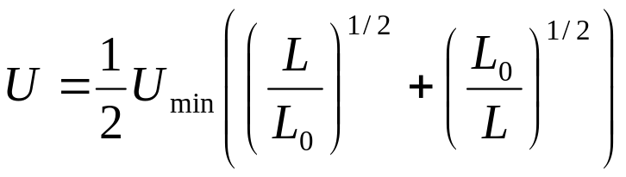
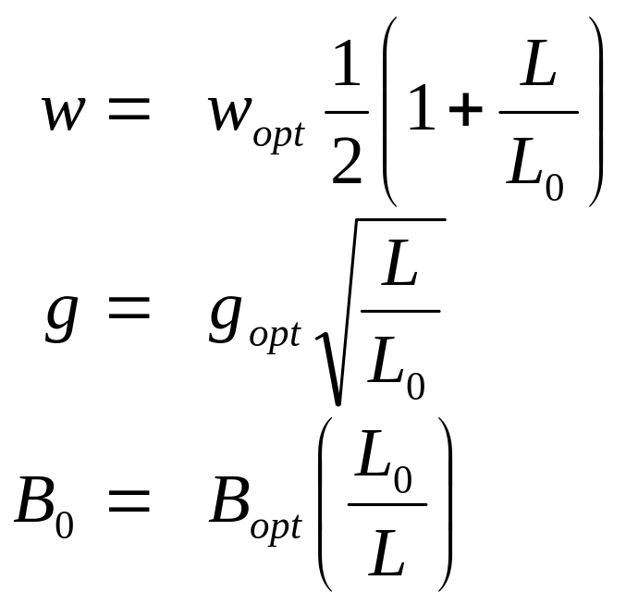
Non-optimum lengths
Optimum length impractical for large β_{x}
Luckily, parameters weak function of length

Slide 8
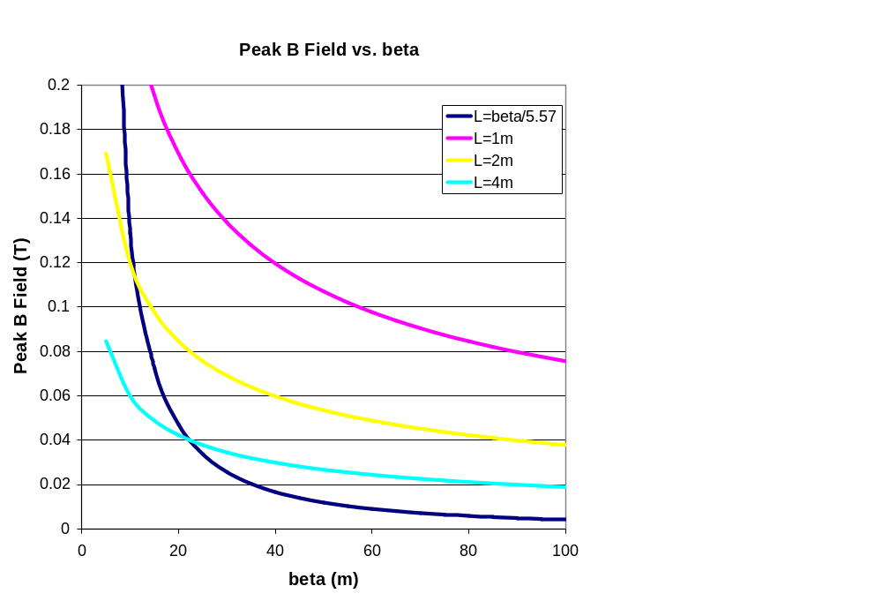
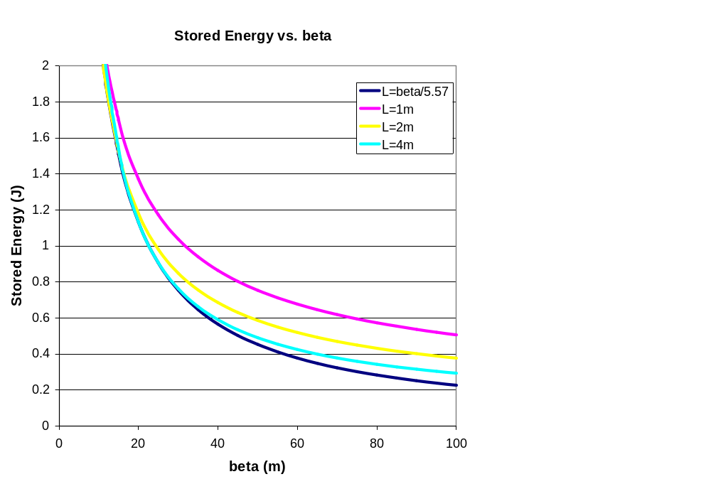
Peak Field and Stored Energy
Use A=50π mm-mr, τ=200 ns

Slide 9
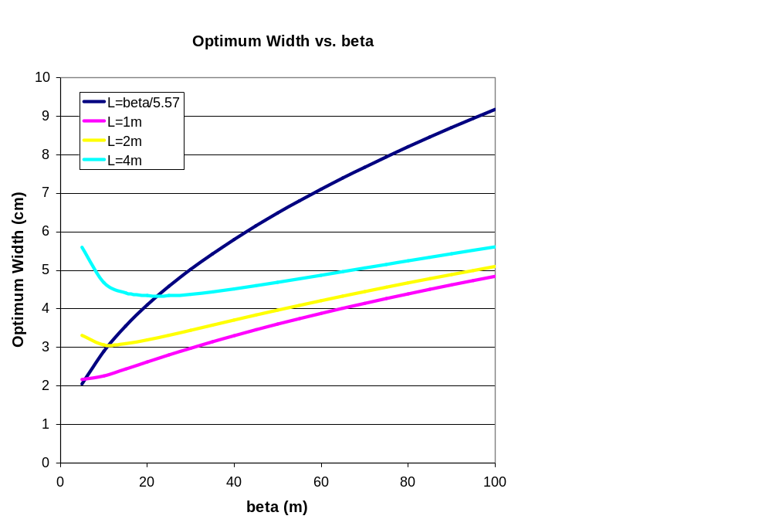
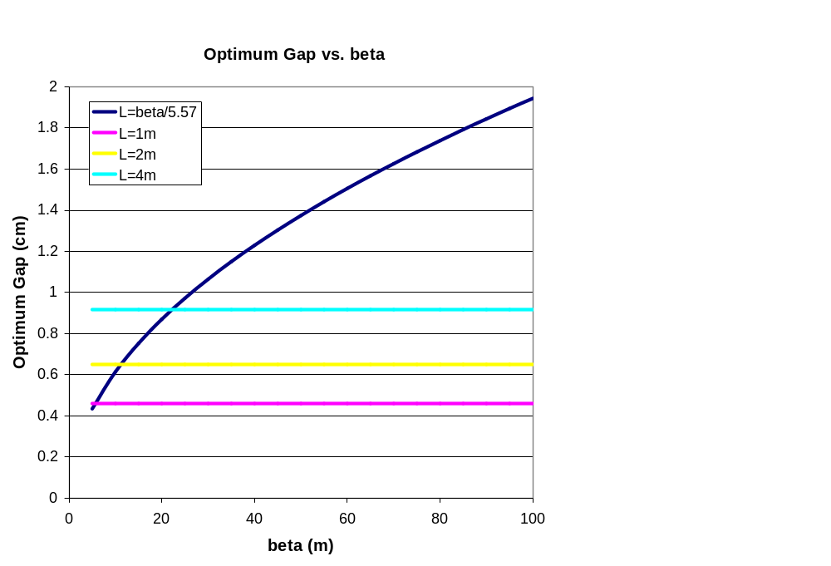
Magnet Aperture

Slide 10
Proposed Parameters for Development
Parameter | Value | Comment
β_{x} | 50 m | Typical beam line beta max
Effective length (L) | 2 m
Full width (w) | 5 cm
Vertical gap (g) | 1 cm | Scaled up for practicality
Peak field (B₀) | 600 Gauss
Peak stored energy (U) | 1.43 J | A little over twice the minimum

