Slide 1
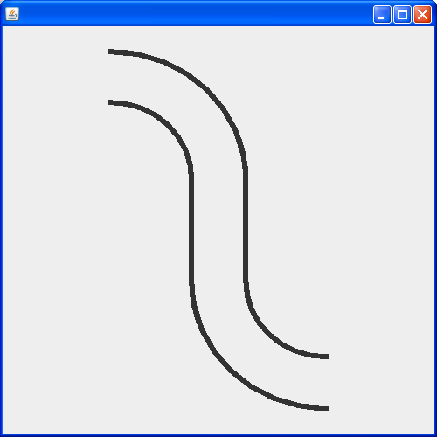
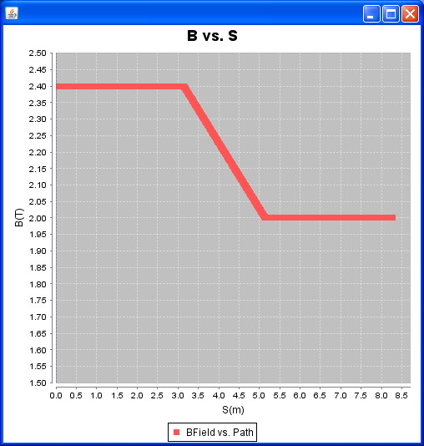
To investigate whether the gradient affects the offset at the end of the TS
E. Prebys –mu2e meeting
4/9/08

Slide 2
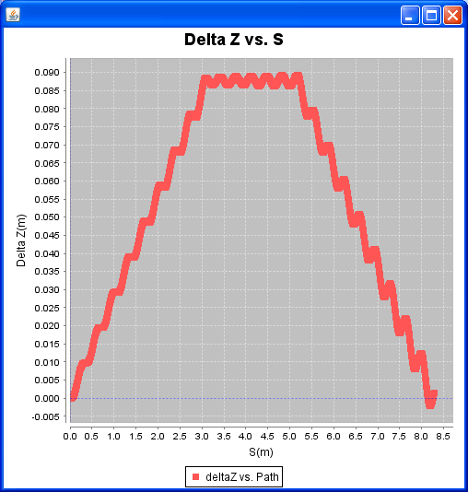
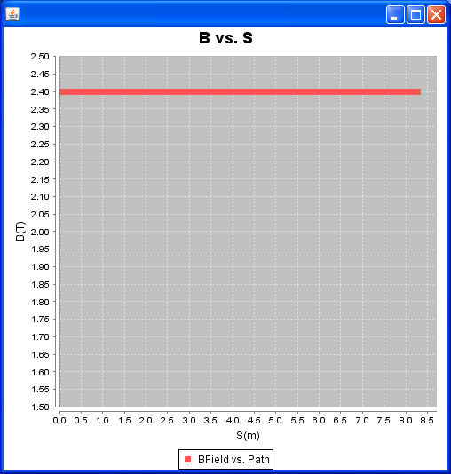
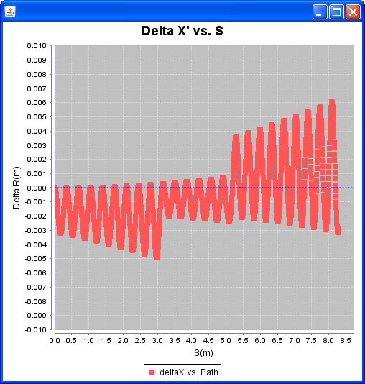
E. Prebys –mu2e meeting
4/9/08

Slide 3
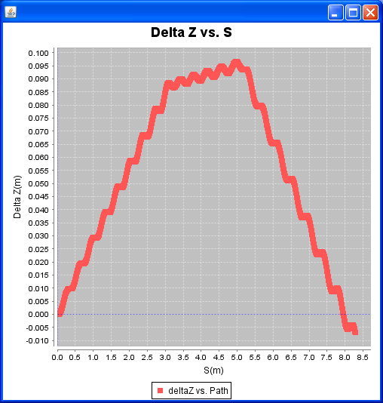
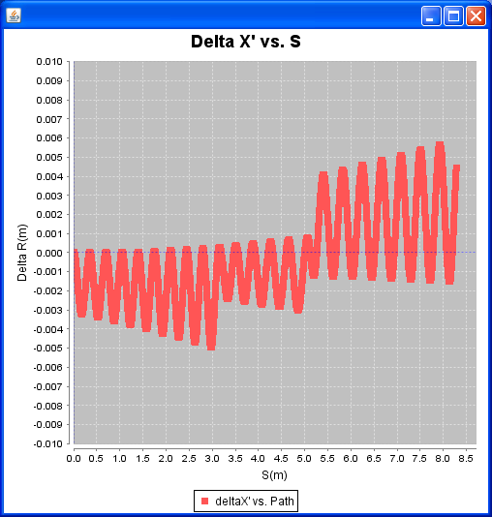
E. Prebys –mu2e meeting
4/9/08

Slide 4
As Designed
Uniform (2.4T) Field
Conclusion
  Gradient doesn’t cause problems
  Probably is fringe fields
E. Prebys –mu2e meeting
4/9/08

