Slide 1
Limits to Proton Intensity
Total proton rate from Proton Source (Linac+Booster):
  Booster batch size
    ~4-5E12 protons/batch, depending on beam quality required.
  Booster repetition rate
    15 Hz instantaneous
    Currently ~9Hz, limited by RF system.
  Beam loss
    Damage and/or activation of Booster components
    Above ground radiation
Total protons accelerated in Main Injector:
  Maximum main injector load
    Six “slots” for booster batches (3E13)
    Up to ~11 with slip stacking (4.5-5.5E13)
    Beam stability (RF issues)
    Beam loss concerns
  Cycle time:
    1.4s + loading time (1/15s per booster batch)
Historically our biggest worry
Critical path for NuMI/MINOS
Mu2e, April 23, 2009 - Prebys

Slide 2
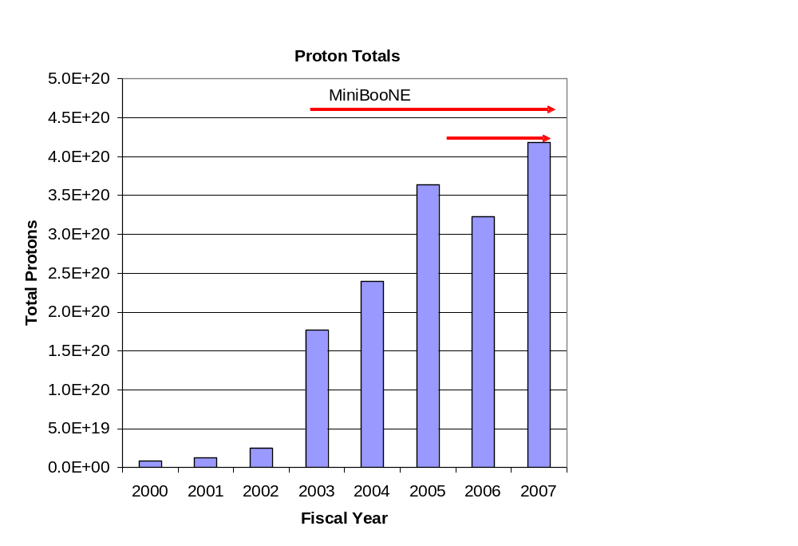
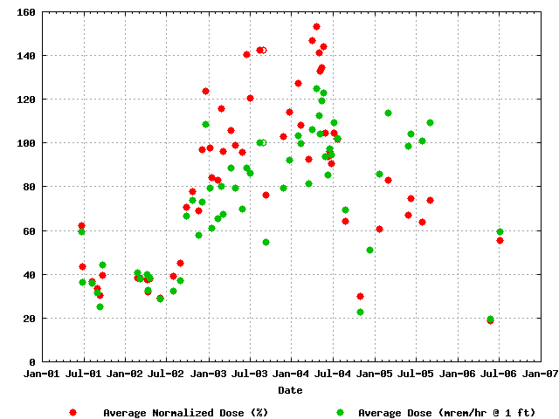
Proton Delivery
Average Booster Activation
MiniBooNE
NuMI
Factor of 15 increase in protons
Mu2e, April 23, 2009 - Prebys

Slide 3
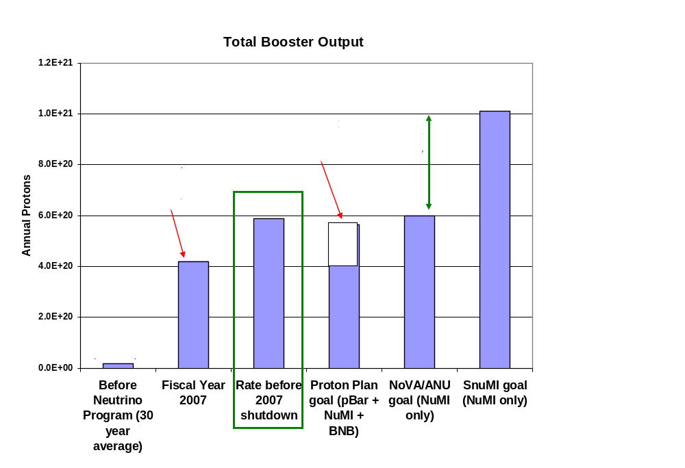
Total Booster Output
Mu2e, April 23, 2009 - Prebys

Slide 4
After the 2007 Shutdown
After the 2007 shutdown, the remaining Proton Plan Projects will he
  Rest of Booster Correctors
    In the 12 remaining long sections.
    In the 24 short straight sections.
  Upgraded gamma-t jump system in Booster (maybe)
    Capable of running at required repetition rate
    Must be installed along with correctors
  Booster chopper notcher
    Reduce losses when creating extraction loss
These are all currently scheduled for the 2008 shutdown
We allow a year after this to achieve the ultimate benefits
  Proton plan will officially end in mid to late 2009
It is likely that the plan will absorb some scope to enable full 15 Hz operation.
  Refurbish RF anode supply
  Retrofit half the RF bias supplies
  Recommission RF cavity tuner cooling
  Not necessary for NuMI
Mu2e, April 23, 2009 - Prebys

Slide 5
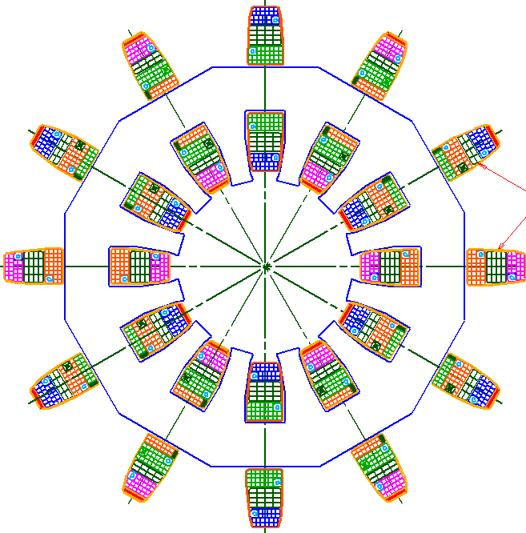
Booster Corrector System
Biggest single project in plan
Replace all 48 (original) Booster corrector packages.
  Unique new design
Six independent multipoles
  Stronger H and V dipoles
    ±1cm beam motion throughout cycle
  Stronger quad
    Arbitrary tune working point throughout cycle
  Skew quad
    Coupling, same strength as before.
  Sextupole and skew sextupole at every period.
    Less emittance blowup
    More control of harmonic resonances.
Integrated BPM
  Saves space
~16”
Mu2e, April 23, 2009 - Prebys

Slide 6
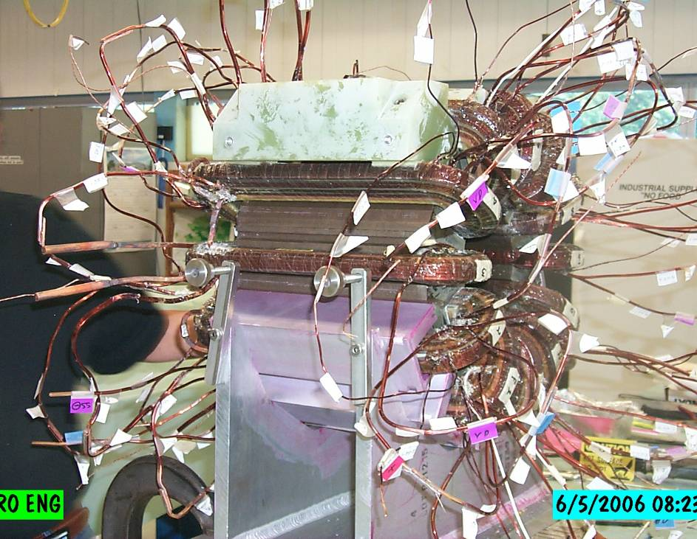
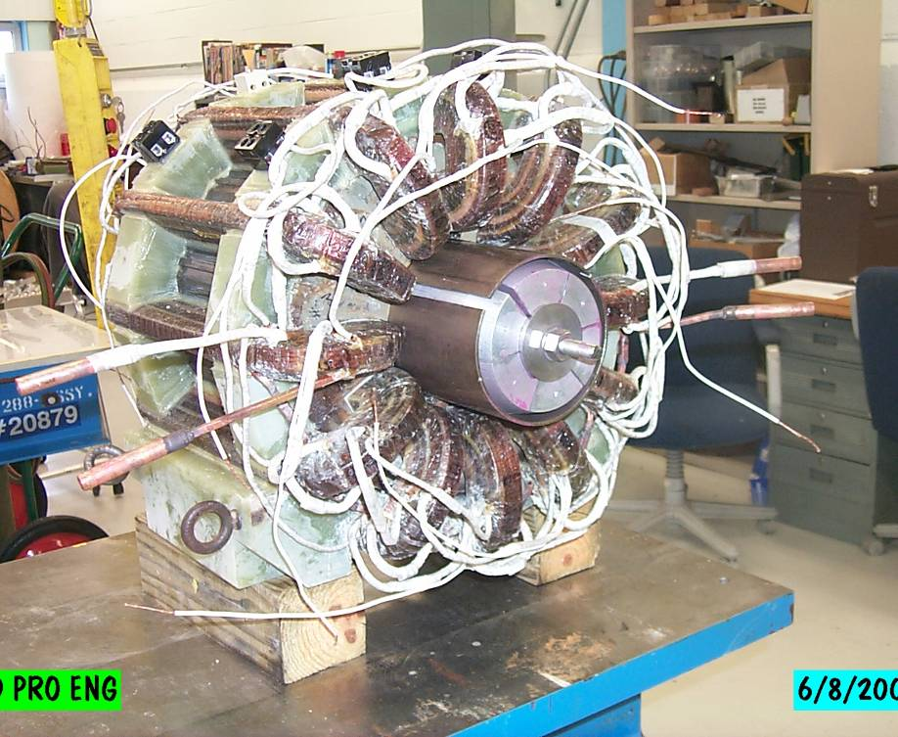
Corrector Prototype
Bad hair day
Ready for testing
Mu2e, April 23, 2009 - Prebys

Slide 7
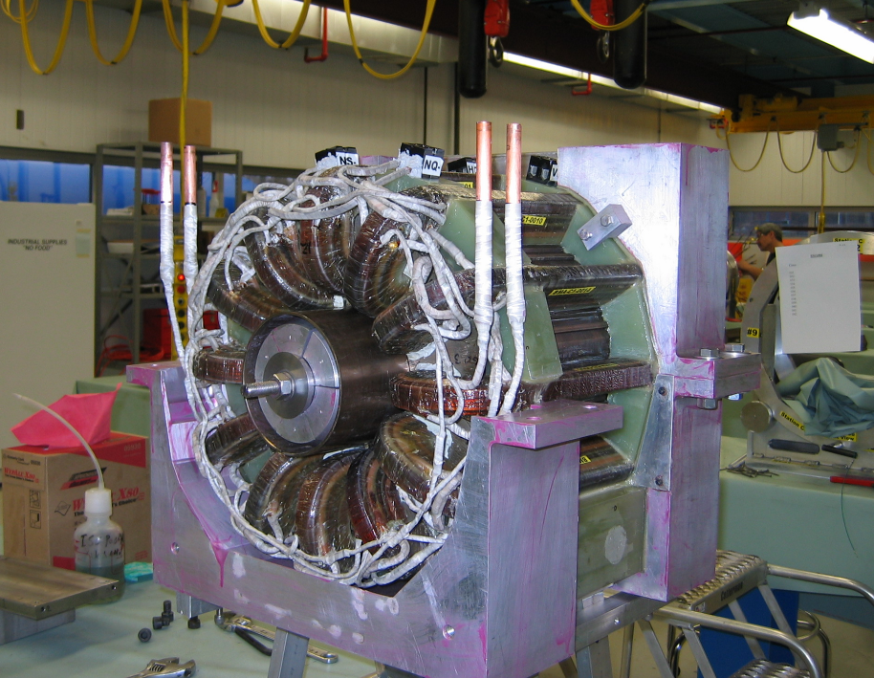
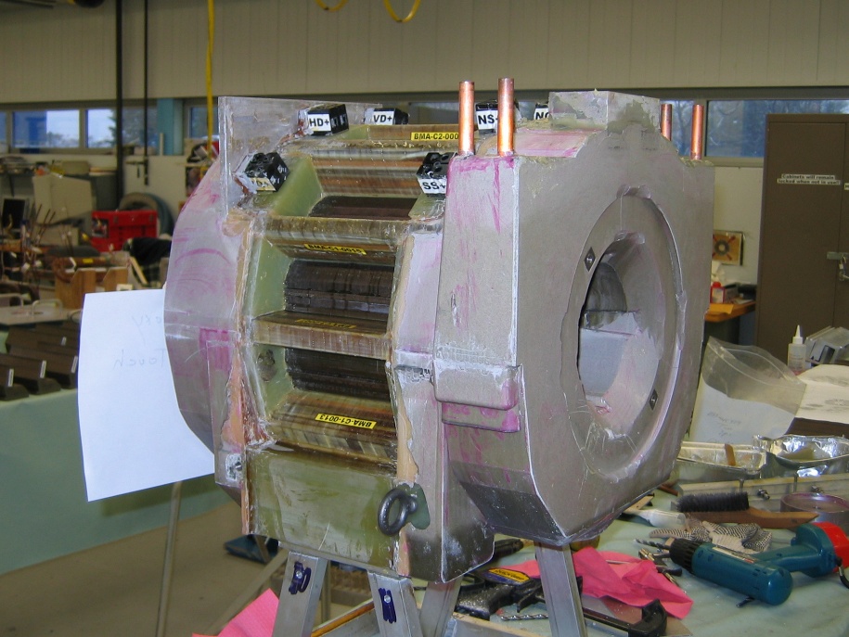
Potting
Mu2e, April 23, 2009 - Prebys

Slide 8
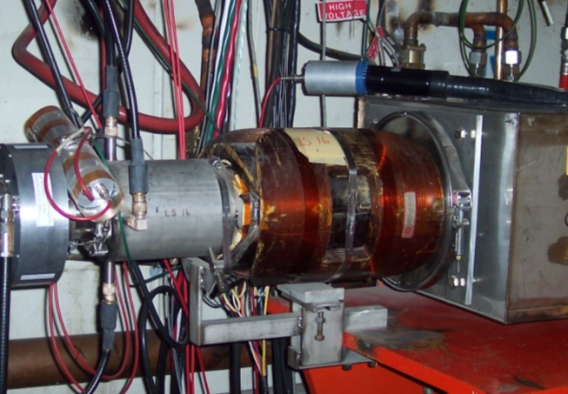
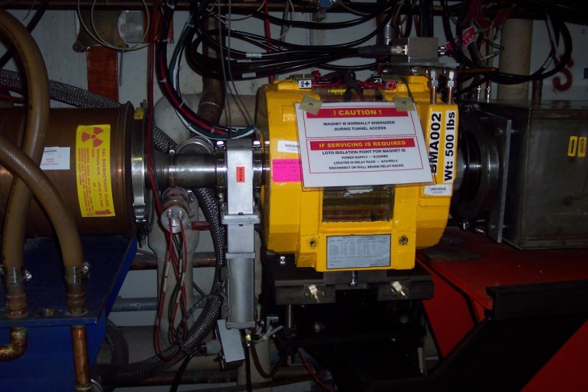
Initial Installation
Installed ¼ of the new Booster corrector system (12/48) in 2008 shutdown
  Odd long straights (primarily vertical control)
Remainder of system will be completed in July and installed in the 2009 shutdown.

Slide 9
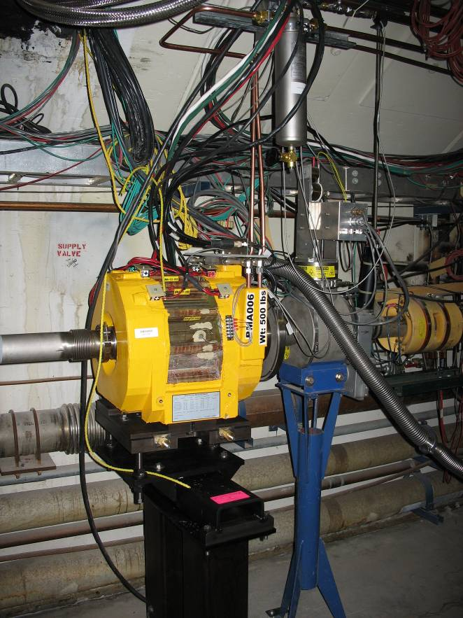
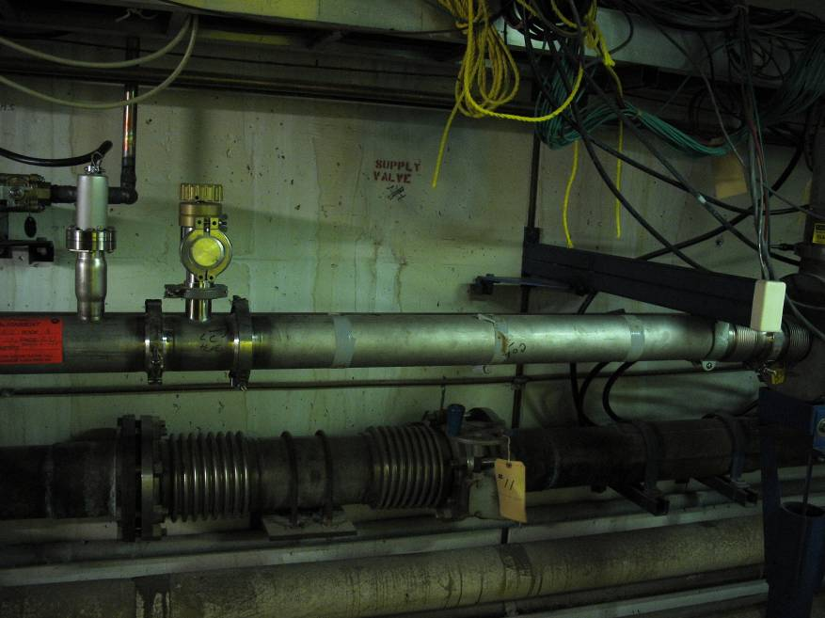
Prototype Installation
All power supplies and water connected
Pulsing (hard) on beam off cycles
Proceeding with beam tests
Mu2e, April 23, 2009 - Prebys

Slide 10
Current Status
Partial system integrated into operation
  Dipoles scaled to behave like existing dipoles and integrated into closed orbit program
  Higher order correctors integrated with existing system in transparent (and therefore limited way)
All correctors completed
  Ready to install in 2009 summer shutdown
Mu2e, April 23, 2009 - Prebys

Slide 11
Importance to Mu2e
The booster has more or less demonstrated the proton flux required by NOvA
We are taking steps to insure the hardware improvements needed to go to 15 Hz will be made.
It is assumed that the new corrector system will reduce losses to the point where the booster can run continuously at 15 Hz, as required by Mu2e
  No one will work on this if we don’t push
Mu2e, April 23, 2009 - Prebys

Slide 12
Goals for student
Initial
  Get closed orbit correction working
  Pretty straightforward, all code already in place
PhD
  Lots of options involving more sophisticated used of higher order elements and/or utilizing the position control for more sophisticated use of the collimation system.
Mu2e, April 23, 2009 - Prebys

