Slide 1
History
In the 1990’s, the lab promised 4e20 protons/year to NuMI and 5e20 protons/year to MiniBooNE, in addition to the ~1e20 needed for pBar stacking.
  No clear plan how they were going to do this
  Accelerator Division began preparations.
  Notion of “Proton Economics” began
    P. Kasper, “Getting Protons to NuMI (It’s a Worry)” (2001)
This led to the “Finley” report (2003) and the Proton Plan (beginning in the 2005)
  Goals
    Deliver what’s needed for pBar stacking
    Slip stack ~4e20 protons/year to NuMI
    Simultaneously deliver 1-2e20 protons/year to MiniBooNE
MiniBooNE has never gotten 5e20 protons/year, even running alone.
Lesson: should think about things before you make promises.
Mu2e, April 30, 2009 - Prebys
1

Slide 2
Limits to Proton Intensity
Total proton rate from Proton Source (Linac+Booster):
  Booster batch size
    ~4-5E12 protons/batch, depending on beam quality required.
  Booster repetition rate
    15 Hz instantaneous
    Currently ~9Hz, limited by RF system.
    Plan to “adiabatically” inrease to 15 Hz
  Beam loss
    Damage and/or activation of Booster components
    Above ground radiation
Total protons accelerated in Main Injector:
  Maximum main injector load
    Six “slots” for booster batches (3E13)
    Up to ~11 with slip stacking (4.5-5.5E13)
    Beam stability (RF issues)
    Beam loss concerns
  Cycle time:
    1.4s + loading time (1/15s per booster batch)
Historically our biggest worry
Critical path for NuMI/MINOS
Mu2e, April 30, 2009 - Prebys

Slide 3
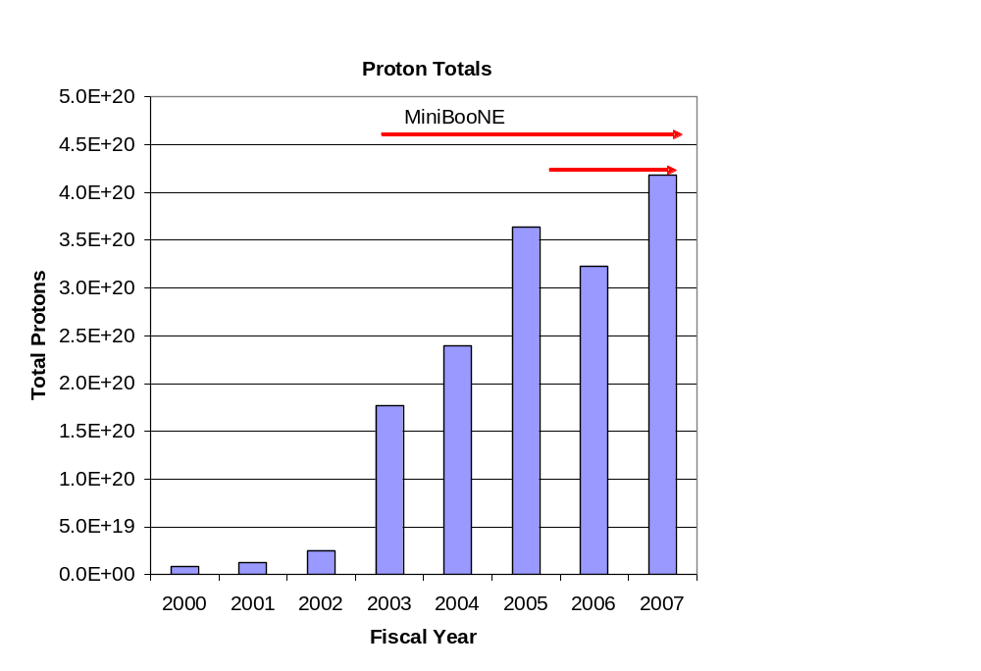
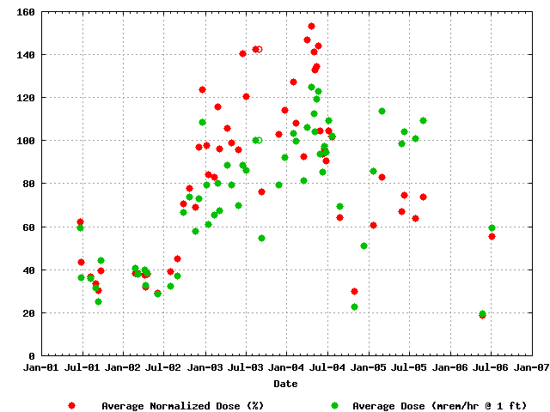
Proton Delivery
Average Booster Activation
MiniBooNE
NuMI
Factor of 15 increase in protons
Mu2e, April 30, 2009 - Prebys

Slide 4
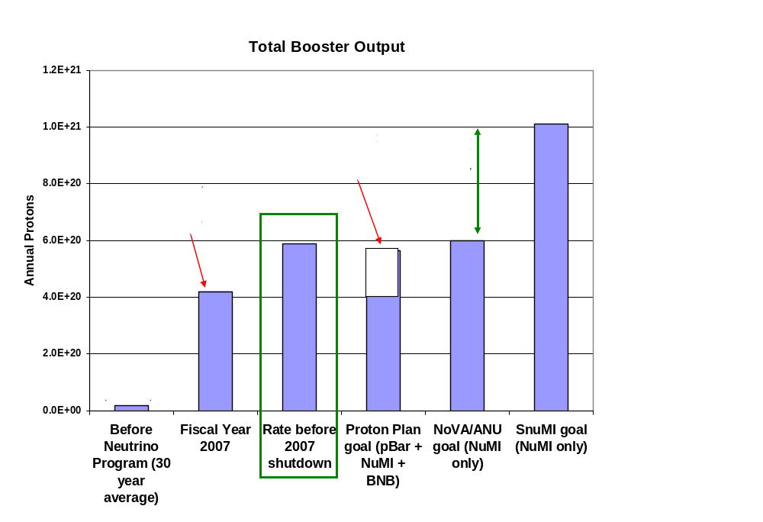
Total Booster Output
Nova + Mu2e
Mu2e, April 30, 2009 - Prebys

Slide 5
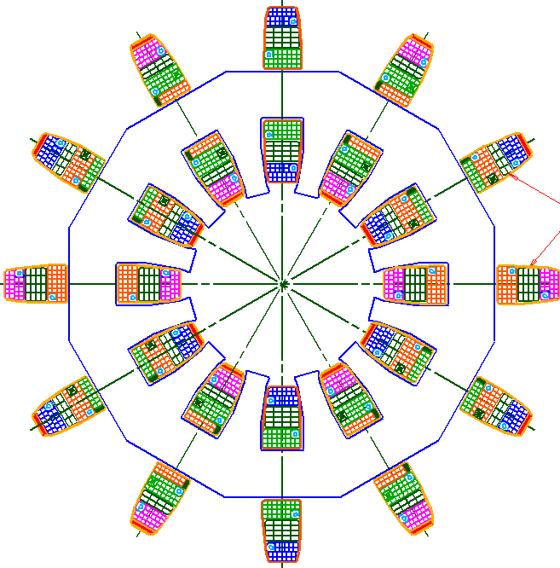
Booster Corrector System
Last remaining part of Proton Plan
Replace all 48 (original) Booster corrector packages.
  Unique new design
Six independent multipoles
  Stronger H and V dipoles
    ±1cm beam motion throughout cycle
  Stronger quad
    Arbitrary tune working point throughout cycle
  Skew quad
    Coupling, same strength as before.
  Sextupole and skew sextupole at every period.
    Less emittance blowup
    More control of harmonic resonances.
Integrated BPM
  Saves space
~16”
Mu2e, April 30, 2009 - Prebys

Slide 6
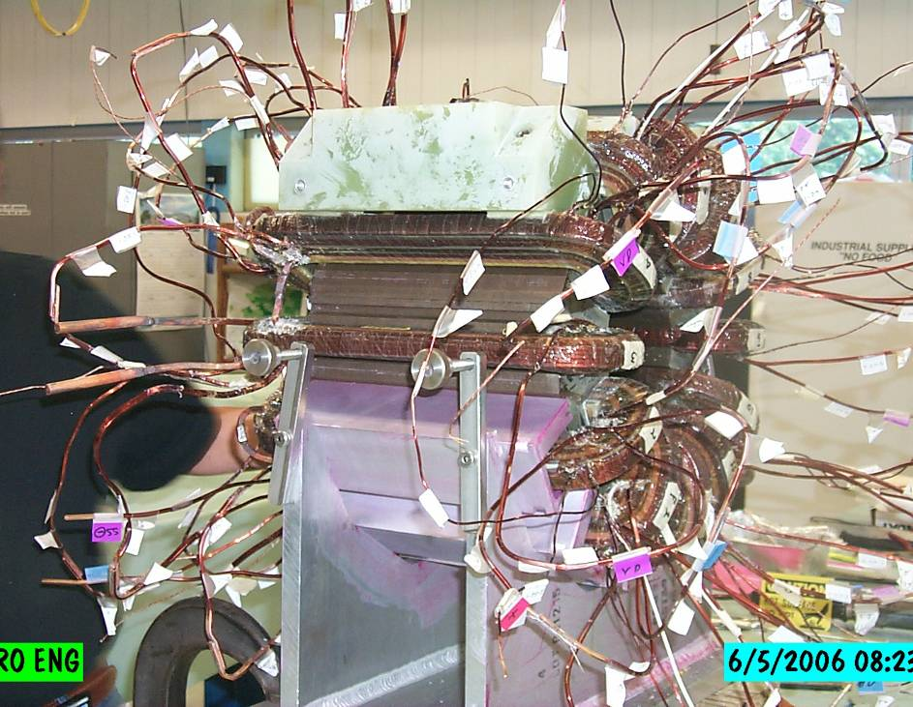
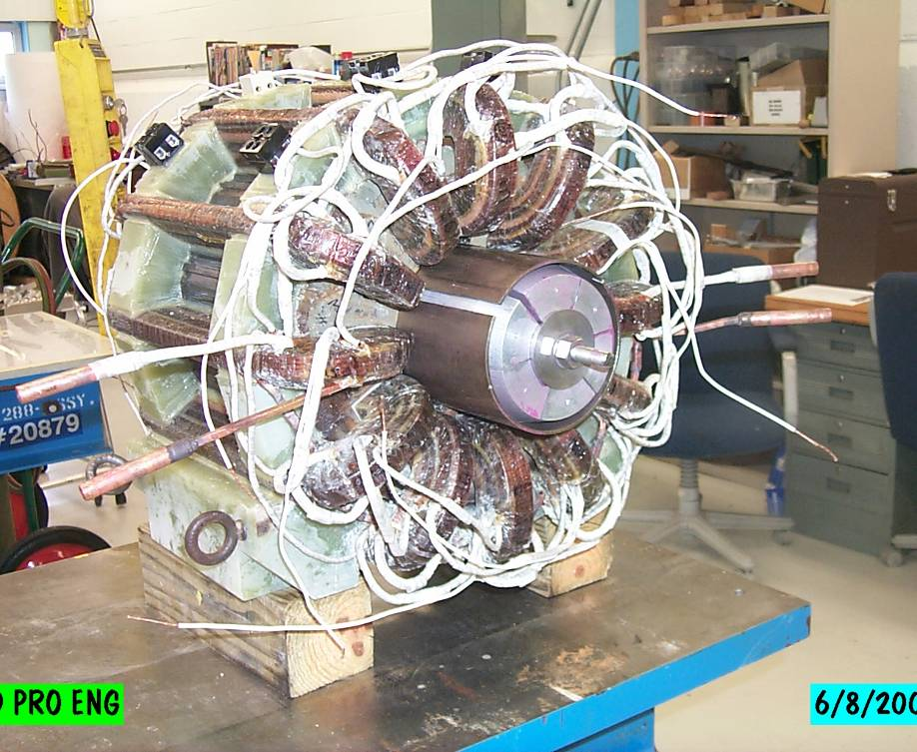
Corrector Construction
Bad hair day
Ready for testing
Mu2e, April 30, 2009 - Prebys

Slide 7
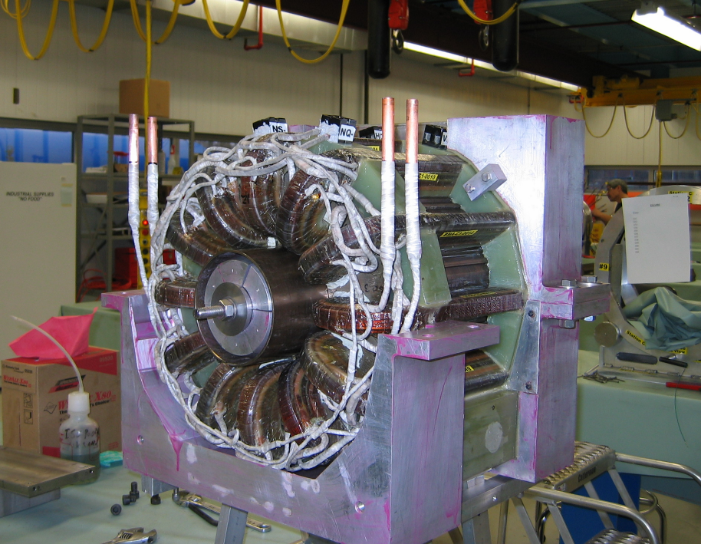
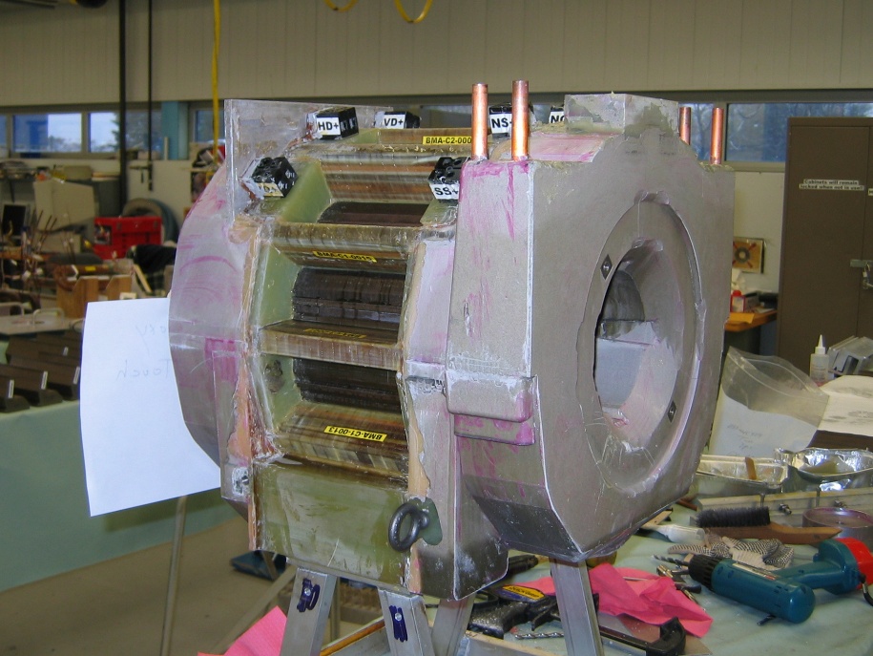
Potting
Mu2e, April 30, 2009 - Prebys

Slide 8
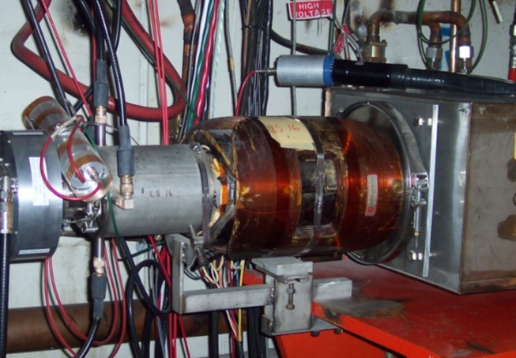
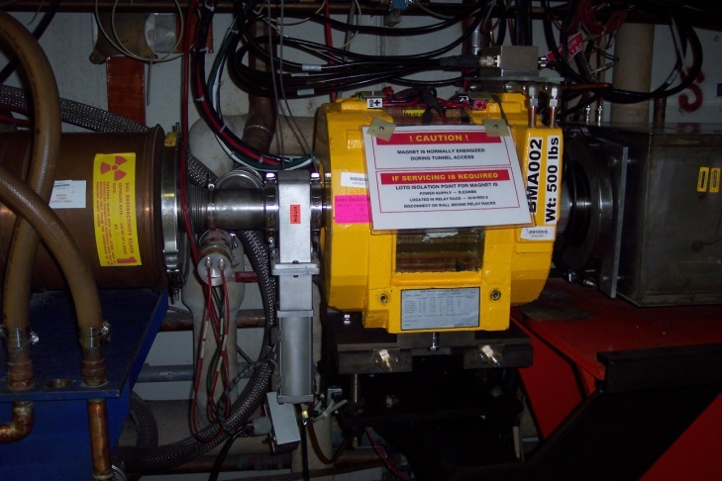
Initial Installation
Installed ¼ of the new Booster corrector system (12/48) in 2008 shutdown
  Odd long straights (primarily vertical control)
Remainder of system will be completed in July and installed in the 2009 shutdown.
Mu2e, April 30, 2009 - Prebys

Slide 9
Current Status
Partial system integrated into operation
  Dipoles scaled to behave like existing dipoles and integrated into closed orbit program
  Higher order correctors integrated with existing system in transparent (and therefore limited way)
All correctors completed
  Ready to install in 2009 summer shutdown (hopefully)
Mu2e, April 30, 2009 - Prebys

Slide 10
Importance to Mu2e
The booster has more or less demonstrated the proton flux required by NOvA
We are taking steps to insure the hardware improvements needed to go to 15 Hz will be made.
It is assumed that the new corrector system will reduce losses to the point where the booster can run continuously at 15 Hz, as required by Mu2e
  No one will work on this if we don’t push
Mu2e, April 30, 2009 - Prebys

Slide 11
Goals for student
Initial
  Get closed orbit correction working
  Pretty straightforward, all code already in place
PhD
  Lots of options involving more sophisticated used of higher order elements and/or utilizing the position control for more sophisticated use of the collimation system.
Mu2e, April 30, 2009 - Prebys

